Slide 1

THRIVE QUOTIENT
FIND THE GOAL & FILL THE GAP

Slide 2
Problem Statement:
Learners today struggle with fragmented platforms for technical, soft skills, and aptitude training.
The absence of personalized guidance and unified tracking reduces motivation, progress, and long-term engagement.

Slide 3



Existing System:
Traditional Learning Management Systems (LMS) and online platforms offer static course content with limited adaptability.
Users must switch between platforms to address various skill areas, lacking personalization and continuity.

Slide 4
Drawback:
Current systems do not provide dynamic learning paths, daily goal setting, or integrated assessment feedback.
They also fail to offer consistent support or data-driven insights on learner performance.
Mostly static content delivery (not personalized).
Focuses on completion & compliance rather than learner passion/purpose.
Limited integration with biometrics, AI, or adaptive learning.

Slide 5
Solution:
Thrive Quotient introduces an AI-enhanced LMS with a personal assistant that generates customized roadmaps, daily learning goals, continuous assessments, and progress tracking.
It enables holistic development by integrating technical, soft skills, and aptitude training into a single platform
It works psychologically in the theory of Ikigai ( A Japanese technique to for an happy life)
As more than just an LMS, it’s a psychological, purpose-driven learning platform based on the Ikigai framework.

Slide 6
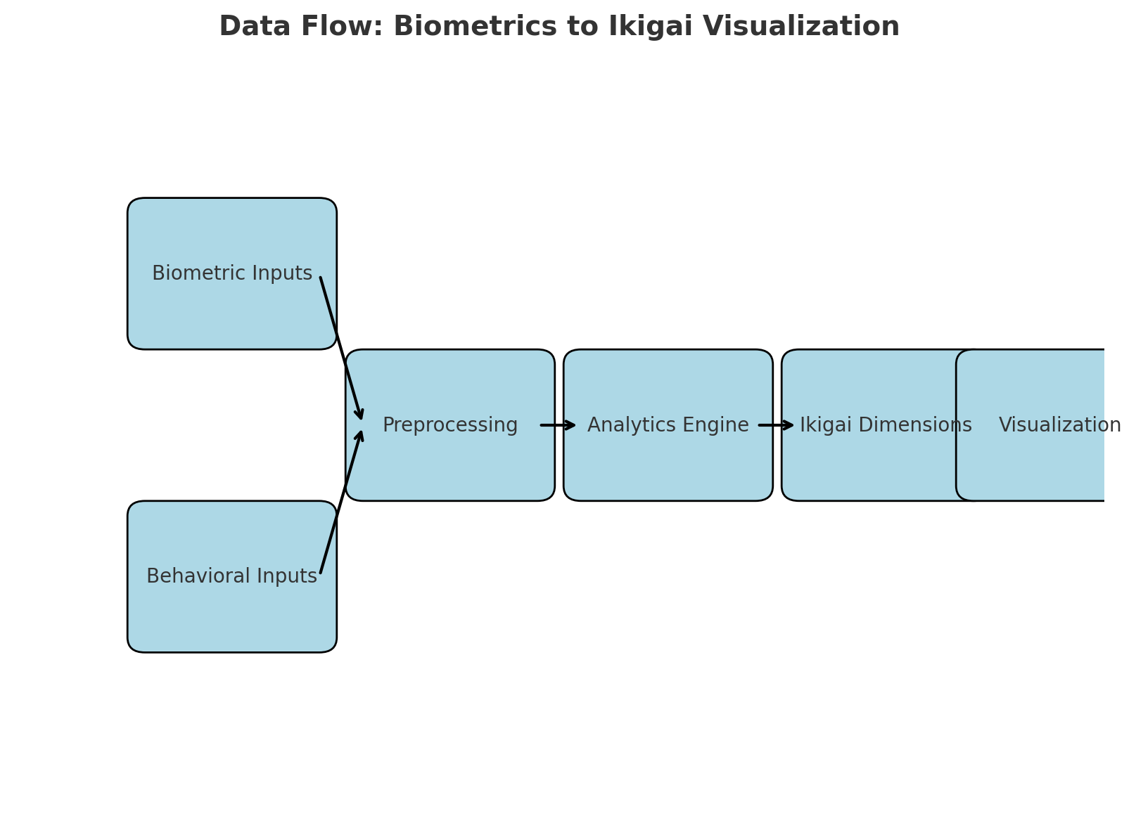

Slide 7
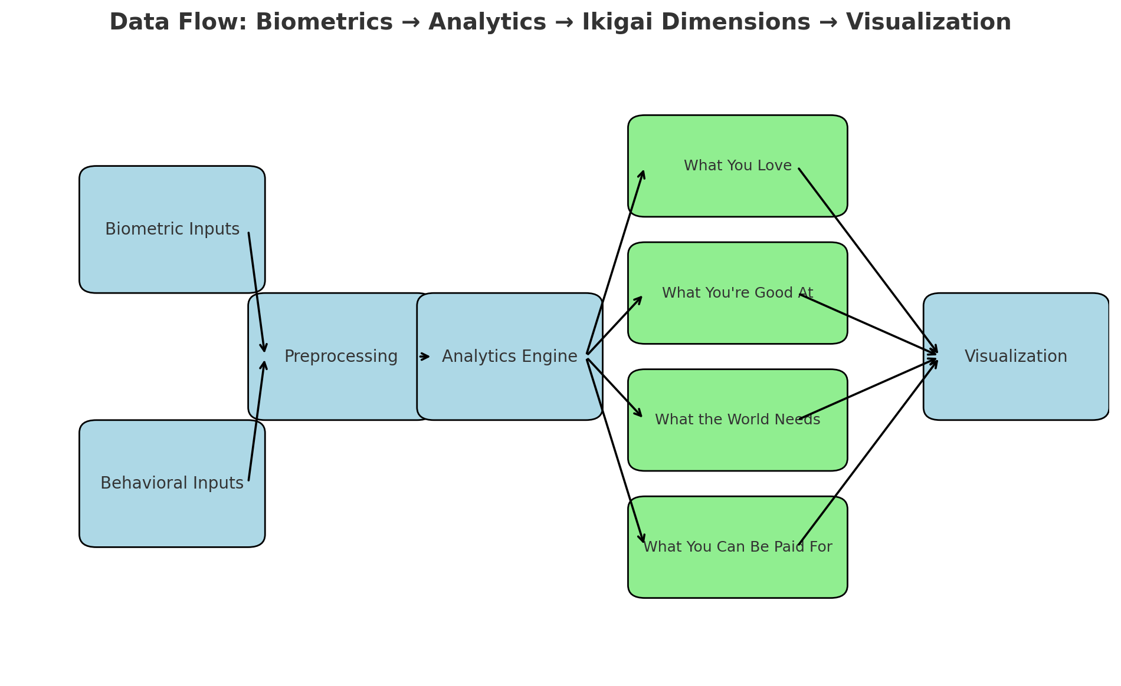

Slide 8
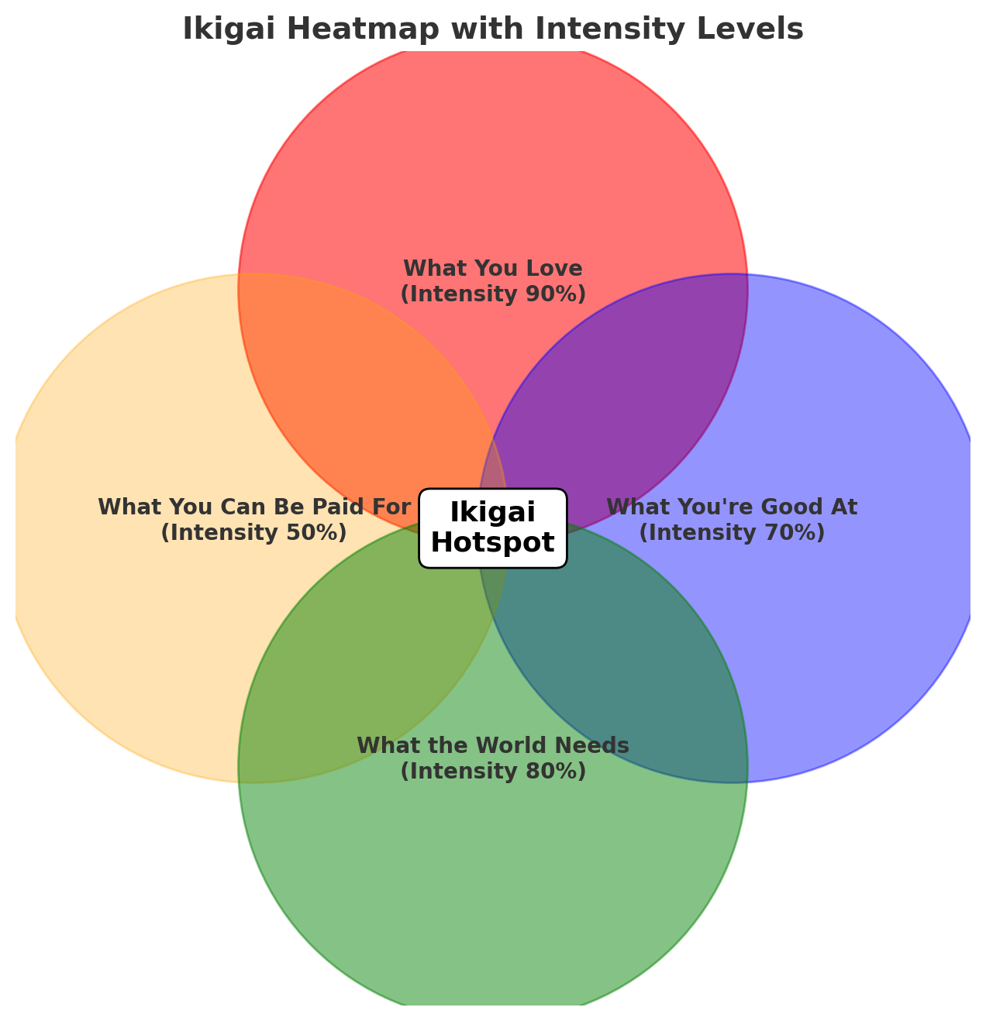
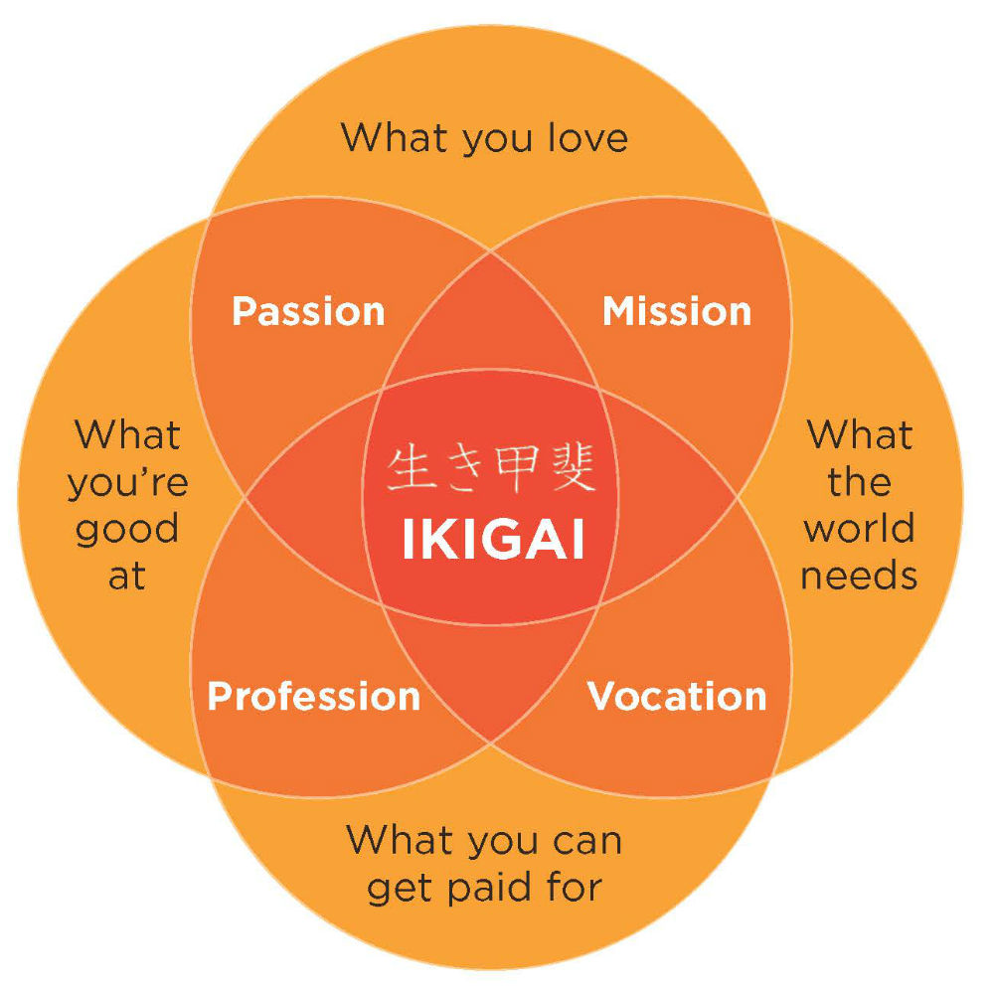

Slide 9
Raw signals → Features → Ikigai scoring → Pattern detection → Predictions → Visualization.

Slide 10
Technology:
The system leverages machine learning for adaptive content delivery, NLP for interactive support, and analytics for performance insights.
It uses cloud-based architecture to ensure scalability and accessibility.

Slide 11
Pattern Detection & Analytics
Time-series analysis: Identify repeating patterns of high joy/skill/impact.
Clustering: Group activities with similar biometric-emotional profiles.
Correlation mapping: Overlay biometrics with outcomes (e.g., joy + skill → strength zone).
Heatmap generation: Show overlaps visually in the Ikigai diagram.

Slide 12
Overcoming Drawbacks:
By combining personalization, intelligent guidance, and integrated learning, the solution addresses fragmentation and engagement issues.
The AI assistant evolves with the learner, offering real-time support and actionable feedback

Slide 13
Conclusion:
Thrive Quotient redefines digital learning by unifying diverse skill development into one intelligent, personalized system.
It empowers individuals to thrive in their careers through ikigai, targeted, AI-driven growth.

