Slide 1
Requirements Excel Add-in

Slide 2
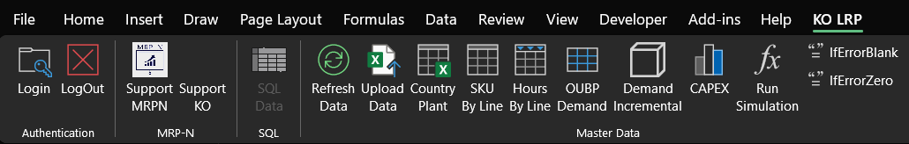
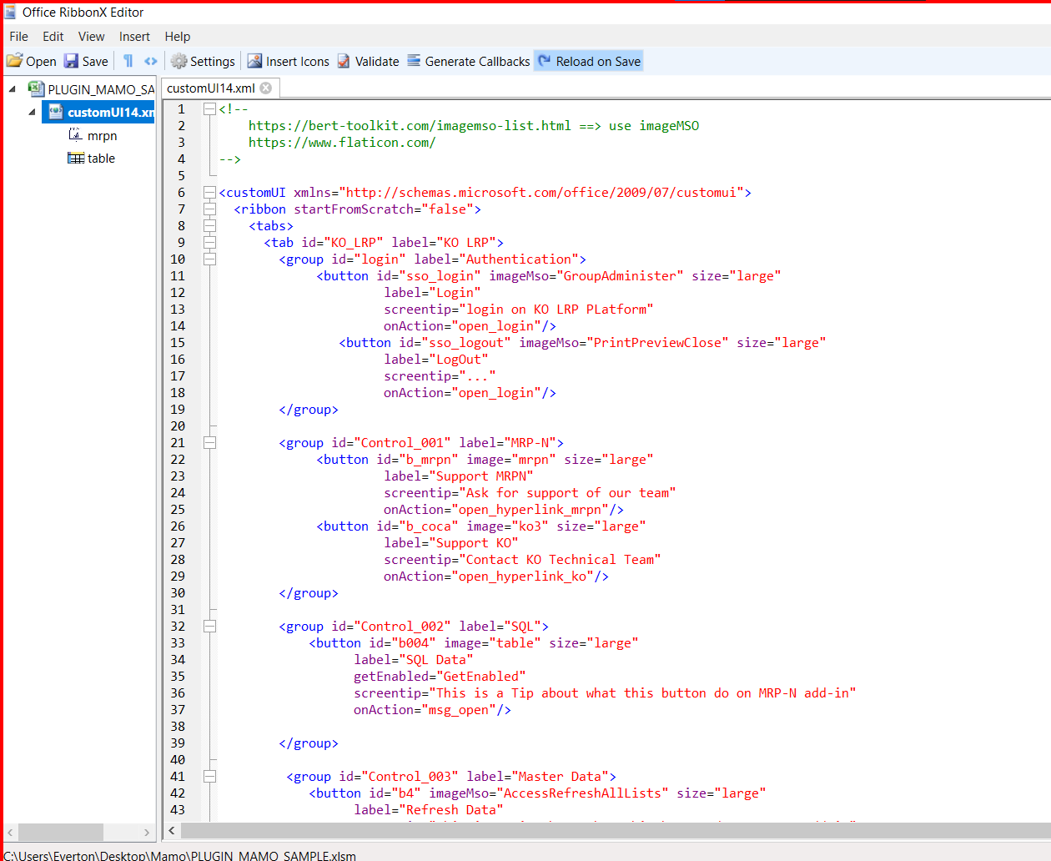
We are sending the XLSM file sample with this “ribbon mask” developed (in XML)

Slide 3
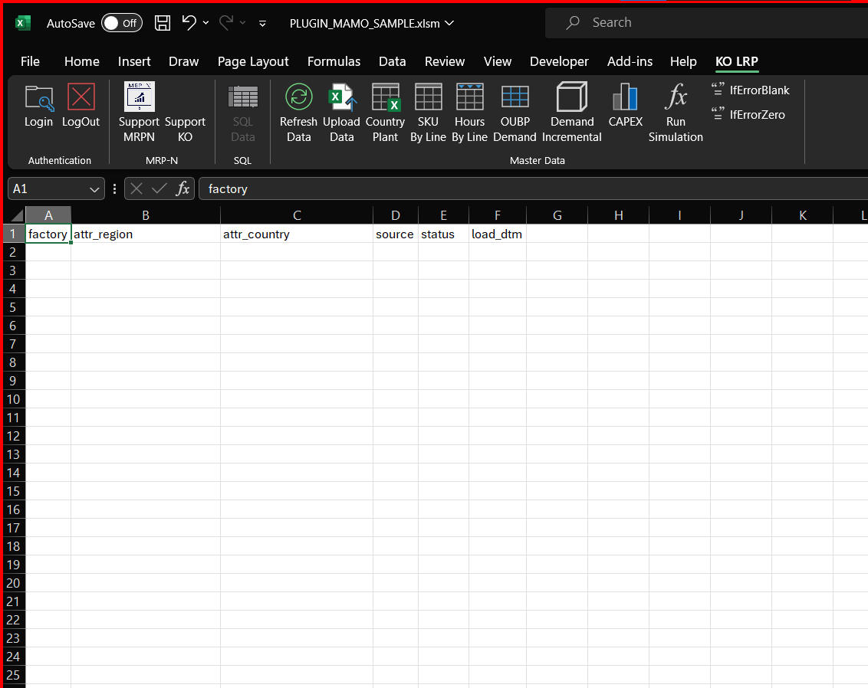
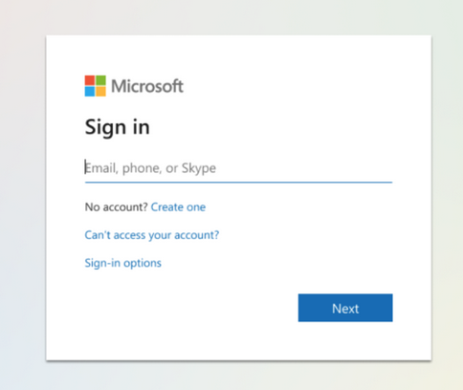
Ex: Button “Country Plant”
1) Login Authentication (Cloud):
Auth in Cloud, Must be a parameter flexible to setup for any authentication (Azure)
Response:
Success/200 (if logged)
User Permission Description (to segregate the data bring, for ex: WHERE clause on SELECT
Authentication
Microsoft
The response must show if was success logged (200)

Slide 4

Ex: Button “Country Plant”
2) Get Data (Cloud SQL):
Country Plant = input data get from SQL (Azure Postgres)
Upload = will persist/insert data on a SQL table
Refresh = get the data updated
When logged, can connect with SQL database and retrieve data

Slide 5
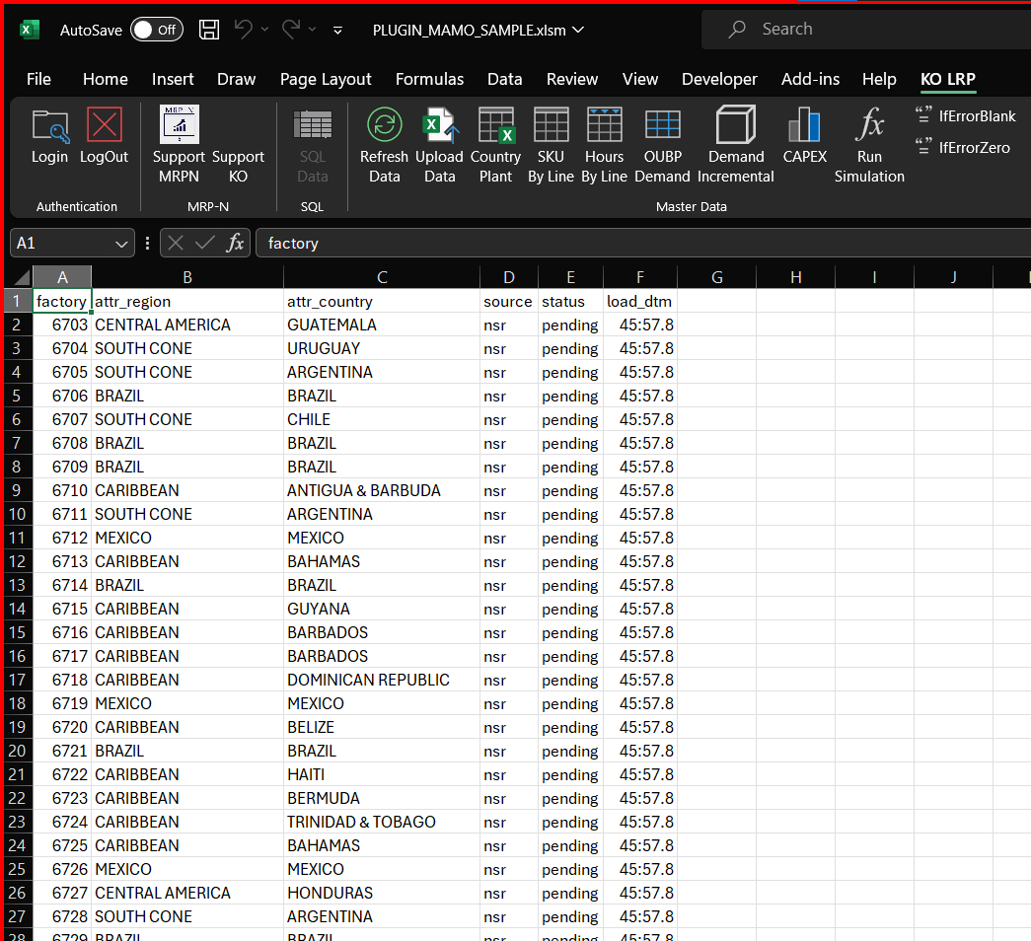
Bring Data from SQL (Select * from Table)
Bring data from
Fact Table (SQL) to Excel

Slide 6
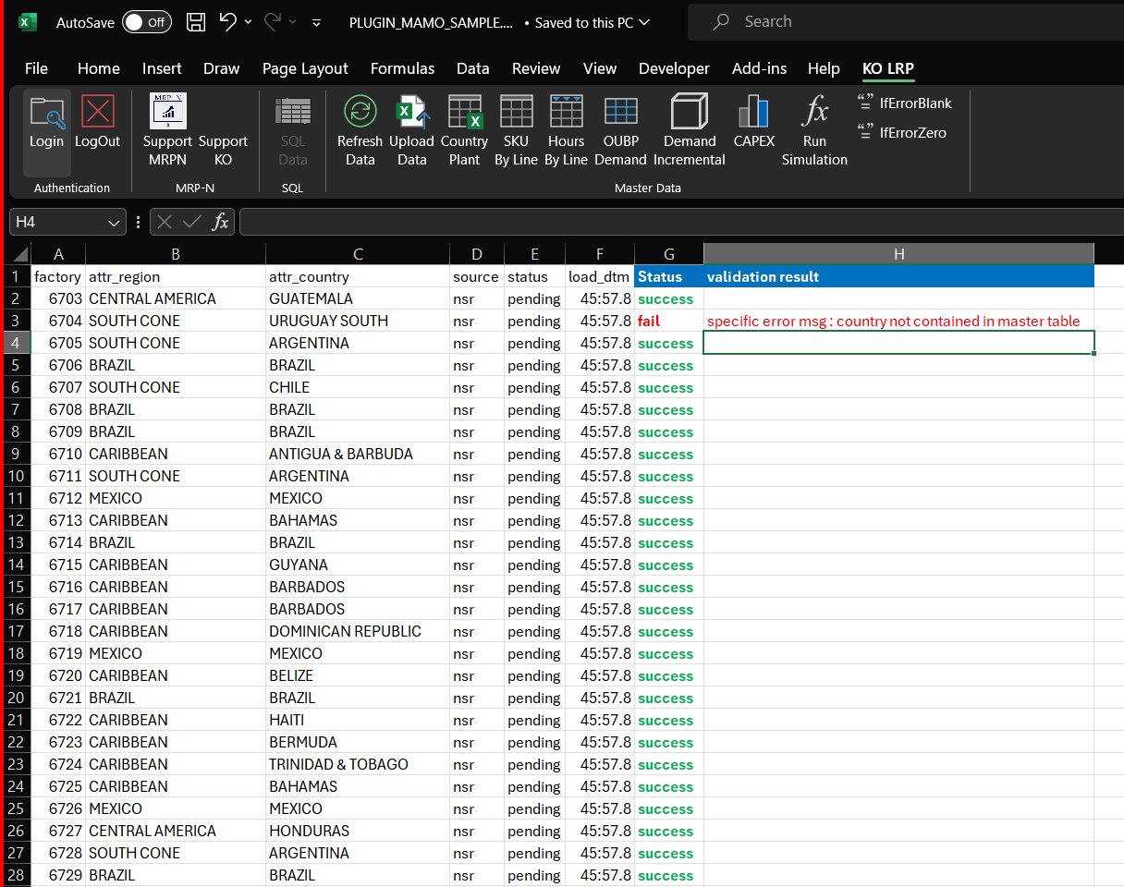
3) Data Validation: Check data rules are being submitted
This message will appear when some error during the validation step
3) Data Validation and Input Data on SQL
When user submit data, before write/persist on database, a script/code will validate the data is uploading, there will be 3 type of validations:
3.1 Data type: int, date, float
3.2 Data Structure: headers matching against table on SQL will receive
3.3 Data content: [Ex] Will the if column B data (from excel template) match with all the unique values from a DIM_Table on SQL Database
PS: data validation can be developed with Python, for ex.

Slide 7
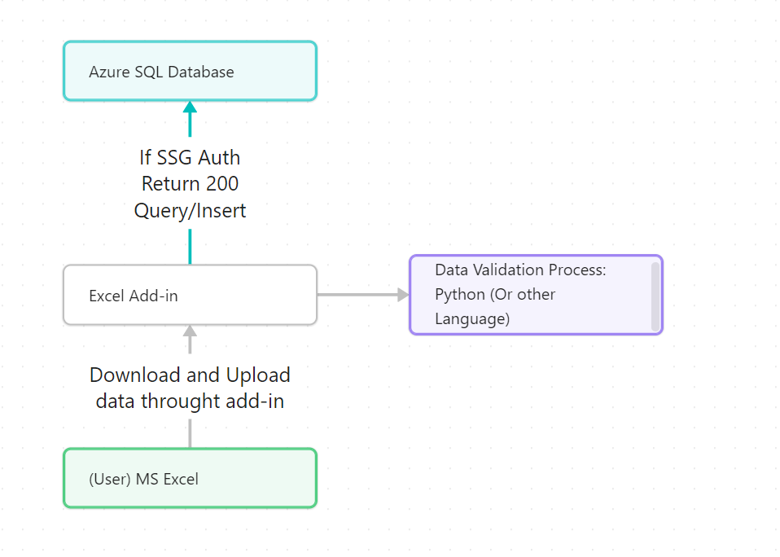
4) Persist data validated
Fact
Table
3) Get dim data to use for validation
Dimension
Table

