Slide 1

Institute of Engineering & Technology , Devi Ahilya Vishwa Vidyalaya
Traffic Light Controller using Arduino
Batch No. – B12
Group members :
Submitted to :
Dr. Vaibhav Neema
Arushi Sinha : 19T6012
Aum Mishra : 19T6014
Prashant Sahu : 19T6045
Prerna Sharma : 20T6084
Date of submission - 20/04/2022

Slide 2
Objective :
This project is a simple version of the traffic light controller using Arduino.
It is a traffic light system where we have demonstrated it for three sides or ways.
We used LEDs to demonstrate a particular sequence to form an actual traffic light controller system.

Slide 3
Introduction
Targeted Problem :
Indian roads without any supervision or guidance can lead to traffic conflicts and accidents. Traffic signals are required for an orderly flow of traffic. Nowadays, everyone prefers a personal vehicle. Hence, the number of vehicles on the road is increasing continuously, which results in traffic jams.
Present Status :
In many parts of our country there is an imperative need of traffic signals at most of the crossroads and due to the unavailability of traffic signals many lives are at stake. So, we need a cheaper and durable solution to this problem. It provides road safety, also helps to solve traffic in simple manners.
Our Contribution :
Using Arduino and minimal hardware we have tackled this problem in an efficient and cost effective way. We have designed a simple and easy to understand traffic light controller.

Slide 4
List of Components used :
This project uses an Arduino and some LEDs to replicate a traffic light. It uses code as an internal timer and continues to run until you cut the Arduino's power supply.
Arduino
Breadboard
Jumper Wires
LEDs
USB Arduino cable
Resistor

Slide 5
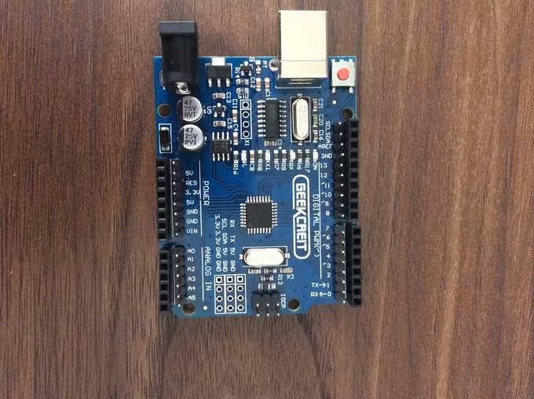
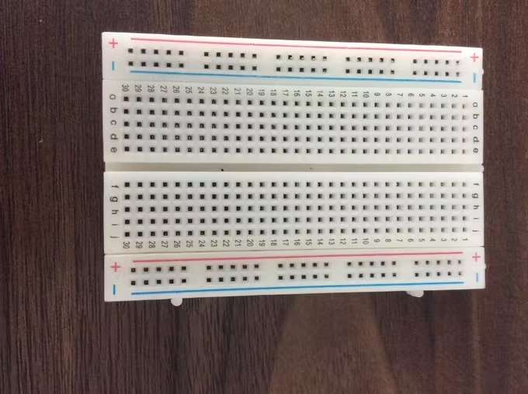
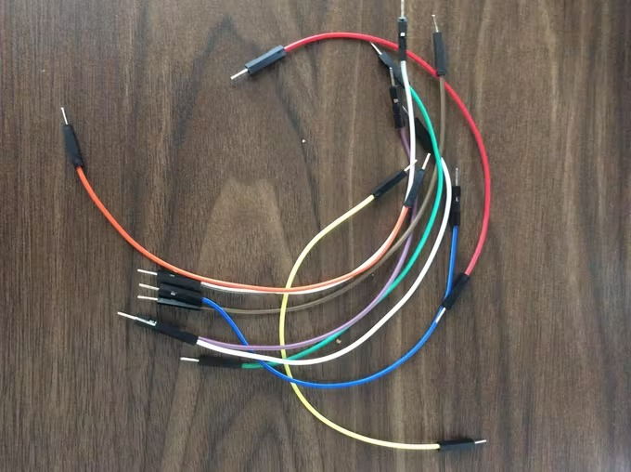
1. Arduino :
Arduino board designs use a variety of microprocessors and controllers. The boards are equipped with sets of digital and analog I/O pins that may be interfaced to breadboards and other circuits.
2. Breadboard :
A breadboard is a solderless device for temporary prototype with electronics and test circuit designs. Most electronic components in electronic circuits can be interconnected by inserting their leads or terminals into the holes and then making connections through wires where appropriate.
3. Jumping wires :
Jumper wire are used to connect on/with a breadboard or other prototype or test circuit, internally or with other equipment or components, without soldering.

Slide 6
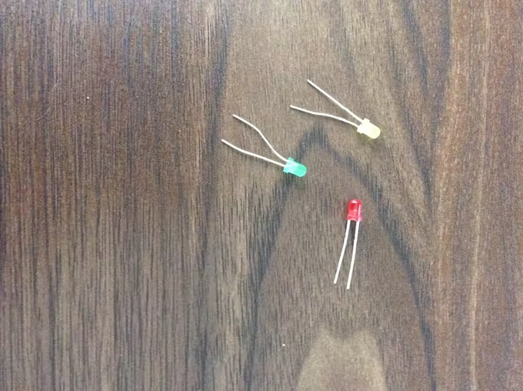
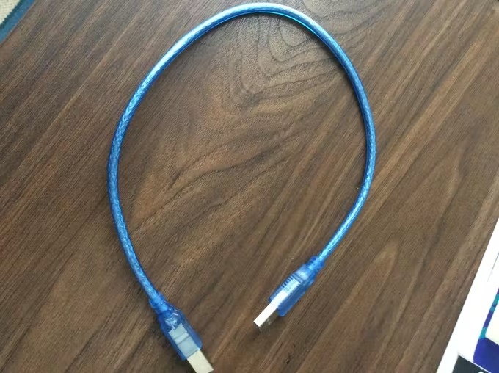
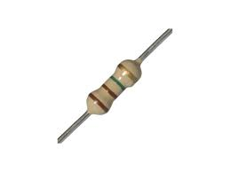
4.LEDs :
Visible LEDs are used in many electronic devices as indicator lamps, in automobiles as rear-window and brake lights, and on billboards and signs as alphanumeric displays or even full-colour posters.The LEDs used in the project are basic 5mm LEDs of Red, Yellow and Green colors
5. Arduino USB cable :
This cable is used to interface any of the Arduino board with your computer, you can also connect your USB printer, scanner, and more to your computer.
6. Resistor(220 ohm) :
The purpose of the resistor is to restrict the amount of current that flows through the resistor into the LED, to a level that the Arduino CAN supply.

Slide 7
void loop() {
// put your main code here, to run repeatedly:
digitalWrite(8,HIGH); // turn on red ligh for 3sec
delay(3000);
digitalWrite(8,LOW); // turn off red light
digitalWrite(10,HIGH); // turn on yellow light for 1sec
delay(1000);
digitalWrite(10,LOW); // turn off yellow light
digitalWrite(12,HIGH); // turn on green ligh for 3sec
delay(3000);
digitalWrite(12,LOW); // turn off green light
delay(500);
//blink
digitalWrite(12,HIGH); // turn on green light for .5sec ---1
delay(500);
digitalWrite(12,LOW); // turn off green light
delay(500);
digitalWrite(12,HIGH); // turn on green light for .5sec ---2
delay(500);
digitalWrite(12,LOW); // turn off green light
delay(500);
digitalWrite(12,HIGH); // turn on green light for .5sec ---3
delay(500);
digitalWrite(12,LOW); // turn off green light
delay(1000);
}
//VLSI group project
//19T6012 Arushi Sinha
//19T6013 Aum Mishra
//19T6045 Prashant sahu
//19T6082 Prerna Sharma
Code:
void setup() {
// put your setup code here, to run once:
pinMode(8,OUTPUT); //RED
pinMode(10,OUTPUT); //YELLOW
pinMode(12,OUTPUT); //GREEN
}

Slide 8
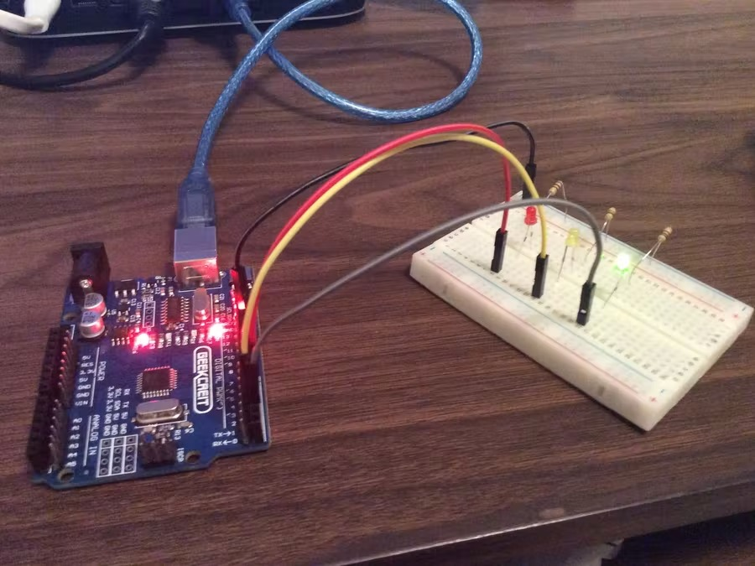
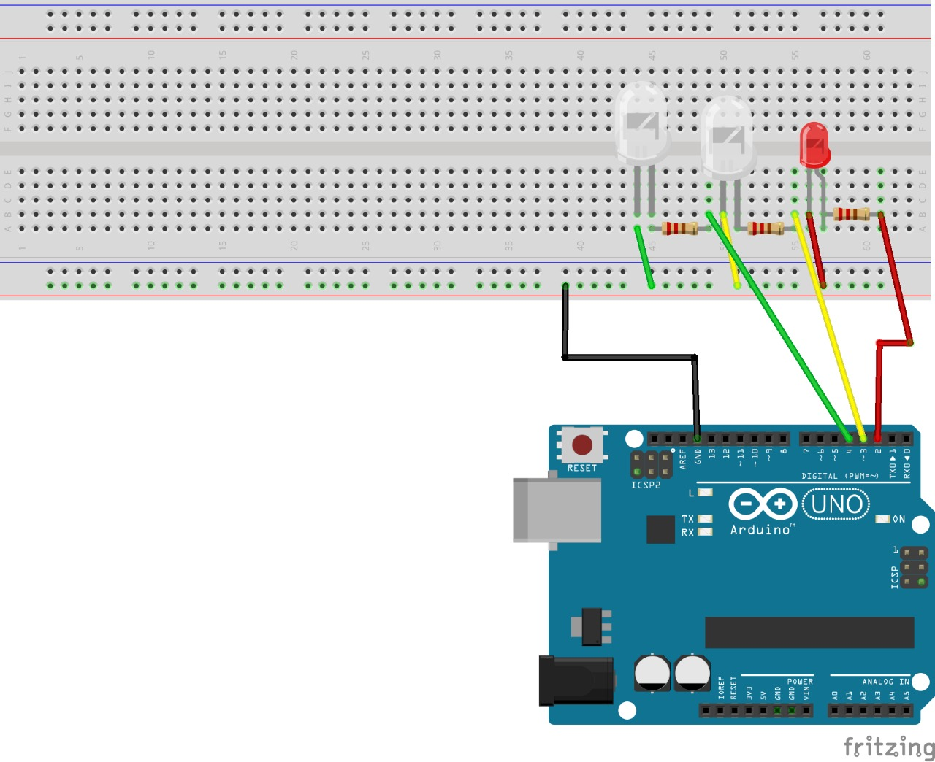
Final Project Model :

Slide 9
1. 19T6012 - Arushi Sinha : Presentation + Software
2. 19T6014 - Aum Mishra : Presentation + Software
3. 19T6045 - Prashant Sahu : Assembled hardware + Presentation
4. 20T6084 – Prerna Sharma : Assembled hardware + Presentation
Roles and Responsibilities

