Slide 1
Lecture-2
Equivalent Electrical circuits for Oscillators

Slide 2
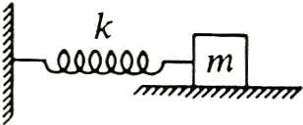
Mechanical Oscillators
s
Equation of motion
(undamped case):
m(d²x/dt²) + sx = 0
Solution: x(t) = A cos(ω₀t +φ)
Natural Frequency: (ω₀)² ≡ (s/m)

Slide 3
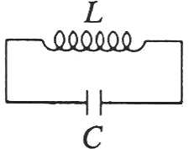
LC Circuit Oscillators
Consider a simple LC (electrical) circuit:
(L = inductor, C = capacitor)
Equation of motion for charge q
(no damping or resistance R):
L(d²q/dt²) + (q/C) = 0 (1)
Kirchhoff’s loop rule ⇒ L(dI/dt) + (1/C)∫Idt = 0 (2)
Solution to (1) or (2): q(t) = q₀ cos(ω₀t + φ )
Natural Frequency: (ω₀)² ≡ 1/(LC)

Slide 4
A comparison of the equations of motion of mechanical & electrical oscillators gives analogies:
x → q, m → L, s → C⁻¹, (dx/dt) → I
Consider (let φ = 0 for simplicity): q(t) = q₀cos(ω₀t)
⇒ [q(t)]² = q₀² cos²(ω₀t) and I(t) = (dq/dt) = -ω₀q₀sin(ω₀t)
⇒ [I(t)]² = [ω₀q₀]²sin²(ω₀t) = [q₀²/(LC)]sin²(ω₀t)
So: (½)L[I(t)]² + (½)[q(t)]²/C = (½)[q₀²/C] (1)
With the above analogies, (1) is mathematically analogous to the total energy for the mechanical oscillator
(½)m[v(t)]² + (½)s[x(t)]² = (½)sA² = E_{m} (2)
From circuit theory, total energy for an LC electrical circuit is E_{e} ≡ (½)[q₀²/C] ⇒ (1) is also analogous physically to (2)

Slide 5
Physics: The total Energy of an LC circuit
⇒ (½)L[I(t)]² + (½)[q(t)]²/C = (½)[q₀²/C] = E_{e} = const.!
Physical Interpretations:
(½)LI² ≡ Energy stored in the inductor
→ Analogous to kinetic energy for the mechanical oscillator
(½)C⁻¹q² ≡ Energy stored in the capacitor
→ Analogous to potential energy for mechanical oscillator
(½)[q₀²/C] = E_{e} ≡ Total energy in the circuit → Analogous to the total mechanical energy E for the SHO Also, E_{e} = constant! ⇒ The total energy of an LC circuit is conserved. The system is conservative only if there is no resistance R. As we’ll see, in electrical oscillators, R plays the role of the damping constant. R_{m} for mechanical oscillators.

Slide 6
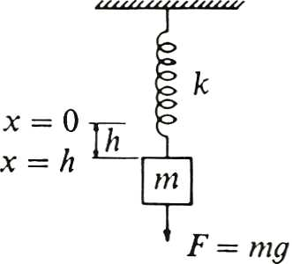
Example 1
Consider a vertical mass-spring system:
~ Similar to a free oscillator, but there
is the additional constant downward
force of the weight F = mg. At
equilibrium, the weight stretches the
spring a distance h = (mg/k)
⇒ There is a new equilibrium position at x = h
⇒ The eqtn of motion is the same as before with
x → x - h . So, it is: m(d²x/dt²) +s(x-h) = 0
with initial conditions x(0) = h +A, u(0) = 0
⇒ Solution: x(t) = h + A cos(ω₀t)
s

Slide 7
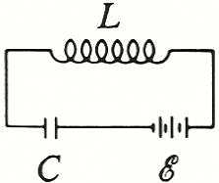
Analogous electrical oscillator system
to the vertical mechanical oscillator? →
LC circuit with a battery →
(a constant EMF source ε)!
Equation of Motion?
Kirchhoff’s loop rule gives:
L(dI/dt) + (1/C)∫I dt = ε = [q₁/C]
q₁ ≡ Charge that must be applied to C to produce voltage ε
With I = (dq/dt) this becomes: L(d²q/dt²) + [q/C] = [q₁/C] (1)
(1) is mathematically identical to the mass-spring system with a constant external force (gravity). For initial conditions:
q(0) = q₀, I(0) = 0, solution is: q(t) = q₁ + (q₀ - q₁) cos(ω₀t)
This circuit is an exact electrical analogue to the vertical spring-mass system in a gravitational field.
s

Slide 8

LRC Circuit
Mechanical
oscillator with damping:
Equation of motion:
m(d²x/dt²) + R_{m}(dx/dt) + sx = 0
We’ve seen that the general solution is:
x(t) = e^{-βt}[A₁ e^{αt} + A₂ e^{-αt}]
where α ≡ [β² - ω₀²]^{½}
A₁ , A₂ are determined by initial conditions: (x(0), v(0)).
ω₀² ≡ (s/m), β ≡ [R_{m}/(2m)]
R_{m}
s

Slide 9
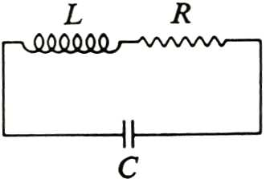
Analogous electrical oscillator system to the damped mechanical oscillator?
An LRC circuit is an electrical
oscillator with damping.
Equation of Motion: Kirchhoff’s
loop rule: L(dI/dt)+RI + (1/C)∫I dt = 0 (1)
In terms of charge, I = (dq/dt), (1) becomes:
L(d²q/dt²) +R(dq/dt) + (q/C) = 0 (2)
(2) is identical mathematically to the damped oscillator equation of motion with x → q, m → L, R_{m} → R, s →(1/C)
⇒ General Solution is clearly q(t) = e^{-βt}[A₁ e^{αt} + A₂ e^{-αt}]
with α ≡ [β² - ω₀²]^{½} ω₀² ≡ (LC)⁻¹, β ≡ [R/(2L)]

Slide 10
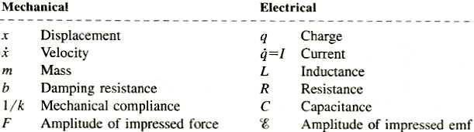
Summary of Electrical-Mechanical Analogies
s
From the last row, clearly, the mechanical oscillator-electrical oscillator analogy also carries over to the driven mechanical oscillator ←→ driven circuit.

Slide 11
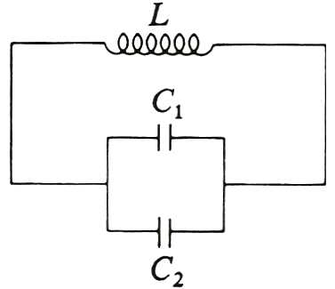
Mechanical Analogies to Series & Parallel Circuits
The mechanical oscillator with spring constant s is analogous to the inverse capacitance (1/C) = C⁻¹ in an electrical oscillator.
Inversely, the mechanical compliance ≡ (1/s) = s⁻¹ is analogous to the capacitance C
Consider a circuit with 2 capacitors
C₁, C₂ in parallel →
From circuit theory, the
effective capacitance is
C_{eff} = C₁+ C₂

Slide 12
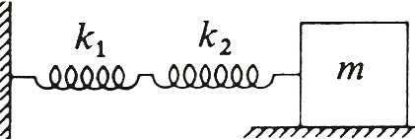
For 2 capacitors C₁, C₂ in parallel →
Effective capacitance: C_{eff} = C₁+ C₂
Consider 2 springs with constants
s1, s₂ in series →
Effective spring
constant (effective compliance):
(1/s_{eff}) = (1/s₁)+ (1/s₂)
Proof: Apply a force F to 2 springs in series:
Spring 1 will extend a distance x₁ = (F/s₁) spring 2 will extend a distance x₂ = (F/s₂). Total extension:
x = x₁+x₂= F[(1/s₁)+(1/s₂)] ≡ (F/s_{eff})
⇒ 2 springs in series are analogous to 2 capacitors in parallel!
s₁
s₂

Slide 13
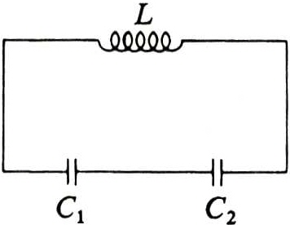
The mechanical oscillator with spring constant s is analogous to the inverse capacitance (1/C) = C⁻¹ in an electrical oscillator.
Inversely, the mechanical compliance ≡ (1/s) = s⁻¹ is analogous to the capacitance C
Consider a circuit with
2 capacitors C₁, C₂ in series →
From circuit theory, the
effective capacitance is
(1/C_{eff}) = (1/C₁) + (1/C₂)

Slide 14
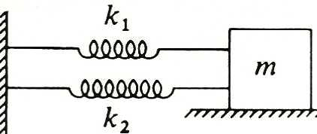
For 2 capacitors C₁, C₂ in series →
Effective capacitance: (C_{eff})⁻¹ = (C₁ )⁻¹ + (C₂)⁻¹
Consider 2 springs with constants
s₁, s₂ in parallel →
Effective spring constant:
s_{eff} = s₁+ s₂
Proof: Stretch 2 springs in parallel a distance x:
Spring 1 will experience a force F₁ = s₁x, spring 2 will experience a force F₂ = s₂x. Total force:
F = F₁+F₂= (s₁+s₂)x ≡ s_{eff} x
⇒ 2 springs in parallel are analogous to 2 capacitors in series!
s₁
s₂

Slide 15
Draw the equivalent electrical circuit for the following mechanical system and find the mechanical impedance with its corresponding unit, where R_{m}=1.4 kg/s, s₁=30 N/m, m=70 kg and F=2cos 314t
R_{m}
S₁
m
F
Draw the equivalent electrical circuit of the Mechanical system given in Fig.1 and drive the expression of mechanical impedance
m
R_{m}
S₁
S₂
F

