Slide 1
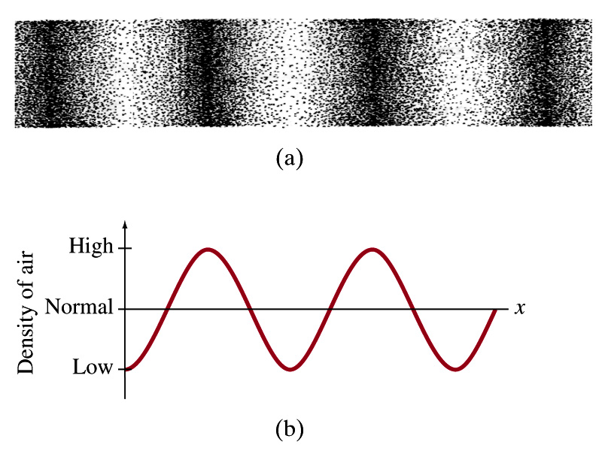
Lacture-3
Acoustic Wave Equation

Slide 2
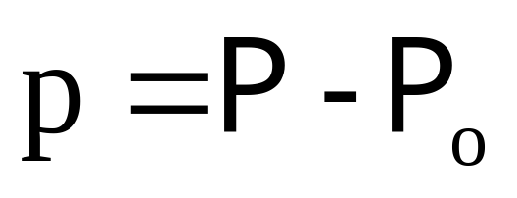
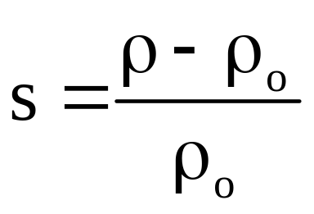
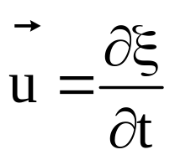
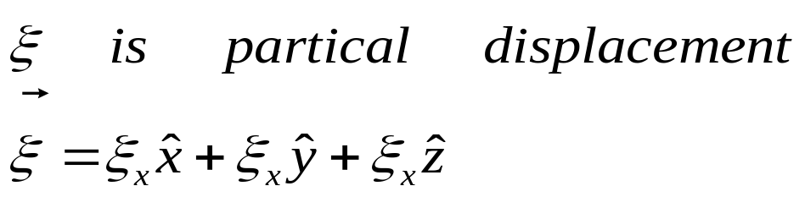
Acoustic Variables
Pressure
Density – Condensation
Velocity (particle)
Temperature
T

Slide 3
Necessary Differential Equations to Obtain a Wave Equation
Mass Continuity/conservation
Equation of State(adiabatic)
Force Equation
Assumptions: homogeneous, isotropic, ideal fluid

Slide 4
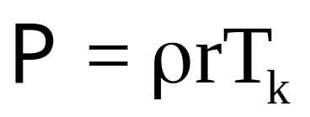
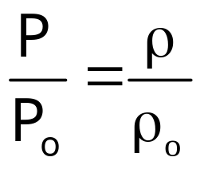
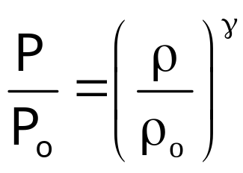
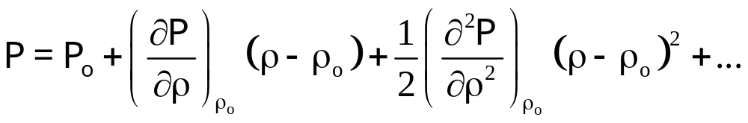
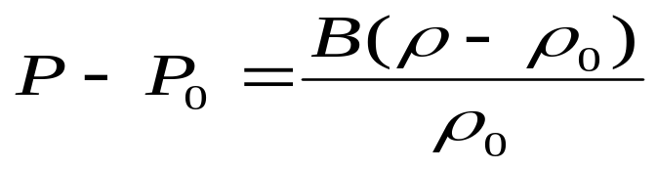
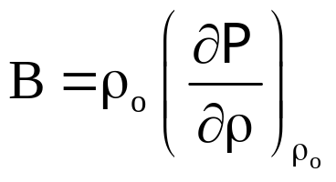
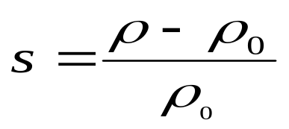

Equations of State
r is specific gas constant
Perfect gas isotherm
γ is ratio of specific heat
Real Fluids:
Taylor expansion
B is adiabatic bulk modulus

Slide 5
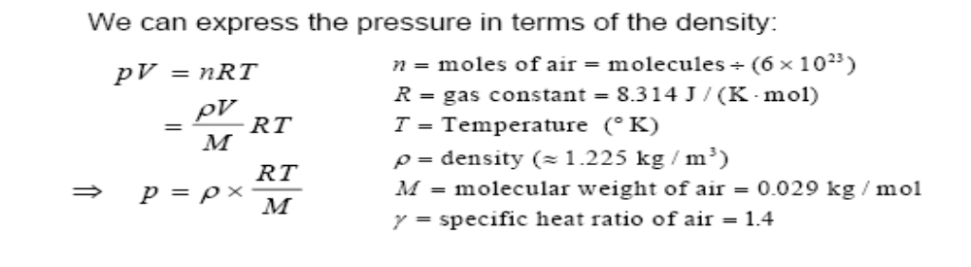
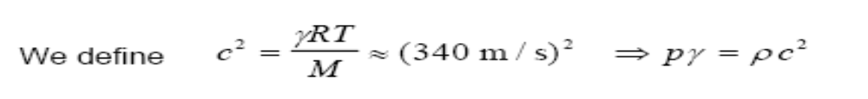
Gas Law

Slide 6
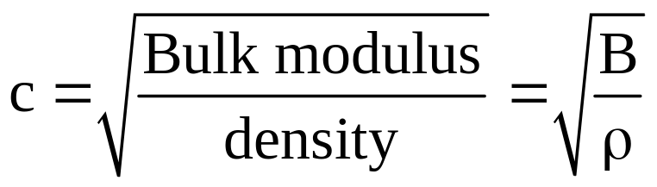
Sound Speed
 | Air | Water Steel
Bulk Modulus | 1.4(1.01 x 10⁵⁾ Pa | 2.2 x 10⁹ Pa ~2.5 x 10¹¹ Pa
Density | 1.21 kg/m³ | 1000 kg/m³ ~10⁴ kg/m³
Speed | 343 m/s | 1500 m/s 5000 m/s

Slide 7
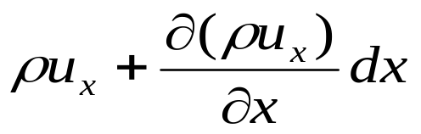
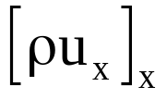
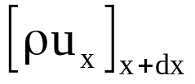



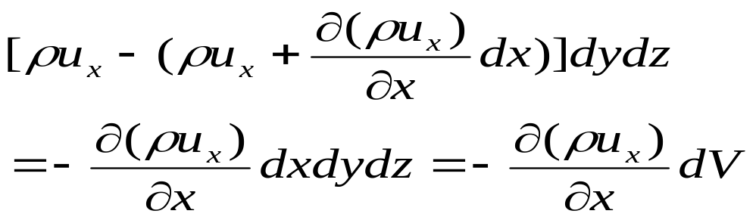
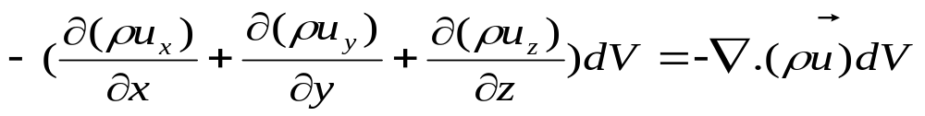
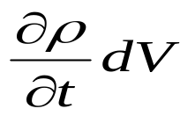
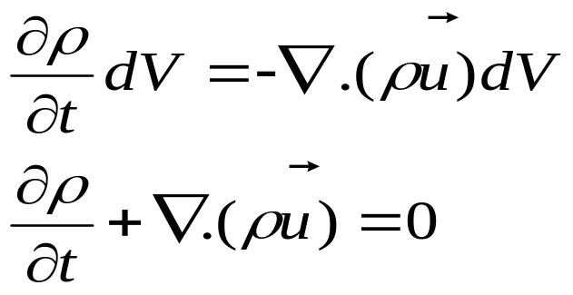
Continuity Equation
Net influx of mass into this spatially fixed volume resulting from flow in the x direction
Rate with which the mass increase in the volume is
The net influx must equal the rate of increase

Slide 8
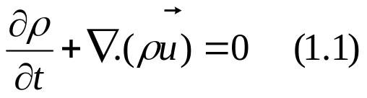

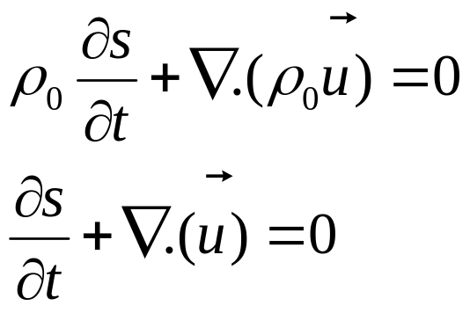
Linear continuity equation
If ρ₀ is sufficiently weak function of time and s is very small

Slide 9
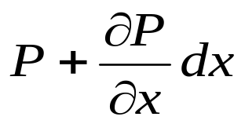
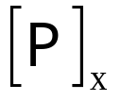
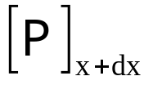
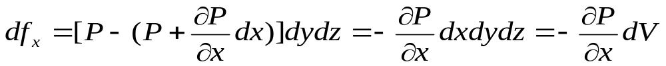
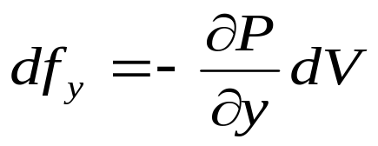
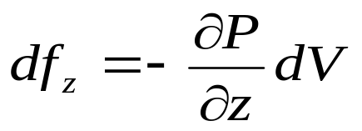

Force Equation
dV=dxdydz has mass dm move with the fluid
Then df=am
Let viscosity is absent
g
Similarly
Gravitational force induces an additional force in the vertical direction
Particle velocity u is a function of position and time
Let at time t+dt particle move to new position

Slide 10
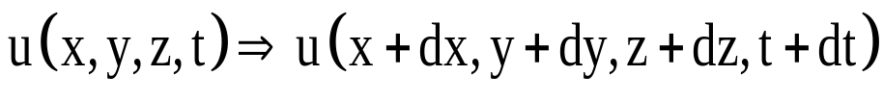
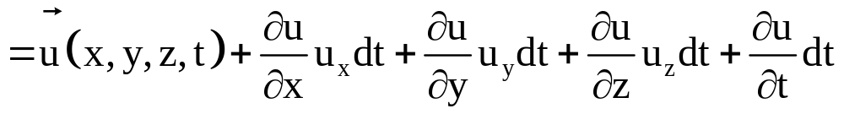
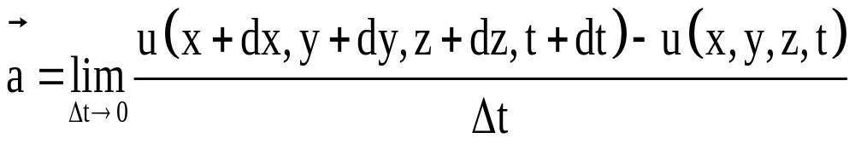
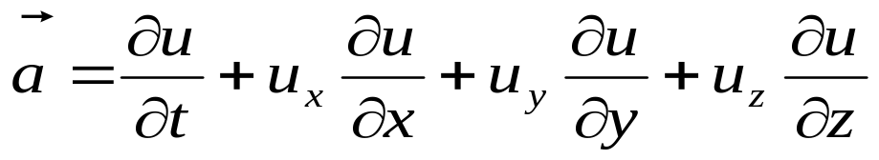
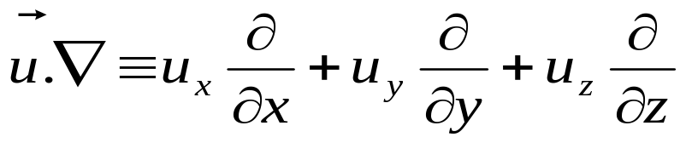
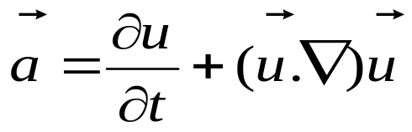
Fluid Acceleration
Taylor expansion
dx=u_{x}dt
dy=u_{y}dt
dz=u_{z}dt
then

Slide 11
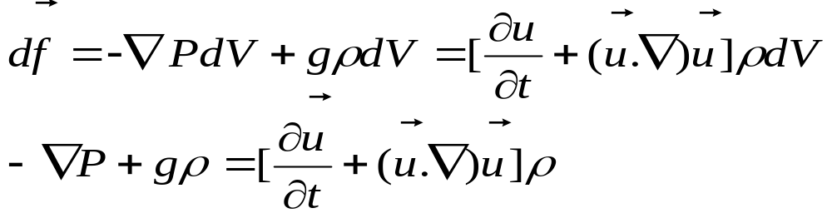


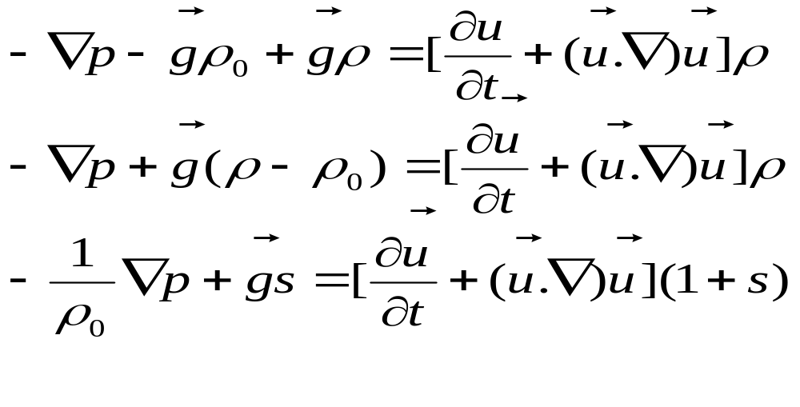
Newton’s Second Law
df=am
Where m=ρdV
If there is no acoustic excitation then

Slide 12
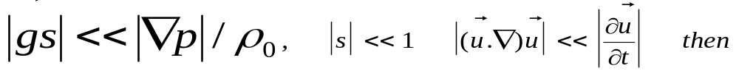
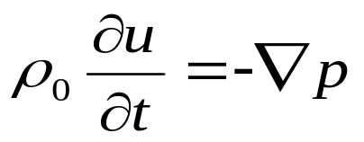
If we assume
Euler’s equation/Linear Force Equation

Slide 13
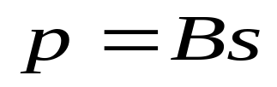
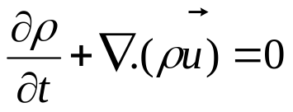
A. Equations of State
B. Linear continuity equation
C. Euler’s equation/Linear Force Equation

Slide 14
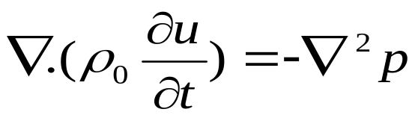
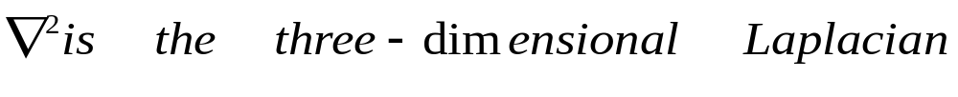
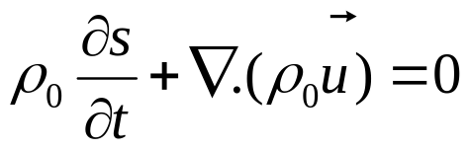
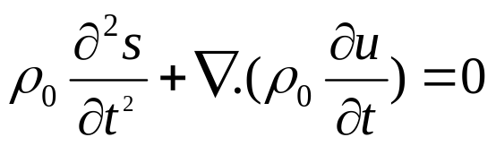
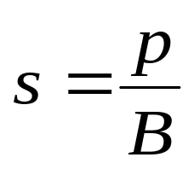
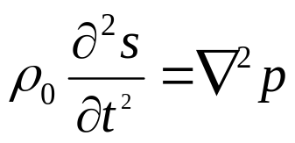
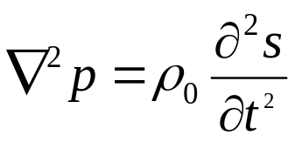
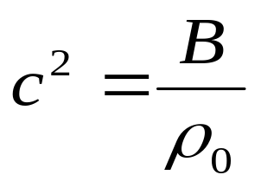

Linear Wave Equation
Take divergence of the
Take time derivative of the
Linear Wave Equation

Slide 15






Velocity Potential
Curl of the gradient of a function must vanish
That means u can be expressed as the gradient of a scalar function

Slide 16







Variation of sound speed with temperature

Slide 17

Class Sound Speed Data

Slide 18





Harmonic Plane Waves
Characteristic property: a plane wave is that each acoustic variable has constant amplitude and phase on any plane perpendicular to the direction of propagation.
If we consider the plane wave propagates along the x axis then wave equation become
Complex harmonic solution

Slide 19







Entire sound field varies as
So can be replaced by

Slide 20






Plane wave in arbitrary direction
Propagation Vector

Slide 21














Propagation Vector has magnitude and a position vector
z
Direction Cosines
y
x
Propagation Vector
Surface of constant phase are given by
constant

Slide 22









k in x-y plane
Let a plane wave whose surfaces of constant phase are parallel to z axis
surfaces of constant phase are given by
constant
Plane surfaces parallel to z axis with a slope in the x-y plane
y
If p is a function of x and t at y=0
Similarly if p is a function of y and t at x=0
x

Slide 23




Specific Acoustic Impedance
Specific Acoustic Impedance
Pa.s/m or Rayl
Specific Acoustic Impedance of the medium is a real quantity for progressive plane wave this is not true for standing plane wave or for diverging wave
r is Specific Acoustic resistant
x is Specific Acoustic reactance

Slide 24






Energy
V₀ is the volume of the small fluid element in the undisturbed fluid.
Change in potential energy associated with volume change from V₀ to V
Negative sign indicate that the potential energy will increase when its volume is decreased by a positive acoustic pressure p

Slide 25







Instantaneous energy density
J/m³
Time average energy density

Slide 26



Average Power and Intensity
A
cdt
For plane waves

Slide 27




Effective Average - RMS

Slide 28








Spherical Waves
z
r
θ
φ
y
x
Conservation of energy and the relationship lead to that the pressure amplitude might fall off as 1/r, so that the quantity rp would have amplitude independent of r

Slide 29

For all r>0
A spherical wave diverging from origin
A spherical wave converging at origin
At r=0 the solution fails
For out going waves solution fails at origin because some source of sound is required to supply the energy carried away but wave equation does not contain any term representing this energy source.→So its means that the medium must be excluded from some volume of space including the origin which will be occupied by the sound source
For incoming waves energy is being focused at the origin and the small amplitude approximations will fail. → this will manifest itself in a nonlinear wave equation and strong acoustic losses.

Slide 30









Angle θ is a function of the ratio of the source distance to the wave length

Slide 31

Angle θ is a function of the ratio of the source distance to the wave length
If the distance from the source is only a small fraction of a wavelength the phase difference between the complex pressure and partial speed is large.
At distances corresponding to a considerable number of wavelength then phase difference and partial speed are very nearly in phase

Slide 32




Acoustic resistance
Acoustic reactance
For large value of kr the
For small value of kr the

Slide 33









Slide 34




Average Energy flows through a closed spherical surface of radius r
Independent of r
r
If we double the radius
I₁ will be drop by 6dB→Inverse square law

Slide 35


Intensity of sound
Loudness – intensity of the wave. Energy transported by a wave per unit time across a unit area perpendicular to the energy flow.
Source | Intensity (W/m²) | Sound Level
Jet Plane | 100 | 140
Pain Threshold | 1 | 120
Siren | 1x10⁻² | 100
Busy Traffic | 1x10⁻⁵ | 70
Conversation | 3x10⁻⁶ | 65
Whisper | 1x10⁻¹⁰ | 20
Rustle of leaves | 1x10⁻¹¹ | 10
Hearing Threshold | 1x10⁻¹² | 1

Slide 36



Sound Level - Decibel

Slide 37




Why the decibel?
Ears judge loudness on a logarithmic vice linear scale
Alexander Graham Bell
deci =
1 bel = 10 decibel

Slide 38

Reference Level Conventions
Location | Reference Intensity | Reference Pressure
Air | 1 x 10⁻¹² W/m² | 20 μPa
Water | 6.67 x 10⁻¹⁹ W/m² | 1 uPa

Slide 39


Sound Pressure Level
Mean Squared Quantities:
Power, Energy, Intensity
“Intensity Level”
Root Mean Squared Quantities:
Voltage, Current, Pressure
“Sound Pressure Level”

Slide 40


Slide 41


Slide 42
The sound source produces 60 dBm power and the sound is propagated as a spherical wave. What is the sound intensity for a person hearing it from 50 m away?
An earth quake wave was traveling through the earth and the intensity detected 100 Km from source was 5.0x 10⁶ W/m². What is the intensity of the earth quake wave at a distance 400 km from the source?

Slide 43
At some location the pressure amplitude and particle speed of a 100Hz sound wave in air are measured to be 2 Pa and 0.01m/s. Assuming that this is a spherical wave calculate the distance of the location from the source. Where density of air ρ₀=1.21kg/m³ and speed of sound in air c=343m/s
Given a small source of spherical wave in air at a radial distance of 100 cm, compute the absolute magnitude of the specific acoustic impedance for 500Hz frequency at this location. Then density of air ρ0=1.21 kg/m3 and velocity of sound in air c = 340m/s.
Show that the specific acoustic reactance of a spherical wave is maximum for kr=1. Where r is the radial distance and k is the propagation constant.

Slide 44




Decibels and Percentages
% change=
% change=
Below Reference
Above Reference

Slide 45


1. An anechoic chamber absorbs 99% of the power and reflect only 1%. What percent of the initial sound pressure level(SPL) is reflected
W_{i} =100 W
Reflected power=1W
99% power absorbed
% change=
So reflected SPL=100-90=10%

Slide 46


2. A sound system gain is increased by 15dB. What is the % power increase
% change=
3. An acoustic signal is reflected off of a surface that is 80% absorptive, the reflected signal will be drop by how many dB?
4. Input voltage of a loudspeaker is raised by 30% what will be the amount of increase in L_{p}

