Slide 1
Microphone

Slide 2
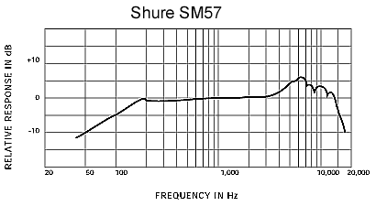
1. Requirements of Professional Microphones
1.1 Frequency response: Is the output level or sensitivity of the microphone over its operating range from lowest to highest frequency. from 20 Hz – 20 KHz flat

Slide 3
Flat Response
A microphone whose output is equal at all frequencies has a flat frequency response. Flat response microphones typically have an extended frequency range. They reproduce a variety of sound sources without changing or coloring the original sound.
Shaped Response
Mics generally have a shaped response designed to enhance a sound source in a particular application. For instance, a microphone may have a peak in the 2 – 8 kHz range to increase intelligibility for live vocals. This shape is called a presence peak or rise. A microphone may also be designed to be less sensitive to certain other frequencies. One example is reduced low frequency response (low end roll-off) to minimize unwanted “boominess” or stage rumble

Slide 4
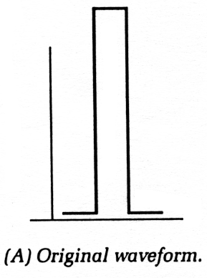
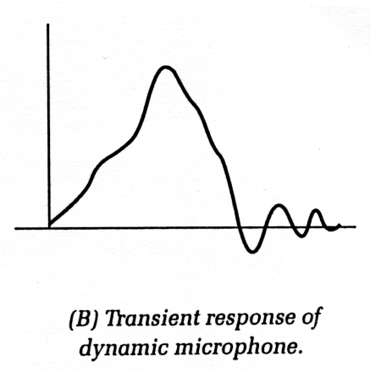
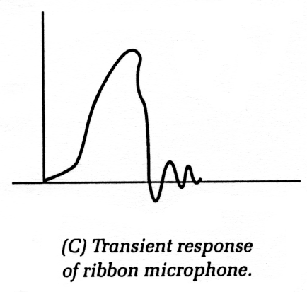
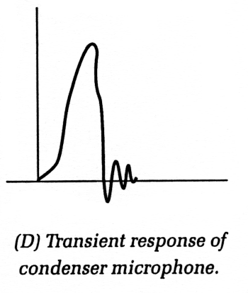
1.2 Transient Response: Response to starting transients (sudden large pressure change at the start) – should be good.
  Frequency response curve does not show this.

Slide 5
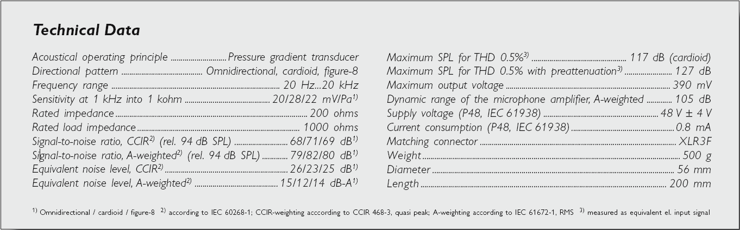
1.3 Sensitivity: electrical output for a given pressure or velocity change, should be high to get a good SNR at output.

Slide 6
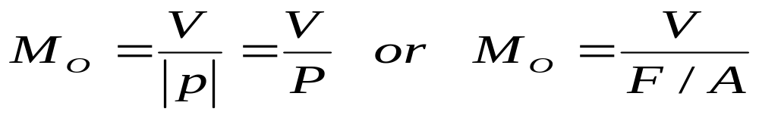
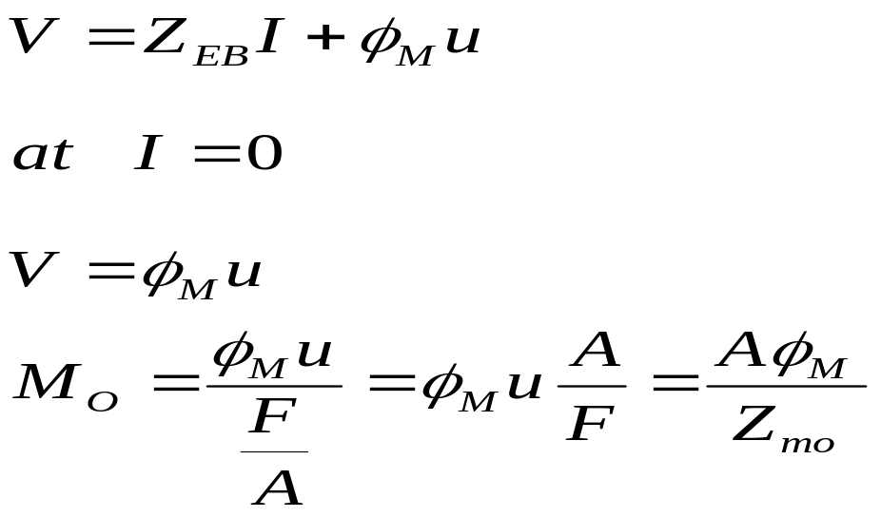
Microphone Sensitivity
Response of a microphone can be expressed as
V=Open circuit output voltage
P= Pressure amplitude where the microphone is placed
F/A= Average force/Unit area
M_{O}=Microphone open ckt. Voltage sensitivity
Since Z_{mo} is frequency dependent so M₀ is frequency dependent
M₀ can be made frequency independent for particular frequency range

Slide 7
1.4 Directivity
The directivity pattern (directional response) should vary as little as possible with frequency.
A microphone’s sensitivity to sound relative to the direction or angle from which the sound arrives.
There are a number of different directional patterns found in microphone design. These are typically plotted in a polar pattern to graphically display the directionality of the microphone.
The polar pattern shows the variation in sensitivity 360 degrees around the microphone, assuming that the microphone is in the center and that 0 degrees represents the front of the microphone.
The three basic directional types of microphones are Omnidirectional, Unidirectional, and Bidirectional.

Slide 8
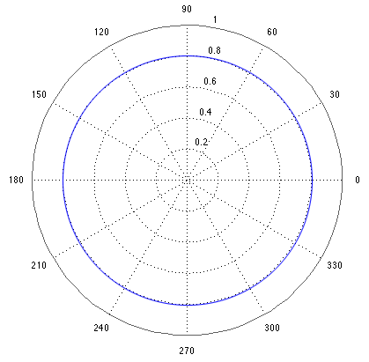
Omni Directional
It has equal output or sensitivity at all angles. Its coverage angle is a full 360 degrees. An omnidirectional microphone will pick up the maximum amount of ambient sound. In live sound
situations an omni should be placed very close to the sound source to pick up a useable balance between direct sound and ambient sound.

Slide 9
Unidirectional
The unidirectional microphone is most sensitive to sound arriving from one particular direction and is less sensitive at other directions.
The most common type is a cardioid (heart-shaped) response. This has the most sensitivity at 0 degrees (on-axis) and is least sensitive at 180 degrees (off-axis). The effective coverage or pickup angle of a cardioid is about 130 degrees, that is up to about 65 degrees off axis at the front of the microphone. In addition, the cardioids mic picks up only about one-third as much ambient sound as an omni. Unidirectional microphones isolate the desired on-axis sound from both unwanted off-axis sound and from ambient noise.

Slide 10
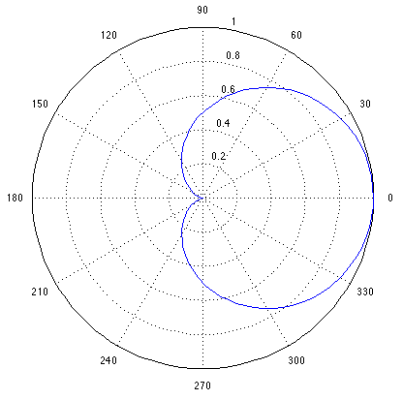

Slide 11
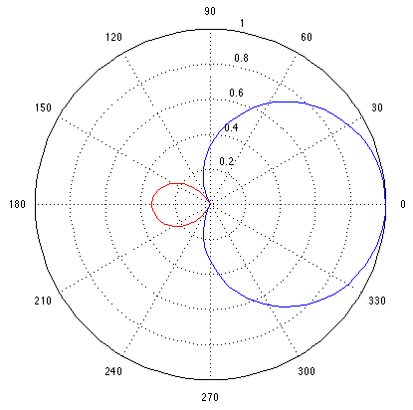
Bidirectional
A. Super Cardioid
The bidirectional microphone has maximum sensitivity at both 0 degrees (front) and at 180 degrees (back). It has the least amount of output at 90 degree angles (sides). The coverage or pickup angle is only about 90 degrees at both the front and the rear. It has the same amount of ambient pickup as the cardioid. This mic could be used for picking up two opposing sound sources, such as a vocal duet.

Slide 12
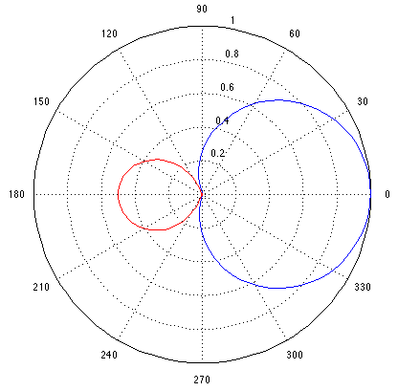
B. Hyper Cardioid
The bidirectional microphone has maximum sensitivity at both 0 degrees (front) and at 180 degrees (back). It has the least amount of output at 90 degree angles (sides). The coverage or pickup angle is less than 90 degrees at the front but slightly more pickup in the rear than a super cardioid mic. It has the same amount of ambient pickup as the cardioid. This mic could also be used for picking up two opposing sound sources, such as a vocal duet.

Slide 13
1.5 Self generated electrical noise should be as low as possible.
1.6 Environmental influences (temperature, humidity, magnetic & electric field changes) should have negligible effect on output.
1.7 Should be mechanically robust, reliable, light weight and not too expensive.
Contd.

Slide 14
2. Components of a basic microphone
2.1 Diaphragm – a thin light membrane which moves in response to sound pressure variation.
2.2 Transducer – usually coupled to diaphragm, although diaphragm is often an integral part of the transducer. Transducer converts the diaphragm movement into a proportional analogue voltage
2.3 Casing – encloses / part encloses diaphram and transducer. Nature of the casing determines the directional response of a microphone.

Slide 15
Basic Microphone Types
Carbon microphones
Piezo-electric (crystal or ceramic)
Dynamic (moving coil)
Condenser (capacitor)
Electret
Ribbon

Slide 16
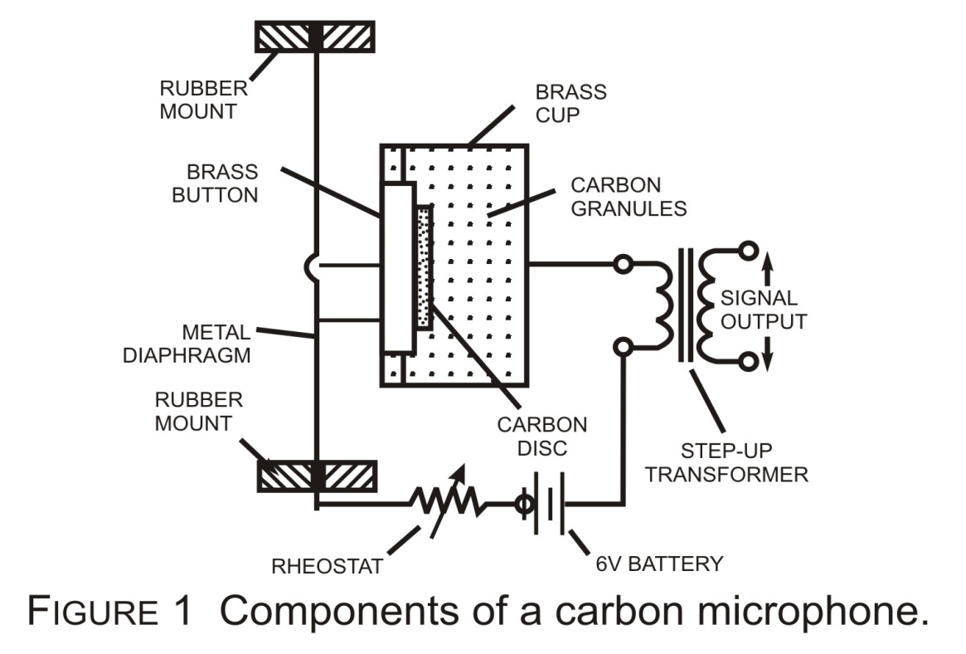
3. Transducer Systems
3.1 Carbon Granules: (Carbon microphones)
Carbon microphones, used in telephone handsets, now obsolete. Brief description given for completeness.
Sound pressure variations transmitted as diaphragm (a thin aluminum sheet) movements to the carbon granules via the brass button causes the carbon granule resistance and hence the current in the circuit to change (proportional to pressure variations).
Sensitivity, distortion, carbon noises are high.
Frequency range is restricted.
Contd.

Slide 17

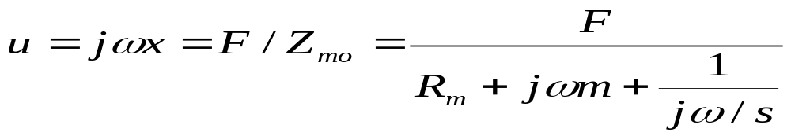
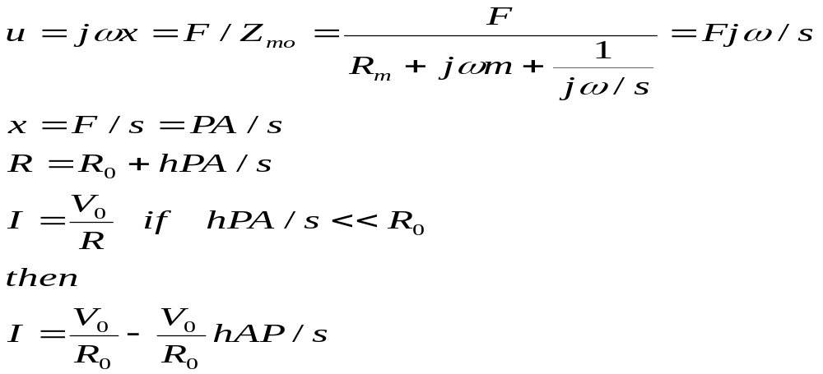
For small x the resistance R varies linearly with x
R0=static resistance
R= dynamic resistance
h= resistance constant (Ω/m)
x=distance moved by centre of diaphragm
Response of a microphone can be expressed as

Slide 18
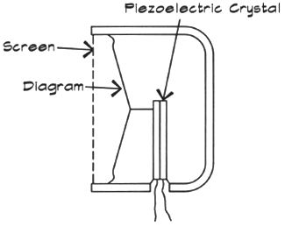
3.2 Piezoelectric Microphone
Diaphragm mechanically coupled to a piezoelectric material
Piezo (lead zirconate titanate (PZT), barium titanate, rochelle salt) generates electricity when strained
Contd.

Slide 19
Operation
Element, mounted as cantilever is actuated by the diaphragm (thin aluminum sheet or polyester film) via a drive pin. V₀ produced depend on type of deformation(bending/ share/ longitudinal) and the orientation relative to the axes of the crystal/axes of polarization of the ferroelectric ceramic meterial
Instead of acting directly on the ceramic/crystal transducer pressure acts upon a diaphragm of longer area to increase the force, which is transmitted by the drive pin to the piezoelectric for increase the sensitivity.
Two element sandwiched together called a bimorph has a smaller R_{m} for the same V₀ than a single element.
Parallel connected element has lower internal Z_{ms} and series connected element has higher V₀
Impedance is capacitive.

Slide 20
Properties
Microphone cable has to be short (less than 1 m) to reduce effects of induction from adjacent circuits.
Load impedance needs to be high.
Frequency response (with a high R_{in}) is uniform upto around 10 KHz.
Sensitivity level generally -30 dB ref. 1V/Pa
No polarization voltage
Generally rugged
Sensitivity and frequency response stable with time, humidity and temperature range.

Slide 21
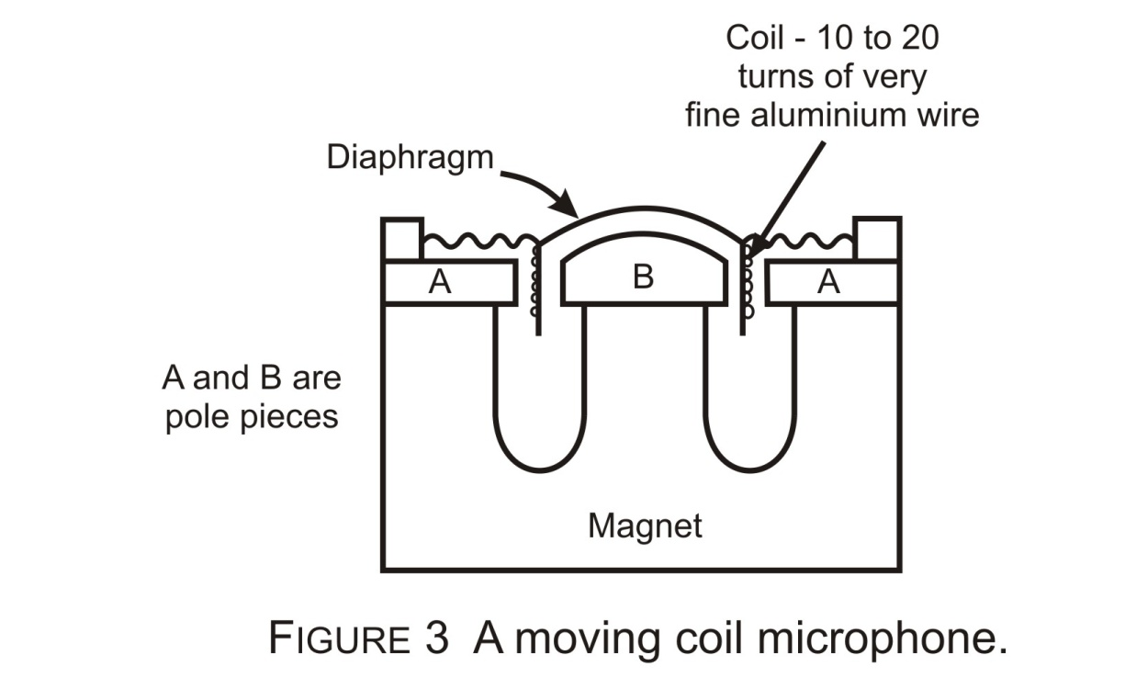
4. Moving Coil (dynamic) microphone
The diaphragm is attached to a small, light weight coil laced in the flux path of a permanent magnet.
The coil is usually made of 15-20 turns of thin aluminum wire to reduce weight and has a typical resistance of 30 ohms.
Pressure changes move diaphragm, which in turn moves the coil and proportional emf is generated in the coil.

Slide 22
The changing current in the coil follows the pressure variations on the diaphragm.
The emf generated is of the order of 0.5 – 1 mV for speech at a distance of 0.5 m.
Generally quite robust and unaffected by humidity.
Expensive as assembly needs considerable skill.
Diaphragm and coil must be light
Low output impedance – good with long cables
Rugged

Slide 23
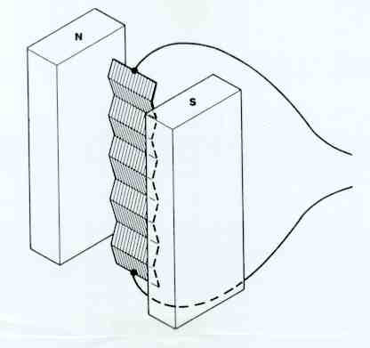
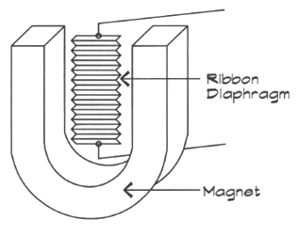
5. Ribbon Microphone
Diaphragm made of very light strip of corrugated (usually perpendicular to the length) aluminum ribbon, typically 20 x 5 x 0.0006 mm (l × w × thickness)
Conductive ribbon diaphragm moving in a magnetic field generates an electric signal
Ribbon is mounted between poles of a permanent magnet.
The emf generated is small because of short length of conductor and less than ideal flux density due to relatively wide gap.

Slide 24
Ribbon impedance is small (less than 1 ohm) but a stipule voltage transformer is often used to increase output voltage similar to moving – coil microphone and an impedance ≥ 30 ohm.
Suitable for pressure – gradient operation (to be discussed later). Mechanical characteristics of the ribbon is such that it moves relatively easily at low frequency and less easily at high frequencies i.e the ribbon is mass controlled.

Slide 25
6. Electrostatic (Condenser) Microphones
Two classes a. Externally polarized (air condenser) b. Prepolarized (Electret)
In its simplest form these consist of a conducting diaphragm (plastic coated with a metallic deposit) positioned near a rigid metal plate to form a capacitor.
- the combination is called a capsule
- C ≅ 20 pF
Lab grade condenser microphone of Fig. 5 has diaphragm made of thin membrane of nickel spaced about 25 micrometer form the back plate.
Since electroacoustic sensitivity is inversely proportional to the spacing distance d, special care has to be taken to ensure that d is not temperature dependent.
Such microphones are made entirely of Ni and Ni alloys and has constant
sensitivity from 20-150 degrees C.

Slide 26
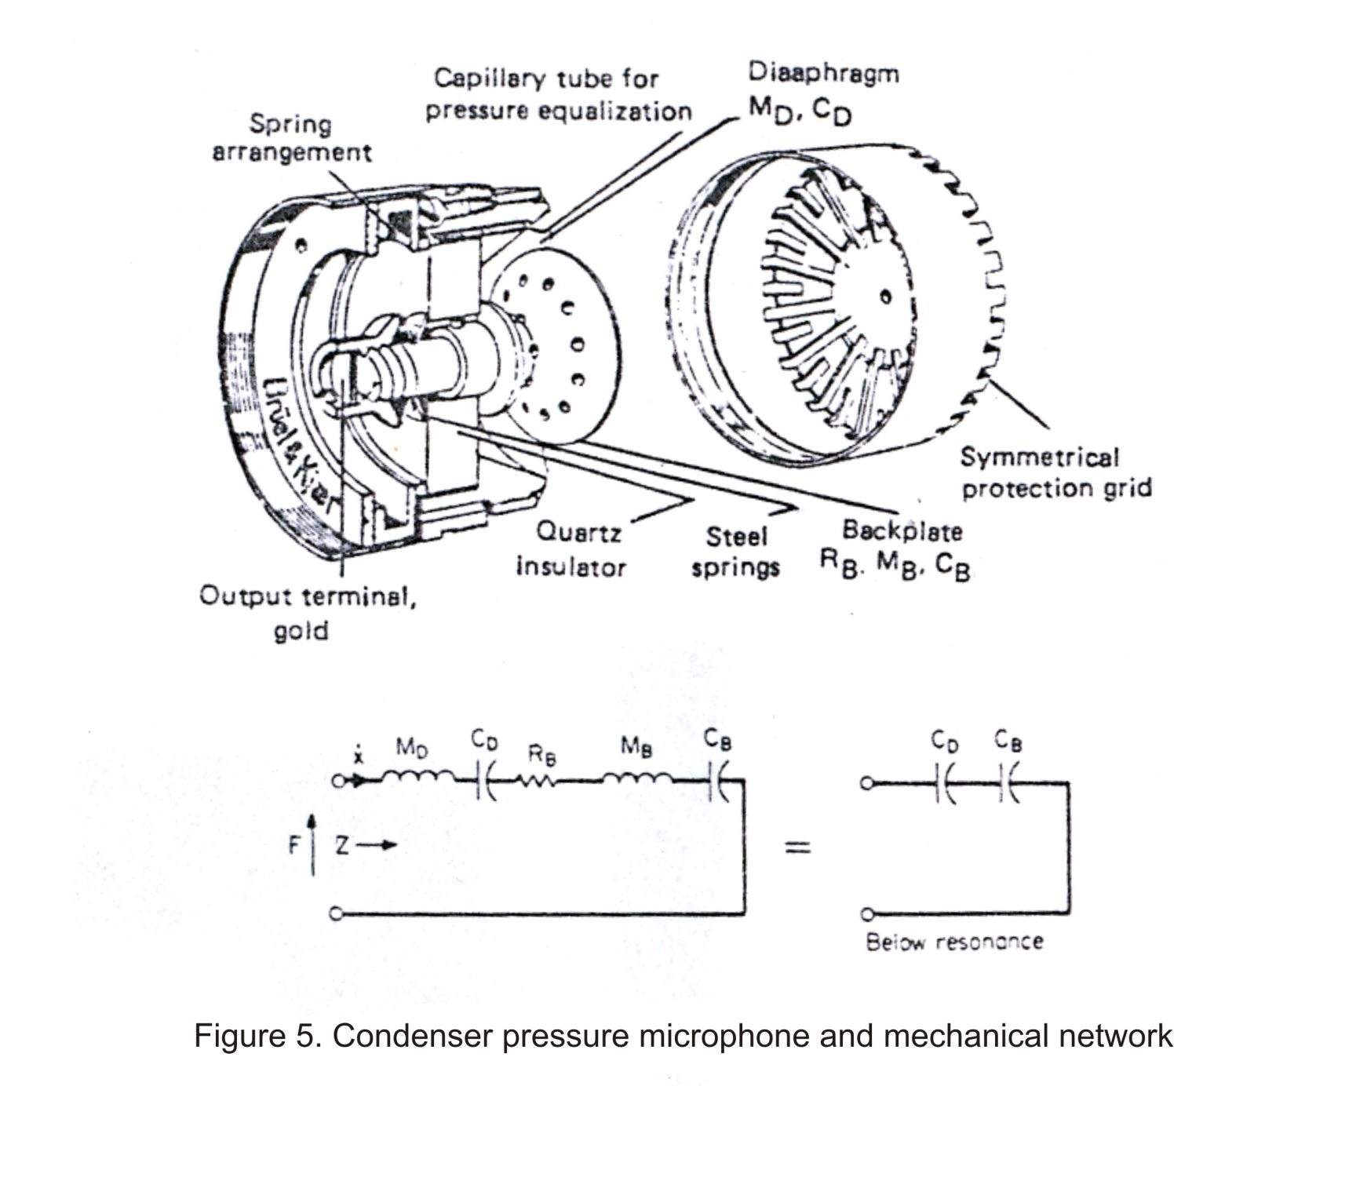

Slide 27
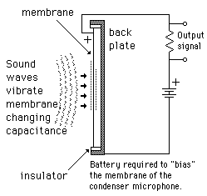

Condenser Microphone
Diaphragm and back plate form a capacitor
Incident sound waves move the diaphragm, change the separation distance, change the capacitance, create current
Comments
  Requires a DC polarizing voltage
  High sensitivity
  Flat frequency response
  Fragile
  High output impedance, nearby pre-amp is necessary
Q = C·V
C A/d

Slide 28
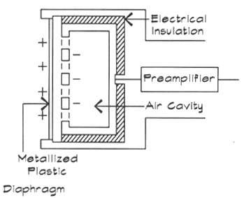
Electret Microphone
Same basic operation principle as the condenser mic
Polarizing voltage is built into the diaphragm
Comments
  High sensitivity
  Flat frequency response
  Fragile
  High output impedance, nearby pre-amp is necessary
Typically one side of a plastic film is coated by vacuum sputtering with a conductive material (Al/gold/Ni) → coating thickness=50 nm(aprox)
Film is then heated and charged with high DC potential and then cooled
A well designed Electret capsule retains its charge and exhibit nearly constant sensitivity for 10 years.

Slide 29
6.4 If a charge Q exists on C then a change in C by δV= Q / δc
6.5 C changes when, due to sound pressure, spacing changes.
6.6 The back plate air load consists of
- Mass M_{B}, Compliance (x/F) C_{B}, Resistance R_{B}
- M_{B}, C_{B} plus the diaphragm mass M_{D} and compliance D_{D} determine resonant frequency.
- R_{B} provides damping of resonance.
- Resonance is placed at the high end of the usable frequency.
- Below resonance the microphone is stiffness, F/x (reciprocal of compliance) controlled and only C_{D} and C_{B} appear in the circuit.
Contd.

Slide 30
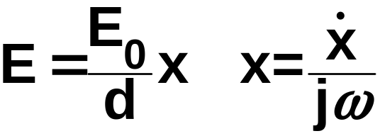
The open circuit output voltage E is given by
Where
E₀ = polarizing voltage (or equivalent voltage for electrets)
d = spacing from diaphragm to back plate, m
X = diaphragm displacement, m
= diaphragm velocity, m/s
ω = 2πf
f = frequency, Hz
The velocity is given by

Slide 31
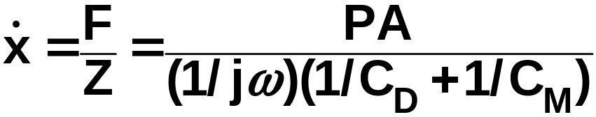
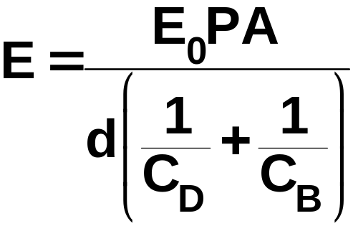
Where:
F = force on diaphragm, N
P = sound pressure on diaphragm, N/m²
A = area of diaphragm, m²
Z = mechanical impedance system, mechanical ohms
The output voltage is obtained by combining Equations above.

Slide 32
This means that below resonance the response is independent of frequency.
The polarization field strength for most condenser microphones, is the order 100,000 V/Cm
Slightest bit of contamination between diaphragm and backplate will cause impulsive noise due to arcing.
Impulsive noise is caused by humidity which can be eliminated by desiccation.
Contd.

Slide 33
6.7 Two methods of putting charge on C.
Connect two halves of the device to a d c source (typically 50 V) through a high value resistor (to ensure a large RC = time constant, which makes Q to be effectively constant). Fig. 6 shows this method.
6.8 Second method of putting charge on the capacitor is to use electrets. These are substances which can, be given a nearly permanent charge by raising the material to a high temperature and then cooling
Contd.

Slide 34
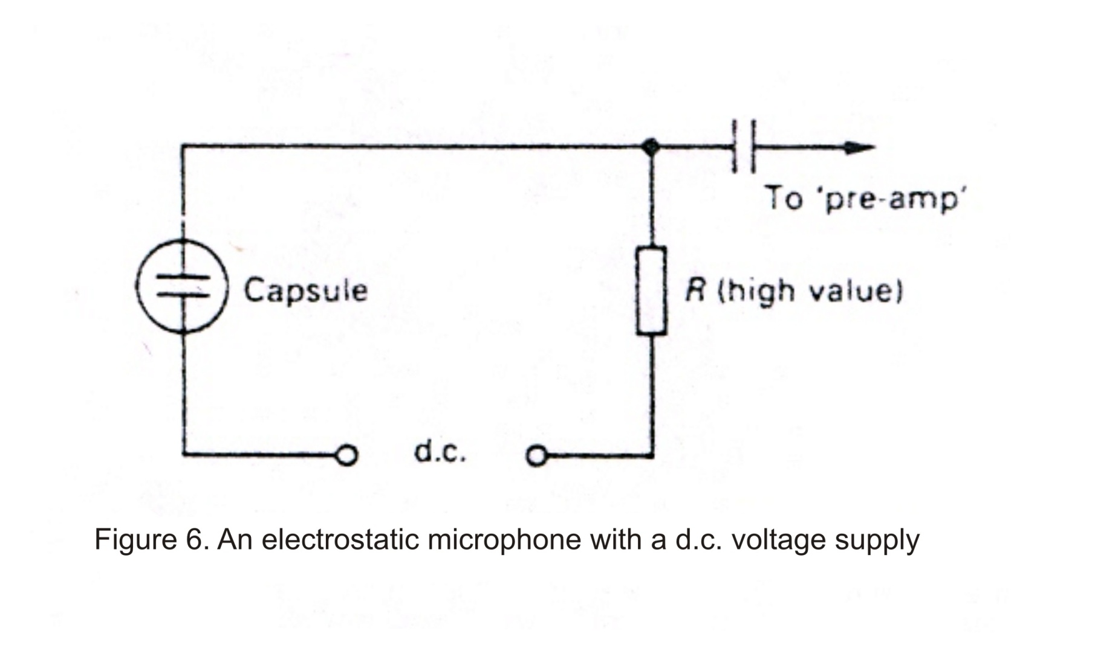

Slide 35
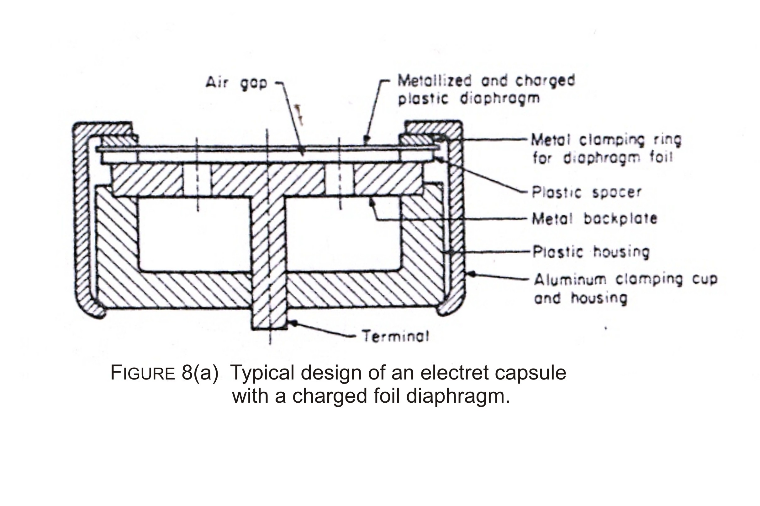

Slide 36
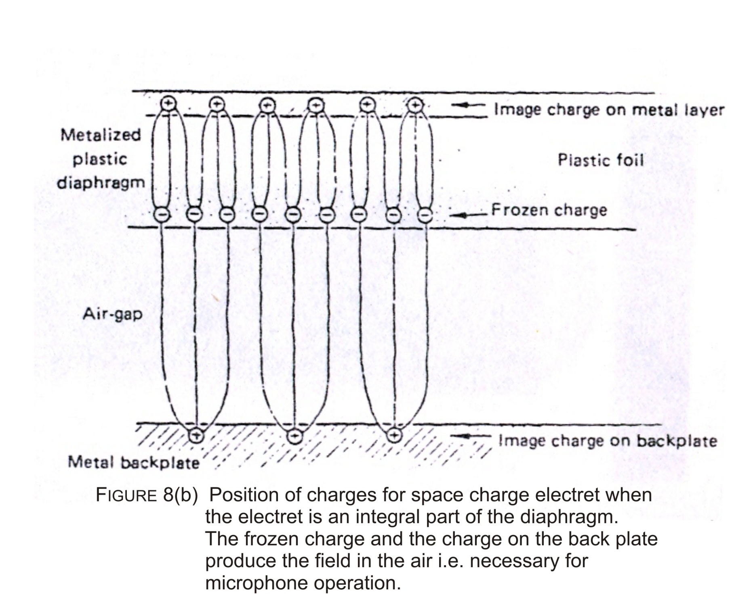

Slide 37
Fig. 8(a) shows the design of Electret capsule.
Fig. 8(b) shows the charge patterns of a space charge electret (integral with diaphragm).
6.9 The charge decay is low; sensitivity reduces less than 1 dB per decade.
Contd.

Slide 38
7. Directivity Patterns – Polar diagrams
Microphones fall broadly into two classes
(i) Pressure microphones (zero order gradient microphone.
(ii) Velocity microphones (1st order gradient microphone).
7.1 In a pressure microphone the diaphragm is exposed to the sound source only on one side (except for a small aperture meant to equalize slow changes in air pressure.
7.2 The diaphragm movement is directly proportional (nearly) to sound pressure (a scaler quantity)
Contd.

Slide 39
7.3 Directivity pattern depends on the relationship between wavelength and diameter of diaphragm. When λ > diameter, sounds from all directions strike the diaphragm, those from back (180⁰) arrive by diffraction.
7.4 Directivity pattern is omni directional.
7.5 When wavelength is comparable or less than diameter, sounds incident at 90⁰ may show phase cancellation. Diffraction may be incomplete at high frequencies for sounds arriving from 180⁰.
7.6 Fig. 9 shows a simplified pressure microphone.
Fig. 10 shows phase cancellation at 90⁰ at small wavelengths.
Contd.

Slide 40
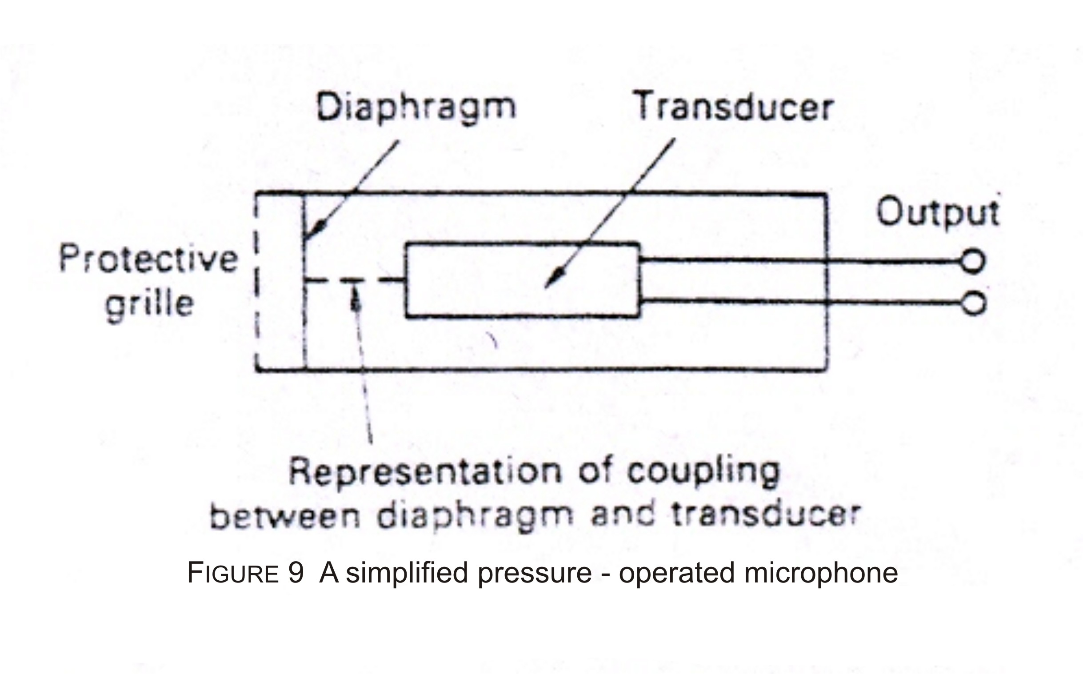

Slide 41
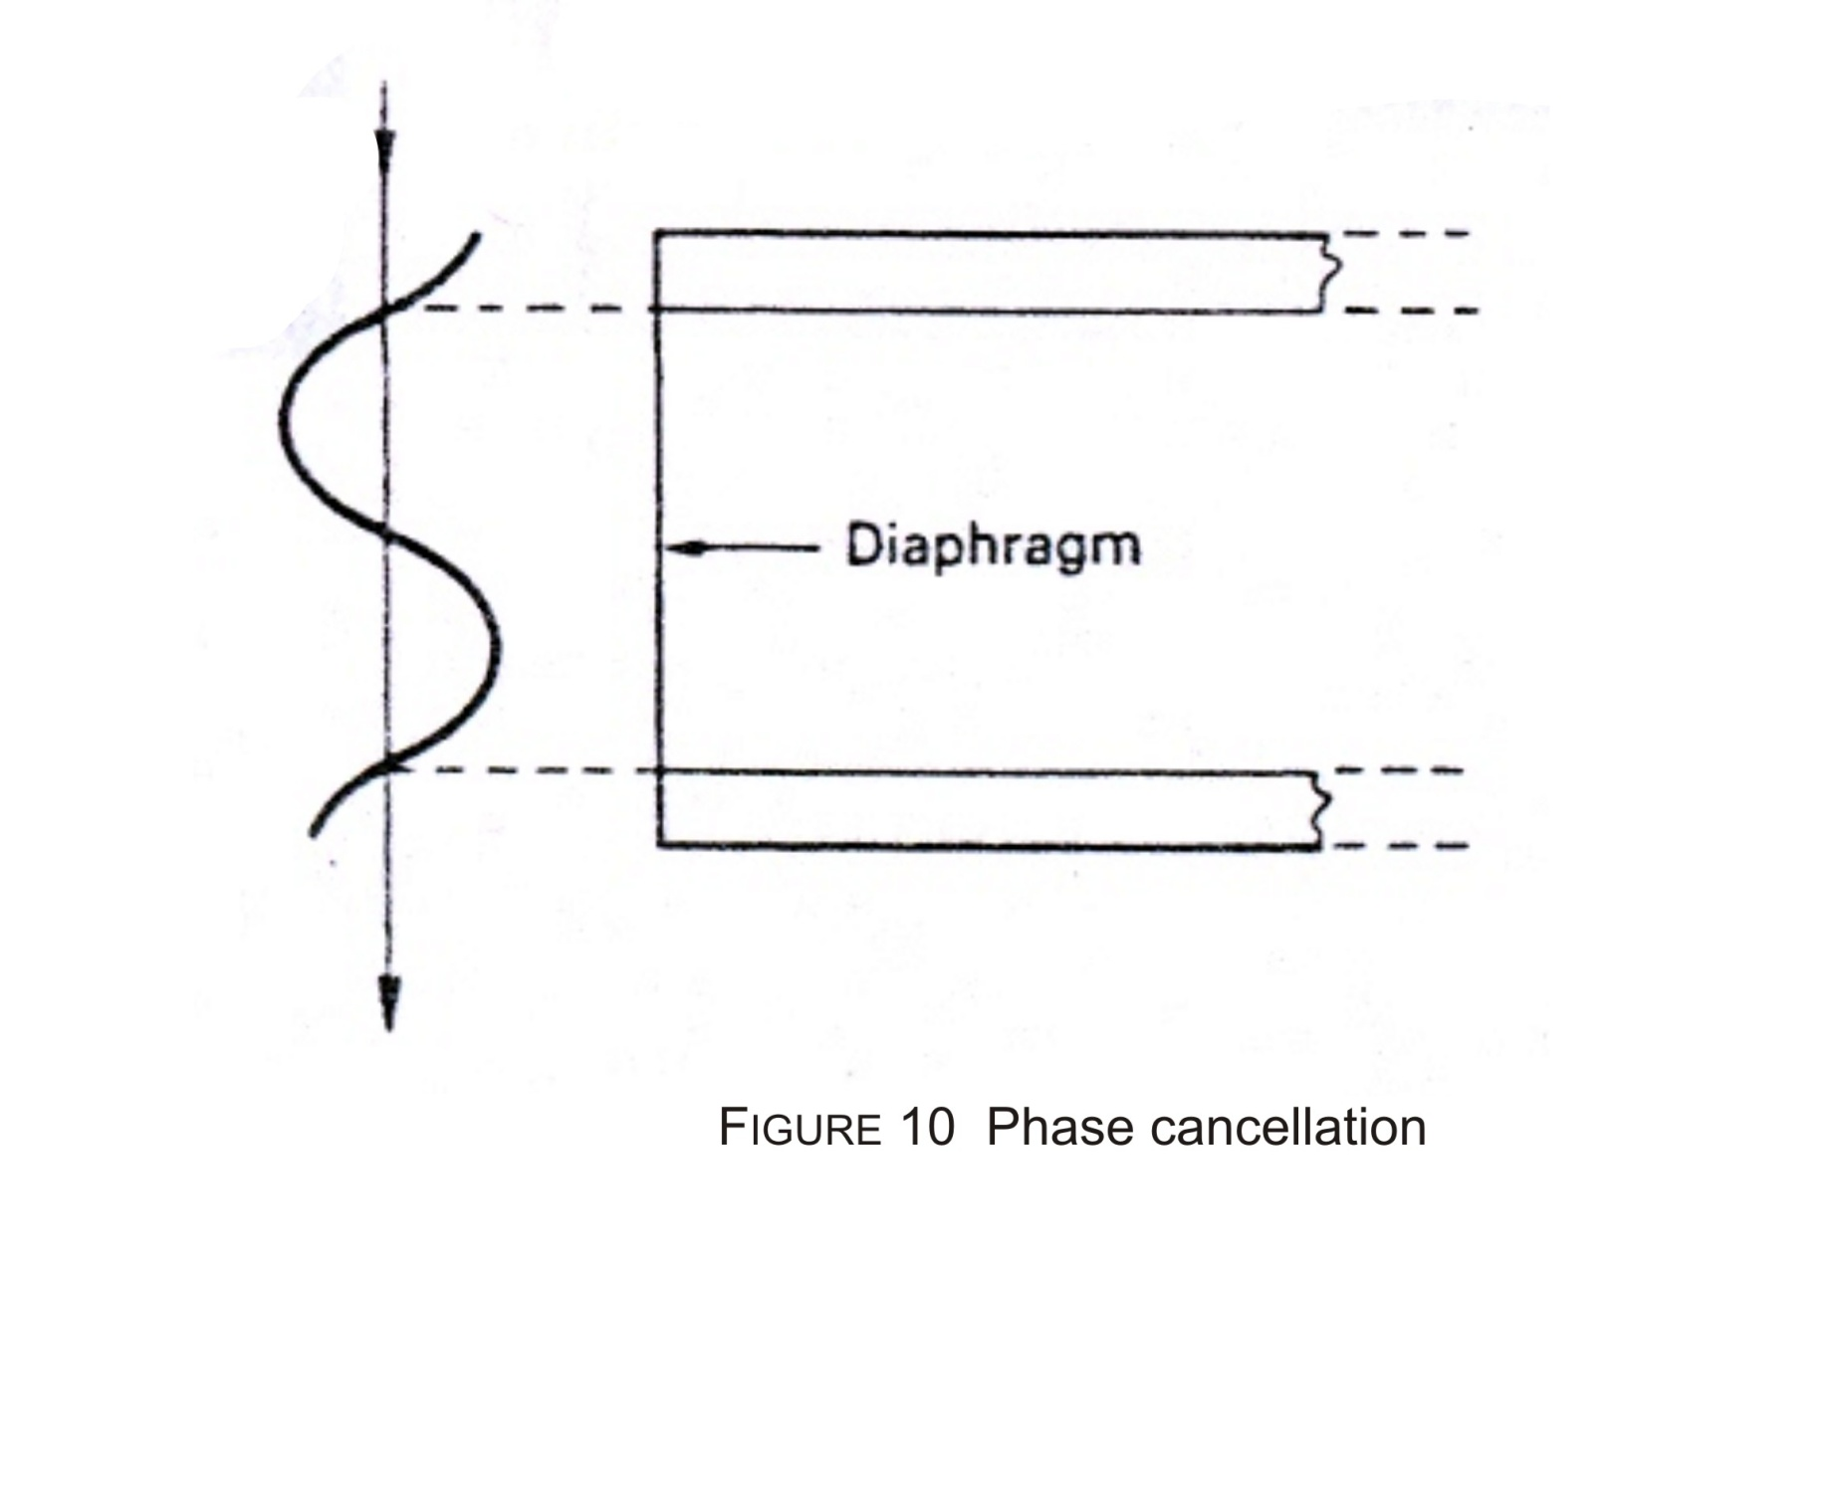

Slide 42
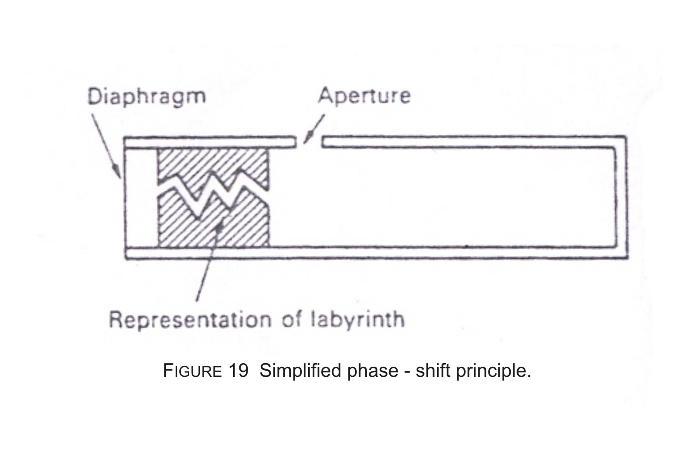

Slide 43
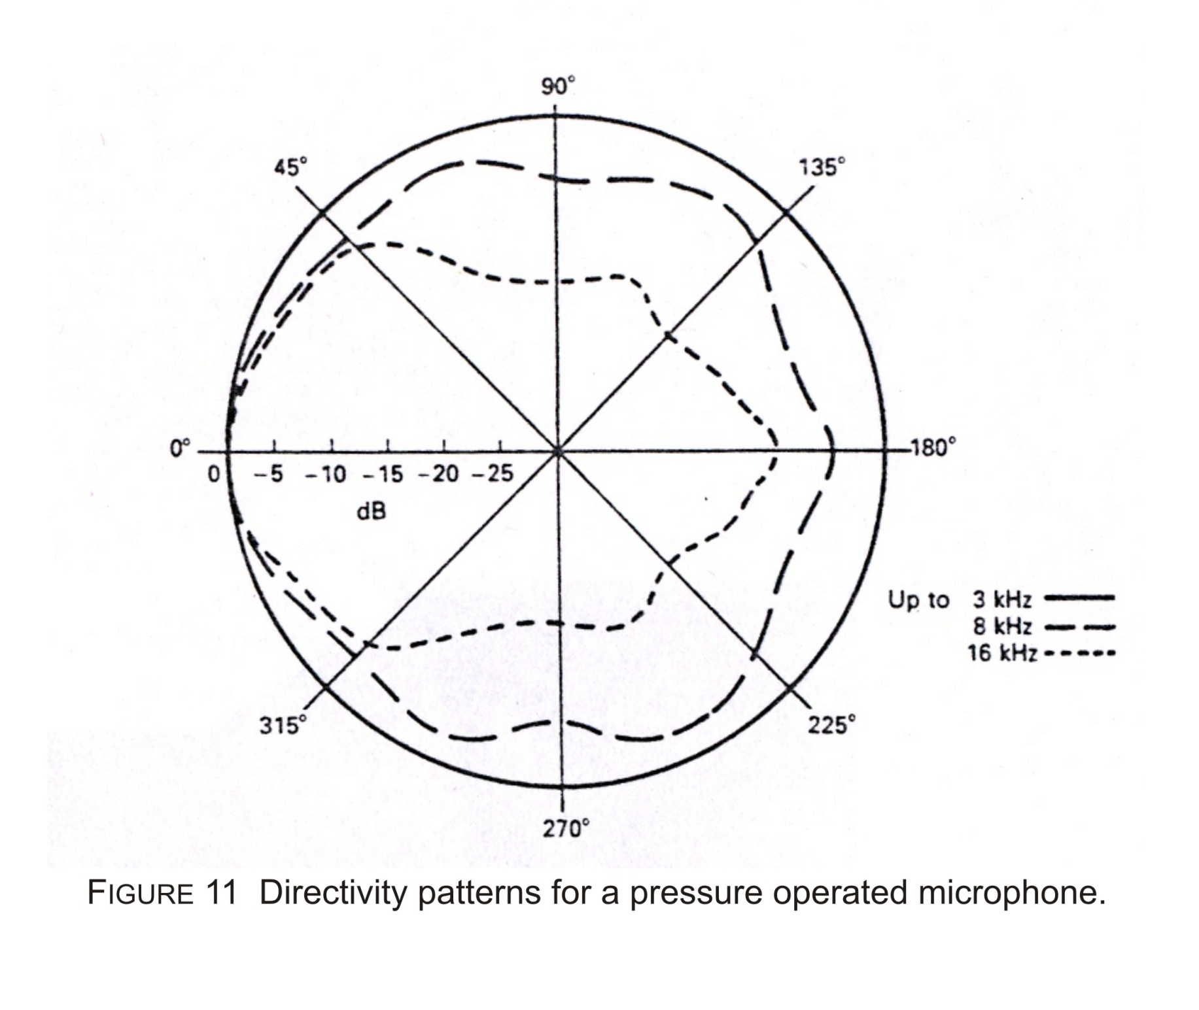

Slide 44
7.7 Pressure gradient (Velocity) microphone
- The output of these type of microphone depends on the pressure difference or gradient between the sound wave that hits the front and the back of the diaphragm.
- The electrical output depends on the instantaneous velocity in the impressed sound wave.
- Ribbon microphone is an example. Other pressure microphones can easily be altered to velocity type.
- Polar microphone is directional. Directivity pattern can be altered by design.
Contd.

Slide 45
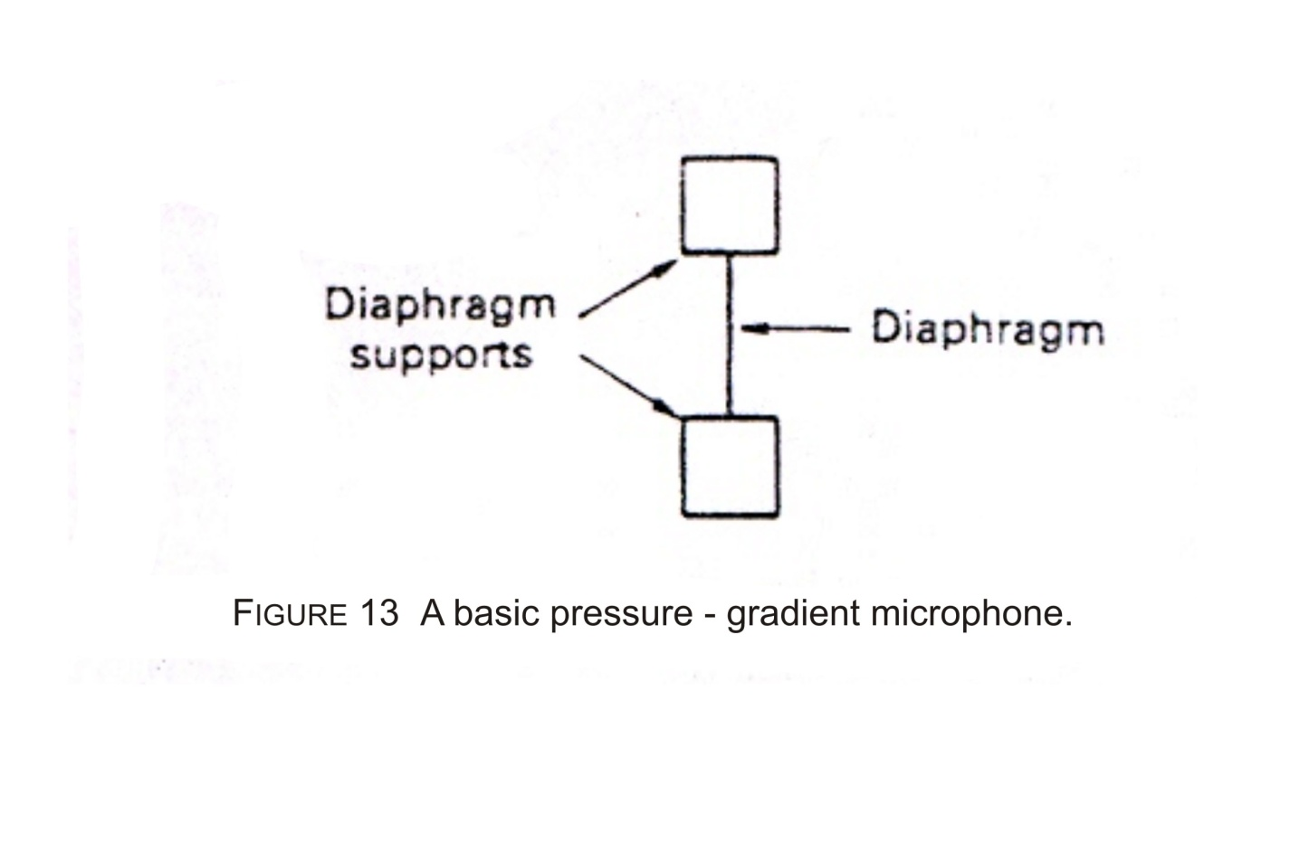
9. Pressure gradient microphone
9.1 Fig. 13 shows the basic principle of a pressure gradient microphone.

Slide 46
9.2 The concept of principal axis is shown in Fig. 13 (a) & 13 (b).
9.3 Fig. 14 shows the directivity pattern of a bidirectional pressure gradient microphone of the type shown in Fig. 13.
Contd.

Slide 47
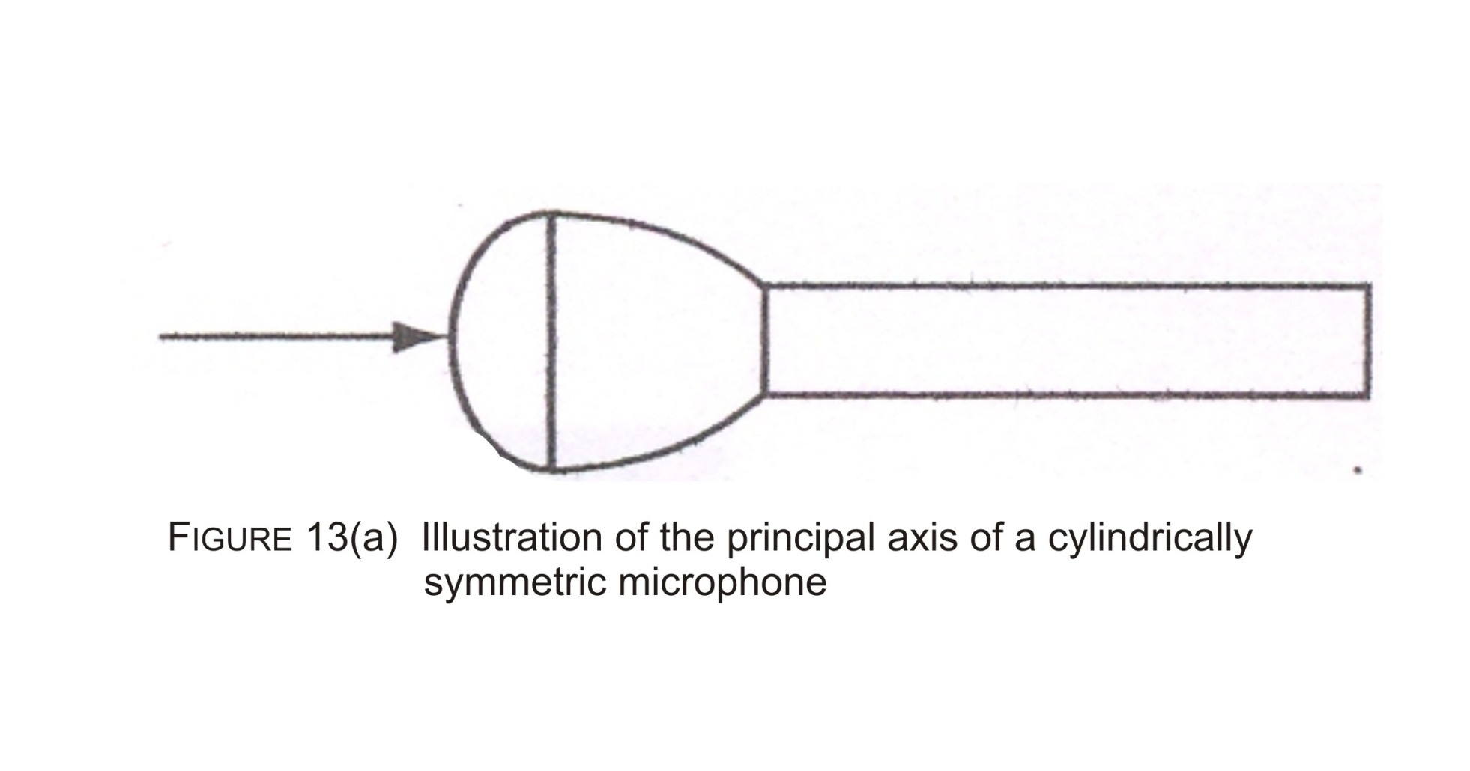

Slide 48
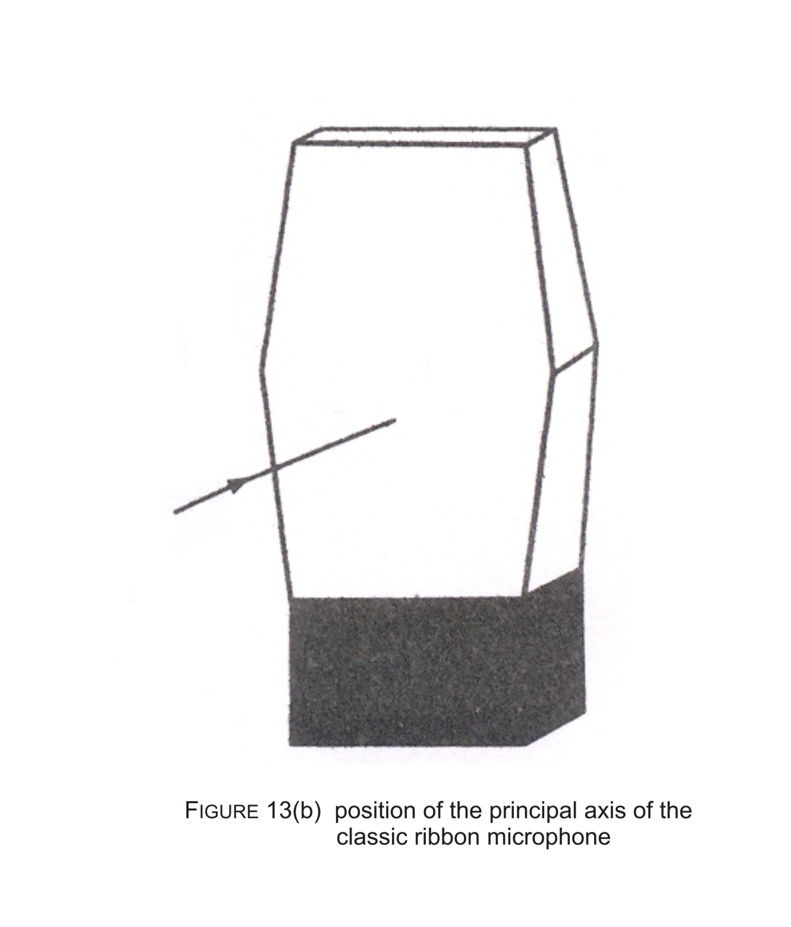

Slide 49
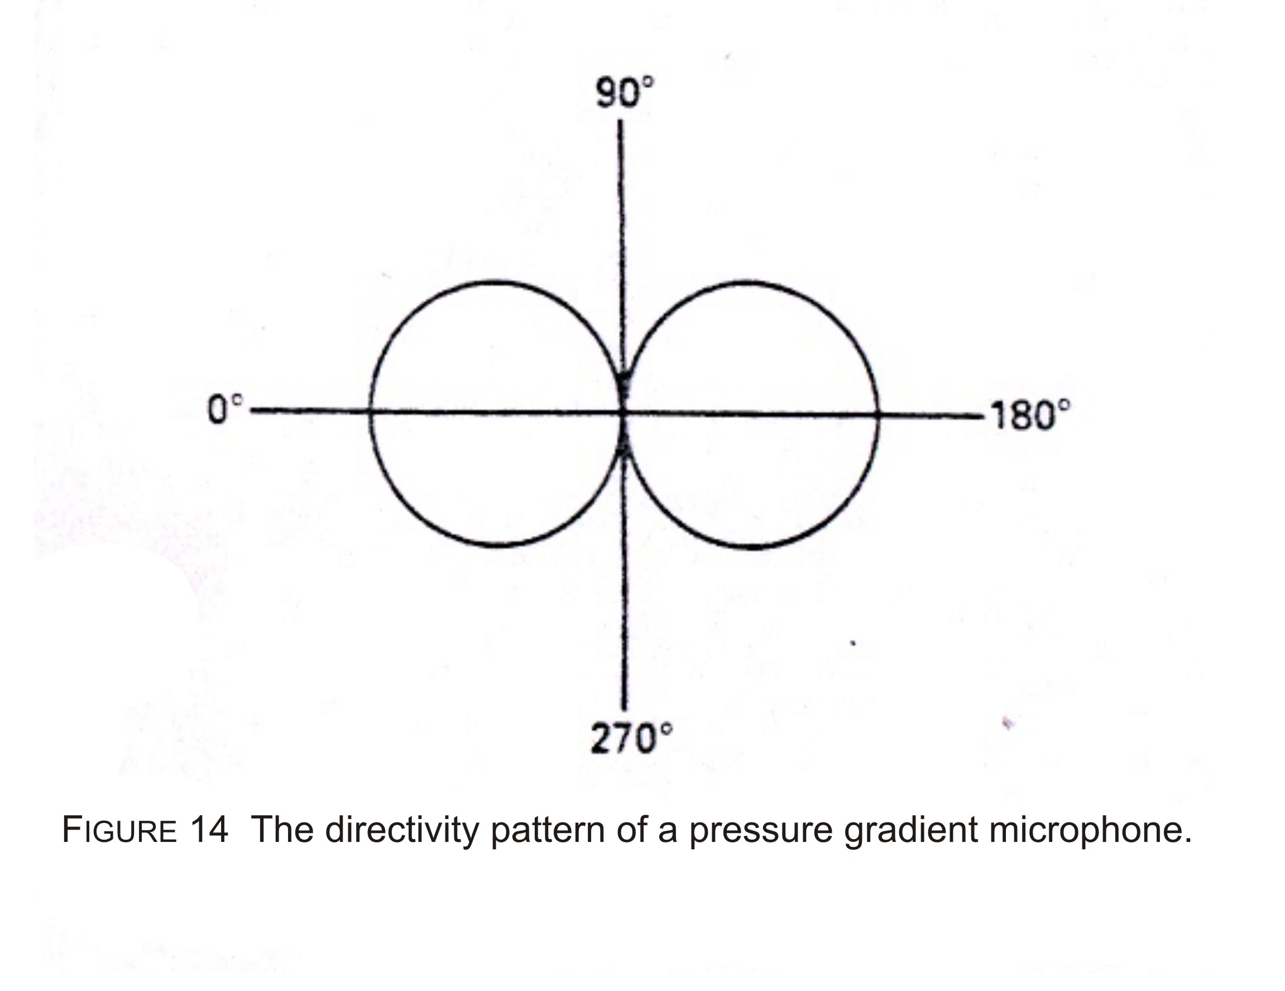

Slide 50
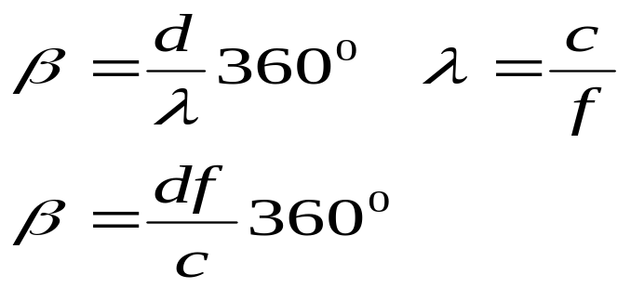
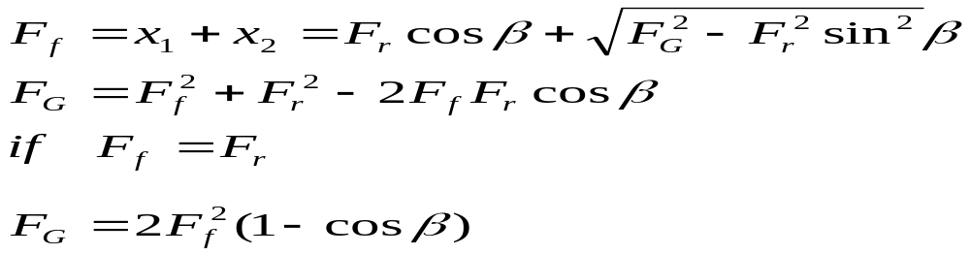
Method of determining pressure gradient
F_{r}
F_{r} = force on rear diaphragm
F_{G}=Pressure gradient
_{β}
x₁
x₂
d=length from front to rear path
F_{f}
F_{f} = force on rear diaphragm
F_{G} is very small when f is low and F_{G} is maximum when β=180º
Beyond this frequency λ is usually small compared to diaphragm d and F_{G} is fall of appreciably .

Slide 51
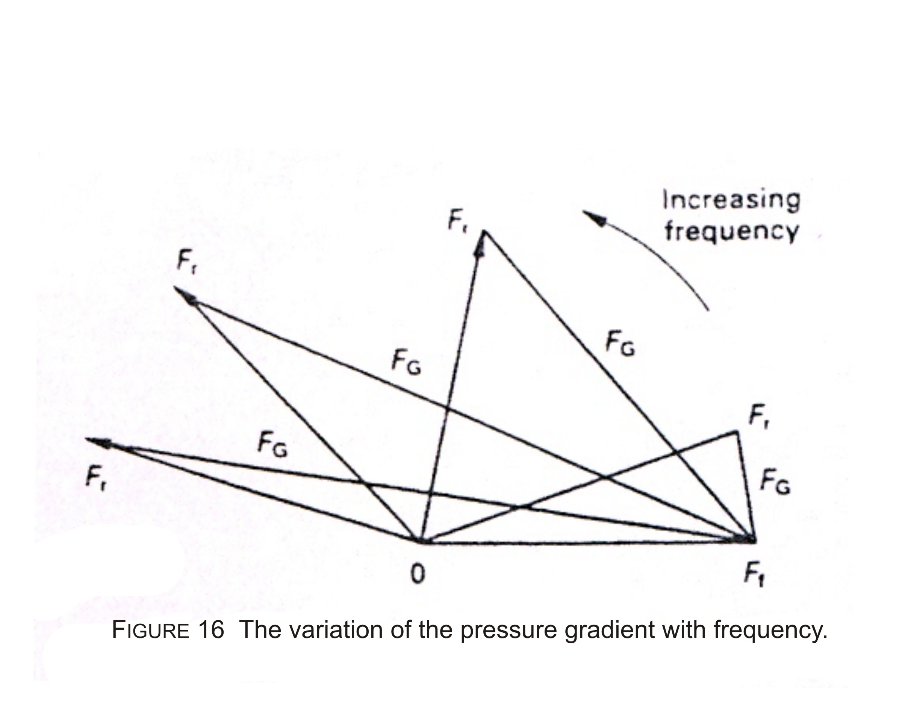

Slide 52
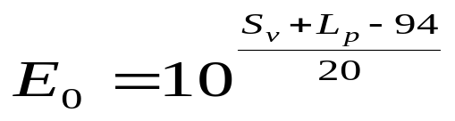
Measurement of microphone sensitivity
Definition of S_{v}
S_{v}= 20 logE₀ dB
E0 is the open circuit voltage output 0dB → 1V/pa incase of power 0dB=1mW/Pa
Given a pressure level L_{p} and sensitivity S_{v} of a microphone

Slide 53
Octave: an octave is band whose highest frequency is exactly double of the lowest frequency
Pink Noise: In case of pink noise acoustical energy distributed uniformly by octave throughout the audible spectrum
In pink noise the total sound power in each octave is the same as total sound power in the octave immediately below or above it.

