Slide 1
Microphone – contd.

Slide 2
1. Microphone Sensitivity
1.1 Definition – may be defined as the output voltage/power of a microphone corresponding to a given input sound pressure level
- it is often expressed in dB referred to a particular voltage / power corresponding to a specified SPL.
1.2 Sensitivity Expressions
Microphone sensitivity may be expressed in any one of the following ways.
1.2.1 Open-circuit voltage, 0dB = 1V/Pa = 1V/10μ bar.
1.2.1 Max power output, 0dB = 1mW/Pa = 1mW/10μ bar.
Contd.

Slide 3
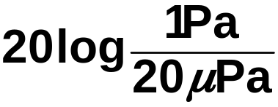
1.2.3 Electronic Industries Association (EIA) sensitivity, 0dB = EIA standard SE-105
Reminder
1 bar = 1.00 x 10⁵ Pa | 1 Atm = 1.031250x10⁵ Pa
10μ bar = 1Pa | 1 Atm ≅ 1 bar
10μ bar = 10 dyne/cm² | 20μ Pa = 0dB SPL
1Pa (10μ bar) = | = 20 x 4.69897dB = 93.979 dB
 | = 94dBSPL
20μPa = 0dB SPL = Threshold of hearing at 1 KHz

Slide 4
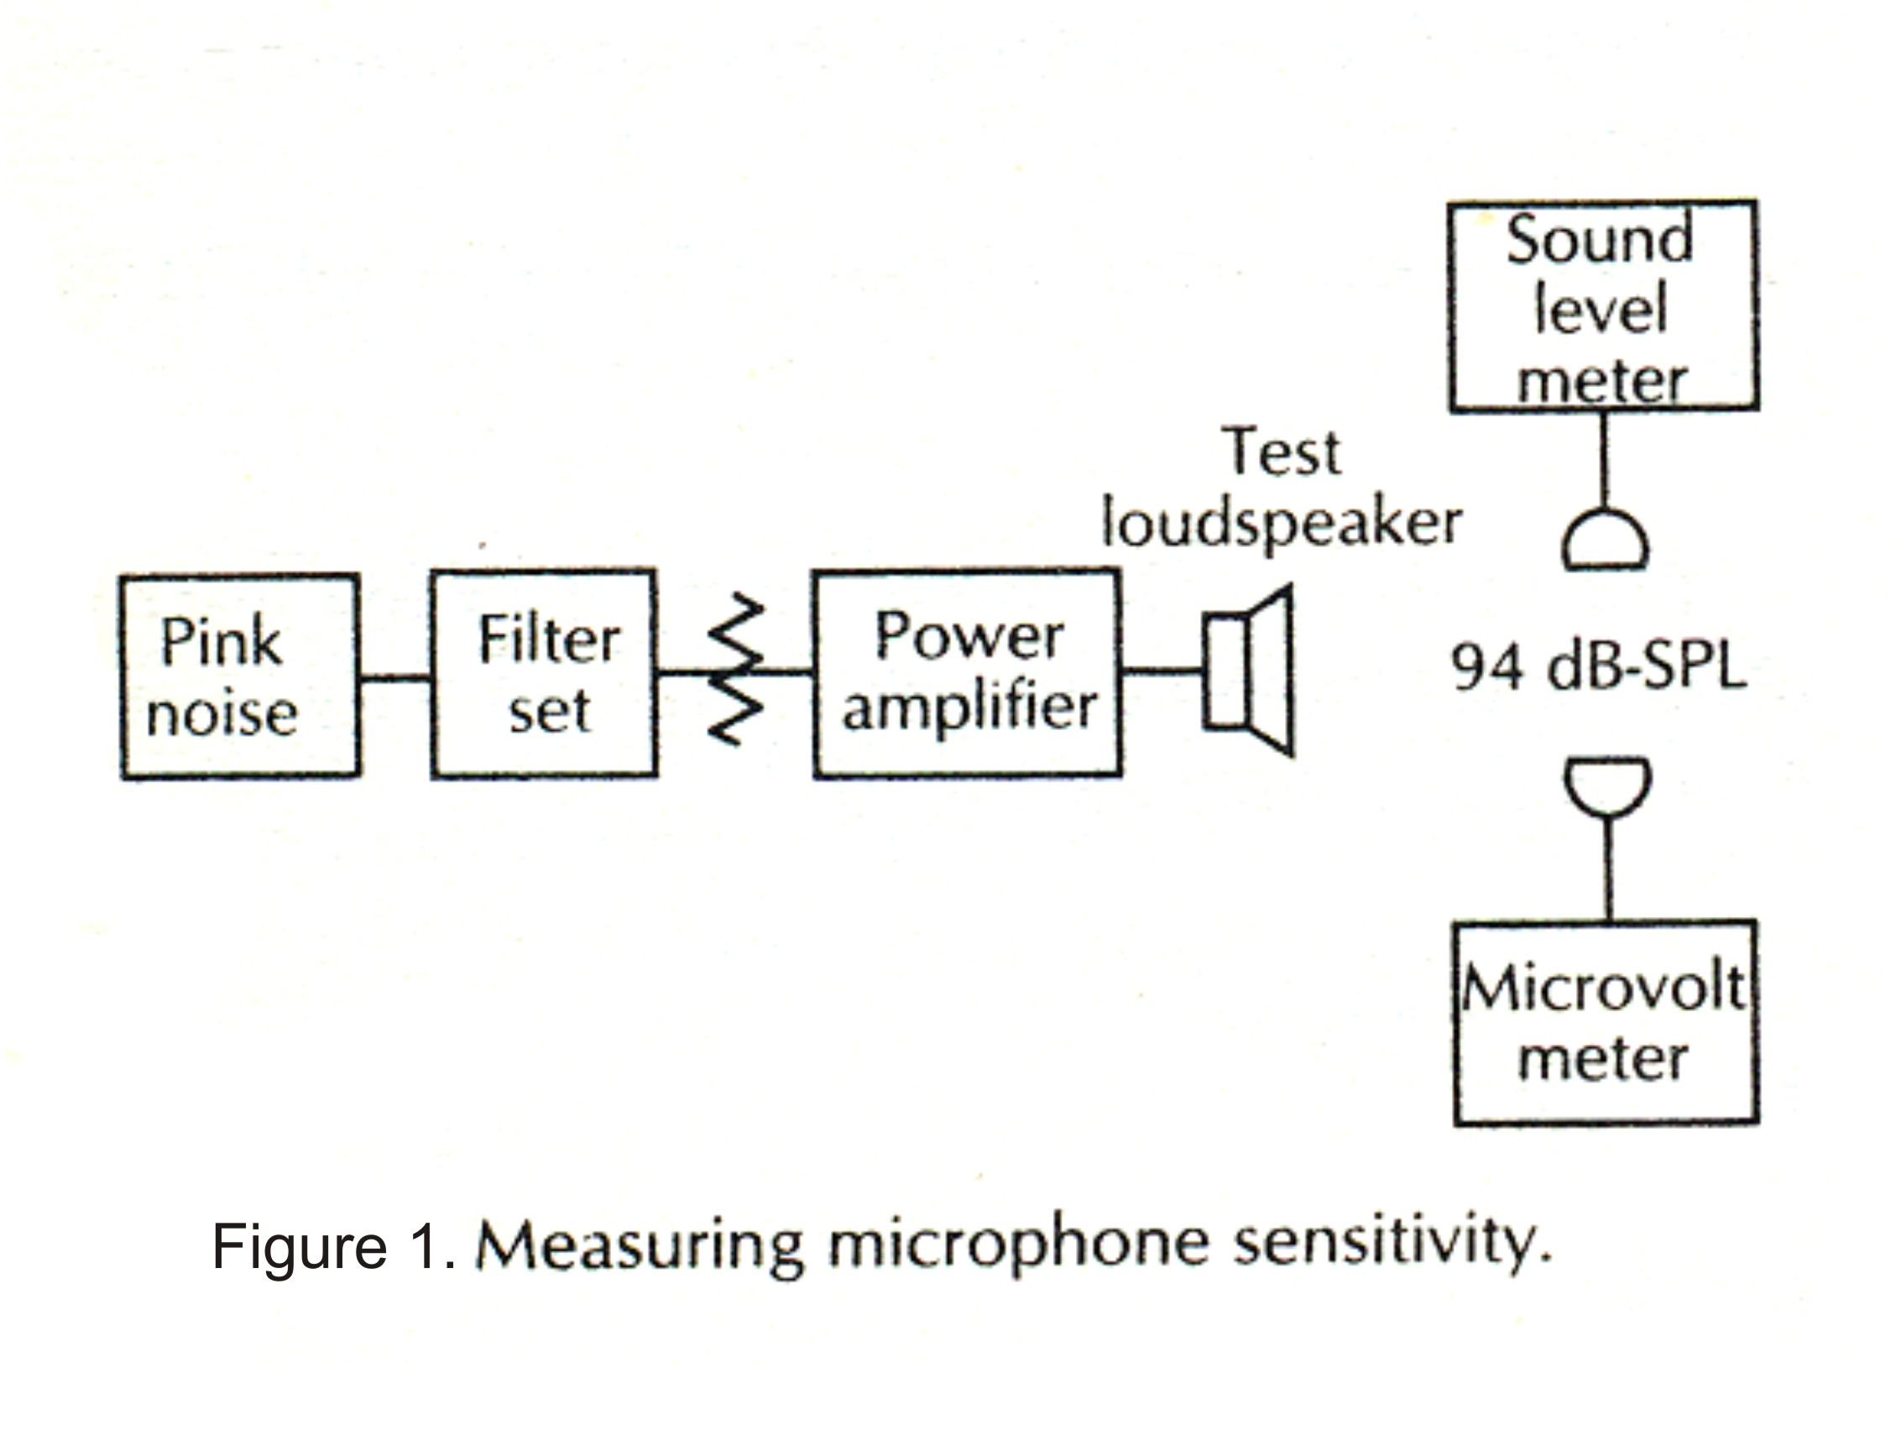

Slide 5
1.3 Measurement of Sensitivity
Fig. 1 shows a typical set up of measurement of microphone sensitivity. An SPL of 94dB (1Pa) is chosen as SPL reference level as this value is well above the normally encountered ambient noise level. A microphone that produces an electrical signal output (Open-circuit voltage) of 1V at this SPL will be rated to have a 0dB sensitivity, but even a “very sensitivity” microphone has a typical sensitivity of around -30dB.
Procedure
(1) Adjust the output level of a pink noise source the filter set (LP & HP) characteristics, the output of the power amplifier so that a sound level meter (SLM) placed at a distance of 1.5-2m in front of a good
Contd.

Slide 6
loud speaker produces an SPL of 94 DB (a band of pink noise from 250 Hz to 5KHz being ideal for the purpose). Fig. 2A & 2B show the response characteristics of a passive filter set.
(2) Replace the SLP with the test microphone and measure the open-circuit voltage using a micro voltmeter.
(3) The voltage sensitivity S_{v} is defined as
S_{v} = 20 log E₀ dB ….. (1)
where S_{v} = voltage sensitivity expressed in dB referenced to 1 V for a 1 Pa acoustic input to the microphone.
E₀= open circuit output of the microphone in volts.
Contd.

Slide 7
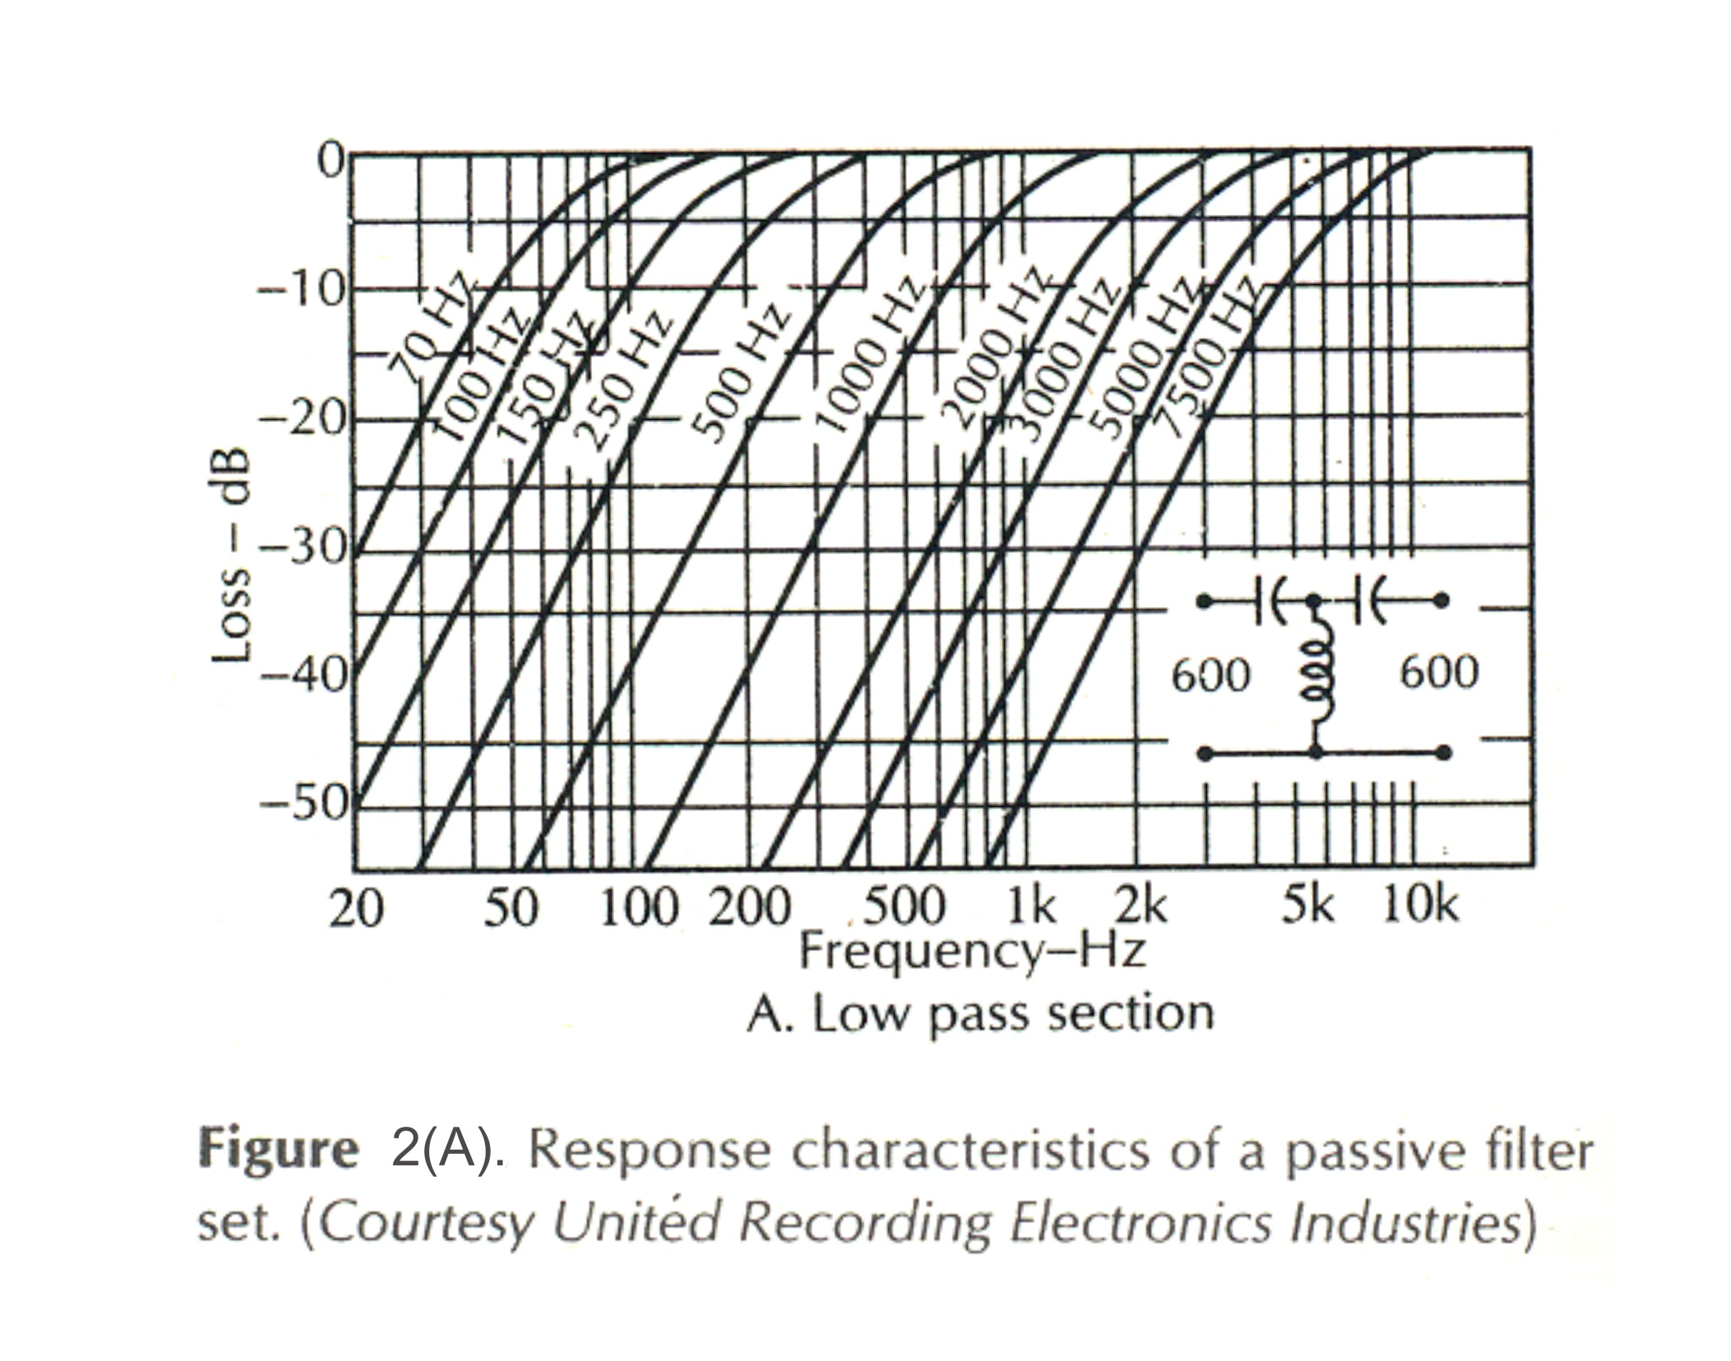

Slide 8
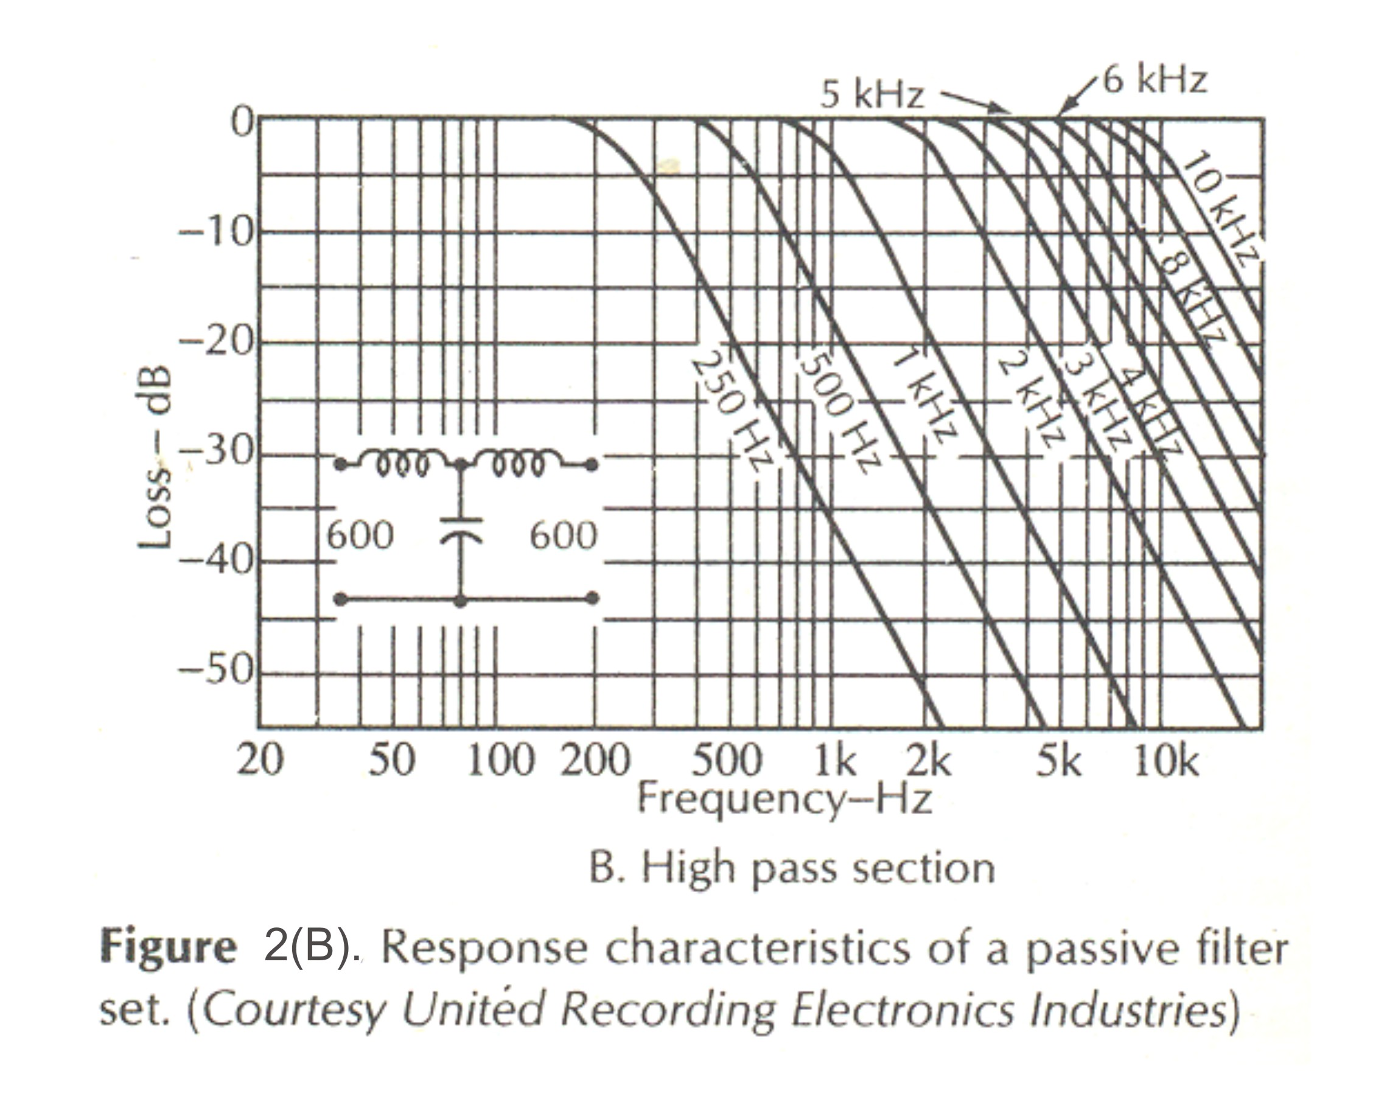

Slide 9
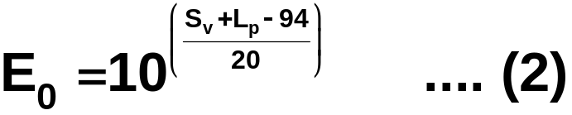
- The open-circuit voltage output of the microphone when exposed to some other acoustic level L_{p} is calculated from
[20 log E₀=S_{v} + L_{p}-94]
Example: If a given microphone tested under the condition shown in Fig. 1, produced an open circuit voltage E₀=0.001, then from equn. (1) we calculate
S_{v} = 20 log (0.001) dB
= - 60 dB
Contd.

Slide 10
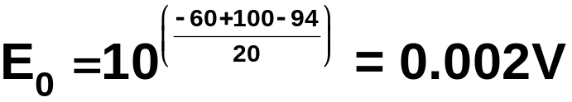
If this microphone is now exposed to an acoustic input level of 100 dB, rather than 94 dB then the open-circuit output voltage would be
Another way of looking at it si to think that the new SPL is 100-94 = 6dB higher. Therefore the new E₀ will be + 6dB higher or double the previous E₀
1.4 Justification of specifying sensitivity in terms of open-circuit voltage.
Contd.

Slide 11
1.4.1 Given E₀ (open-circuit voltage) and R₀ (resistive component of Z₀, the output impedance) of a microphone, the voltage across the input terminals of the microphone preamplifier can be calculated if the R_{in} of the preamplifier is know.
1.4.2 Usually R₀ is in the range of 150 Ω to 250 Ω and R_{in} ≥ 2k Ω. Therefore for all practical purpose E₀ is effectively the voltage at the input of the microphone preamplifier and the specified voltage represents the actual operating condition.
1.4.3 If Rin ≥ 10 R₀ then small variations in R₀ does not alter final voltages significantly.
1.4.4 When a microphone operates in an open-circuit condition (Rin ≥ R₀) the overall SNR can improve by 3dB, compared to the situation when R_{in}=R₀ (matched impedance).
Contd.

Slide 12
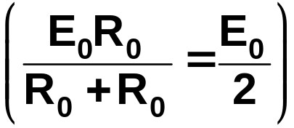
Under R_{in} = R₀ condition, the thermal noise at preamp input is reduced by 3dB, but the signal level across R_{in} drops by 6dB
1.5 Power Sensitivity Expression
  When we specify sensitivity as power output 0dB = 1mW / Pa the reference power level is 1mW or 0dBm and the reference pressure level is 94 dB SPL
  Since both Z_{in} & Z_{out} are in general complex impedances, a matched impedance condition requires R_{in} = R_{out} & the reactance of the load being equal to the –ve of the reactance of the source (matched on a conjugate basis).
Contd.

Slide 13
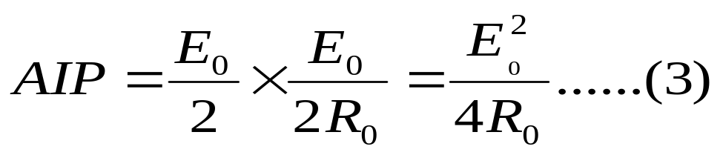
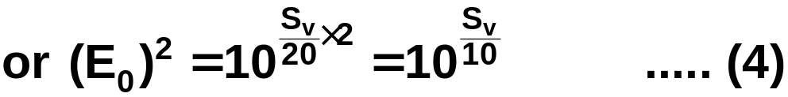
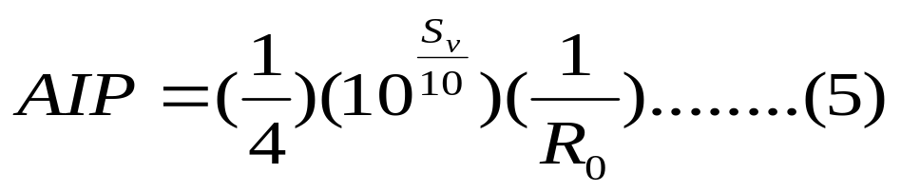
Let AIP = Available Input Power that a microphone with an output resistance R₀ can deliver across the input of the preamplifier.
∴ E₀ = Open circuit voltage of the microphone
Recall equn (1) S_{v} = 20log E₀
Substituting (4) in (3)
Contd.

Slide 14
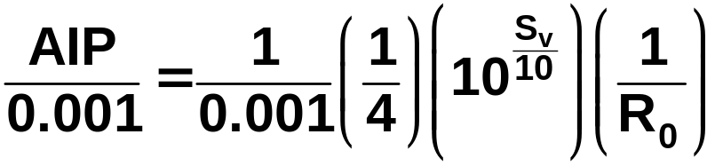
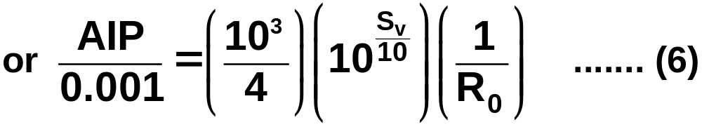
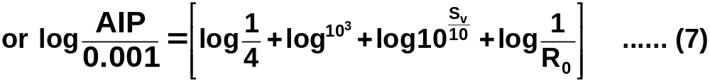
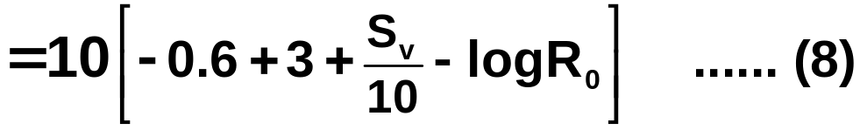
Since we wish to refer AIP to 1mW, we write
Taking log of both sides and multiplying by 10
Contd.

Slide 15
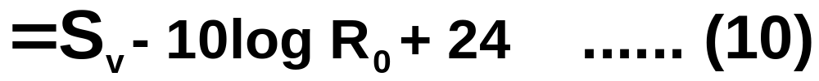
For example a microphone has R₀ = 200Ω & S_{v} = - 60dB
Then L_{AIP} = (-60 -10 log 200 + 24) dBm
= (-60 – 23 + 24) dB m
= - 59 dB m/Pa
1.6 EIA Sensitivity Expression
The power sensitivity of a microphone may be referenced to 0dB SPL (20μ Pa, threshold of hearing), instead of 94 dB (1 Pa). Since the SPL is lower by 94 dB, the L_{AIP} of equn (I0) will be lower by 94dBm.
If we denote this power sensitivity as G_{AIP}
Contd.

Slide 16
For a microphone with S_{v} = -60 dB, R₀ = 200Ω
G_{AIP} = L_{AIP}-94
=(-60 – 23 – 70) dBm
= -159 dBm. at the threshold of hearing.
The advantage of this form of specification is that the power level supplied by a given microphone is obtained by simply adding the G_{AIP} to the SPL at the microphones position. (as it is referenced to 0dB SPL).
In the EIA rating system R₀ is replaced by R_{MR}, where R_{MR} is the EIA centre value of the nominal impedance range shown below.
Contd.

Slide 17
Range (ohms) | EIA Centre values
20-80 | 38
80-300 | 150
300-1250 | 600
1250-4500 | 2400
4500-20,000 | 9600
20,000-70,000 | 40,000
Contd.

Slide 18
2.0 Thermal Noise
2.1 Thermal noise, generated in resistors (real part of microphone impedance) is caused by thermally induced variations in conduction electron distribution through the body of a resistance. Although the resulting instantaneous voltage difference between the ends of a resistor has an average value of zero, the RMS value is not zero. Such thermal noise voltage sources can be represented by an equivalent Nyquist voltage source shown in Fig. 3A
Contd.

Slide 19
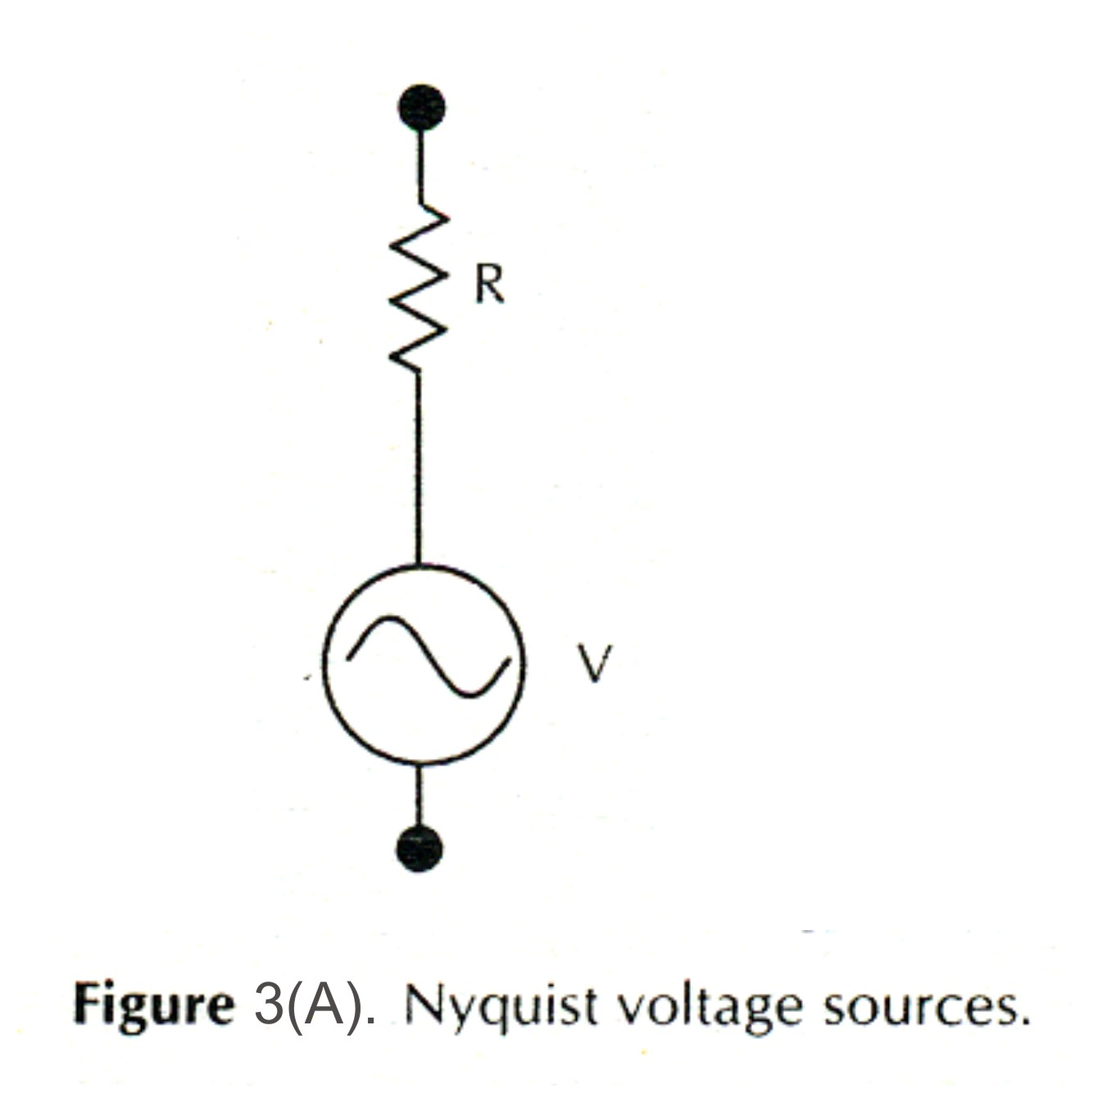

Slide 20
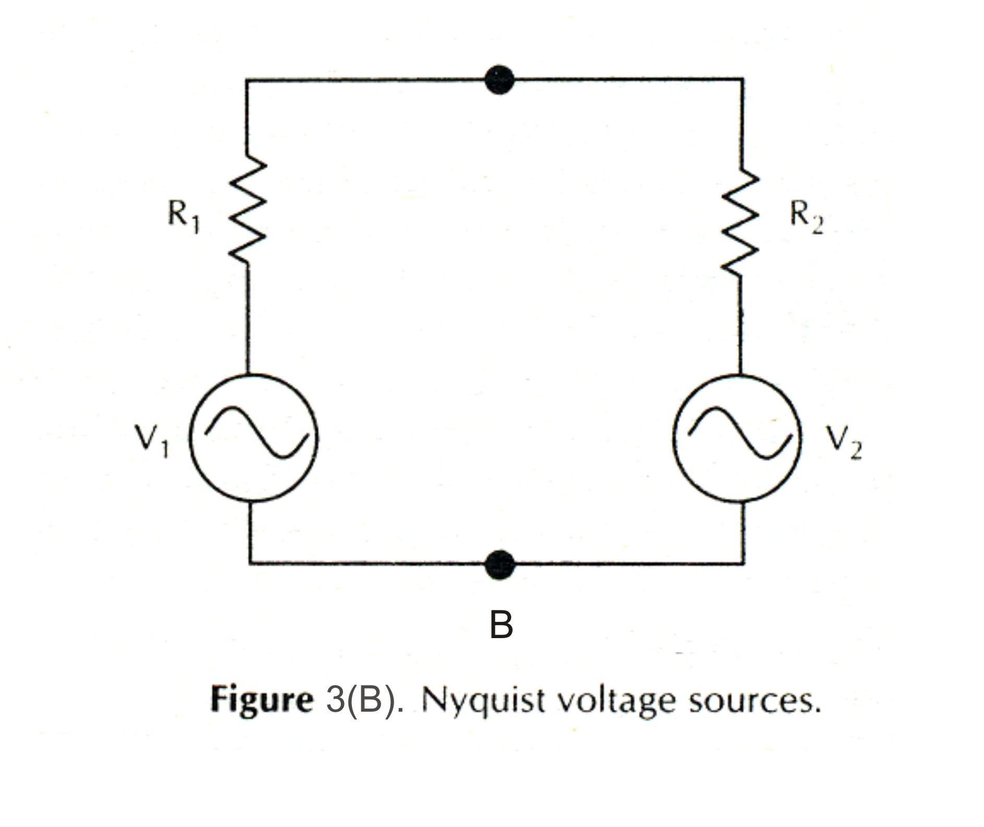

Slide 21
V = (4KTRB)^{1/2} …….. (1)
Where V = RMS value of the noise voltage
K = Boltzmanns constant = 1.38x10⁻²³ J/K
T = Absolute temp (K)
R = Resistance in Ω
B = is the observation bandwidth in Hz
Fig 3 B depiets a situation when two Resistors are connected in parallel as would be case when a microphone is connected to the input of a preamplifier.
Contd.

Slide 22
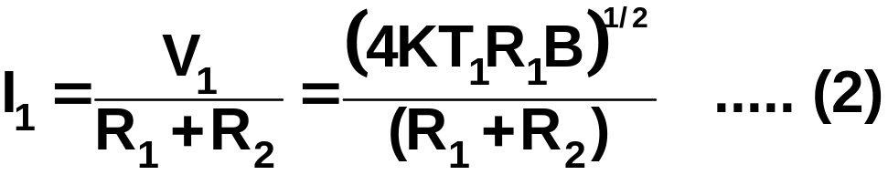
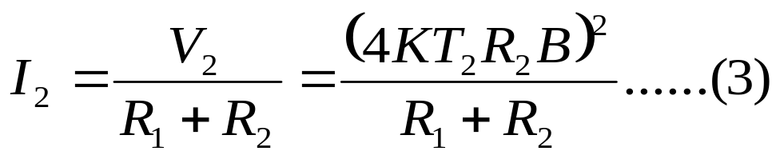
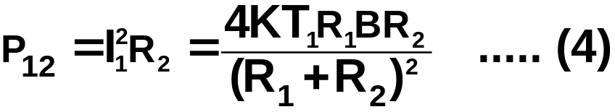
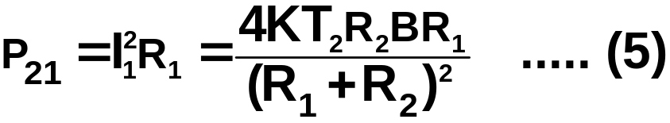
To calculate the noise power P₁₂ delivered by source 1 to 2 and similarly P₂₁, we first calculate the circuit currents (I₁ and I₂) when each source acts alone
Contd.

Slide 23
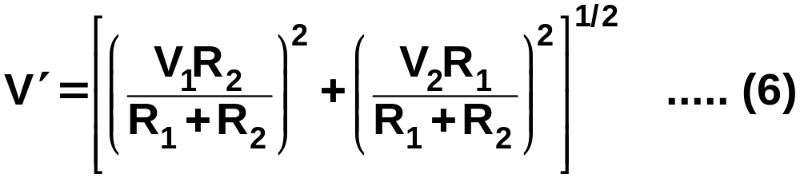
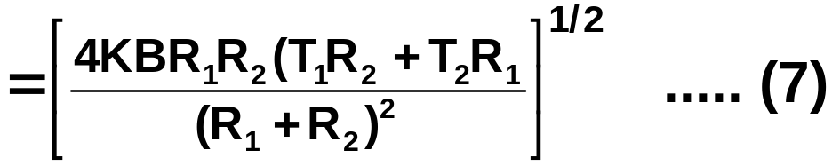
The source with a lower T receives power from the other source.
When T₁ = T₂ P₁₂ = P₂₁ and equilibrium is established.
The noise voltage across the common terminals
The appropriate voltage = V’
Contd.

Slide 24
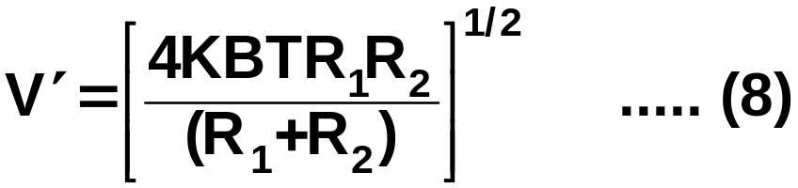
If T₁ = T₂ = T then
If R₂ >> R₁
V‘ = [4KBTR₁]^{1/2} …... (9)
This is the common situation when microphone output resistance << preamp input resistance
Contd.

Slide 25
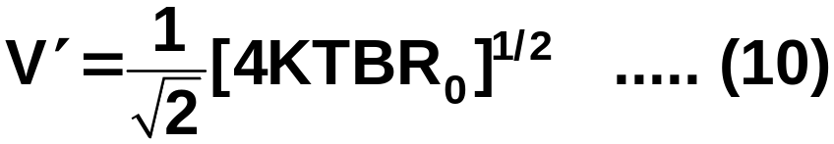
When R₁ = R₂ = R₀
In this situation thermal noise voltage is reduced by 3dB. At the same time the effective microphone output is reduced by 50 % i.e. 6 dB. Therefore SNR is reduced by 3dB

Slide 26
Other noise source of Amplifiers
Short noise
Flicker noise
Partition noise
Recombination noise
A figure of merit with regard to noise behavior of amplifier can be obtained by considering the degrading effect that the amplifier has upon the signal to noise ratio of the signal source

Slide 27
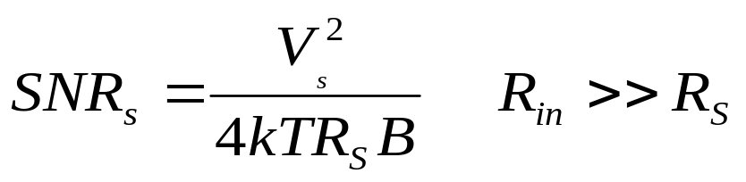
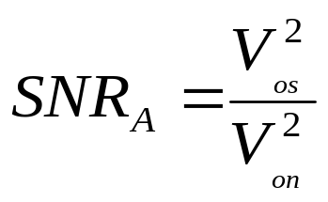
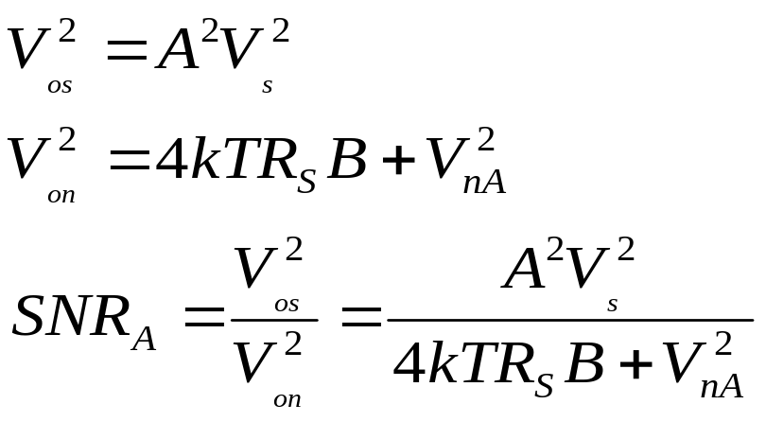
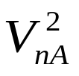
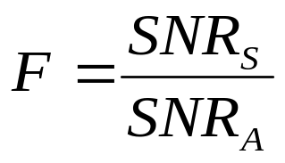
Source Signal to noise ratio ( thermal noise)
is the mean square noise voltage at the amplifier output contributed by the amplifier

Slide 28
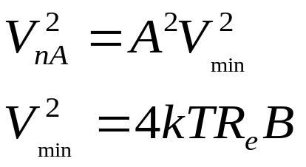
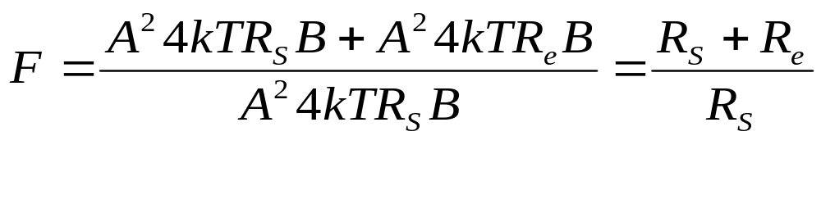
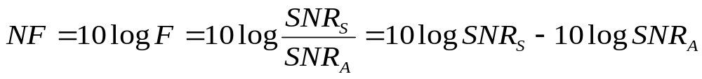
Noise Figure of the amplifier

Slide 29
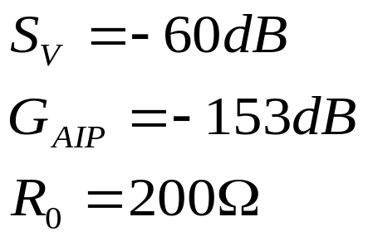
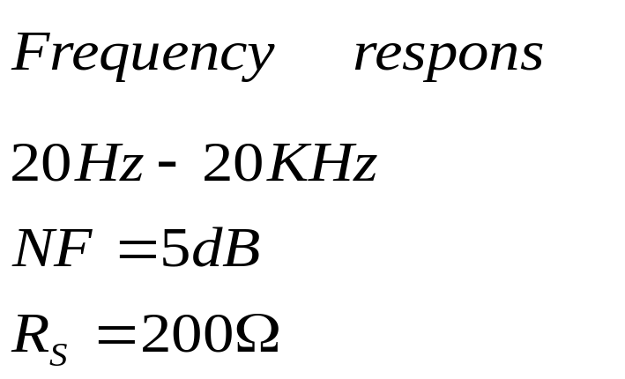
Microphone specification and amplifier specification as in given below
Microphone specification
amplifier specification
If a talker produce 80dB near the microphone find out the signal to noise ratio at amplifier out put at 20° C

Slide 30
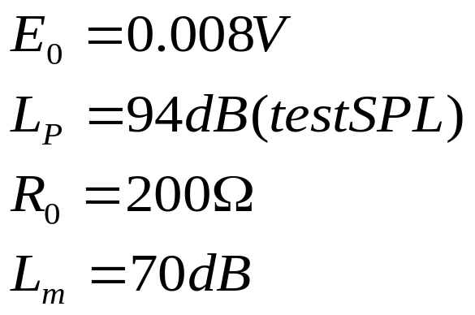
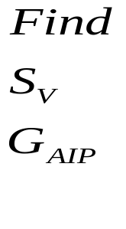
Microphone specification

