Slide 1
The Acoustic Environment

Slide 2
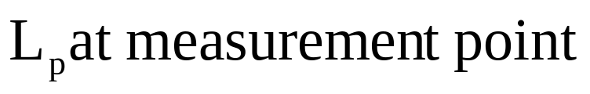
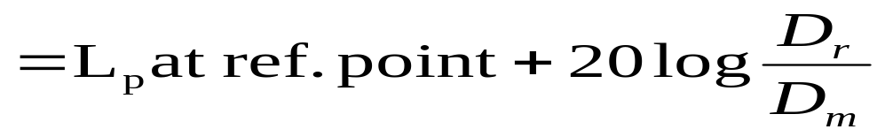
Factors effecting Acoustic Environment
Inverse Square Law: The geometrical spreading of sound from a coherent source is changing in level 6 dB for each doubling of distance.
Attenuation due to atmospheric absorption
Reflection and diffraction around solid objects
Refraction and shadow formation by wind and temperature.
Reflection and absorption by the ground surface itself.

Slide 3
Sound Field
Free Fields
A sound field is said to be a free field if it is uniform, free of boundaries, and is undisturbed by other sources of sound. In practice, it is a field in which the effects of the boundaries are negligible over the region of interest. The flow of sound energy is in one direction only. Anechoic chambers and well-above-the-ground outdoors are free fields.
The direct sound level from a sound source in a free field is labeled L_{D}
Diffuse (Reverberant) Fields
A diffuse or reverberant sound field is one in which the time average of the mean square sound pressure is the same everywhere and the flow of energy in all directions is equally probable. This requires an enclosed space with essentially no acoustic absorption.
The reverberant sound level is labeled L_{R}.

Slide 4
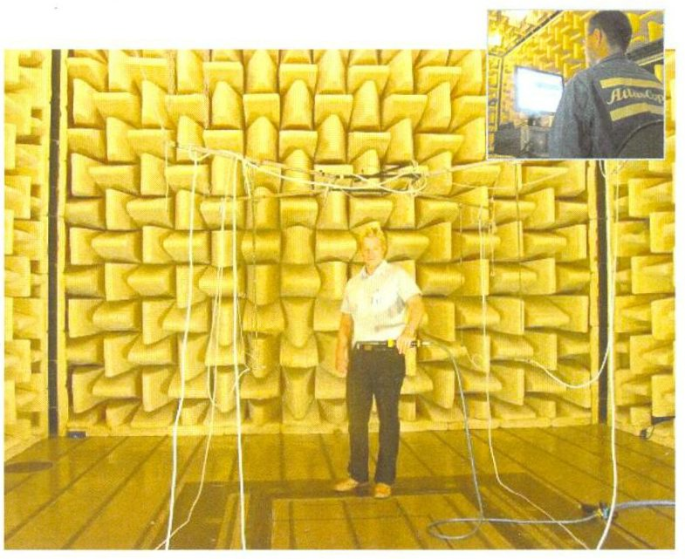
MWL Lab, KTH Sweden
Finding sound power (ISO 3745)

Slide 5
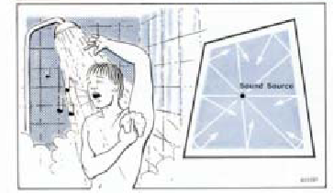

Slide 6
Semi-reverberant Fields
A Semi-reverberant Fields is one in which sound energy in both reflected and absorbed. The flow of energy is in more than one direction
Pressure Field
A Pressure field is one in which the instantaneous pressure is everywhere uniform. There is no direction of propagation. Used for microphone calibration.
Near field
The near field of a source is the region close to a source where the sound pressure and acoustic particle velocity are not in phase. In this region the sound field does not decrease by 6 dB each time the distance from the source is increased
The near field is limited to a distance from the source equal to about a wavelength of sound or equal to three times the largest dimension of the sound source

Slide 7
Far field
The far field of a source begins where the near field ends and extends to infinity. Note that the transition from near to far field is gradual in the transition region. In the far field, the direct field radiated by most machinery sources will decay at the rate of 6 dB each time the distance from the source is doubled.
Ambient Noise field
The ambient noise field is comprised of those sound source not contributing to the desired L_{D .}

Slide 8
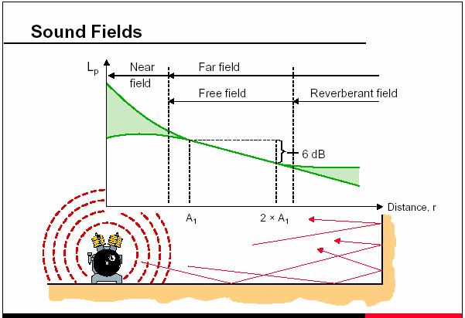

Slide 9
Outdoor Acoustic
The ambient noise level is 70dB and a sound system generate SPL of 110dB at 4ft. How far the sound will travel before it submerged with noise.

Slide 10
Room Acoustics

Slide 11
Room Acoustics
Much of basic acoustics is a simplified model that assumes that free field conditions exist.
In free field the SPL or SIL drops off 6 dB every time distance from the source is doubled. (Review example).
The presence of an enclosure alters free field conditions:
  Multiple reflections lead to reverberation (>200 Hz)
  Closed path reflections lead to standing wave resonances— Room Modes (<200 Hz)

Slide 12
Room parameters
Dimensions—height, width, length and shape of the room (these values imply room volume).
How the surfaces reflect sound is determined by the wall material and its preparation. This quantity is described by the absorption coefficient a.
The properties of the whole room are described by the sum of absorption coefficients weighted by their areal contribution to the room--the absorptivity A.

Slide 13
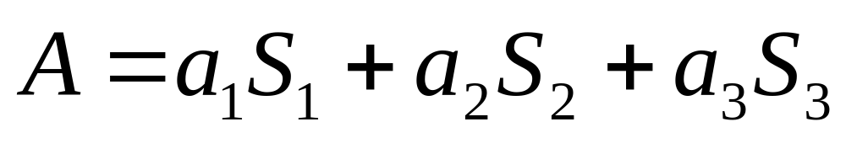
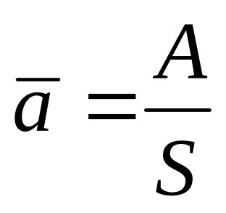
Absorptivity
Absorptivity formula
Average Absorptivity
Example: Room 3 m tall with floor and ceiling 8 m x 5 m. a_{ceil}=0.3, a_{flr}=0.6, a_{walls}=0.12.
  What is A?
  What is weighted average a?
  Remember a depends on frequency.

Slide 14
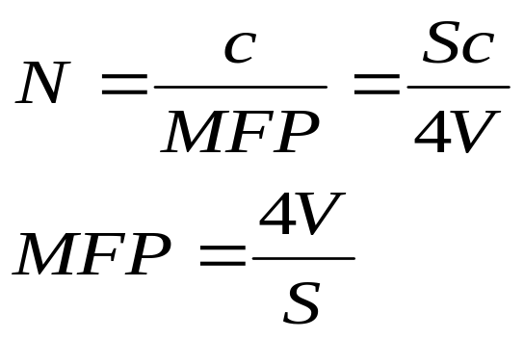
Statistical model of reverb time
Statistical model assumes that the entire room is uniformly filled with sound energy. The sound has repeated collisions with the walls losing energy with each collision as determined by a.
In a room with volume V and interior surface area S the average number of reflection(RPS) per second, N, is given by
Mean free path is the average distance between reflection in a space

Slide 15
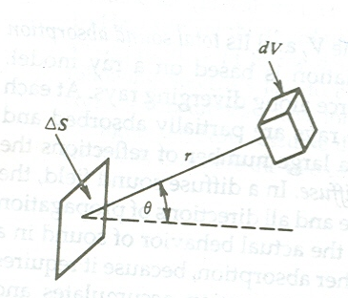

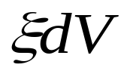
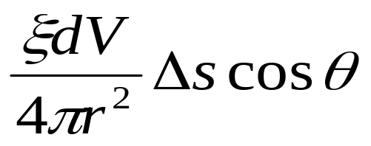
A Simple Model for the growth of sound in a room
When a source of sound is started in a live room, reflection at the walls produce a sound energy distribution that become more and more uniform with increasing time. Ultimately except close to the source or to the absorbing surface, this energy distribution may be assumed to be completely diffuse.
Where is the energy density
Acoustic energy in dV
The amount of energy strike Δs

Slide 16
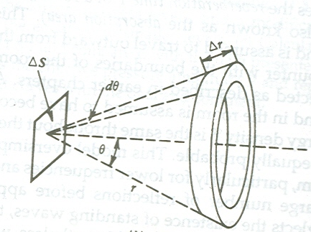

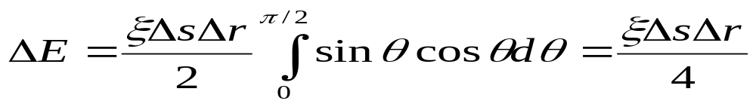
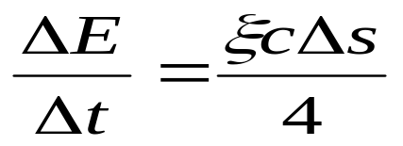
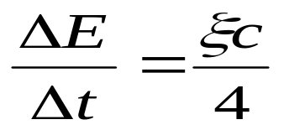
Let dV be part of a hemispherical shell of thickness Δr and radius r centered on Δs.
The acoustic energy ΔE contributed to Δs by this entire shell is obtained by assuming that energy arrived from any direction with equal probability. Integrating over the hemisphere with
The energy arrived during time interval Δt= Δr/c
The rate of energy falls on a unit area

Slide 17
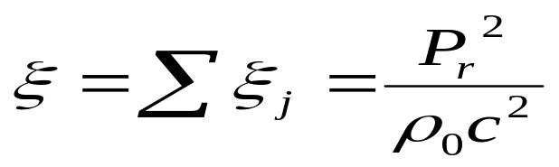
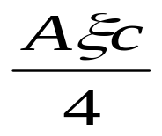
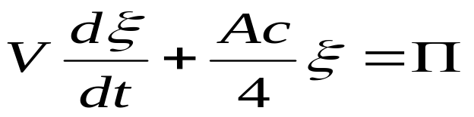
Assume that at any point within the room (1) energy is arriving and departing along individual ray paths and (2) the ray have random phase.
So the energy density at the point is the sum of the energy densities of each of the ray.
The total sound absorption by the surfaces of the room is A. so the rate at which energy is being absorbed is
The rate of absorption of energy by the surfaces plus the rate at which it increase in volume V must equal the input power.

Slide 18
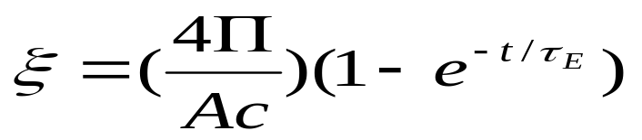
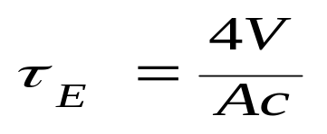
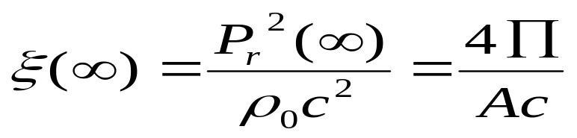
If the sound source is started at t=0, solution gives
Equilibrium energy density

Slide 19
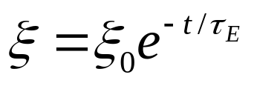
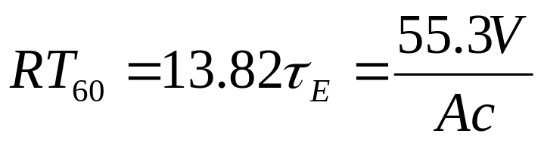
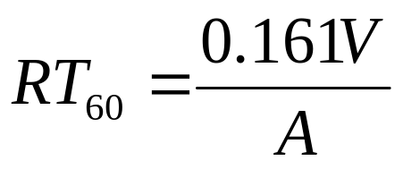
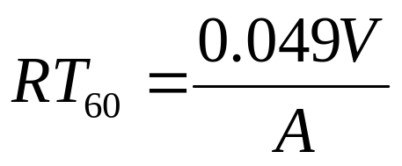
Reverb time definition
Assume that in a live room a sound source has been turned on long enough to establish a steady state energy density ξ₀ and it then turned off at time t=0
Reverb time, RT₆₀, is defined as the time for the sound energy to drop by 60dB. Thus
If V is in cubic meters and A is in metric sabin and c=343m/s then
If V is in cubic feet and A is in english sabin and c=1125ft/s then

Slide 20
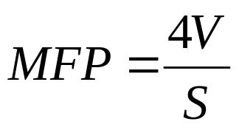
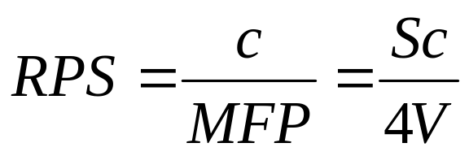
Mean Free Path (MFP) is the average distance between reflection in a space
Average number of reflection(RPS) per second
V=500,000ft³
S=42000ft²
à=0.128
Let
a) Calculate MFP and RPS and RT₆₀
b) Total number of reflection during RT₆₀

Slide 21

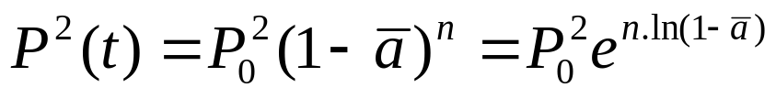
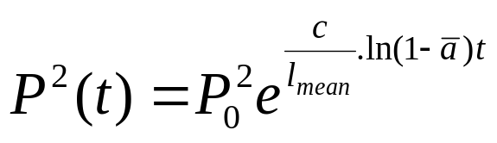
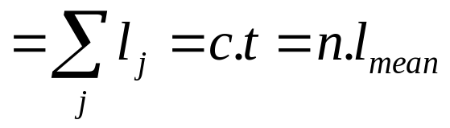

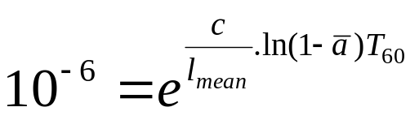
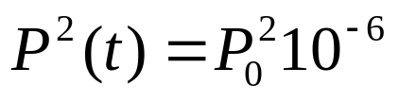
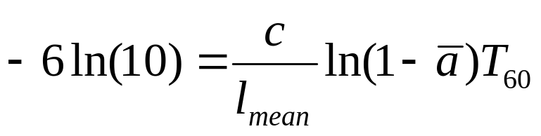
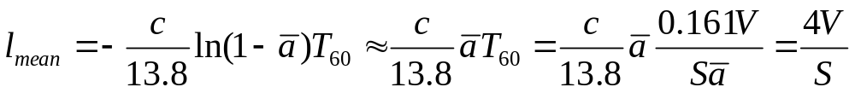
Let
P₀ is the Pressure at t=0 and Average Absorptivity is
Sound pressure after n reflections
Total path
Is the mean free path (MFP)
At t=T₆₀

Slide 22
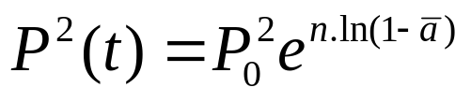
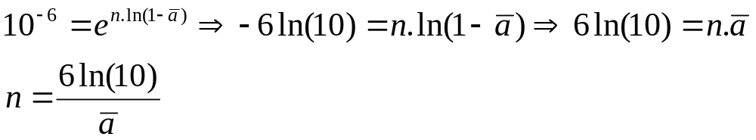
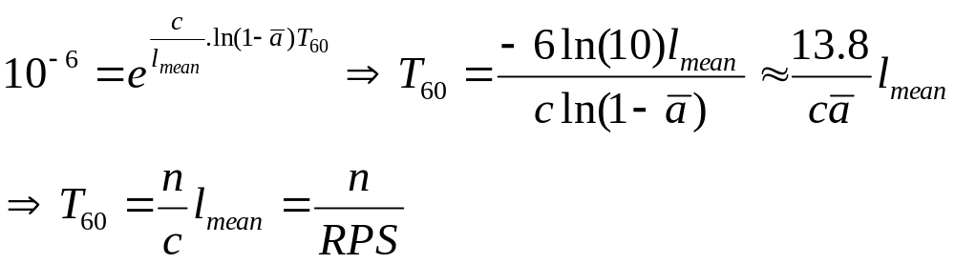
Total number of reflection during the 60dB decay is n
From

Slide 23
Some Absorption Coefficients
Frequency (Hz)
Material 125 250 500 1000 2000 4000
Concrete/brick 0.01 0.01 0.02 0.02 0.02 0.03
Glass 0.19 0.08 0.06 0.04 0.03 0.02
Plasterboard 0.20 0.15 0.10 0.08 0.04 0.02
Plywood 0.45 0.25 0.13 0.11 0.10 0.09
Carpet 0.10 0.20 0.30 0.35 0.50 0.60
Curtains 0.05 0.12 0.25 0.35 0.40 0.45
Acoustical board 0.25 0.45 0.80 0.90 0.90 0.90

Slide 24
Absorptions (in sabins)
Frequency (Hz)
Material 125 250 500 1000 2000
Unupholstered seat 0.15 0.22 0.25 0.28 0.50
Upholstered seat 3.0 3.1 3.1 3.2 3.4
Adult person 2.5 3.5 4.2 4.6 5.0
Adult/upholstered seat 3.0 3.8 4.5 5.0 5.2

Slide 25
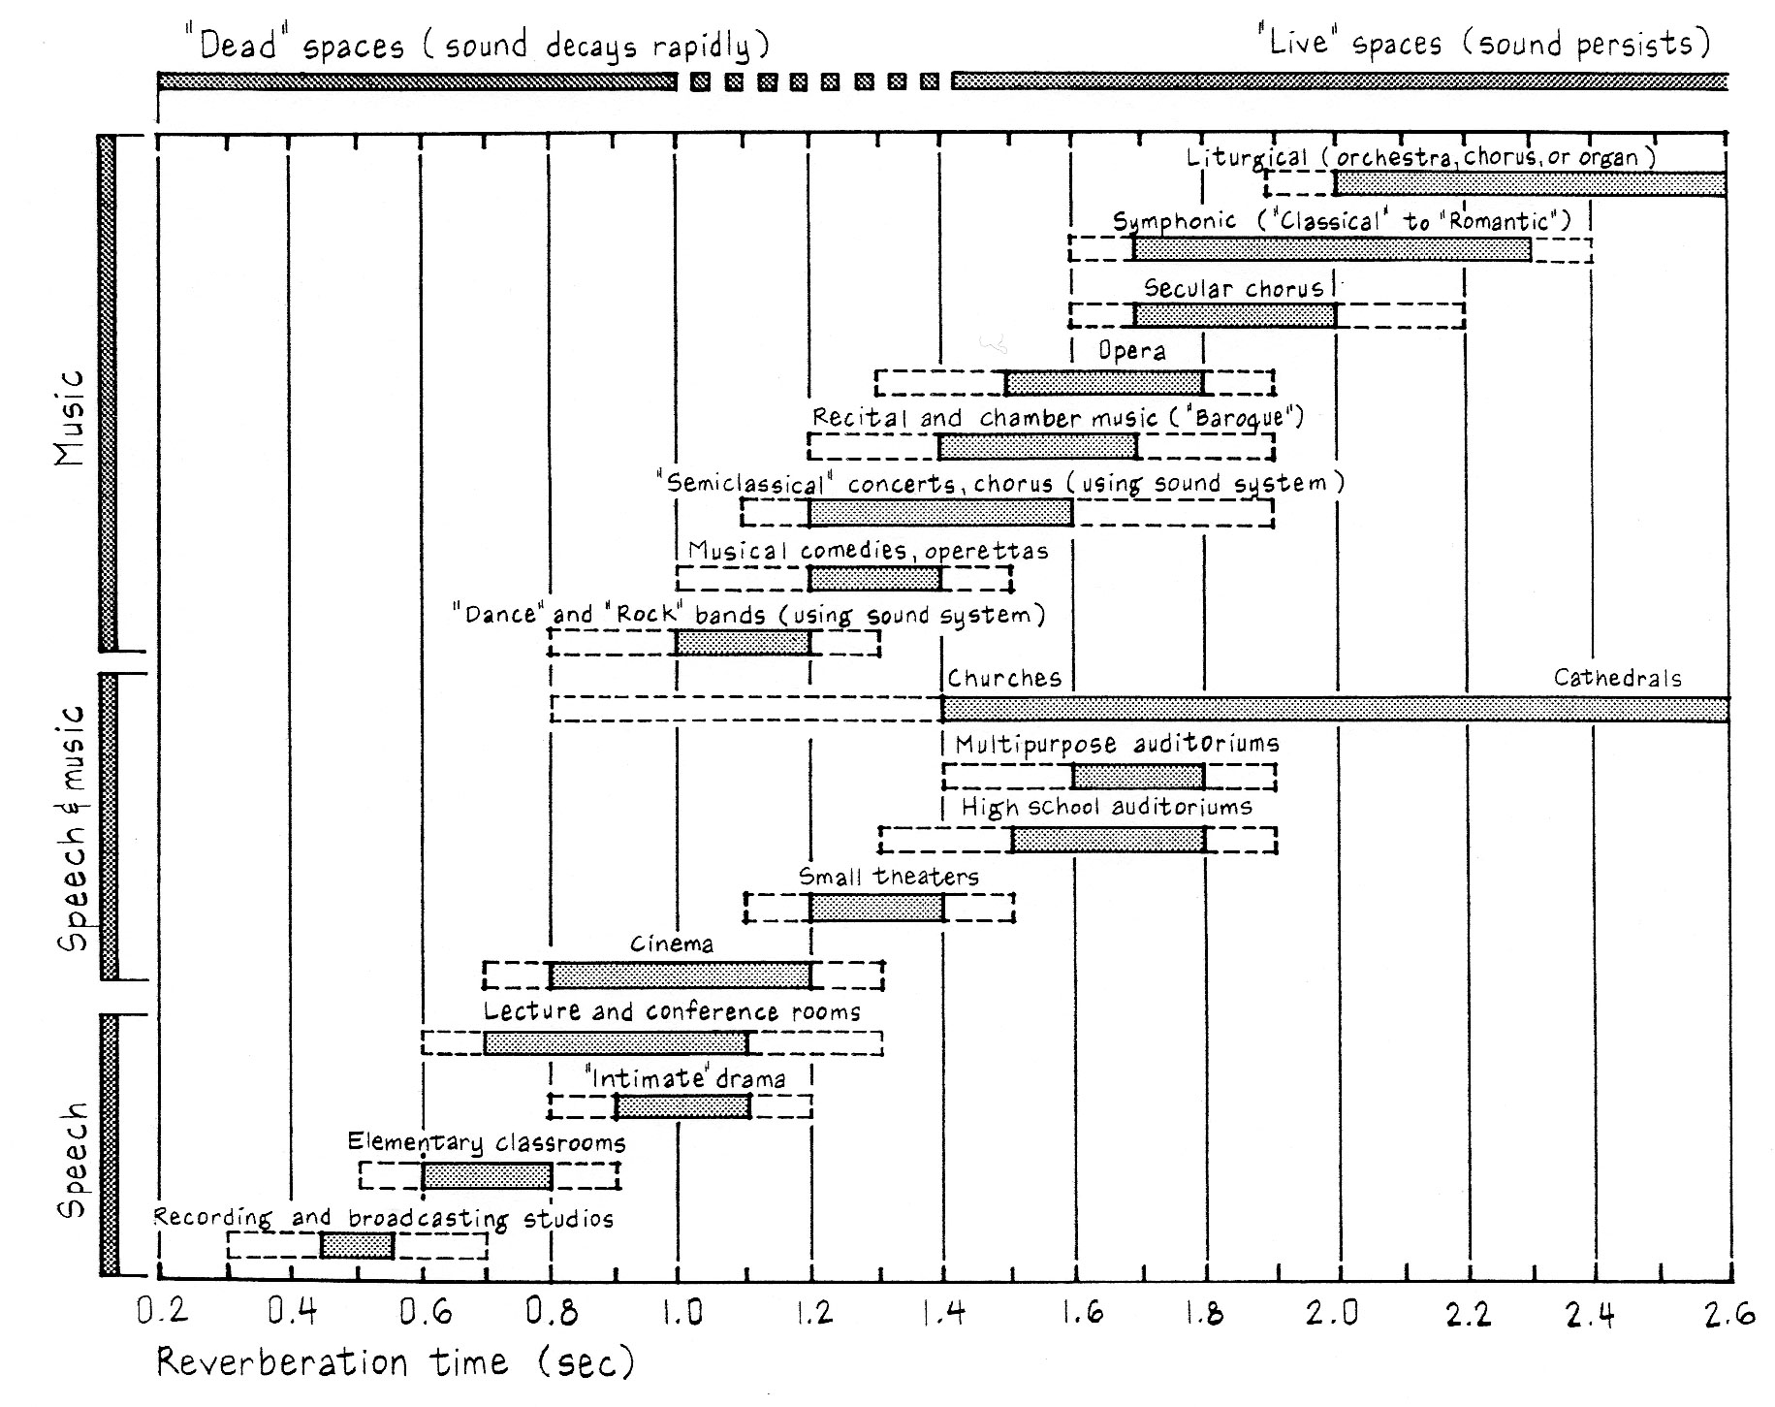
Suitable Reverberation Time (RT)

Slide 26
When does the statistical model apply?
Statistical model applies to “large” rooms ones in which the reverberant field dominates the properties of the room.
  A reverberant or diffuse field is one in which the time-averaged sound pressure is equal everywhere in the room. Sound energy flow is equally probable in all directions.
In a “small room” the resonant standing waves—the so-called room modes dominate the response.

Slide 27
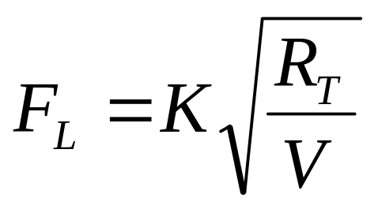
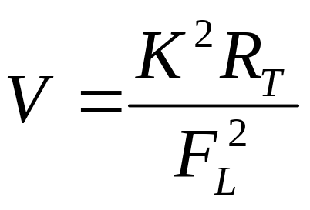
What is the large room
F_{L} is the large room frequency
K=2000 in SI
R_{T} is the reverberation time
V is the volume of the room
Low frequency limit for speech is 80Hz and for music is 30 Hz.
Let R_{T}=1.6

Slide 28
Room modes
Room modes refer to the standing wave resonances that exist in an enclosed space.
To visualize the standing wave modes recall the resonant modes on a string. When a resonant frequency excites the string a standing wave is set up with nodes and antinodes. The resonant frequencies are harmonic.
In 2 and 3 dimensions similar standing waves exist but the resonant frequencies are not harmonically related.

Slide 29
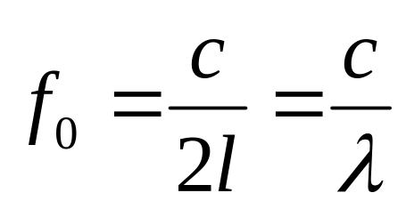
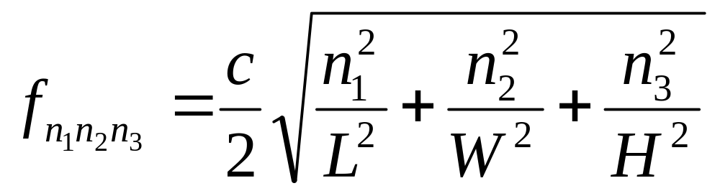
What is an Eigen Mode
An Eigen mode is the European name for a standing wave. Standing wave are dependent upon the internal dimensions of an enclosure. The first mode will be
Modes are described by mode numbers n₁, n₂, n₃
Room dimensions are L (length), W (width), and H (height).

Slide 30
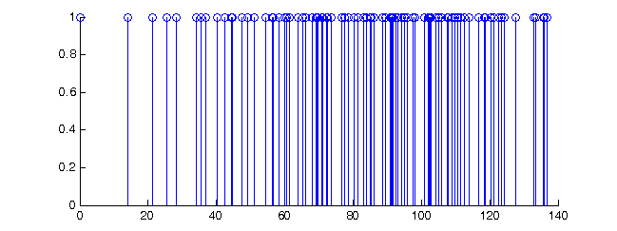
Examples
Large room 12mx4mx8m
Frequency of mode resonance

Slide 31
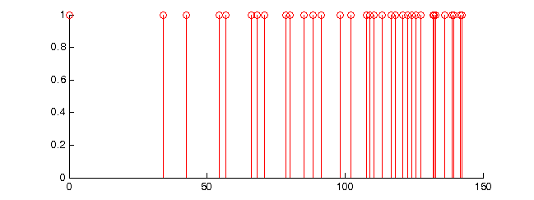
Example
Small room 4m x 5m x 3m
Frequency of mode resonance

Slide 32
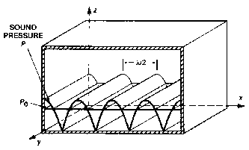
Modes Definition
Axial Mode: the component wave parallel to an axis (one dimensional), N_{x},0,0

Slide 33
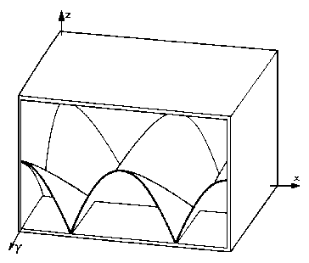
Tangential Mode: component waves are tangential to one pair of surfaces but oblique to other two pair (Two Dimensional) i.e N_{x},0,N_{z}

Slide 34
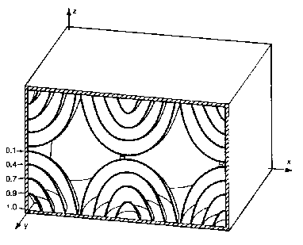
Oblique mode: the component wave are oblique to all three pairs of the walls (three dimensional) N_{x},N_{y},N_{z}

Slide 35
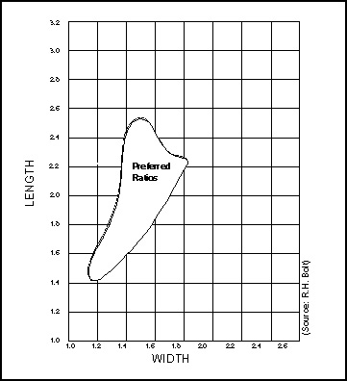
Small room Geometry
ASHRAE
1: 1.17:1.47
1:1.45:2.10
BOLT
1:1.28:1.54
IAC
1:1.25:1.60
Acceptable room ratio

Slide 36
Semi-reverberant room calculations
A room that has a mix of reverberant sound and direct sound from a source is called semi-reverberant.
Note that most real rooms are semi-reverberant.
The sound in many parts of the room is reverberant with energy flow equal in all directions (far from the sound source); however, near the source, the sound flow is directional.

Slide 37
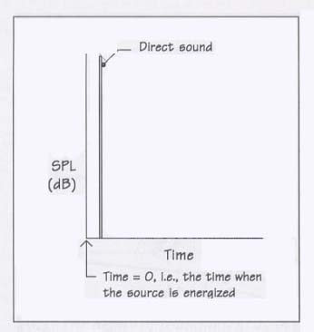
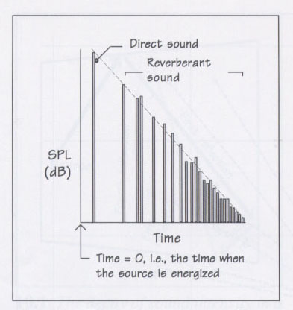
Loudness
Perception of sound pressure level
Ability to hear sound source
Ear integrates sound (in impulse response)
Direct Sound only
Direct + Sound reflections

Slide 38



Sound source calculations
Non-directional sound source in free field. At distance R from source, direct sound is
Directional sound source (Q is directivity)
Where W is the watts of acoustic power from source and W₀=1x10⁻¹² Watts

Slide 39


Directivity factor
The directivity factor Q is a measure of the directional nature of a sound source. Q is defined as the ratio of intensity from the directional source, I_{d}, divided by the intensity of an omnidirectional source, I₀.
Directivity Index (DI) is Q expressed in dB.

Slide 40

Q due to wall and corner reflections

Slide 41

Reverberant sound
Far from the source the decibel level of the reverberant sound is given by
Example—noise reduction. Change A from 45 Sabins to 120 Sabins. What is the change in reverberant sound of a 10⁻³ Watt source.

Slide 42


Direct and reverberant sound
Combined formula for both direct and reverberant sound

Slide 43


Critical distance
The critical distance, D_{c}, is the distance at which the direct and reverberant sound levels are equal.
Equal when
Thus,

Slide 44
Why is critical distance important?
Speech intelligibility
  For distances from the source much greater than the critical distance, speech becomes increasingly more difficult to understand because most of the sound energy comes from reflections. %ALCONS measures the loss of understanding of consonants. A room with a Reverberation time exceeding 1.6s there will be no listener beyond 3.16D_{c}. If time raises the multiplier become lower.
Microphone placement
  General rule: microphone should be no more that 0.3D_{c} for omni-directional mic. 0.5D_{c} for directional mic.
  The loudspeaker and the microphone should be at least as far as D_{c}

Slide 45
Effect of critical distance
It determines maximum acoustic separation (maximum acoustic gain)
It determines the ratio of direct-to-reverberant sound
It determines the required directivity of loudspeaker in an already existing room
It determines the determine the required room characteristic in a space being planned is a chosen loudspeaker is desired

Slide 46

%Articulation Loss of Consonants
%ALCONS formula
  R Distance from speaker to listener
  T_{r} Reverb time
  Q directivity factor
  V room volume
  n number of reinforcing loudspeakers

Slide 47
%Articulation Loss of Consonants
What does the %ALCONS number mean?
  Low numbers are good, that means very few (as a percentage) misunderstood consonants.
10% is good
15% is the limit beyond which intelligibility decreases
As we will show later (and Wheel of Fortune proves every night) language is redundant—we don’t need all the consonants to get meaning.

Slide 48
Large Room Example
Room dimensions 12 m x 14 m x 6 m
a = 0.2
  Calculate A and T_{r}.
  What are the lowest 5 standing wave frequencies?
  If a 3x10⁻² W average output acoustic source is placed in the center of the front wall find
    The reverberant level in dB
    The total dB at a distance of 3 m from the source
    The critical distance
    %ALCONS at R=3 m, 9 m, and at 15 m from the source.

Slide 49


Slide 50
Initial signal delay gap(ISD)
It is the time between the arrival of direct sound LD at a listener’s ears and the arrival of first significant reflection.
This is the fundamental room parameter.
For small room ISD is in the order of 1 to 5 ms

Slide 51

Live End Dead End(LEDE)
For design of control rooms for monitoring recording studio this is used
Front half of the room was made as absorptive as possible and the other half (the half to the near of the listener) was made as reflective and diffusive as possible.
Is the total sound in decibels
Is the direct sound in decibels
Is the reverberant sound in decibels
Is the ambient noise level in decibels

Slide 52
Factors to watch for in room
Curved surfaces, especially concave curved surfaces
Absolutely parallel walls such wall cause flutter echo.
Absorption on the ceiling. Unless the ceiling is very high (over 60 feet) the placement of absorption on its means the sound system lost some useful reflecting surfaces.
Potential ambient noise sources
Extra wide or round audience seating

Slide 53
Early Reflections
The timing of the first reflection is an important aesthetic parameter in auditorium acoustics.
If the first reflection is delayed by greater than about 35 ms then we hear an echo—an undesirable effect.
Best values obtained by evaluating “good” concert halls are less than 35 ms. 20 ms for an “intimate” hall.

Slide 54
Precedence or Haas effect
Even in the presence of reflections we can localize the sound source. If similar sounds arrive at the ear within 35 ms the direction of the source is the direction of the first arriving sound. Note that we only hear one sound—not an echo which would need a longer delay of 65 ms or so.
Localization review—for frequencies up to 1kHz localization is due to inter-aural differences in phase (continuous signal) or in time delay (clicks). For >4kHz inter-aural intensity difference (diffraction around the head). In between some combination.

Slide 55
Acoustical Characteristics
Liveness
Intimacy
Clarity
Warmth and Brilliance
Texture
Blend
Ensemble

Slide 56
Liveness
Measure of reverberation time

Slide 57
Intimacy
Sense of closeness – occupying the same space as the source
Room said to be “intimate” when the first reverberation arrives within 20 ms of the direct sound.

Slide 58

Clarity
Ability to distinguish and articulate individual sound
Refers to the amount of reflected sound relative to the amount of direct sound

Slide 59

Warmth & Brilliance
Richness or fullness of sound in low & high frequencies
Bass Ratio = (RT₁₂₅ + RT₂₅₀)/(RT₅₀₀ + RT₁₀₀₀)
Heavy massive materials
Multiple scales of articulation

Slide 60

Texture
“Good texture” when at least
five reflections arrive within
60ms of direct sound

Slide 61
Blend and Ensemble
Ability to hear the entire performing group on the stage (ensemble) and in the audience (blend)

Slide 62

Ensemble
Blending of sounds to form holistic composition
Surface articulation
Ceiling and side wall reflections
Surfaces near musicians

Slide 63

Diffusers
Diffusers are used to minimize strong specular reflections in a small room.
Aim: eliminate specular reflection and replace it with diffuse scattering.

Slide 64
How do diffusers work?
Two basic methods
  Random scattering from a roughened or textured surfaces. Easy to make but not predictable in response.
  Diffraction by profiles that possess “all” necessary grating spacing to ensure a uniform diffraction pattern.

Slide 65


Slide 66


Quadratic residue method
A method of designing a multilevel diffuser that operates over a greater wavelength range.
Sequence of depths d_{n} is generated by
Where the sequence s_{n} is defined by

Slide 67
Well width and diffuser bandwidth
Maximum well depth should be 1.5 times wavelength of lowest frequency of operations
Well width should be 0.5 the wavelength of the highest frequency of operation
Highest frequency to lowest frequency define the operating bandwidth of the diffuser

Slide 68

Slot Absorber
One example of absorber based on Helmholtz resonator
Slotted panel that is spaced away from one of the walls of the enclosure.

Slide 69


Helmholtz Resonator
Trapped air acts as a spring
Air in the neck acts as the mass.
(v_{s} is the speed of sound)

Slide 70


Slot absorber is a HR!
Fraction of open area, e
In one repeat distance V=A_{tot}D, thus

Slide 71


Slot absorber
Resonance frequency f is given by

Slide 72
Uses of the Slot Absorber
Reduce low frequency reverb time without affecting high frequency reverb time.
Suppress low frequency standing wave resonances
Absorption can be varied by placement of foam either close to opening or set back between the wall and the slats.

Slide 73

Perforated panel absorber
Yet another version of the damped Helmholtz resonator
p=perforation percentage; D=air space; t=effective hole length (panel thickness +0.8*hole diameter) Use meters for all measurements.

Slide 74

Industrial Panel absorber
Absorption coeff.
  125 Hz 0.22
  250 Hz 0.77
  500 Hz 1.12
  1000 Hz 1.00
  2000 Hz 0.78
  4000 Hz 0.57

Slide 75


Panel absorber
Thin flexible plate (e.g. plywood) clamped at the edges. Low frequency pressure amplitude waves oscillate the plate—absorbing backing turns vibration to heat.
Plate has vibrational
resonant frequencies.
Not an HR!
m mass per m², D depth m

Slide 76
Room treatment depends greatly on the purpose of the space—classroom, musical auditorium, small vs large space…
Main parameters that affect experience—reverb time (large spaces), early reflections, standing wave resonances (small spaces).
Control methods—absorptivity, diffusers, low frequency traps

