Slide 1
Transduction

Slide 2
Transduction
Transduction means converting energy from one form to another
Acoustic transduction generally means converting sound energy into an electrical signal, or an electrical signal into sound
Microphones and loudspeakers are acoustic transducers

Slide 3
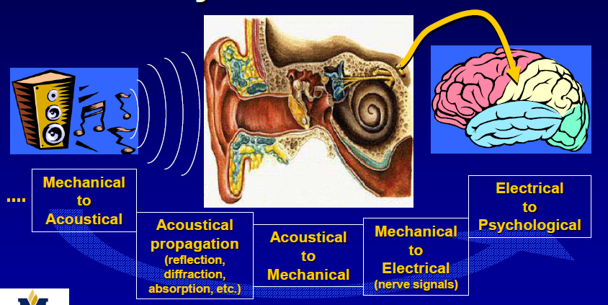
Acoustics and Psychoacoustic

Slide 4
Electrodynamics transducer
Drive mechanism: Force F acting on a wire of length l carrying current I and located in a magnetic field B:
the other way round, a voltage V is induced for a wire moving with velocity u:

Slide 5
Electrostatic transducer
Drive mechanism: Electrostatic force F acting on a plate condenser of area S and distance x and for a voltage V:
Dielectric constant

Slide 6
Transducer as an electrical network
I
u
V
F
Blocked electrical impedance
Free electrical impedance
Open-circuit mechanical impedance
Short-circuit mechanical impedance

Slide 7
If u is not zero and linear relationship with V
1
2
are Transduction coefficient
If V=0

Slide 8
Reciprocal Transducer
Transformation factor is real and constant for more frequency of interest
I
u
F
V

Slide 10
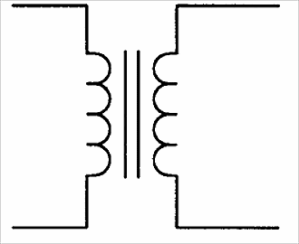
Z_{ms}
Z_{EB}
Z_{EB}

Slide 11
Example
Crystal, ceramic and Electrostatic transducer

Slide 12
Antireciprocal Transducer
Transformation factor is either real or complex and constant for more frequency of interest

Slide 13
I
F
V
u
Mechanical Dual

Slide 14
I
F
u
V
Z_{EB}
I
Y_{mo}

Slide 16
Where epsilon (ε) is the dielectric constant
S is the surface area

Slide 18
If electrical capacitance equivalent to short- circuit mechanical stiffness

Slide 19
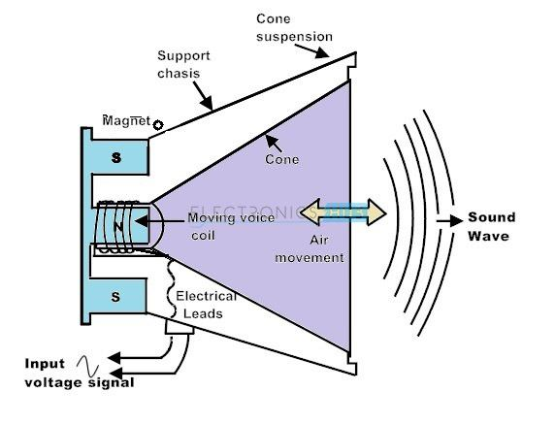
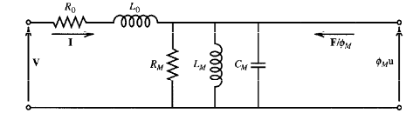
Moving Coil Transducer

