Slide 1
Sound Perception

Slide 2
Why Do We Have Two Ears
Sound localization – spatially locate sound sources in 3-dimensional sound fields
Sound cancellation – focus attention on a ‘selected’ sound source in an array of sound sources – ‘cocktail party effect’
Effect of listening over headphones => localize sounds inside the head (rather than spatially outside the head)

Slide 3
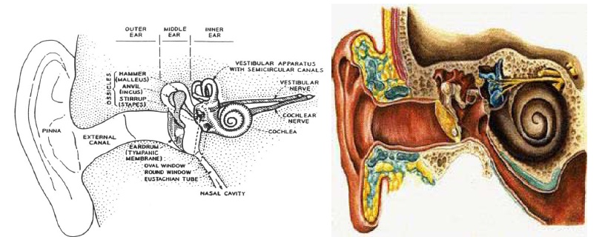
The Human Ear
Outer ear: pinna and external canal
Middle ear: tympanic membrane or eardrum
Inner ear: cochlea, neural connections

Slide 4
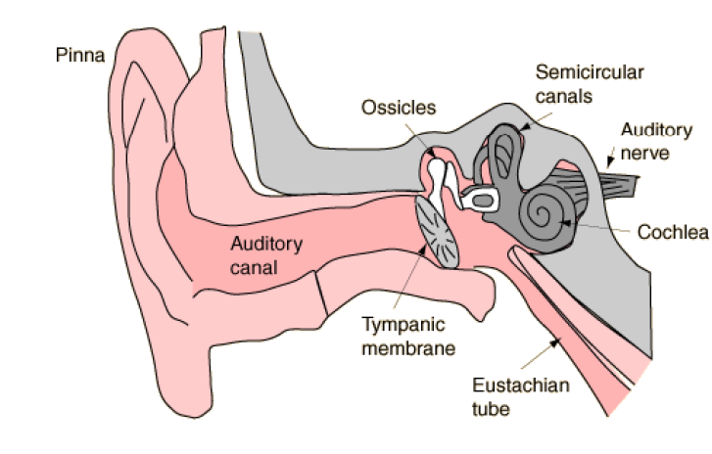
Ear and Hearing

Slide 5
Human Ear
Outer ear: funnels sound into ear canal
Middle ear: sound impinges on tympanic membrane; this causes motion
Middle ear is a mechanical transducer, consisting of the hammer, anvil and stirrup; it converts acoustical sound wave to mechanical vibrations along the inner ear
Inner ear: the cochlea is a fluid-filled chamber partitioned by the basilar membrane
The auditory nerve is connected to the basilar membrane via inner hair cells
Mechanical vibrations at the entrance to the cochlea create standing waves (of fluid inside the cochlea) causing basilar membrane to vibrate at frequencies commensurate with the input acoustic wave frequencies (formants) and at a place along the basilar membrane that is associated with these frequencies

Slide 6
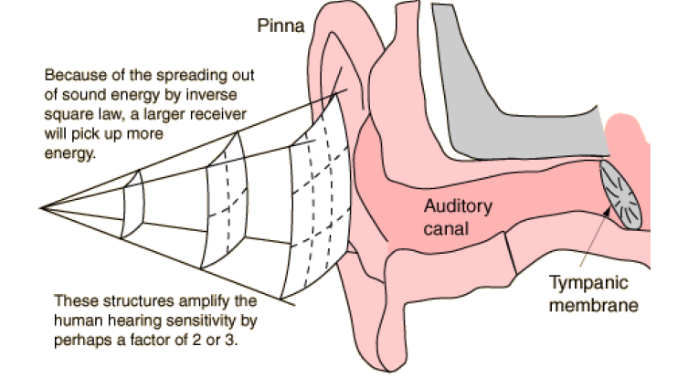
The Outer Ear

Slide 7
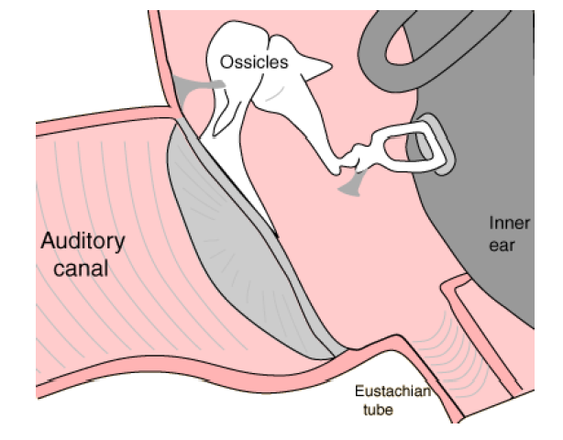
The Outer Ear

Slide 8
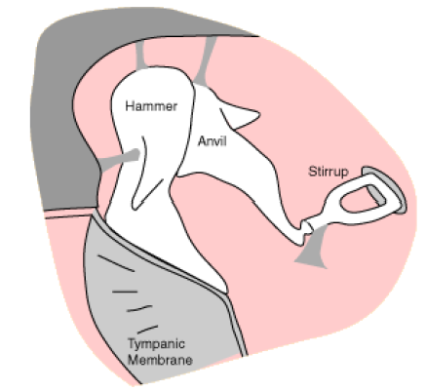
The Middle Ear
The Hammer (Malleus), Anvil (Incus) and Stirrup (Stapes) are the three tiniest bones in the body. Together they form the coupling between the vibration of the eardrum and the forces exerted on the oval window of the inner ear.
These bones can be thought of as a compound lever which achieves a multiplication of force—by a factor of about three under optimum conditions. (They also protect the ear against loud sounds by attenuating the sound.)

Slide 9
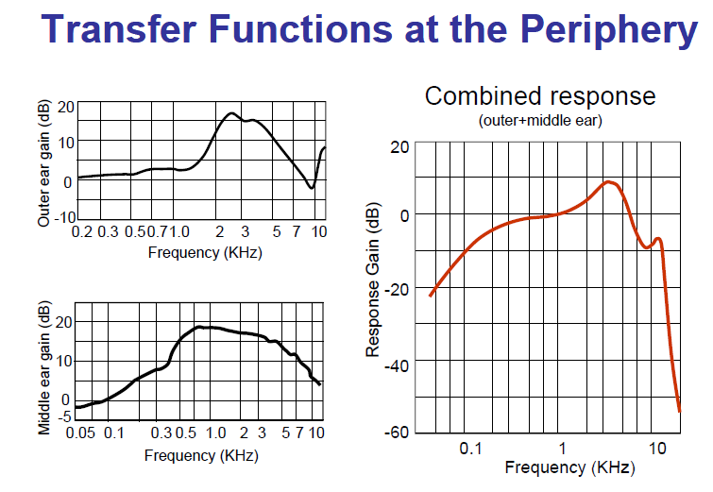

Slide 10
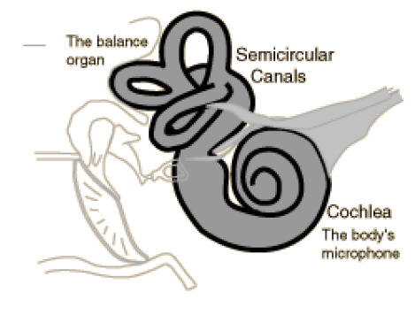
The Inner Ear
The inner ear can be thought of as two organs, namely the semicircular canals which serve as the body’s balance organ and the cochlea which serves as the body’s microphone, converting sound pressure signals from the outer ear into electrical impulses which are passed on to the brain via the auditory nerve.

Slide 11
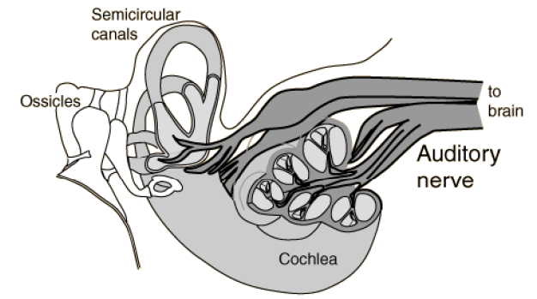
The Auditory Nerve
Taking electrical impulses from the cochlea and the semicircular canals, the auditory nerve makes connections with both auditory areas of the brain.

Slide 12
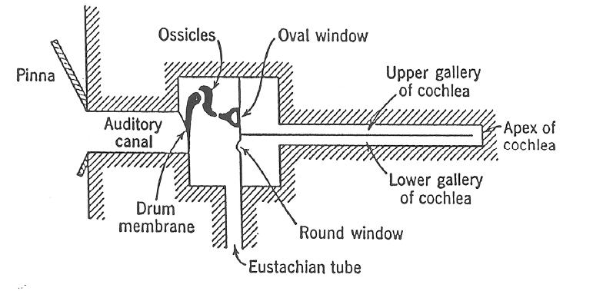
Schematic Representation of the Ear

Slide 13
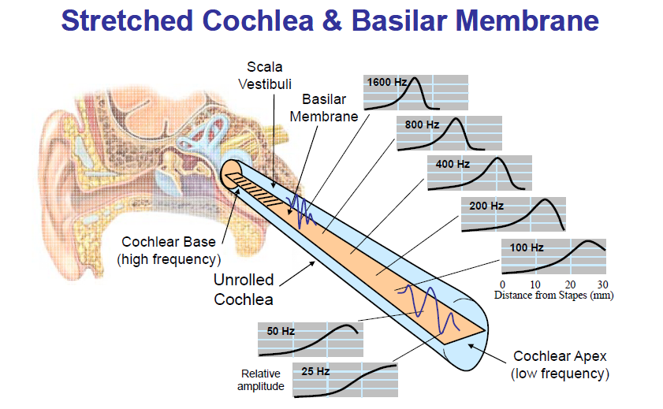

Slide 14
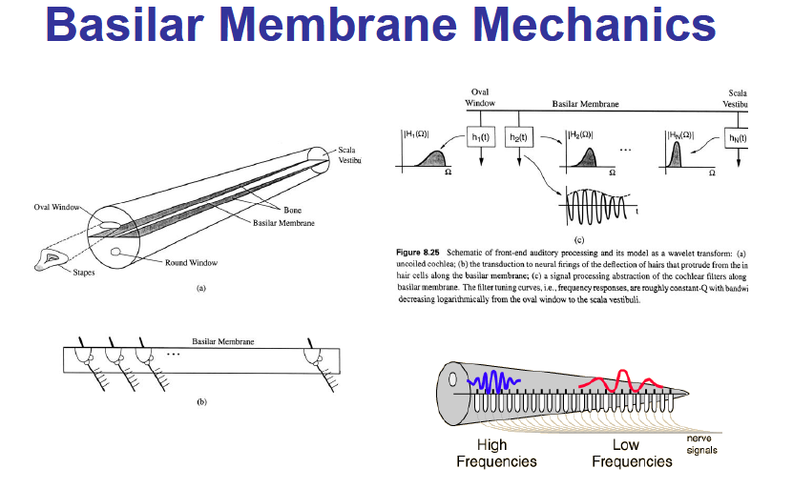

Slide 15
Basilar Membrane Mechanics
Characterized by a set of frequency responses at different points along the membrane
Mechanical realization of a bank of filters
Filters are roughly constant Q (center frequency/bandwidth) with logarithmically decreasing bandwidth
Distributed along the Basilar Membrane is a set of sensors called Inner Hair Cells (IHC) which act as mechanical motion-to-neural activity converters
Mechanical motion along the BM is sensed by local IHC causing firing activity at nerve fibers that innervate bottom of each IHC
Each IHC connected to about 10 nerve fibers, each of different diameter => thin fibers fire at high motion levels, thick fibers fire at lower motion levels
30,000 nerve fibers link IHC to auditory nerve
Electrical pulses run along auditory nerve, ultimately reach higher levels of auditory processing in brain, perceived as sound

Slide 16
Basilar Membrane Motion
The ear is excited by the input acoustic wave which has the spectral properties of the speech being produced
Different regions of the BM respond maximally to different input frequencies => frequency tuning occurs along BM
The BM acts like a bank of non-uniform cochlear filters
Roughly logarithmic increase in BW of filters (<800 Hz has equal BW) => constant Q filters with BW decreasing as we move away from cochlear opening
Peak frequency at which maximum response occurs along the BM is called the characteristic frequency

Slide 17
Frequency (temporal) Theory
The basis for the temporal theory of pitch perception is the timing of neural firings, which occur in response to vibrations on the basilar membrane.
Periodic stimulation of membrane matches frequency of sound
  one electrical impulse at every peak
  maps time differences of pulses to pitch

Slide 18
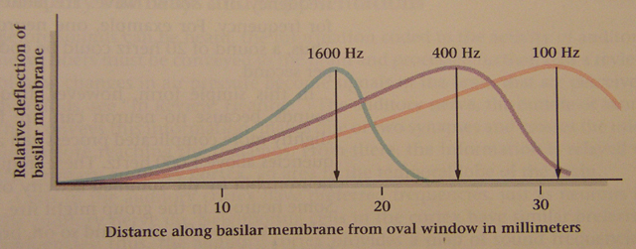
Place Theory
Waves move down basilar membrane
  →stimulation increases, peaks, and quickly tapers
  → location of peak depends on frequency of the sound, lower frequencies being further away

Slide 19
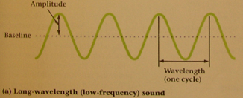
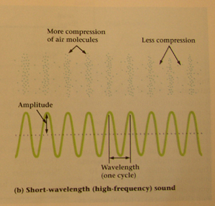
Physical Dimensions of Sound
Amplitude
  height of a cycle
  relates to loudness
Wavelength (w)
  distance between peaks
Frequency ( λ )
  cycles per second
  relates to pitch
  λ w = velocity
Most sounds mix many frequencies & amplitudes
Sound is repetitive changes
in air pressure over time
Spring 2006
IEOR 170

Slide 20
Auditory Perception
Auditory perception is a branch of psychophysics.
Psychophysics studies relationships between perception and physical properties of stimuli.
Physical dimensions: Aspects of a physical stimulus that can be measured with an instrument (e.g., a light meter, a sound level meter, a spectrum analyzer, a fundamental frequency meter, etc.)
Perceptual dimensions: These are the mental experiences that occur inside the mind of the observer. These experiences are actively created by the sensory system and brain based on an analysis of the physical properties of the stimulus. Perceptual dimensions can be measured, but not with a meter. Measuring perceptual dimensions requires an observer (e.g., a listener).

Slide 21
Visual Psychophysics:
Perceptual Dimensions Physical Properties of Light
Hue Wavelength
Brightness Luminance
Shape Contour/Contrast
Auditory Psychophysics:
Perceptual Dimensions Physical Properties of Sound
Pitch Fundamental Frequency
Loudness Intensity
Timbre (sound quality) Spectrum Envelope/Amp Env
The terms pitch, loudness, and timbre refer not to the physical characteristics of sound, but to the mental experiences that occur in the minds of listeners.

Slide 22
Perceptual Dimensions
Pitch
  higher frequencies perceived as higher pitch
  humans hear sounds in 20 Hz to 20,000 Hz range
Loudness
  higher amplitude results in louder sounds
  measured in decibels (db), 0 db represents hearing threshold
Spring 2006
IEOR 170

Slide 23
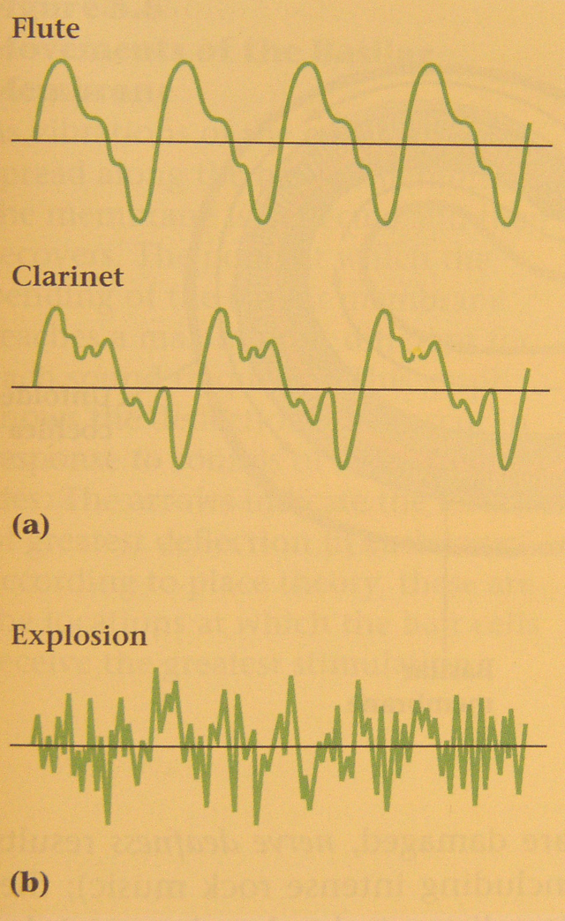
Perceptual Dimensions (cont.)
Timbre
  complex patterns added to the lowest, or fundamental, frequency of a sound, referred to as spectrum envelope
  spectrum envelopes enable us to distinguish musical instruments
Multiples of fundamental frequency give music
Multiples of unrelated frequencies give noise
Spring 2006
IEOR 170

Slide 24
The Perception of Sound
Key questions about sound perception:
What is the `resolving power’ of the hearing mechanism
How good an estimate of the fundamental frequency of a sound do we need so that the perception mechanism basically can’t tell the difference
How good an estimate of the resonances or formants (both center frequency and bandwidth) of a sound do we need so that when we synthesize the sound, the listener can’t tell the difference
How good an estimate of the intensity of a sound do we need so that when we synthesize it, the level appears to be correct

Slide 25
The Range of Human Hearing
Human hearing perceives both sound frequency and sound direction
Threshold of hearing — Thermal limit of Brownian motion of air particles in the inner ear
The acoustic intensity level of a pure tone that can barely be heard at a particular frequency is called Threshold of Audibility
    threshold of audibility ≈ 0 dB at 1000 Hz
    threshold of feeling ≈ 120 dB
    threshold of pain ≈ 140 dB
    immediate damage ≈ 160 dB
Thresholds vary with frequency and from person-to-person
Masking is the phenomenon whereby one loud sound makes another softer sound inaudible
  masking is most effective for frequencies around the masker frequency

Slide 26
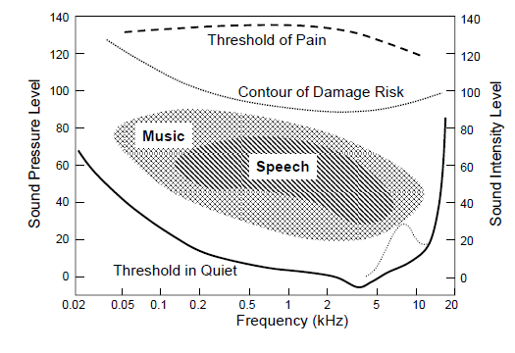
Range of Human Hearing

Slide 27
Sound Intensity
Intensity of a sound is a physical quantity that can be measured and quantified
  Acoustic Intensity (I) defined as the average flow of energy (power) through a unit area, measured in watts/square meter
  Threshold of hearing defined to be: I₀=10⁻¹² watts/m²
  The intensity level of a sound I_{L} is defined relative to I₀
  I_{L} =10 log₁₀I/I₀

Slide 28
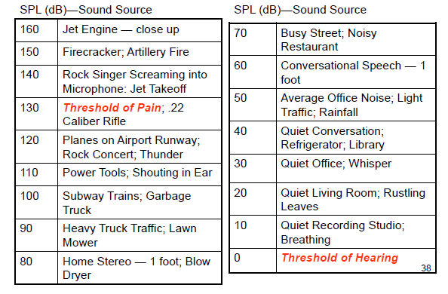
Sound Pressure Levels (dB)

Slide 29
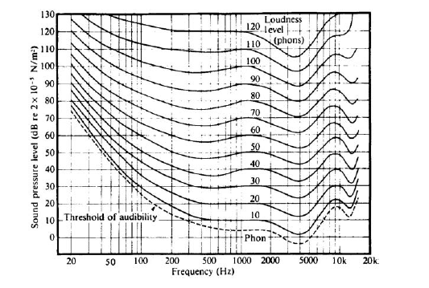
Loudness
Loudness is a perceptual quality that is related to the physical property of sound pressure level.
Loudness is quantified by relating the actual sound pressure level of a pure tone (in dB relative to a standard reference level) to the perceived loudness of the same tone (in a unit called phons) over the range of human hearing (20 Hz–20 kHz)

Slide 30
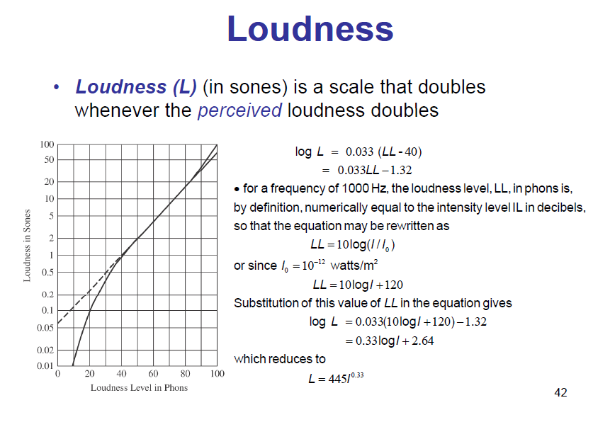

Slide 31
Perception of Frequency
Pure tone
Pitch is a perceived quantity while Frequency is a physical one (cycle per second or Hertz)
Mel is a scale that doubles whenever the perceived pitch doubles;
start with 1000 Hz = 1000 mel, increase frequency of tone until listener perceives twice the pitch (or decrease until half the pitch) and so on to find mel-Hz relationship
The relationship between pitch and frequency is non-linear

Slide 32
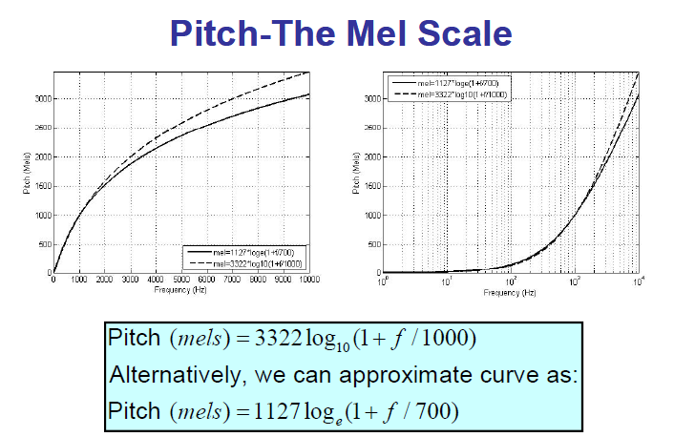

Slide 33
Parameter Discrimination
JND-Just Noticeable Difference
S/l | Parameter | JND
1 | Fundamental frequency | 0.3-0.5%
2 | Formant frequency | 3-5%
3 | Formant bandwidth | 20-40%
4 | Overall Intensity | 1.5 dB

Slide 34

Critical Bands
The ear cannot distinguish sounds within the same band that occur simultaneously.
Each band is called a critical band
The auditory system can be roughly modeled as a filterbank, consisting of 25 overlapping bandpass filters, from 0 to 20 KHz
The bandwidth of each critical band is about 100 Hz for signals below 500 Hz, and increases non-linearly after 500 Hz up to 5000 Hz
1 bark = width of 1 critical band

Slide 35
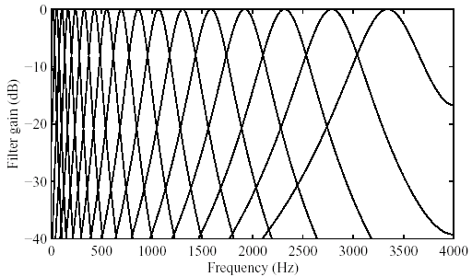
Critical Bands in Masking
Critical bands: The widths of the masking bands for different masking tones are different, increasing with the frequency of the masking tone.

Slide 36
Cochlea-Overlapping Bandpass Filter
A frequency-to-place transformation takes place in the cochlea (inner ear), along the basilar membrane.
Distinct regions in the cochlea, each with a set of neural receptors, are “tuned” to different frequency bands.
In fact, the cochlea can be viewed as a bank of highly overlapping band-pass filters.
The magnitude responses are asymmetric and non-linear (level-dependent).
Moreover, the cochlear filter pass-bands are of non-uniform bandwidth, and the bandwidths increase with increasing frequency.
The “critical bandwidth” is a function of frequency that quantifies the cochlear filter pass-bands.

Slide 37

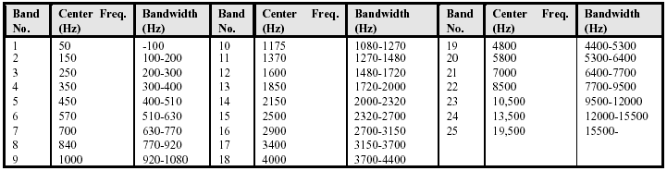
Cochlea-Overlapping Bandpass Filter
A distance of 1 critical band is commonly referred to as “one bark” in the literature.

Slide 38
Timbre
Timbre, also known as sound quality or tone color, is oddly defined in terms of what it is not:
When two sounds are heard that match for pitch, loudness, and duration, and a difference can still be heard between the two sounds, that difference is called timbre.
For example: a clarinet, a saxophone, and a piano all play a middle C at the same loudness and same duration. Each of these instruments has a unique sound quality. This difference is called timbre, tone color, or simply sound quality.
There are also many examples of timbre difference in speech. For example, two vowels (e.g., /å/ and /i/) spoken at the same loudness and same pitch differ from one another in timbre.
There are two physical correlates of timbre:
spectrum envelope
amplitude envelope

Slide 39
Different Views of Auditory Perception
Functional: based on studies of psychophysics – relates stimulus (physics) to perception (psychology): e.g. frequency in Hz. vs. Mel/Bark scale.
Sensation or Perception
Stimulus
Auditory system
Black Box
Structural: based on studies of physiology/anatomy – how various body parts work with emphasis on the process; e.g. neural processing of a sound

Slide 40
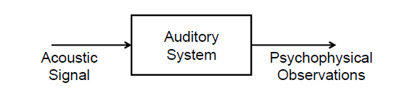
The Black Box Model of the Auditory System
Researchers have resorted to a “black box” behavioral model of hearing and perception
Model assumes that an acoustic signal enters the auditory system causing behavior that we record as psychophysical observations
Psychophysical methods and sound perception experiments determine how the brain processes signals with different loudness levels, different spectral characteristics, and different temporal properties
Characteristics of the physical sound are varied in a systematic manner and the psychophysical observations of the human listener are recorded and correlated with the physical attributes of the incoming sound
Then determine how various attributes of sound (or speech) are processed by the auditory system

