Slide 1
Customer Booking Analysis
Insights from 50,000 Flight Bookings
Task 2 Report

Slide 2
Key Metrics
Total Bookings: 50,000
Average Passengers: 1.59 per booking
Booking Success Rate: 14.96%
Top Booking Channel: Internet (88.8%)

Slide 3
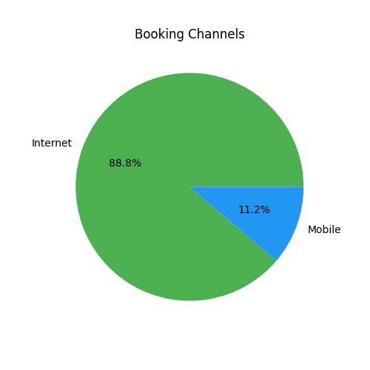
Booking Channels
88.8% of bookings come through our website

Slide 4
Trip Type Distribution
Key Insights:
- 99% of bookings are RoundTrips
- Opportunity to promote OneWay/CircleTrip packages
Trip Type | Count
RoundTrip | 49497
OneWay | 387
CircleTrip | 116

Slide 5
Strategic Recommendations
1. Enhance web platform (88.8% bookings come via Internet)
2. Create RoundTrip bundles with meals/seats
3. Target last-minute bookers (avg. lead time: 85 days)
4. Increase staffing during peak hours (9AM flights)

