Slide 1
Customer Booking Analysis
Task 2 Report | 50,000 Flight Bookings

Slide 2
Methodology
✓ Data: 50,000 anonymized bookings
✓ Sources: sales_channel, trip_type, booking_complete
✓ Cleaning: Removed duplicates & null values
✓ Tools: Python (Pandas, Matplotlib)

Slide 3
Key Metrics
Total Bookings: 50,000
Booking Success Rate: 15%
Dominant Channel: Internet (88.8%)
Avg. Passengers: 1.59

Slide 4
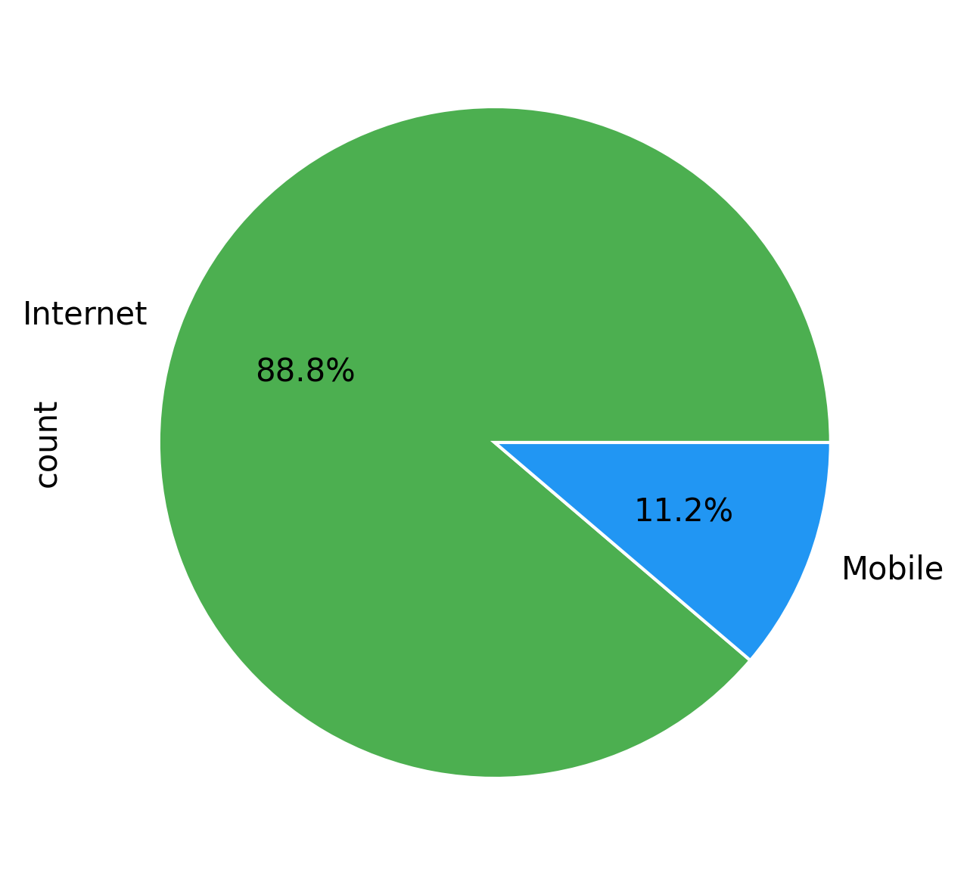
Booking Channels
88.8% via Website
→ Prioritize web UX improvements

Slide 5
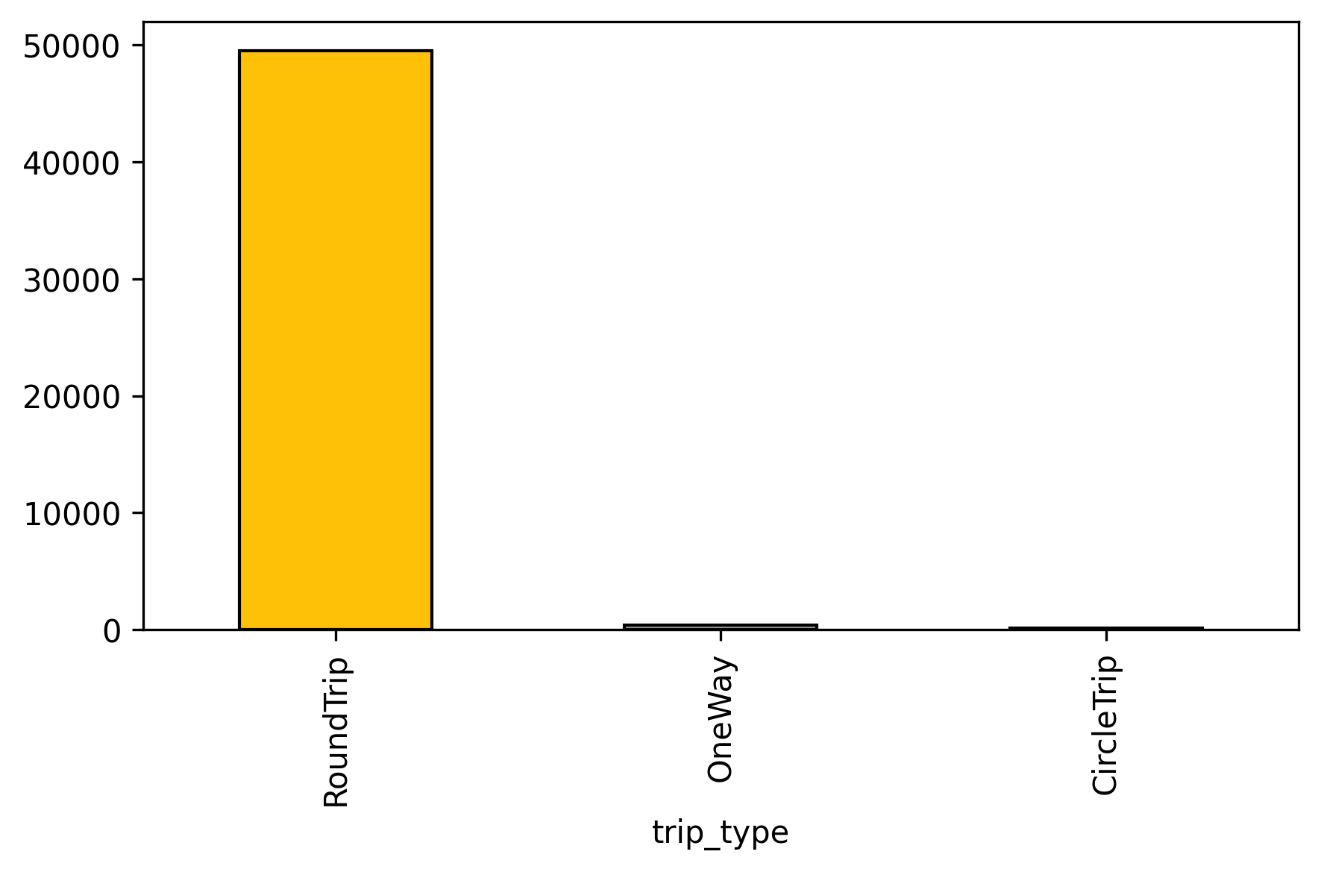
Trip Type Distribution
99% RoundTrips
→ Bundle offers for OneWay flights

Slide 6
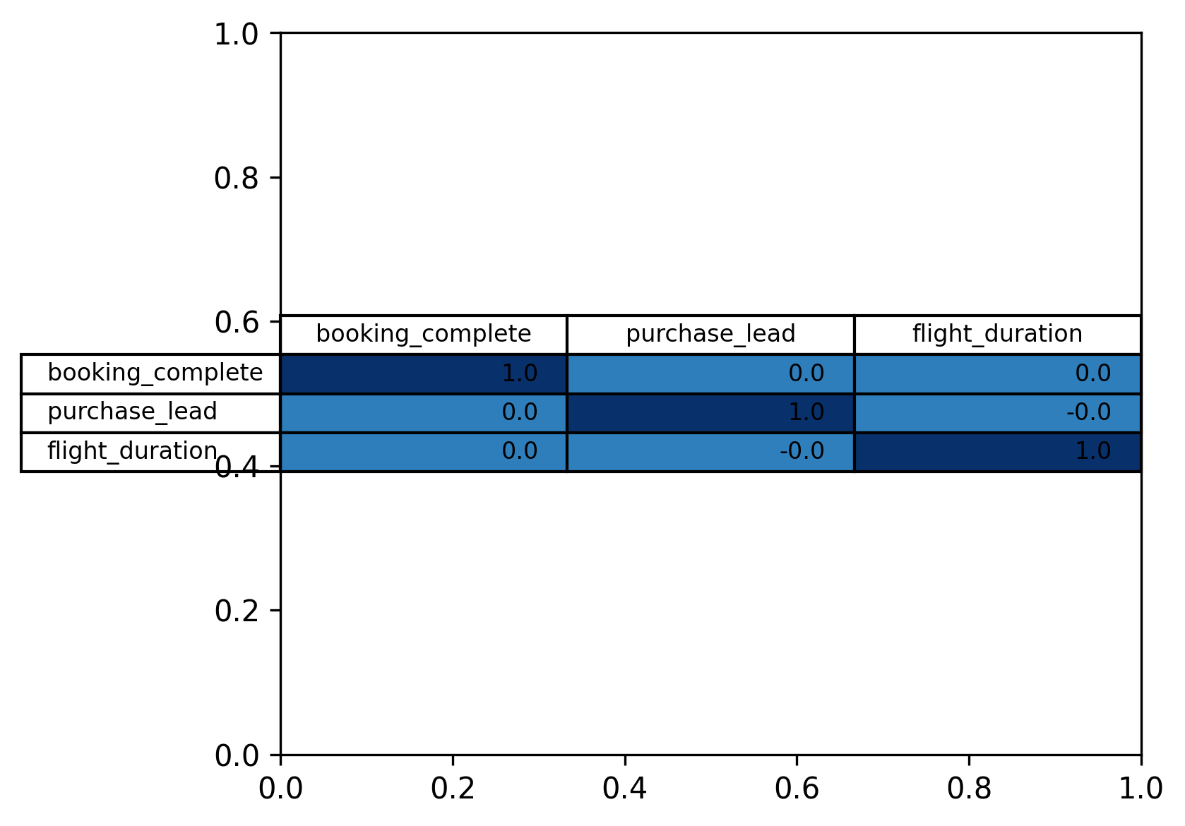
Booking Success Drivers
Key Insight:
Shorter lead times → Higher success

Slide 7
Strategic Recommendations
💻 Enhance web platform (88.8% bookings)
🛎️ Create RoundTrip bundles with meals/seats
⏱️ Target last-minute bookers (avg. 85-day lead time)
📊 A/B test mobile app promotions

Slide 8
Thank You
Q&A

