Slide 1
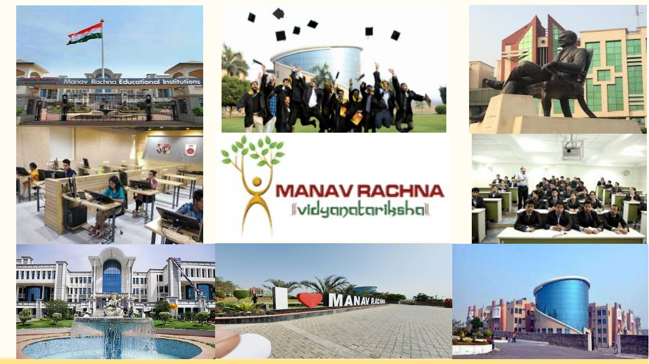
AURA
AI Desktop Automation Assistant — Phase 2 Progress Review
B.Tech CSE (AIML) Final Year Project

Slide 2

Project Title
Language Understandable Natural Agent (LUNA) / Aura
A unified AI automation system for controlling laptop tasks through natural language
Student's Name
Roll Number
Branch
Prateek Sharma
Withheld
B.Tech CSE (AIML)
Dhruv Singh
Withheld
B.Tech CSE (AIML)
Dhruv Saini
Withheld
B.Tech CSE (AIML)
Under the Guidance of
Dr. Kushagra Agarwal
2

Slide 3
CONTENTS
1
Introduction and project goal
7
Browser and application automation
2
Motivation and problem statement
8
LLM/API/local-model experiments
3
Phase-2 MVP progress
9
PyAGI, Hermes and coding harness work
4
Prototype journey and contribution clarity
10
Current limitations and future work
5
System architecture
11
References
6
File management automation
3

Slide 4
PROBLEM STATEMENT AND OBJECTIVES
Problem statement
Phase-2 scope
To design and implement a single AI automation assistant that can understand user commands and perform laptop tasks through verified modules instead of only giving chatbot-style answers.
Phase-2 focuses on MVP-level automation: file management, browser automation, application automation, and supporting experiments for voice, memory, local models and APIs.
Main objectives
• Take voice/text commands from user
• Understand intent and choose correct capability
• Execute actions on OS, files, apps and browser
• Verify result and report progress clearly
• Identify limitations of free-tier APIs and local LLMs
4

Slide 5
FILE MANAGEMENT AUTOMATION
Implemented and tested file-management ideas from the LUNA file-manager branch and other agent prototypes.
User file
PDF/DOCX/PPTX
Extract text
OCR / parser
Embedding
MiniLM vectors
Compare
subject vectors
Classify
best match
Move
target folder
• Scans Downloads recursively and filters supported documents by time window.
• Extracts document text from PDF/PPT/DOCX-style files for processing.
• Generates subject embeddings and compares file content with stored subject embeddings.
• Performs file actions such as create, read, move, rename, search and organize through tool modules.
• Current focus is safety: avoid uncontrolled delete/overwrite and validate paths.
Example use case
“Find recently downloaded PDFs and arrange them by subject/course folder.”
Phase-2 result
Core file automation exists, but needs a unified UI and stronger verification before final submission.
5

Slide 6
PHASE-2 MVP: COMPLETED WORK
File management
Browser automation
Application automation
Create folders/files, search files, read documents, move files, recycle files, organize selected content.
Open public pages, search, extract visible text/links/tables, follow exact observed links.
Discover installed apps, launch applications, inspect windows and basic native controls.
Voice + memory
System / desktop controls
UI + verification
Voice input/replies tested; user-authored memory and preference storage experimented in prototypes.
Mouse, keyboard, screenshots, open/close app, hotkeys and limited system operations tested in separate agents.
Aura interface shows plan, progress, reviewed actions and verified task state instead of only chat replies.
Status: working MVP modules exist; the remaining task is unifying them into one stable assistant runtime.
6

Slide 7
SYSTEM ARCHITECTURE
The LLM is not the whole assistant. It is one reasoning component inside a larger automation runtime.
User
Voice/Text
Intent
Router
Planner / LLM
Optional
Action
Engine
OS / Apps
Browser / Files
Memory + Logs
Observe + Verify
Fast path
Reasoning path
Known commands should go through deterministic tools without waiting for a large model call.
Ambiguous tasks use LLMs to plan, but execution is still controlled by validated tools.
7

Slide 8
PROTOTYPE JOURNEY: MANY AGENTS → ONE FINAL ASSISTANT
The final target was always one unified automation agent. Multiple agents were built as experiments because each stage revealed practical limitations.
ARIA
Mark / JARVIS
PyAGI
Aura / LUNA
Local desktop assistant
File/app control experiments
Voice, memory, browser,
plugin-style actions
Tool-call backend, local
LLM + hardware control
Integrated desktop UI +
verified automation runtime
Reason for multiple prototypes
• Free-tier APIs showed high latency and rate/quality limits.
• Local models reduced dependency but were weaker for reliable tool use.
• Desktop automation needed safe deterministic actions, not only LLM text.
• Memory, UI, voice and verification needed separate experiments before unification.
Contribution clarity: LUNA-side reference/prototype work is treated as supporting work; Phase-2 progress here focuses on the team’s integrated MVP and automation experiments.
8

Slide 9
LLM, API AND LOCAL MODEL EXPERIMENTS
A major part of Phase-2 was understanding why an AI assistant cannot depend blindly on free APIs or local LLMs.
Free-tier API testing
Local model testing
Practical conclusion
Gemini/OpenRouter/NVIDIA/Groq-style providers were tested for reasoning, voice, and tool planning. Main issue: latency, quota/rate limits, invalid keys and inconsistent throughput.
Ollama/LM Studio and open-source model routes were explored. Main issue: weaker tool-call reliability and higher hardware dependency.
LLMs should help with ambiguity and planning, but fast commands must use local deterministic tools.
Architecture decision from this study
Known command → deterministic tool → verify result.
Ambiguous command → LLM planner → validated tool execution → observe result.
9

Slide 10
PYAGI, HERMES AND CODING HARNESS WORK
Additional backend and development tools were used to test automation capability, tool schemas and code generation workflows.
PyAGI backend
Hermes Agent Harness
Claude Code and code LLMs
Python agent loop with LLM provider manager, safe file operations, mouse/keyboard actions, app launch, screenshots, voice loop and webcam finger tracking experiments.
Used as a coding/agent harness reference for connecting structured tools, planning loops and UI-side automation ideas.
Used during development to speed up code generation, debugging, refactoring and comparison of implementation approaches.
Why this matters for the project
• It helped separate assistant architecture from model hype.
• It proved tool schemas and safe dispatch are necessary for real desktop actions.
• It clarified that the final assistant needs a stable runtime first, then replaceable LLM providers.
10

Slide 11
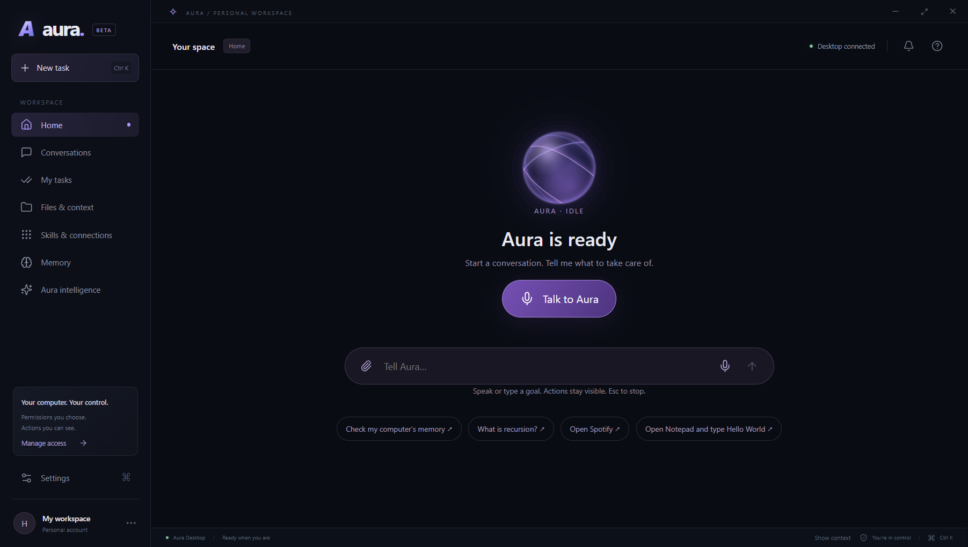
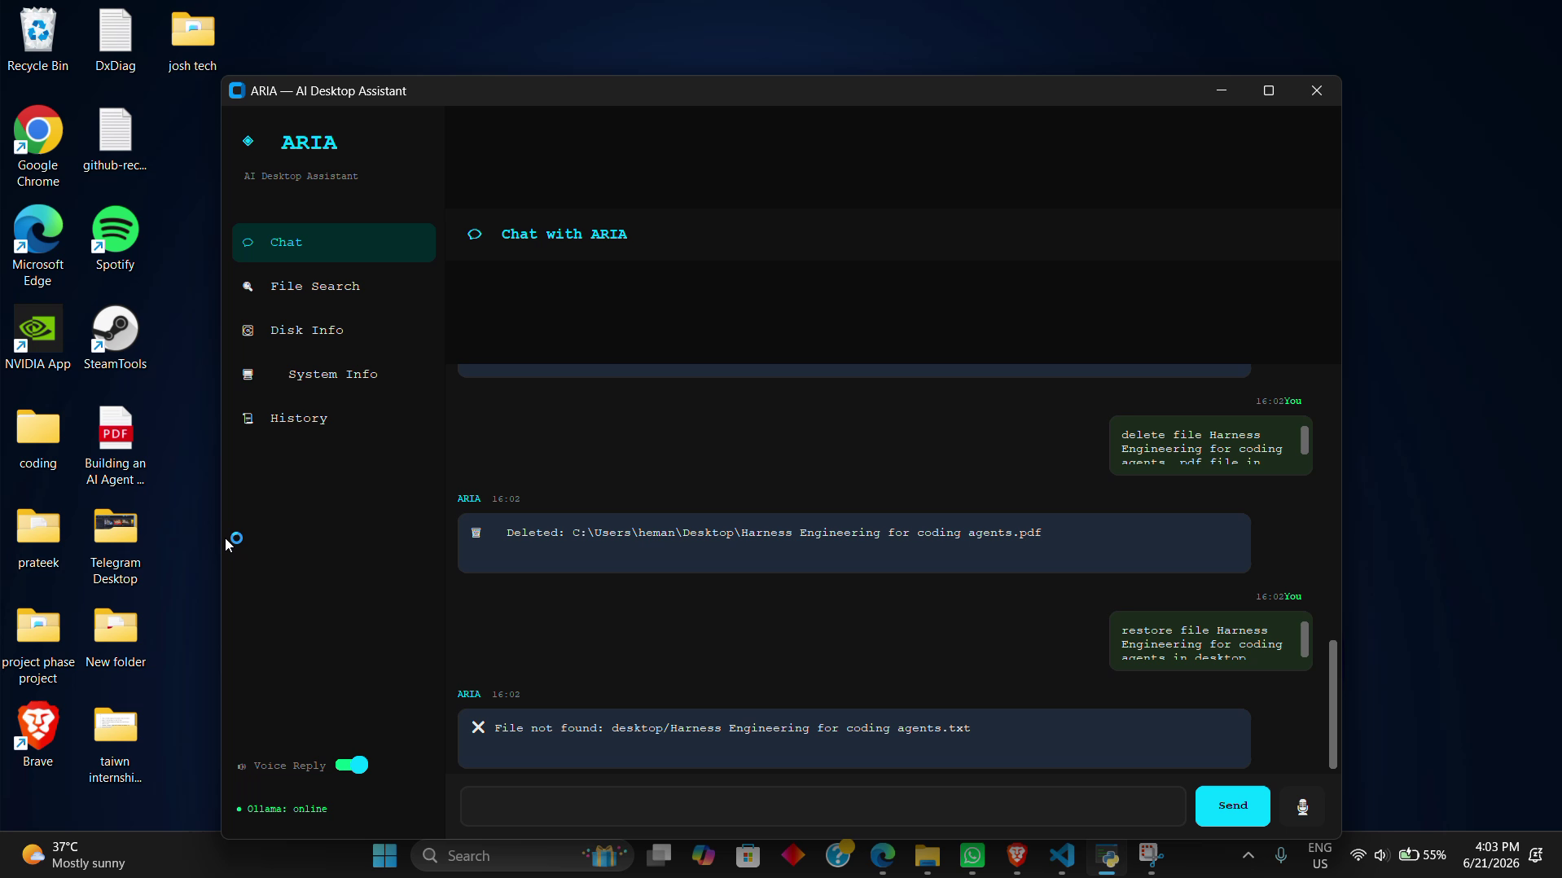
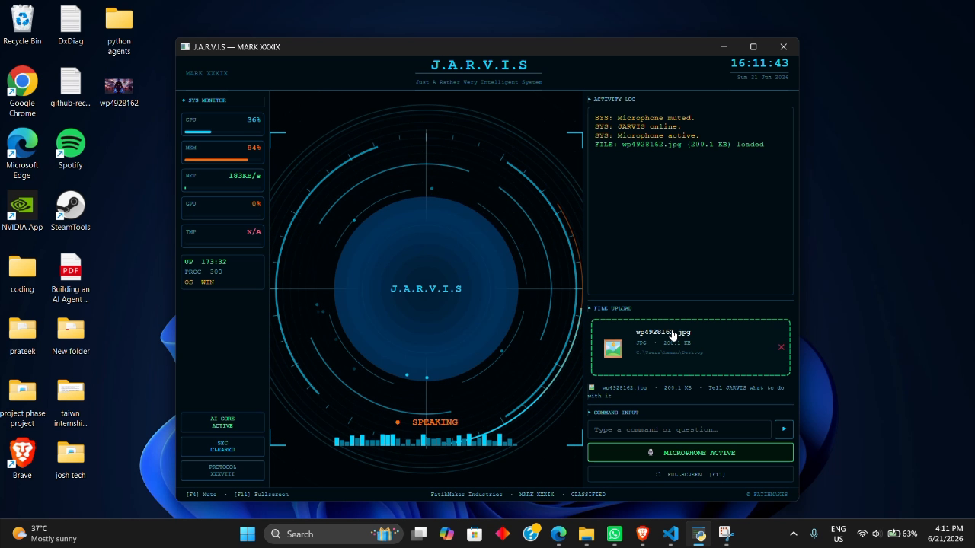
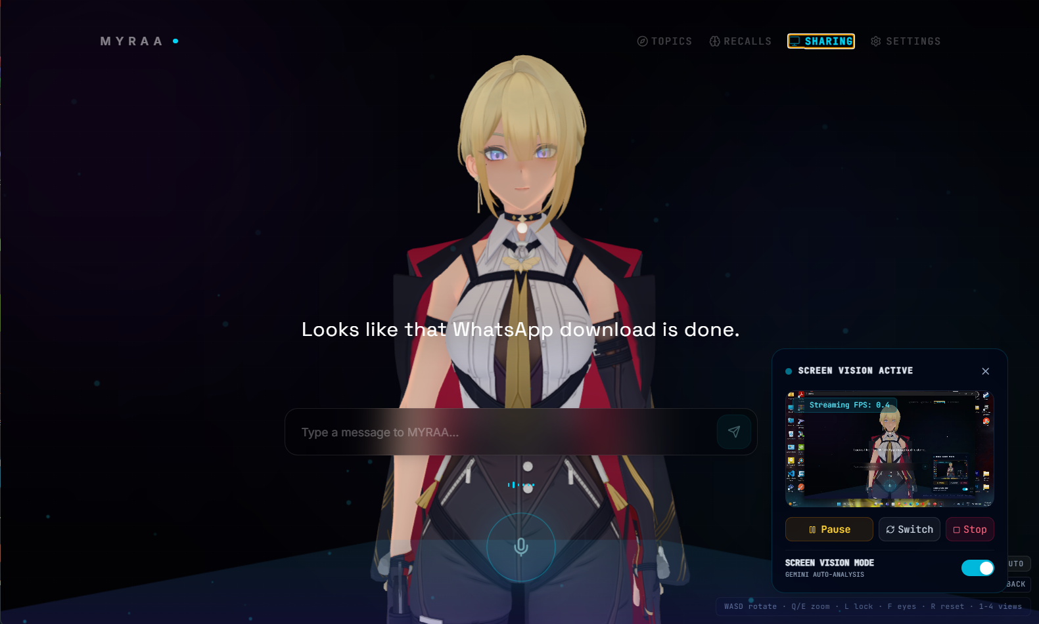
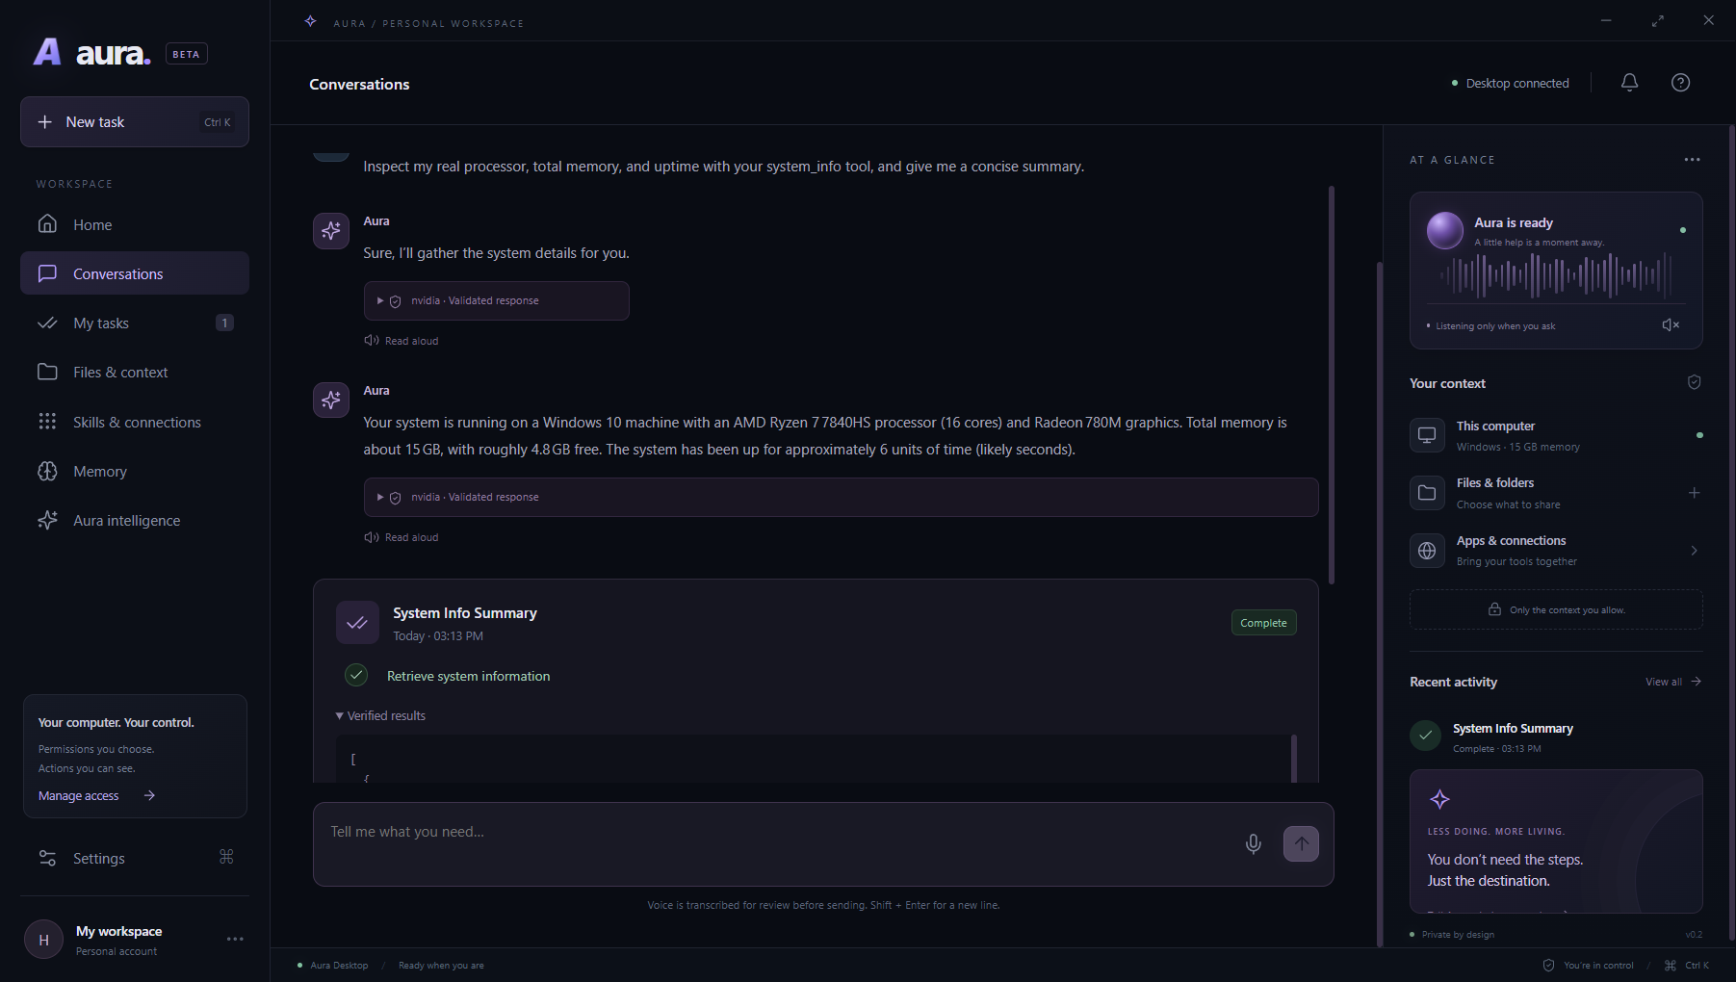
IMPLEMENTATION SNAPSHOTS
Screenshots from the working prototypes show the evolution from simple desktop agents to a more complete Aura-style interface.
Aura interface
ARIA prototype
JARVIS / Mark prototype
The desired final UX: not just chatbot text — visible plan, action progress, permission handling and verified completion.
MYRAA Prototype
11

Slide 12
PROGRESS STATUS AND CONTRIBUTION CLARITY
This slide separates completed MVP work from ongoing work to avoid confusion during evaluation.
Area
Phase-2 Status
Notes
File management automation
Completed
Create/search/read/move/organize supported files with safety checks.
Browser automation
Completed
Public page navigation and extraction; complex authenticated actions pending.
Application automation
Completed
App launch, desktop actions, window/control experiments.
Unified final assistant
In progress
Multiple prototypes will be merged into one stable runtime.
LLM/API research
Completed
Latency/free-tier/local-model limitations documented for architecture decision.
12

Slide 13
FUTURE WORK
Next phase: merge the useful parts of all prototypes into one reliable LUNA/Aura assistant.
Unified runtime
Better perception
Safer automation
Practical intelligence
• Single command router
• Common capability registry
• Shared memory and logs
• Screen awareness
• Window/UI accessibility
• Observe → act → verify loop
• Permission system
• Undo/rollback
• Risk checks before file/app actions
• Local fast commands
• LLM only for complex planning
• Provider switching and fallbacks
Final expected outcome
A single assistant that can understand simple user commands, use files/browser/apps safely, remember useful context, and visibly complete laptop automation tasks.
13

Slide 14
REFERENCES
Project material used for this Phase-2 presentation
• LUNA repository: OS control / File Manager alpha branch
• Aura desktop project source and UI screenshots
• ARIA desktop assistant prototype source and demo video frames
• Mark/JARVIS assistant source and demo video frames
• PyAGI backend source: LLM provider manager, safe file operations and hardware control
• Development harnesses and coding tools: Hermes Agent Harness, Claude Code and other code-oriented LLM workflows
Security note: API keys and private credentials were not included in this presentation.
14

Slide 15
Thank You
Aura — Phase 2 Progress Review

