Slide 1


22CSP72 – PROJECT WORK II PHASE I
ADAPTIVE CHAOTIC JAYA AND XGBOOST BASED
DDoS DETECTION FOR HAPS NETWORKS
DONE BY,
23CSR165 PRATEEKSHA G K
23CSR161 PRAJIT PRANAV K
23CSR163 PRANEESH C
SUPERVISED BY,
Ms.D.NANTHYA
1

Slide 2
PROBLEM DEFINITION
Distributed Denial-of-Service (DDoS) attacks are among the most dangerous cyber threats.
Attackers flood networks with excessive traffic, making services unavailable.
Existing systems face challenges in detecting attacks efficiently.
High-dimensional network traffic increases computational complexity.
Lack of explainable and optimized DDoS detection frameworks.
PROBLEM SIGNIFICANCE AND IMPACT
DDoS attacks cause service outages and network disruption.
Financial and operational losses for organizations.
Damage to organizational reputation and loss of customer trust.
Increased cybersecurity risks in 5G/6G communication systems.
HAPS networks are vulnerable to traffic-based attacks.
2

Slide 3

DOMAIN UNDERSTANDING
Domain: Cybersecurity & Network Intrusion Detection
• Cybersecurity protects networks from malicious activities. • DDoS attacks flood systems with fake traffic. • Machine Learning helps identify abnormal traffic patterns. • Feature selection reduces irrelevant network attributes. • Explainable AI improves trust in security decisions.
3

Slide 4
FEASIBILITY ANALYSIS
TECHNICAL FEASIBILITY
• Publicly available CIC-DDoS2019 dataset. • Open-source ML libraries available.
• Well-documented algorithms like XGBoost and Jaya.
HARDWARE FEASIBILITY
• No GPU requirement. • Standard CPU-based processing is adequate.
IMPLEMENTATION FEASIBILITY
• XGBoost is easy to implement. • Python libraries like Scikit-learn, Pandas, and NumPy are readily available. • Easy integration of feature selection and classification modules. • Availability of open-source tools reduces development cost. • SHAP library can be used for explainability without complex setup.
4

Slide 5
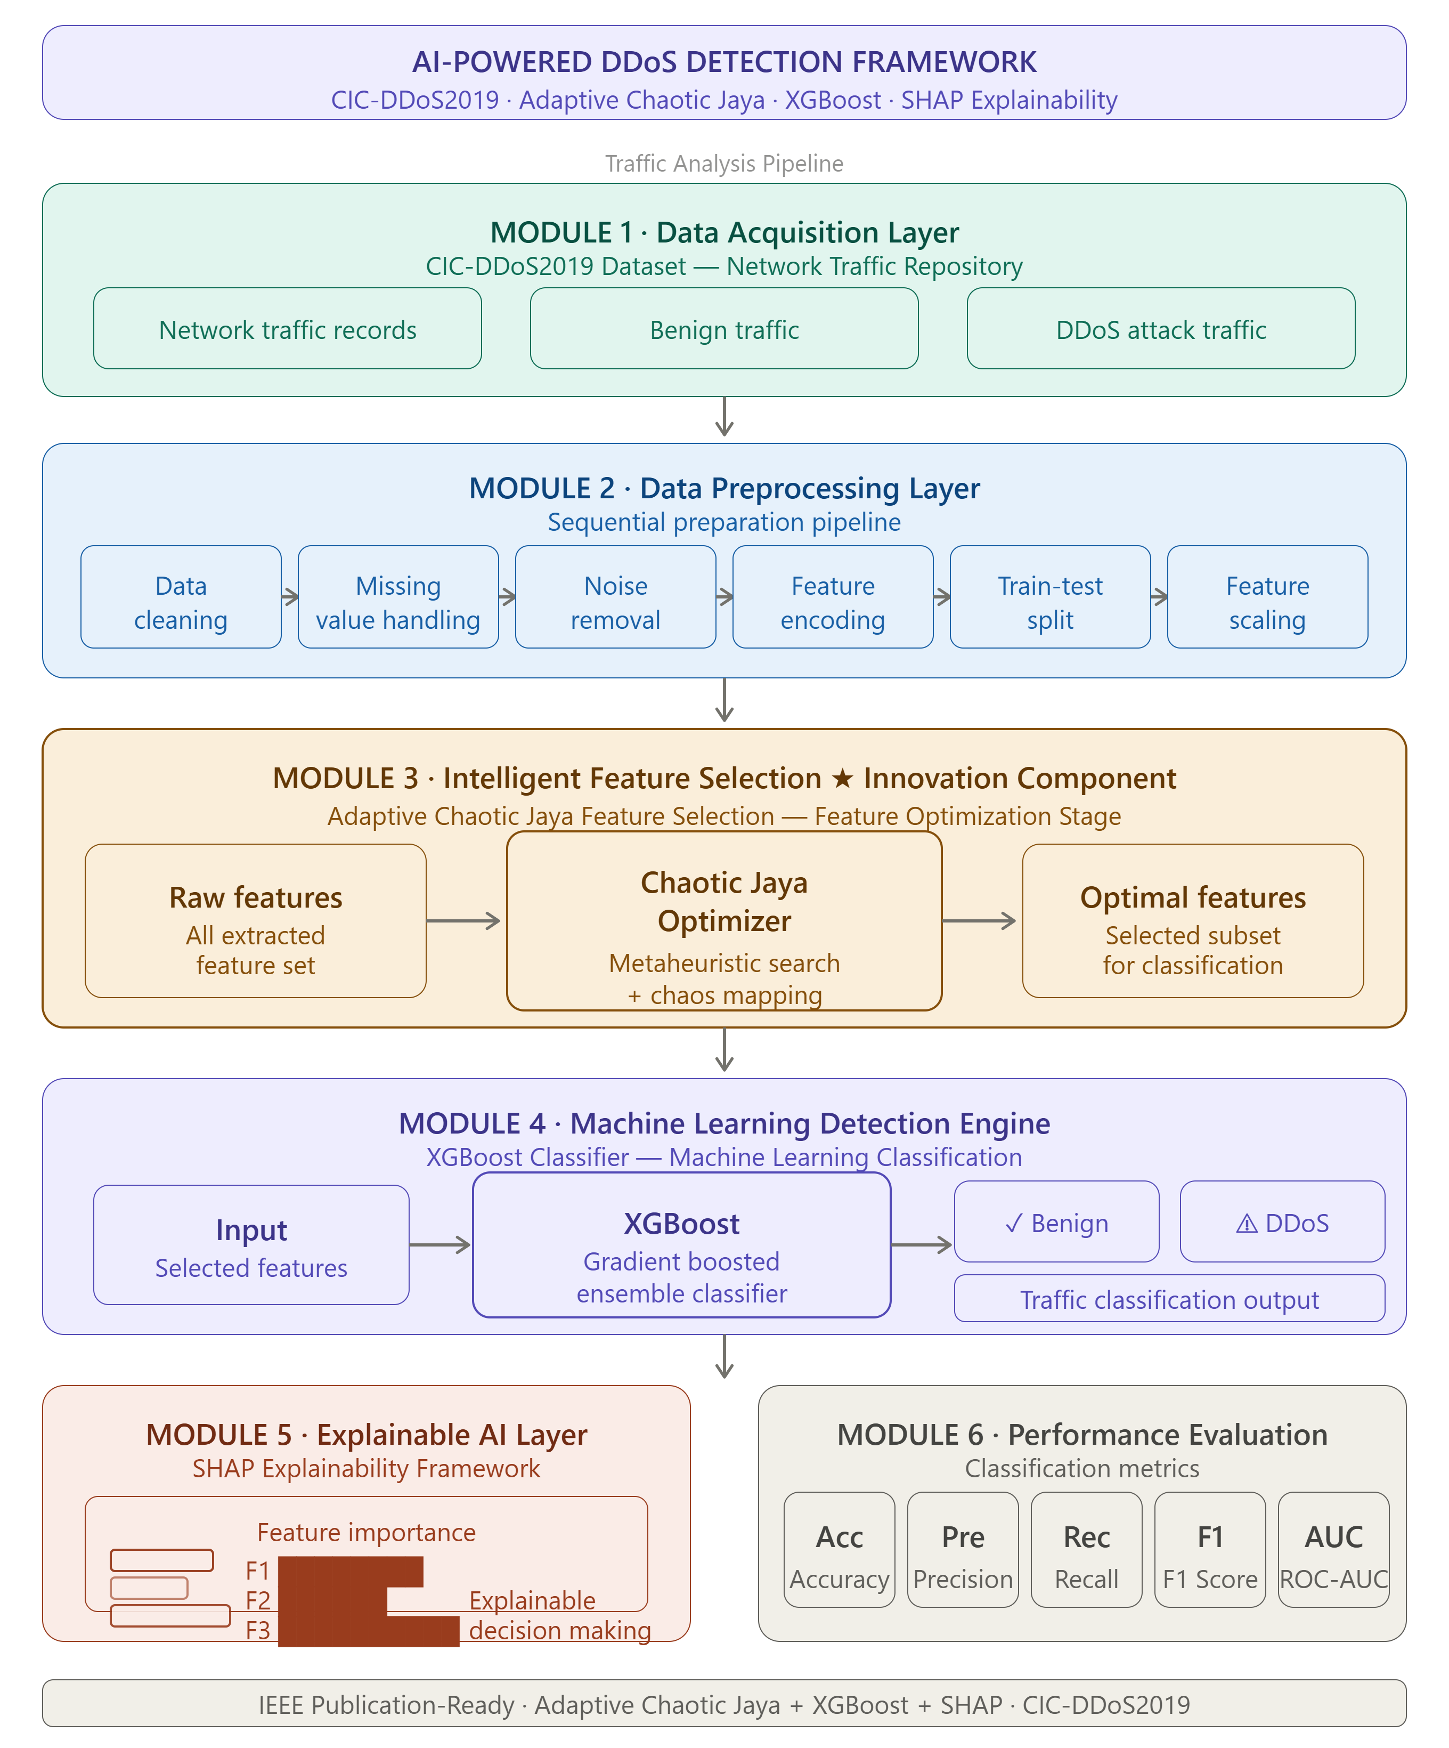
WORKFLOW
5

Slide 6
RESEARCH PAPERS
PAPER-1 Memory-Efficient Multi-Island Jaya Feature Selection for Large-Scale DDoS Attack Detection (IEEE 2026)
CONTRIBUTION: • Uses CIC-DDoS2019 dataset. • Jaya-based feature selection. • H2O AutoML classification. • Detects multiple DDoS attack types.
LIMITATION: • High implementation complexity. • No explainable AI component. • AutoML increases computational overhead.
6

Slide 7
PAPER-2 Cybersecurity of High-Altitude Platform Stations: Threat Taxonomy, Attacks and Defenses With Standards Mapping—DDoS Attack Use Case (IEEE 2026)
CONTRIBUTION: • Studies HAPS cybersecurity threats. • Identifies DDoS as a major attack. • Discusses defense mechanisms.
LIMITATION: • Survey-based work. • No machine learning framework. • No attack detection model proposed.
7

Slide 8
PAPER-3 Performance Analysis of Machine Learning Techniques for Server Health Monitoring Using Time Series Data Against DDoS Attacks
(IEEE 2025)
CONTRIBUTION: • ML-based DDoS detection. • Server health monitoring. • Uses boosting algorithms.
LIMITATION: • Detect impact after server degradation. • No feature optimization technique. • No explainable AI support.
8

Slide 9

RESEARCH GAP
• Existing models focus mainly on classification accuracy. • Limited explainability in DDoS detection. • High-dimensional features increase complexity. • Lack of optimized ML frameworks for HAPS security. • Need for lightweight and interpretable detection systems.
PROPOSED SOLUTION AND EXPECTED OUTCOMES
• CIC-DDoS2019 dataset + Adaptive Chaotic Jaya Feature Selection • XGBoost for binary classification (DDoS / Non-DDoS) • SHAP for explainable predictions • Lightweight XGBoost-based detection for HAPS • Accurate detection with fewer features, better efficiency • Explainable decisions, improved cybersecurity
DATASET:
https://www.kaggle.com/datasets/dhoogla/cicddos2019
9

Slide 10
THANK YOU!

