Slide 1


Satellite–AIS Fusion for Oil Spill Detection & Vessel Attribution
Bytecoders
• India: 7,500 km coastline, ~75% of oil arrives by sea — zero automated spill-source attribution today
• Ennore 2017: two ships, 251 tonnes spilled, years of litigation — culprit identification was manual guesswork
1 · DETECT
U-Net finds slick polygons
in Sentinel-1 SAR
2 · REWIND
OpenDrift runs ocean physics
backwards to origin zone
3 · ATTRIBUTE
AIS tracks cross-scored:
proximity · heading · dark-window
4 · PROVE
Ranked suspect dossier
with confidence %, court-ready
WHY NOBODY ELSE HAS THIS
• Only pipeline that reasons BACKWARDS in time from slick physics
• Catches "dark vessels" that switched AIS off during the spill window
• EU's CleanSeaNet needs analysts; ours runs end-to-end automatically & open-source
• India-first: sovereign capability instead of foreign service dependency
OUTCOME
Anonymous slick → ranked suspect list
in under 30 minutes
with quantified uncertainty — not guesses
@SIH Idea submission- Template
2
Notes:
2

Slide 2
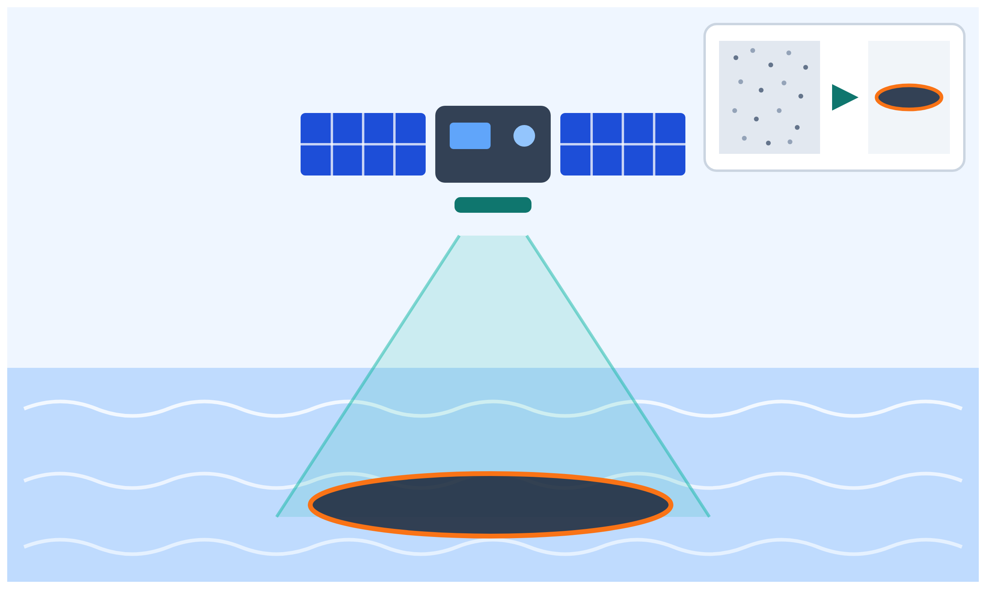
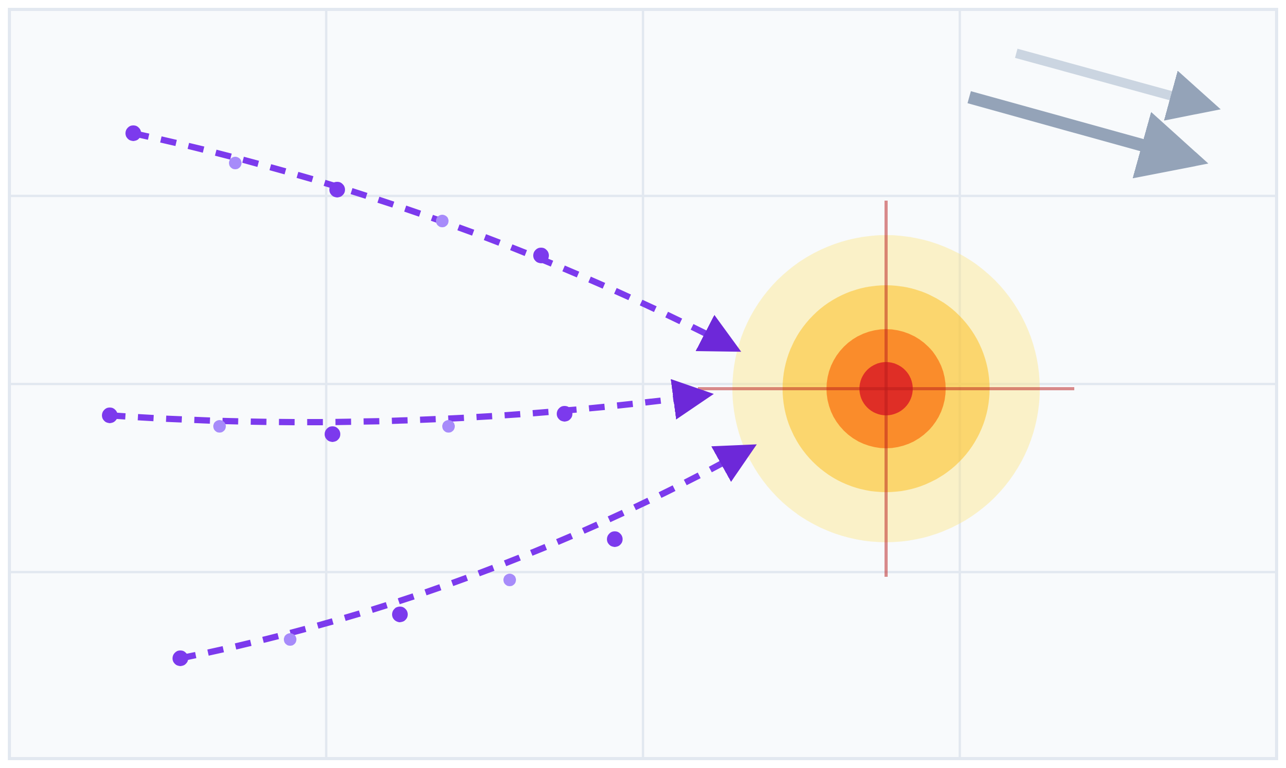
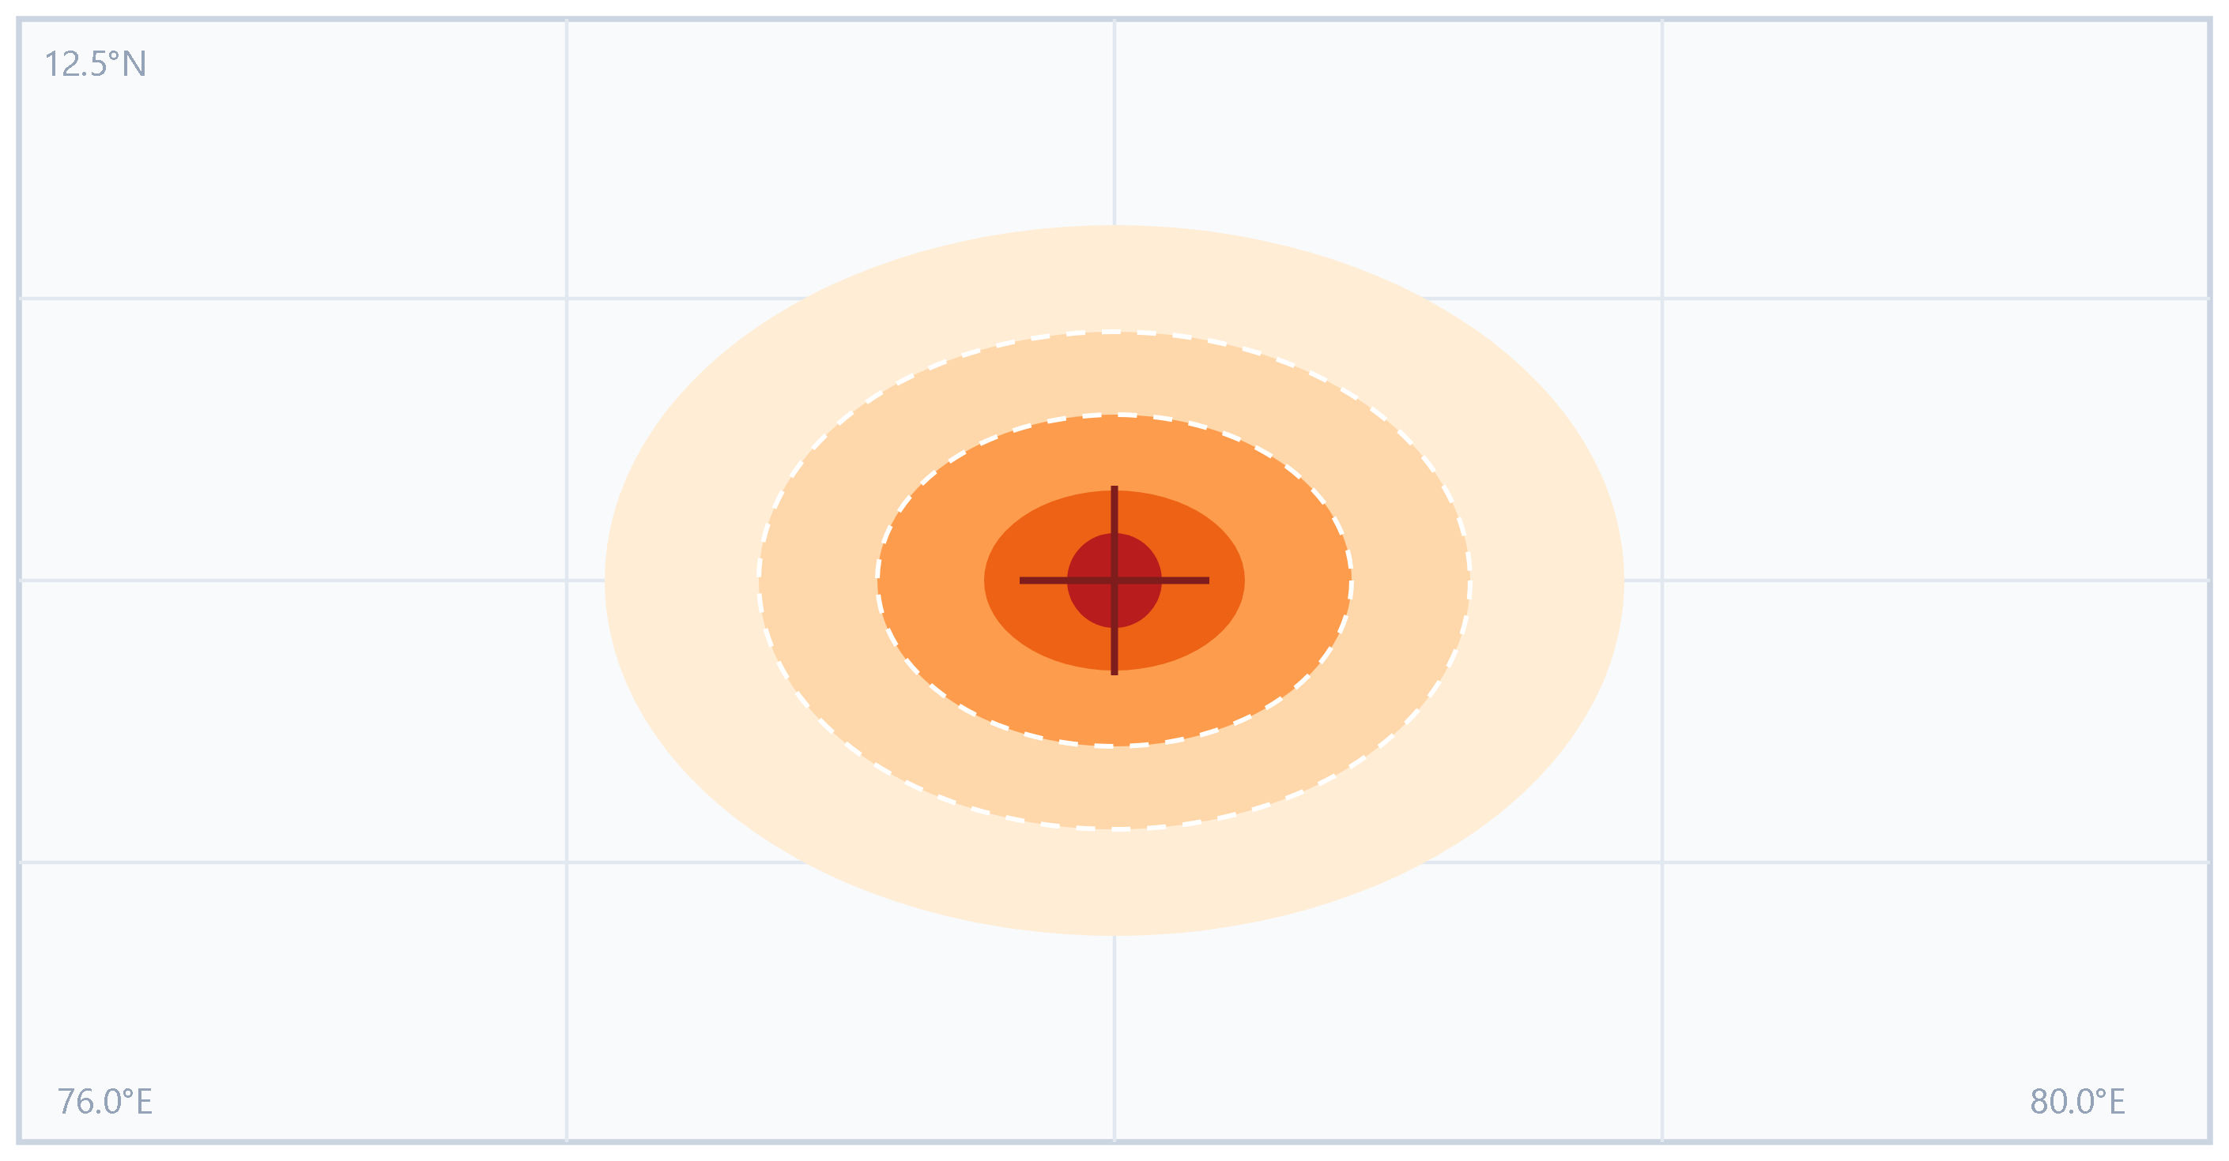
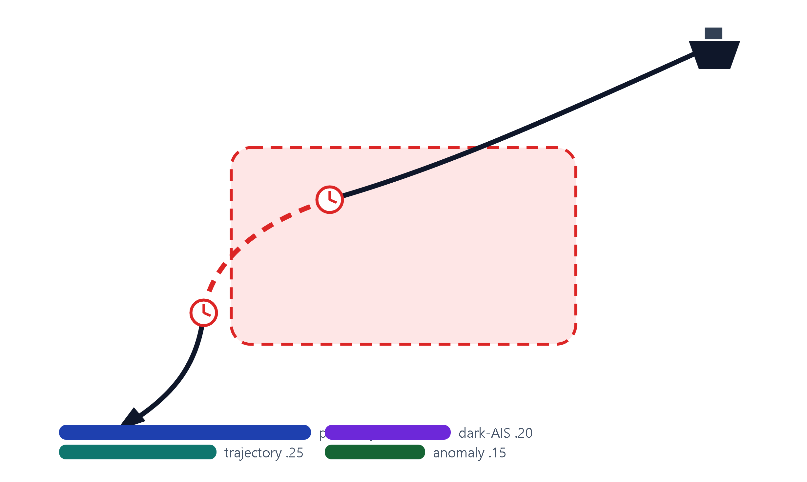
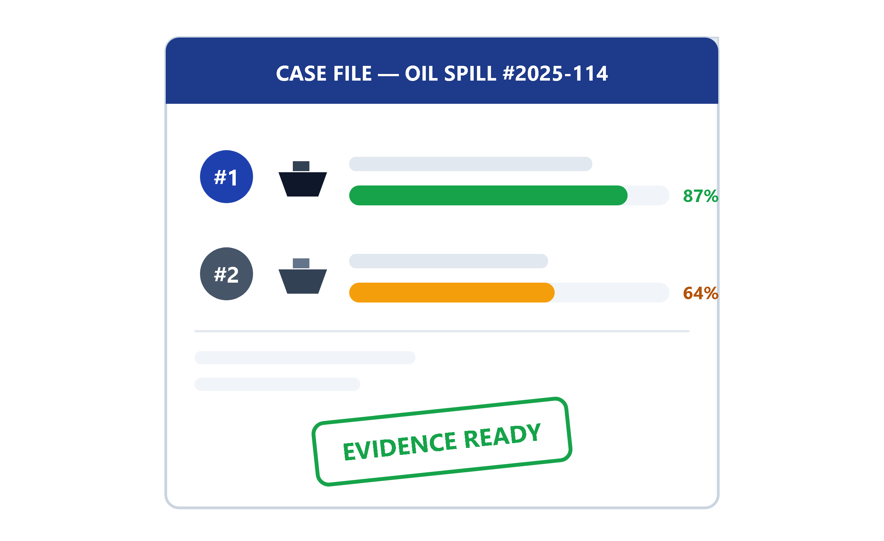
TECHNICAL APPROACH
Bytecoders
STAGE A · DETECT — FIND THE SLICK
PREPROCESS
IW GRD VV+VH · 10 m resolution
orbit revisit 6–12 days
Lee speckle filter + land mask
U-NET SEGMENTATION
trained on Zenodo Parts I–III (~3,500 scenes)
classes: slick · ship wake · biogenic · rain · low-wind
dual-pol features kill look-alikes
SLICK POLYGONS
GeoJSON polygon + confidence mask
area · perimeter · shape index
backscatter statistics attached
▶
▶
▶
STAGE B · REWIND — OCEAN PHYSICS IN REVERSE
OPEN DRIFT · BACKWARD HINDCAST
OpenOil ensemble ×100 virtual particles
forcing: CMEMS currents + ERA5 winds
wind drift 1–6% · Ekman angle · Stokes drift
ORIGIN PROBABILITY MAP
PDF over sea surface — never a single guess
hindcast window 2–12 h
uncertainty reported, not hidden
▶
▶
▶
STAGE C · ATTRIBUTE → PROVE — NAME THE SHIP
AIS FUSION SCORING
proximity to origin mode .40
trajectory bearing match .25 · anomaly .15
AIS dark-window during spill .20
OUTPUTS
dashboard map overlay · ranked suspects
court-ready PDF case-file + GeoJSON export
< 5 min inference per scene, Colab-class GPU
▶
▶
▶
PyTorch · smp
FastAPI · MongoDB
React · Leaflet
OpenDrift
CMEMS · ERA5
MarineCadastre AIS
@SIH Idea submission- Template
3
Notes:
3

