Slide 1




SMART INDIA HACKATHON 2026
TITLE PAGE
  Problem Statement ID – SIH26143
  Problem Statement Title- Leveraging satellite imagery to determine oil spills at sea along with AIS data correlations to identify the vessel responsible for the spill
  Theme- Space Technology
  PS Category- Software
  Team ID- [Insert Team ID]
  Team Name- ByteCoders

Slide 2
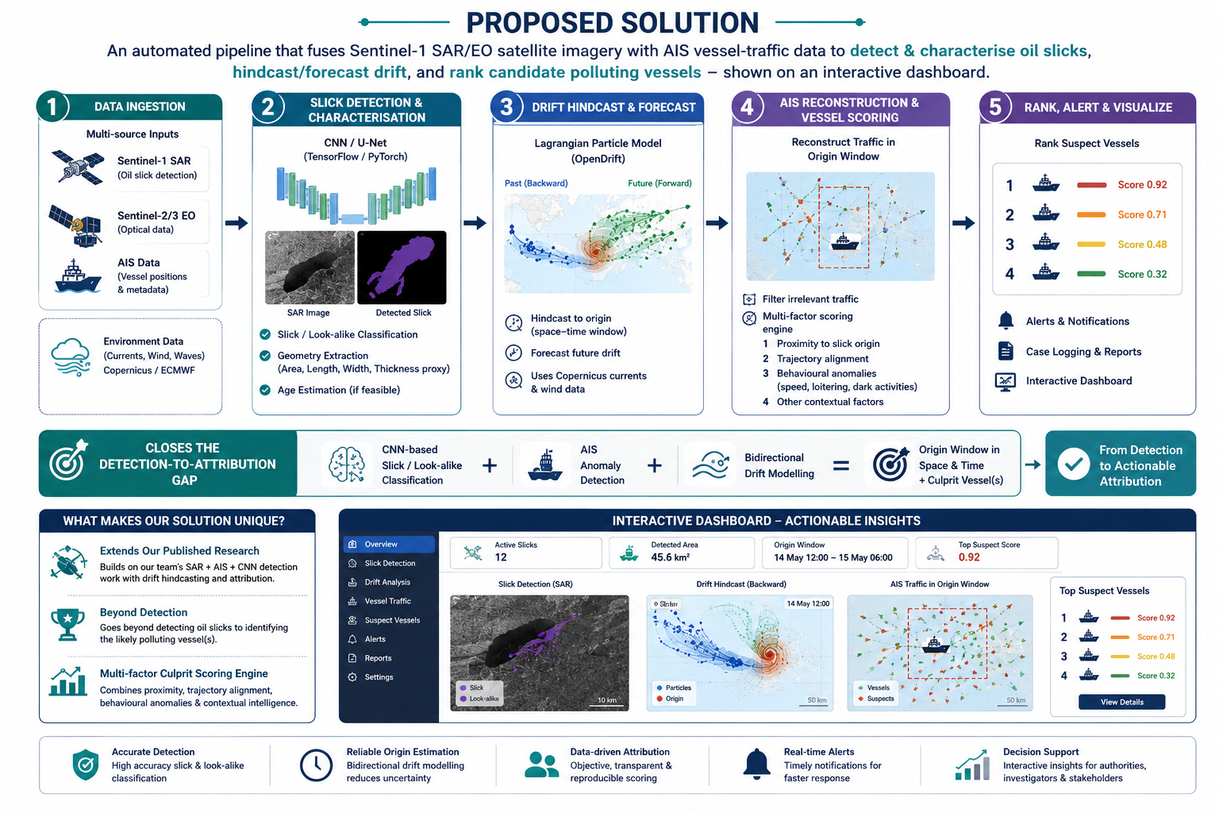
Satellite–AIS Fusion for Oil Spill Detection & Vessel Attribution
Bytecoders
Yahan apna dashboard hoga
@SIH Idea submission- Template
2
Notes:
2

Slide 3
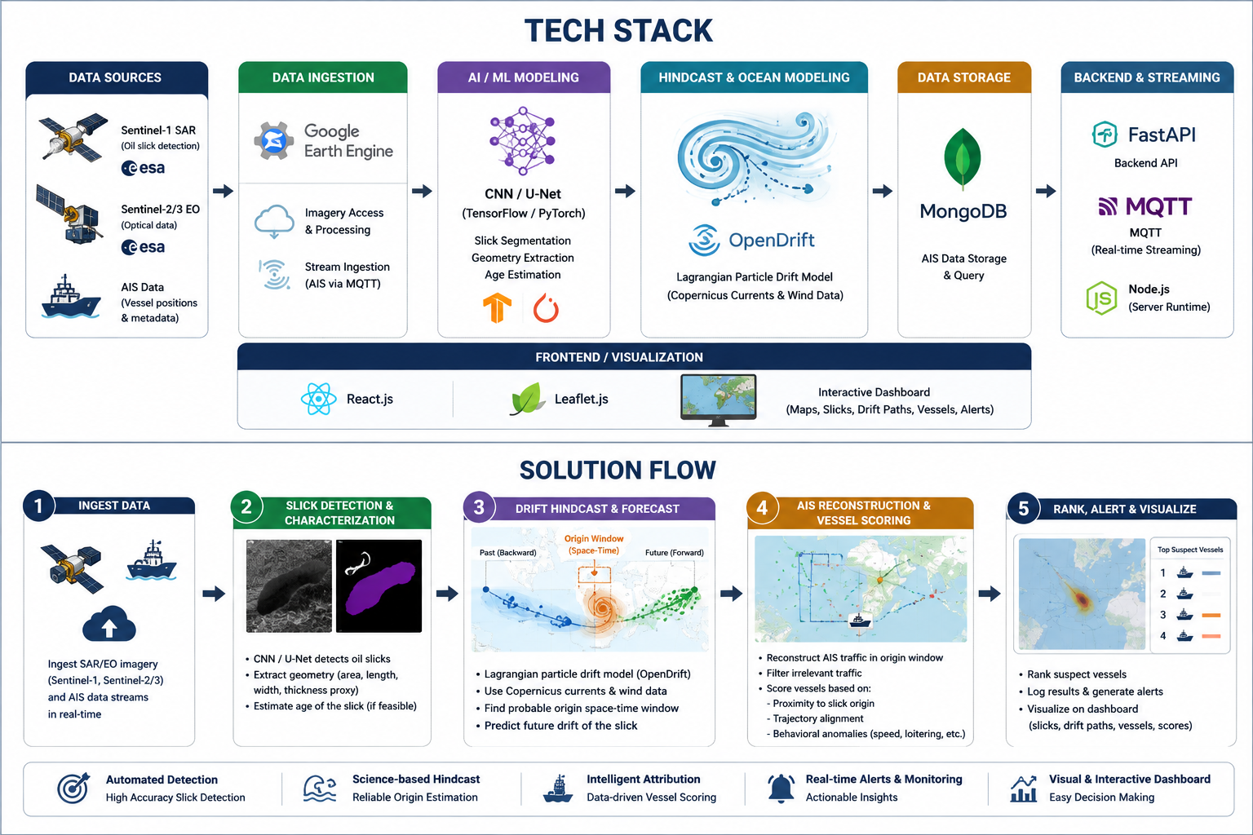
TECHNICAL APPROACH
Bytecoders
@SIH Idea submission- Template
3
Notes:
3

Slide 4
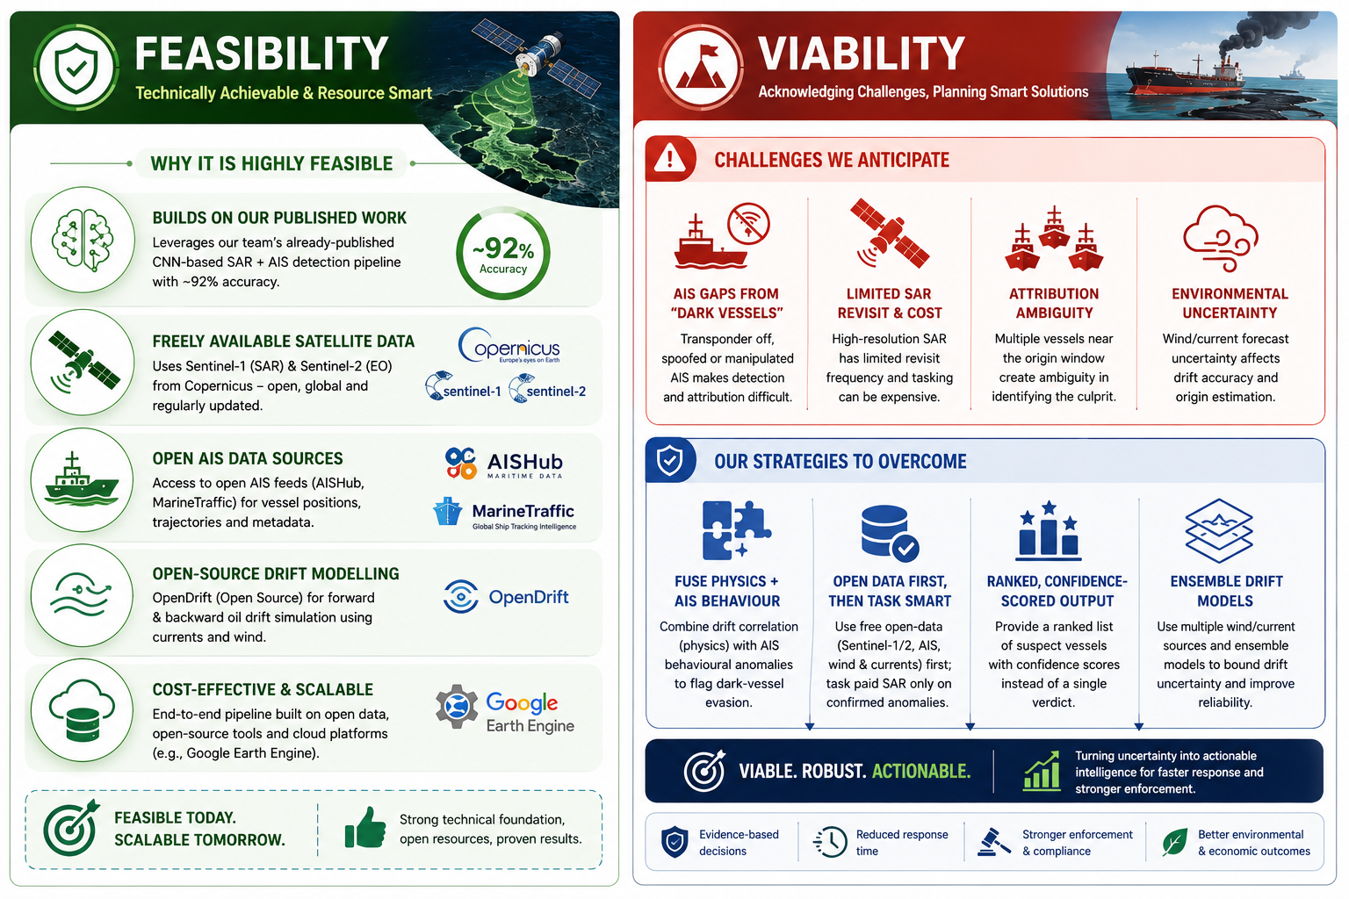
FEASIBILITY AND VIABILITY
Bytecoders
@SIH Idea submission- Template
4
Notes:
4

Slide 5
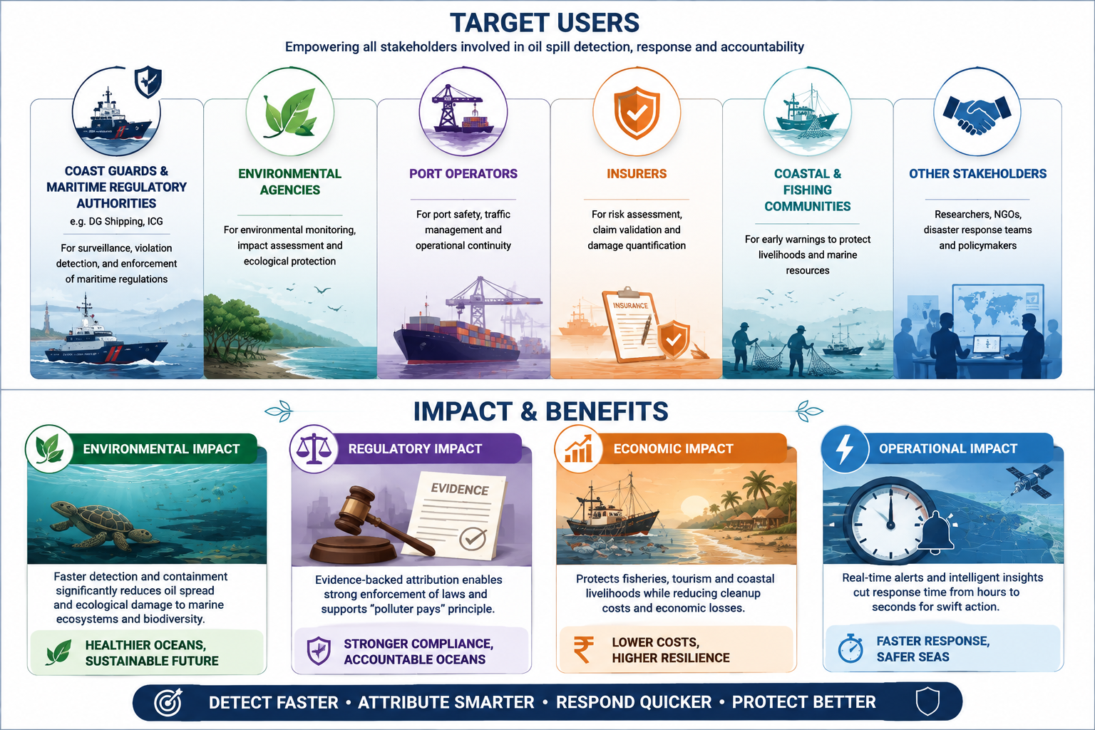
IMPACT AND BENEFITS
Bytecoders
@SIH Idea submission- Template
5
Notes:
5

Slide 6
RESEARCH AND REFERENCES
Bytecoders
  Detecting Oil Spills at Marine Environment Using AIS and Satellite Datasets (2025) - Paper PDF
  A Novel Deep Learning Method for Marine Oil Spill Detection from Satellite SAR Imagery (2022) - ScienceDirect
  Exploiting AIS Data for Intelligent Maritime Navigation: A Comprehensive Survey (2018) - IEEE DOI
  Oil Spill Identification from Satellite Images Using Deep Neural Networks (2019) - MDPI / Remote Sensing
  OpenDrift : A Generic Framework for Trajectory Modelling -opendrift.github
Data Sources:
  Copernicus Sentinel-1 & Sentinel-2 — ESA - Copernicus / ESA
  Google Earth Engine — Google Earth Engine
  Copernicus Marine Service — Ocean Currents & Environmental Data — Copernicus Marine
  AISHub — AIS Vessel Data — AISHub
  MarineTraffic — AIS & Vessel Tracking — MarineTraffic
@SIH Idea submission- Template
6
Notes:
6

Slide 7
IMPORTANT INSTRUCTIONS
Please ensure below pointers are met while submitting the Idea PPT:
  Kindly keep the maximum slides limit up to six (6). ( Including the title slide)
  Try to avoid paragraphs and post your idea in points /diagrams / Infographics /pictures
  Keep your explanation precise and easy to understand
  Idea should be unique and novel.
  You can only use provided template for making the PPT without changing the idea details pointers (mentioned in previous slides).
  You need to save the file in PDF and upload the same on portal. No PPT, Word Doc or any other format will be supported.
  Note - You can delete this slide (Important Pointers) when you upload the details of your idea on SIH portal.
@SIH Idea submission- Template
7
Notes:
7

