Slide 1



SMART INDIA HACKATHON 2026
TITLE PAGE
  Problem Statement ID – SIH26143
  Problem Statement Title- Leveraging satellite imagery to determine oil spills at sea along with AIS data correlations to identify the vessel responsible for the spill.
  Theme- Space Technology
  PS Category- Software
  Team ID- 122818
  Team Name- ByteCoders.

Slide 2
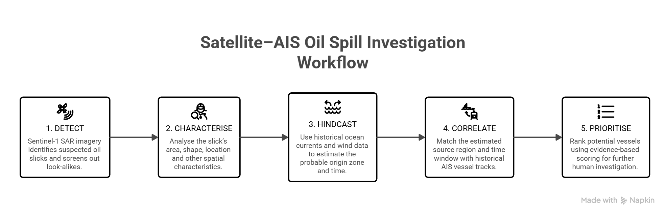
ByteCoders.
Satellite–AIS Fusion for Oil-Spill Detection & Investigation
Detect the slick. Trace its origin. Rank candidate vessels for investigation
Our solution fuses Sentinel-1 SAR, oceanographic and AIS data to detect slicks, trace their origin and rank candidate vessels.
1. DETECT
2.CHARACTERISE
3. HINDCAST
4.CORRELATE
5.PRIORITISE
Sentinel-1 SAR imagery identifies suspected oil slicks and screens out look-alikes.
Analyse the slick’s area, shape, location and other spatial characteristics.
Use historical ocean currents and wind data to estimate the probable origin zone and time.
Match the estimated source region and time window with historical AIS vessel tracks.
Rank potential vessels using evidence-based scoring for further human investigation.
Working:
  Satellite–AIS Fusion — Integrates Sentinel-1 SAR and AIS data.
  Slick Detection — Detects oil slicks and filters look-alikes.
  Drift Modelling — Reconstructs slick movement using wind & currents.
  Vessel Attribution — Matches probable source with historical AIS tracks.
  Investigation Dashboard — Presents vessel scores, alerts and case reports.
Our USP:
  Multi-Source Fusion — Satellite + oceanographic + AIS data in one workflow
  Look-Alike Screening — Reduces false positives before vessel investigation
  Uncertainty-Aware Origin Estimation — Provides probable source zones with confidence
  Explainable Vessel Ranking — Evidence-based scoring instead of simple proximity matching
  Human-in-the-Loop — Supports investigators without automatically declaring a culprit
@SIH Idea submission- Template
2
Notes:
2

Slide 3
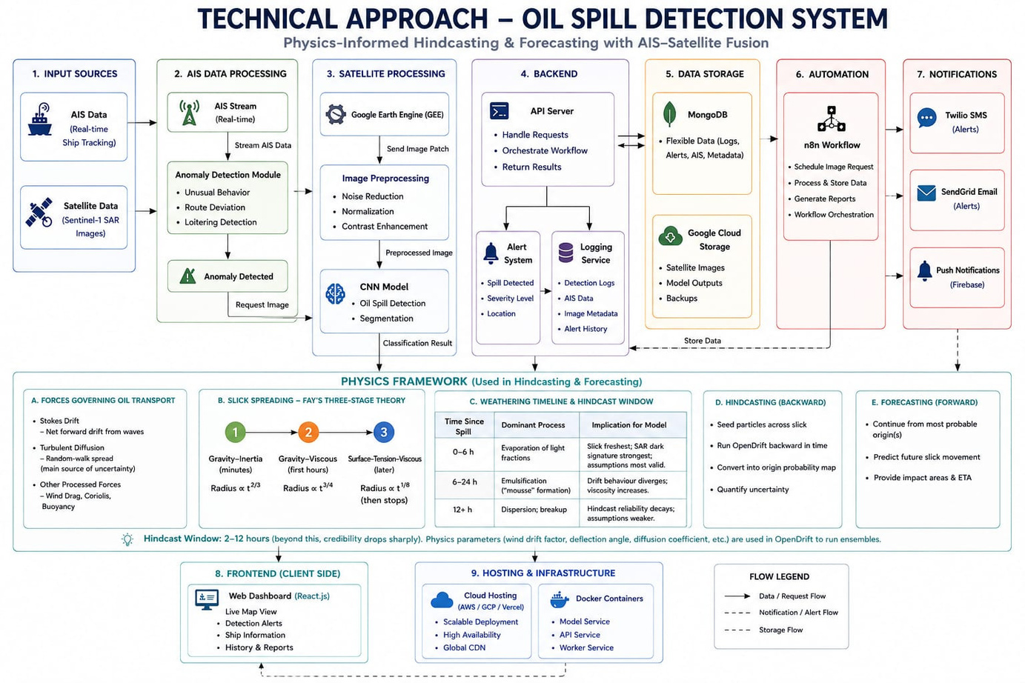
TECHNICAL APPROACH
ByteCoders.
Category | Technology
Frontend | React · TypeScript · Vite · MapLibre GL (deck.gl)
Backend | FastAPI (Python) · Spring Boot (Java) · WebSocket
Database | MongoDB
AI / ML | PyTorch · segmentation-models-pytorch (U-Net)
Drift Modelling | OpenDrift · OpenOil (backward hindcast)
Data Sources | Sentinel-1 SAR · CMEMS · ERA5 · MarineCadastre AIS
@SIH Idea submission- Template
3
Notes:
3

Slide 4
FEASIBILITY AND VIABILITY
ByteCoders.
Aspect | Feasibility | Viability
Data Availability | Sentinel-1, Sentinel-2, EOS-06 and AIS data are available for analysis. | Supports continuous monitoring of marine pollution and vessel movement.
Technology Readiness | Proven AI/ML models, oceanographic data and open-source tools are available. | Enables faster, automated and cost-effective oil-spill detection.
System Development | The solution can be developed using Python, geospatial libraries, cloud infrastructure and open APIs. | Can be deployed for real-time monitoring and decision support.
National Relevance | The system can be adapted to Indian coastal regions and major shipping routes. | Supports marine safety, environmental protection and maritime surveillance.
Impact | Satellite and drift models can identify spill locations and probable movement. | Helps authorities respond faster, reduce ecological damage and investigate responsible vessels.
Scalability | The MVP can start with one region and later expand using cloud infrastructure. | Has potential for regional, national and eventually global deployment.
LOW / MANAGED RISK
Cloud cover in optical imagery
Sentinel-1 SAR
MEDIUM RISK
High processing requirements
Limited labled oil-spill data
Cloud+parallel processing
Transfer learning + augmentation
HIGH RISK
False detection from look-alikes
AIS gaps or spoofing
Uncertainity in spill-origin estimation
Multi source validation
AIS-satelite verification
Ensmeble drift simulation
@SIH Idea submission- Template
4
Notes:
4

Slide 5
IMPACT AND BENEFITS
ByteCoders.
Impact | Key Benefits | Key Benificiary
Regulatory & Enforcement | Supports potential vessel identification through satellite–AIS correlation. Provides evidence-backed reports for investigations and improves maritime accountability. | Indian Coast Guard, DG Shipping, pollution-control authorities, maritime law-enforcement agencies
Operational Benefits | Enables automated oil-spill detection, hindcasting, forecasting, real-time alerts and interactive monitoring for faster emergency response. | Indian Coast Guard, port authorities, disaster-management agencies, oil-spill response teams
Environmental Impact | Supports early detection, faster containment and protection of marine biodiversity, fisheries, coral reefs, mangroves and coastal habitats. | Ministry of Environment, Forest and Climate Change, State Pollution Control Boards, marine research institutes, coastal communities
Economic & Social Benefits | Reduces cleanup costs and losses in shipping, tourism and fisheries while protecting coastal livelihoods and supporting the blue economy. | Fishing communities, shipping companies, port operators, tourism industry, insurance companies, coastal-state governments
Government & Regulatory
Authorities
Maritime & Port Operator
Beneficiary of
AI-Powered
Maritime Oil-Spill Detection and Prediction System
Environmental & Research
Economic & Social
@SIH Idea submission- Template
5
Notes:
5

Slide 6
ByteCoders.
RESEARCH AND REFERENCES
  Detecting oil spills at marine environment using ais and satellite datasets(2025):https://computersciencejournal.org/wp-content/uploads/10-JCS1684.pdf
  A Novel Deep learning method for marine oil spill detection from satellite SAR imagery: https://www.sciencedirect.com/science/article/abs/pii/S0025326X22003484
  Oil spill identification from satellite images using deep neural networks MDPI/Remote Sensing:https://www.mdpi.com/2072-4292/11/15/1762
  Exploiting AIS data for intelligent Maritime Navigation : A comprehensive survey (2018)-IEEE DOI
  Open drift: a generic framework for trajectory modelling :https://opendrift.github.io
  Copernicus Sentinel-1 & sentinel-2 (ESA):Earth observation satellite providing SAR and optical data for oil spill detection:https://www.esa.int/Applications/Observing_the_Earth/Copernicus
  Google earth engine : Cloud platform for planetary scale geospatial analysis and satellite data processing:https://earthengine.google.com
  Copernicus marine service : Provides ocean currents, waves and environmental data for modelling:https://marine.copernicus.eu
  AIShub Acces to global AIS data including vessel positions,identities and trajectories:https://www.aishub.net
  Marine Traffic: Real time AIS vessel tracking and maritime intelligence platform:https://www.marinetraffic.com/en/ais/home/centerx:-12.0/centery:25.0/zoom:4
Existing Solution | What It Does | Limitation
EMSA CleanSeaNet | Satellite-based oil pollution monitoring and vessel detection. | Mainly Europe-focused; limited public access.
NOAA GNOME | Simulates oil-spill movement using wind and currents. | Does not identify the responsible vessel.
OpenDrift / OpenOil | Open-source oil trajectory hindcasting and forecasting. | Requires accurate environmental data and calibration.
Sentinel-1 SAR | Detects possible oil slicks day and night, through clouds. | Cannot reliably distinguish all look-alikes.
Sentinel-2 | Provides optical and multispectral spill validation. | Limited by clouds, haze and sunlight.
MarineTraffic / AISHub | Provides AIS-based vessel positions and trajectories. | Data gaps, spoofing and access restrictions.
Google Earth Engine | Processes large-scale satellite and geospatial datasets. | Not a complete oil-spill attribution system.
Our Proposed Solution | Integrates satellite, AI, ocean modelling and AIS for vessel ranking. | Requires human verification; does not prove legal guilt.
@SIH Idea submission- Template
6
Notes:
6

