Slide 1

WALCHAN COLLEGE OF ARTS AND SCIENCE ( AUTONOMOUS ) , SOLARUR
( Reaccredited “A” NAAC, UGC-CPE status )
Bsc.BIOTECHNOLOGY 1st Year
2nd semester
5057 Samiksha Anbhule
5058 Banti Mantati
5059 Shweta Sitap
5060 ziya shaikh

Slide 2
BIOCHEMISTRY
NOMENCLATURE AND CLASSIFICATION OF ENZYMES
Introducing
Trivial Systematic
IUB NOMENCLATURAL
Oxidoreductase and transferases

Slide 3
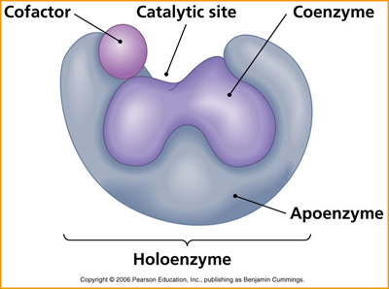
ENZYMES
Enzymes are the protein and function as biological catalysts
It speedups the chemical reaction without being consumed and resumed the maximums product

Slide 4
Properties Of Enzymes
Enzymes are biological macromolecules that have several properties, including:
Catalytic property: Enzymes act as biological catalysts, speeding up the rate of biochemical reactions without being used up or changing the nature of the reaction.
Specificity: Enzymes are highly specific in their action, meaning that a specific enzyme will only act on a particular substrate.
Reversibility: Some enzymes catalyze reversible reactions.

Slide 5
Sensitivity to temperature: Enzymes are sensitive to temperature and are destroyed by heating. Most enzymes in liquid medium are inactivated at 60°C.
Specificity to pH: Enzymes act best at a particular pH.
Produced by living cells: Unlike catalysts, enzymes are only produced by living cells.
Required in minute amounts: Enzymes are required in minute amounts.
Affected by inhibitors: Some enzymes are inhibited by inhibitors

Slide 6
FUNCTIONS OF ENZYMES
Breaking down molecules: Enzymes break down large molecules into smaller ones.
Producing energy: Enzymes help produce energy through metabolism, the sum of all chemical reactions in an organism.
Digesting food: Enzymes help digest food into energy.
Building molecular structures: Enzymes help build complex biomolecules.
Removing toxins: Enzymes help remove toxins from the body.
Degrading molecules: Hydrolases, a class of enzymes, break down large molecules into smaller fragments that can be used for synthesis, excretion, or energy production.

Slide 7
CLASSIFICATION OF ENZYMES
“Enzymes can be defined as biological polymers that catalyze biochemical reactions.”
Enzyme Structure
Enzymes are a linear chain of amino acids
Rise to a three-dimensional structure.
The sequence of amino acids specifies the structure, which in turn identifies the catalytic activity of the enzyme.
Heating, the enzyme’s structure denatures, resulting in a loss of enzyme activity, which typically is associated with temperature.

Slide 8
Enzymes
Oxidoreductases
Transferases
Hydrolases
Lyases
Isomerases
Ligases

Slide 9
EC Numbers
There are six groups of enzymes as per the reaction that is being catalyzed. Therefore, all enzymes are designated as “EC numbers”. This classification does not consider protein structure, amino acid sequence or even the chemical mechanism.
EC number is a 4 digit number for instance – a.b.c.d. Here “a” is class, “b” is subclass, “c” is sub-subclass and “d” is the sub-sub-subclass. The “b” and “c” part of the EC number describes the reaction, “d” differentiates between different enzymes with similar function on the basis of the actual substrate in the reaction.
Example – EC number of Alcohol: NAD+ oxidoreductase is 1.1.1.1

