Slide 1
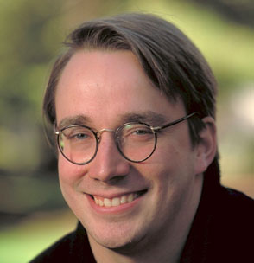
Linus Torvalds
“Intelligence is the ability to avoid doing work, yet getting the work done”.
-Linus Torvalds
Name: Alok Bhawankar
Roll No.: PA06
Panel: 1

Slide 2



Life
Linus was born on 28th December 1969 in Helsinki, Finland
Linus graduated with a master's degree in computer science from the NODES research group.
Lars Wirzenius introduced Linus to GNU, which led to Linux being licensed under GPLv2
Linus Torvalds is the son of journalists Anna and Nils Torvalds. Linus Torvalds is married to Tove Torvalds, a six-time Finnish national karate champion. He has three daughters, out of which two of them were born in the United States.
2

Slide 3

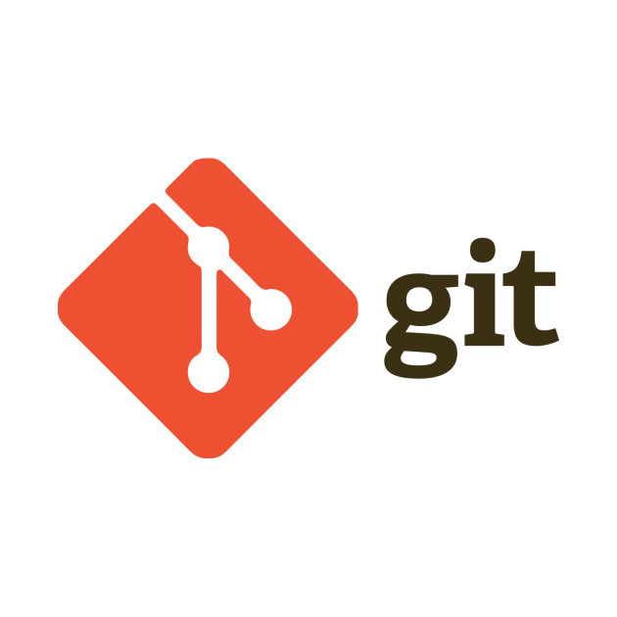

Work
He is the principal developer of the Linux Kernel.
He founded Git as a free-software replacement of bitkeeper.
He also created scuba dive logging and planning software Subsurface.
2
3
“Most good programmers do programming not because they expect to get paid or get adulation by the public, but because it is fun to program.”
-Linus Torvalds
2

Slide 4
The Birth Of Linux
In 1991, while studying computer science at University of Helsinki, Linus Torvalds began a project that later became the Linux kernel. He wrote the program specifically for the hardware he was using and independent of an operating system because he wanted to use the functions of his new PC with an 80386 processor. Development was done on MINIX using the GNU C Compiler. The GNU C Compiler is still the main choice for compiling Linux today, but can be built with other compilers, such as the Intel C Compiler.
According to Torvalds, Linux began to gain importance in 1992 after the X Window System was ported to Linux by Orest Zborowski, which allowed Linux to support a GUI for the first time.
“Talk is cheap. Show me the code”.
- Linus Torvalds
4

Slide 5
Linux
The first prototypes of Linux were publicly released later that year (1991). Version 1.0 was released on 14 March 1994.
Torvalds first encountered the GNU Project in 1991, after another Swedish-speaking computer science student, Lars Wirzenius, took him to the University of Technology to listen to free software guru Richard Stallman's speech. Torvalds used Stallman's GNU General Public License version 2 (GPLv2) for his Linux kernel.
His personal mascot is a penguin nicknamed Tux, which has been widely adopted by the Linux community as the mascot of the Linux kernel.
5

Slide 6
Move to California
In 1997 he moved to sunny Santa Clara in California's fabled Silicon Valley to accept a position with Transmeta Corporation. His job there was to help develop commercial software to facilitate communication between operating systems and that company's microprocessors. Linux devotees were initially concerned not only about his move to a for-profit business but also about the fact that it was funded in part by Microsoft co-founder Paul Allen.
For Torvalds, however, the decision was not difficult. Not only was it an opportunity for a change and to experience a much-improved climate (from the long, cold and dark Finnish winters), but Silicon Valley was the ultimate destination for almost everyone in the computer field, even him.
Torvalds' arrangement with Transmeta permitted him to devote part of his time to his Linux activities. This was, in fact, a clever publicity move on the part of Transmeta, which benefited not only by receiving the services of an extremely talented and motivated engineer but also by having someone on their staff who brought them exceptional media attention.
6

Slide 7
Linus vs NVIDIA
Linus Torvalds, the creator of the Linux kernel, isn’t shy about criticizing things that displease him.
Torvalds publicly criticized the company last week during a question and answer session that followed a presentation. He called NVIDIA the “single worst company” that Linux developers have ever worked with, then pointed out NVIDIA’s failure to work constructively with the Linux community.
After criticizing NVIDIA’s development practices, Torvalds concluded by addressing the company directly: “NVIDIA, F*** YOU." Torvalds proceeded to raise his hand and present his middle finger.
6

Slide 8
Linus Torvalds vs Richard Stallman
Richard Stallman has criticised Linus Torvalds for not including GNU in the name. “Today tens of millions of users are using an operating system that was developed so they could have freedom—but they don't know this, because they think the system is Linux and that it was developed by a student 'just for fun’.
To which Linus replied, “Well, I think it's justified, but it's justified if you actually make a GNU distribution of Linux ... the same way that I think that "Red Hat Linux" is fine, or "SUSE Linux" or "Debian Linux", because if you actually make your own distribution of Linux, you get to name the thing, but calling Linux in general "GNU Linux" I think is just ridiculous.”
<number>

Slide 9
What distribution does Linus Torvalds use?
In a 2007 interview, Linus professed that he didn’t use Debian because he found it hard to install.
Anyway, he buttressed his reason for not using Debian in a later interview from 2014, when he explained that because he is responsible for maintaining his computer and all the computers used by his household, he likes to use an OS with virtually no installation hassle.
He uses Fedora on most of his computers because of its good support for PowerPC. And he uses GNOME 3 as the DE of choice
<number>

Slide 10






Awards and recognition
In 1999, he was given the title of 'one of the top 100 innovators, under the age of 35, in the world' by MIT Technology Review TR100.
In 1998, he was a recipient of the EFF Pioneer Award.
In 2005, he was given the Vollum Award from Reed College.
Those that can, do. Those that can't, complain.
- Linus Torvalds
In 2010, he was awarded the C&C Prize by the NEC Corporation.
In 2012, he was inducted into the Internet Hall of Fame.
In 2012, he was one of the recipients of the Millennium Technology Prize.
<number>

