Slide 1
Backend Project
Topic: E-commerce Website
Team Details:
Pratham Midha (2210992076)
Pratham Bajaj (2210992072)
Pratham Chaudhary (2210992073)
Prince Kumar(2210992090)
Nikhil Singla(2210991982)
Submitted To: Mr. Rahul Singh Rajput
Chitkara University Institute of Engineering and Technology,
Chitkara University, Punjab

Slide 2
Table of Contents
Introduction
Problem Statement
Key Features
Project Highlights/Outcomes
Code Snippets
Conclusion
References/Links used
Appendices

Slide 3
Introduction
In today's digital age, e-commerce has become a cornerstone of the global economy, transforming how businesses operate and how consumers shop. The backbone of any successful e-commerce platform is its backend system, which manages everything from inventory and order processing to customer management and data security. This project focuses on developing a robust and scalable backend for an e-commerce website, aiming to provide a seamless shopping experience for users while ensuring efficient business operations.
The primary goal of this project is to design and implement a backend system that supports the core functionalities of an e-commerce platform. This includes managing product catalogs, processing orders, handling payments, and maintaining customer data. The backend will be developed using modern technologies and frameworks that ensure scalability, security, and performance.

Slide 4
Problem Statement
E-commerce websites have significantly transformed the shopping experience by addressing several key challenges faced by traditional retail models. One major problem solved by e-commerce is the limitation of geographical reach. Traditional brick-and-mortar stores are confined to serving customers within a specific location, whereas e-commerce platforms allow businesses to reach a global audience, breaking down geographical barriers and expanding their customer base.
E-commerce also addresses the challenge of operational costs. By eliminating the need for physical storefronts, businesses can reduce overhead expenses such as rent and utilities. These savings can be passed on to consumers in the form of lower prices and more frequent promotions, making online shopping more attractive.

Slide 5
Key features
User-Friendly Navigation:
A clear and intuitive navigation structure is crucial for enhancing the user experience. It allows customers to easily find products and information, reducing the effort and time required to make a purchase decision.
A robust search bar is essential, as it helps users quickly locate products. Advanced search features might include autocomplete, filtering options, add to cart option, product handing features and handling of misspellings.
Responsive Design:
Ensuring that the website is mobile-friendly is critical, as many users shop on their smartphones and tablets. A responsive design ensures that the site is accessible and easy to use across various devices.
Product Management:
Detailed product pages with high-quality images, descriptions, and specifications help customers make informed purchasing decisions. Features like zoom options and demo videos can further enhance the shopping experience.

Slide 6

Project Highlights

Slide 7

Project Highlights

Slide 8
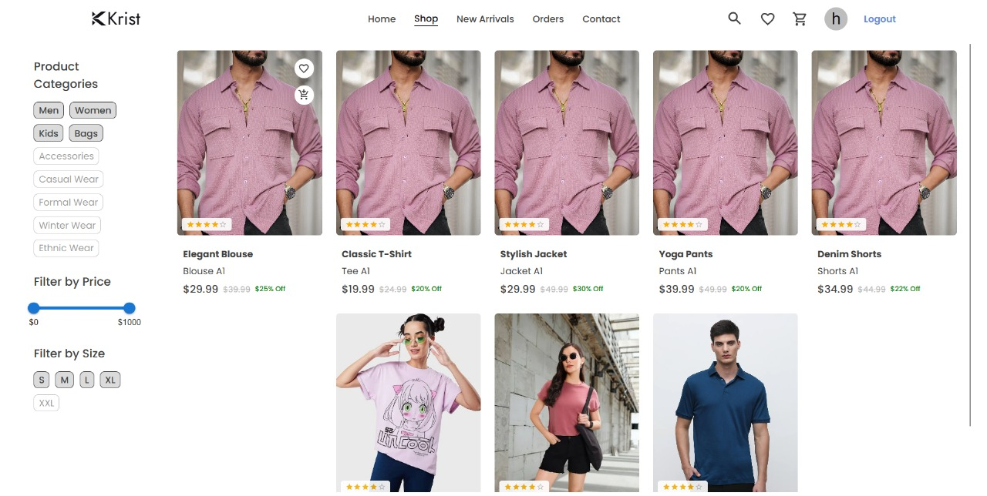
Project Highlights

Slide 9
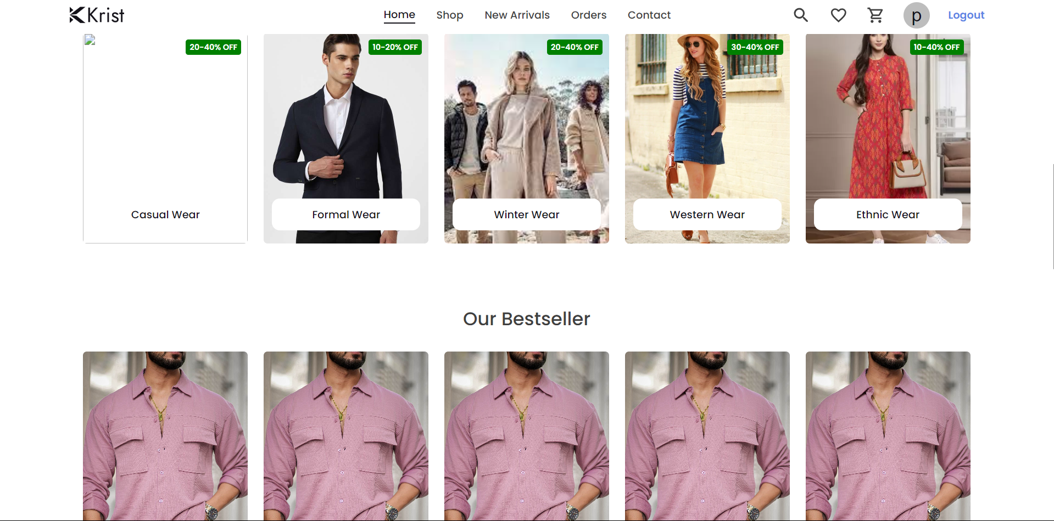
Project Highlights

Slide 10
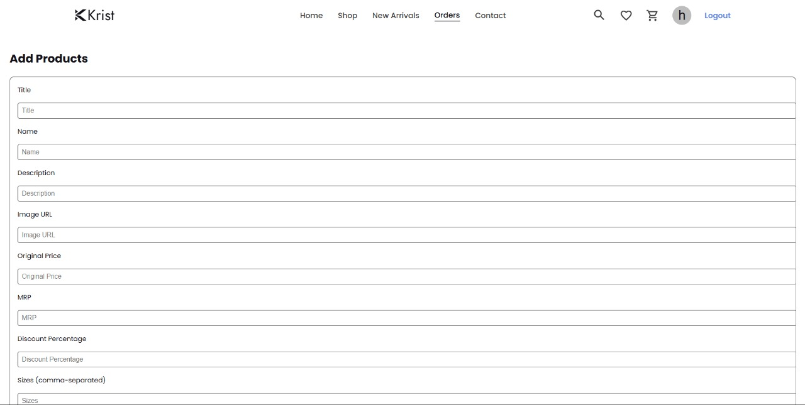
Project Highlights

Slide 11
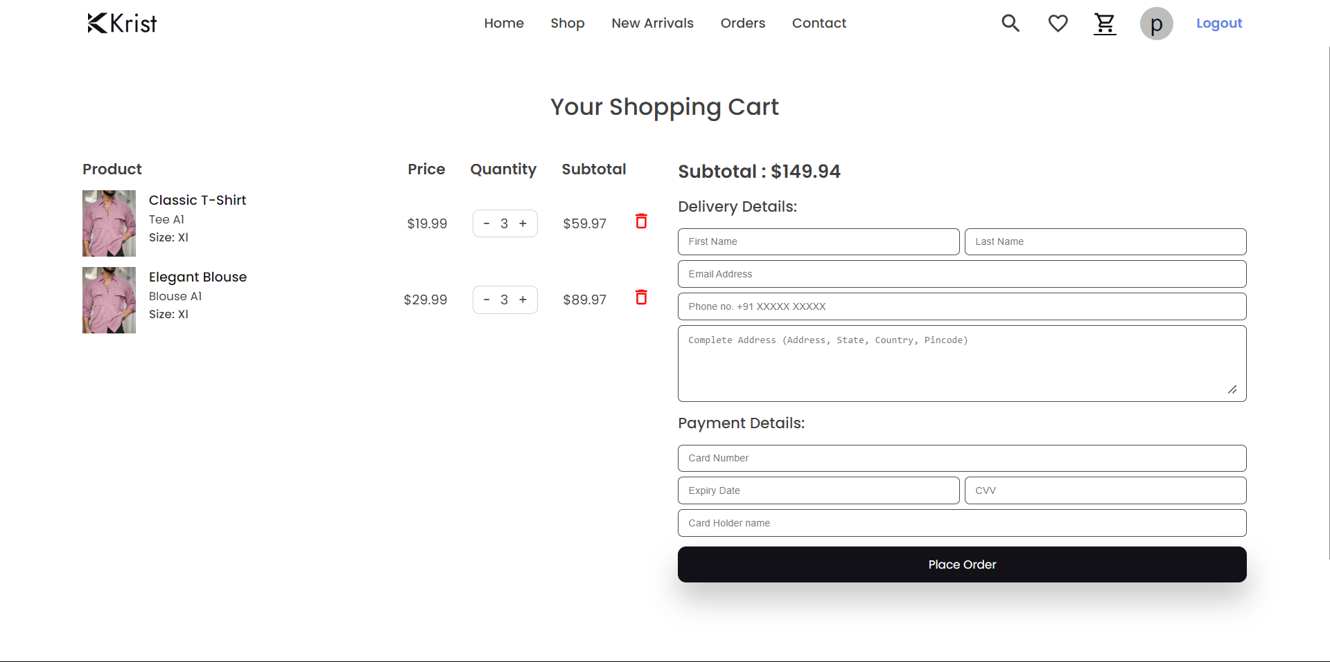
Project Highlights

Slide 12
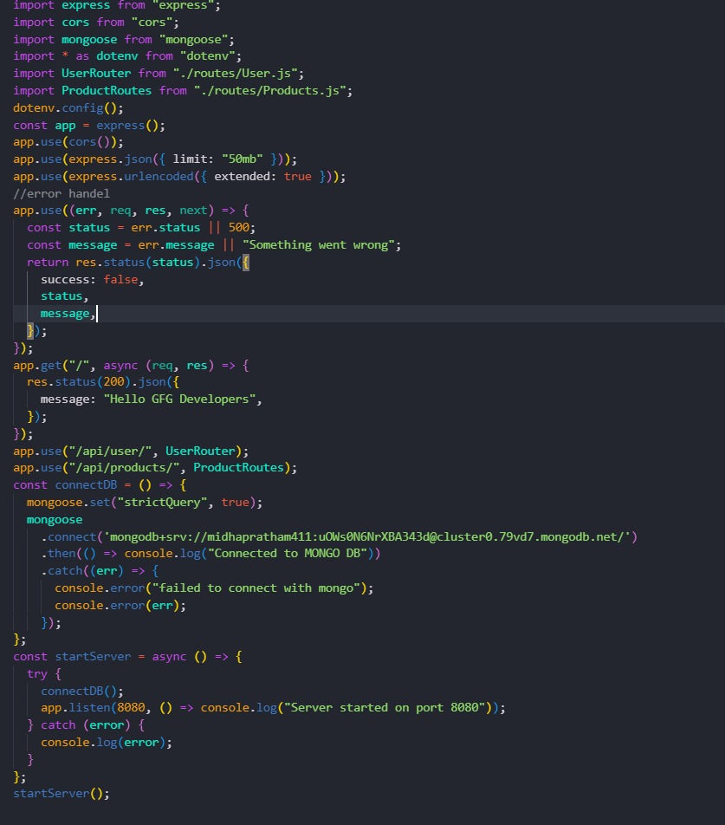
Code Snippets

Slide 13
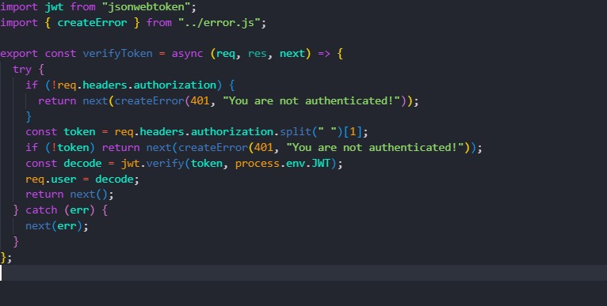
Code Snippets

Slide 14
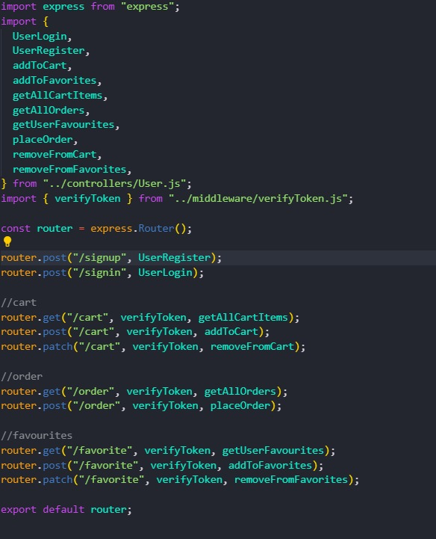
Code Snippets

Slide 15
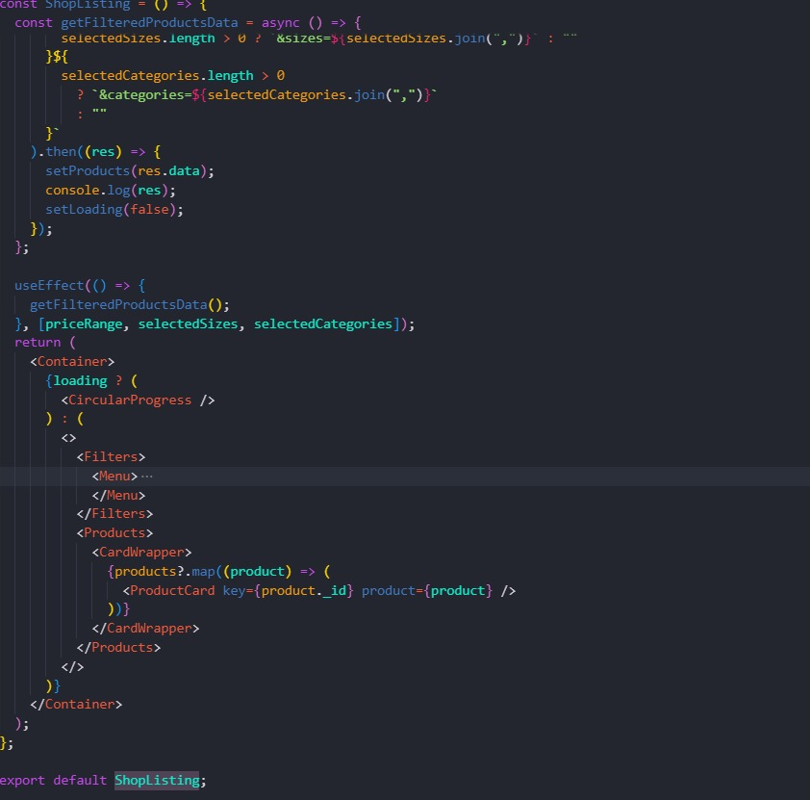
Code Snippets

Slide 16
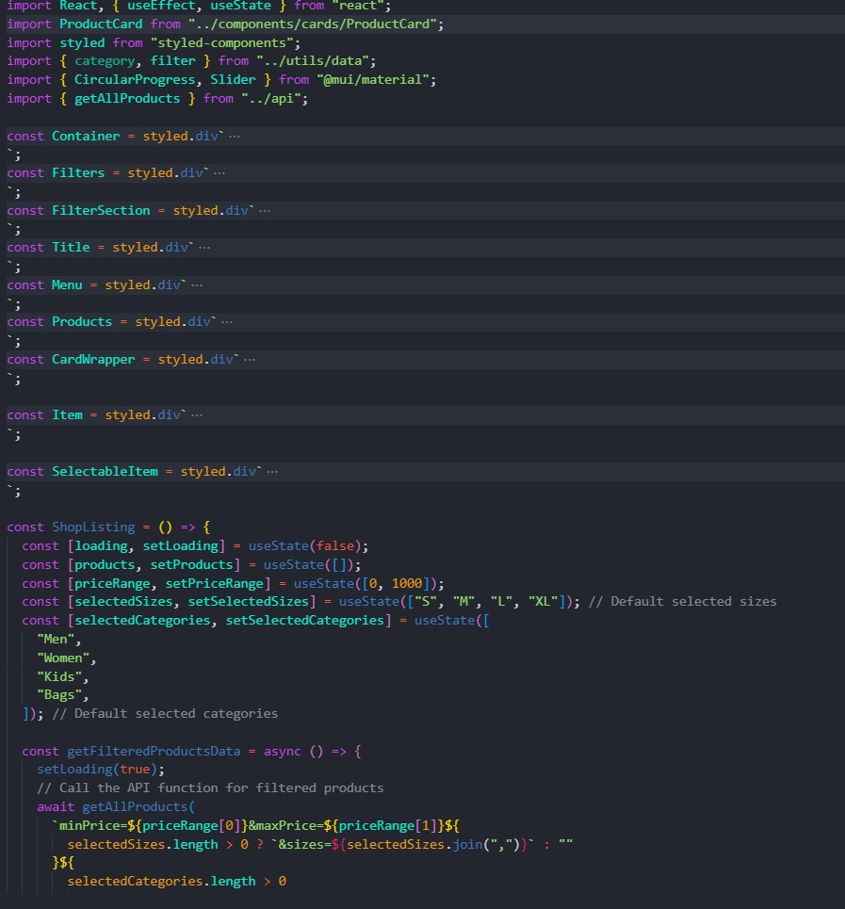
Code Snippets

Slide 17
Conclusion
The completion of the e-commerce website backend project marks a significant milestone in the development of a robust and scalable online shopping platform. This project has been instrumental in laying the foundation for a seamless and efficient e-commerce experience, addressing the complex needs of modern online retail environments. Through the integration of advanced technologies and best practices, the backend system has been designed to support core functionalities essential for the success of an e-commerce business
Scalability and performance have been key considerations throughout the development process. The backend is designed to handle high volumes of traffic and transactions, ensuring that the platform remains responsive and reliable even during peak shopping periods. This scalability is vital for accommodating business growth and adapting to changing market demands.

Slide 18
References
React.js: https://react.dev - Official documentation for learning and implementing React.js.
Node.js: https://nodejs.org/docs/latest/api/ - Documentation and guides for setting up and using Node.js.
Express.js: https://expressjs.com/ - Documentation and guides for setting up and using Express.js.
MongoDB: https://www.mongo.db.com- Documentation and guides for setting up and using MongoDB.
React - The Complete Guide: Comprehensive course on building frontend applications with React.js.
The Complete Node.js Developer Course: Covers building backend services using Node.js, Express, and MongoDB.

Slide 19


