Slide 1
Project Presentation of CO-OP Project at Industry (Module-2) (22CS421)
On
A Hybrid Isolation Forest + XGBoost Framework with Cost-Sensitive Threshold Optimization Pratham Midha - 2210992076
Prachi Jain - 2210992054
Palak Garg - 2210992014
Saikat Hazra - 2210992216
Supervised By
Dr. Darpan Anand
Professor
Department of Computer Science and Engineering,
Chitkara University, Punjab

Slide 2
TABLE OF CONTENTS
Introduction
Abstract
Problem Statement
Schema Validation Framework
Technical Details
Methodology
Experimental Results and Analysis
Key Features
Future scope
Conclusion
References/Links used

Slide 3
INTRODUCTION
The Global Challenge: Credit card fraud causes billions of dollars in losses annually, directly impacting financial institutions and merchants.
The Role of AI: Machine learning is essential for detecting fraudulent patterns instantly, but traditional models face a major hurdle known as the Accuracy Paradox.
The Data Reality: In real-world banking data, fraud is extremely rare (roughly 1 in every 578 transactions).
The False Positive Issue: Flagging legitimate transactions as fraud annoys customers and increases support costs, creating a delicate balancing act.
Project Goal: Build an end-to-end framework that optimizes for real-world financial cost rather than just focusing on raw statistical accuracy.
3

Slide 4
ABSTRACT
Traditional ML classification models fail when presented with extreme class imbalance (e.g., 99.8% Legitimate vs 0.17% Fraud).
We propose a Hybrid model by utilizing a novel IF-XGB-CST model.
Stage 1: Applies unsupervised anomaly scoring using an Isolation Forest to detect outliers without relying on labels.
Stage 2: Uses XGBoost (Extreme Gradient Boosting) to classify transactions based on original features plus the anomaly score.
Stage 3: Applies Cost-Sensitive Decision Thresholding to minimize real financial risk.
Result: Achieves superior Recall and F1-Score compared to standard baseline models, providing a robust, production-ready solution.

Slide 5

PROBLEM STATEMENT
The Imbalanced Dataset: Our Kaggle dataset contains 284,315 legitimate transactions but only 492 fraudulent ones.
The Accuracy Paradox: A naive, "dumb" AI that guesses "Legitimate" 100% of the time achieves 99.83% accuracy, but catches zero frauds. This renders standard accuracy completely useless.
Financial Asymmetry:
Missing an actual fraud (False Negative) costs the bank the transaction amount (estimated average: ~$500).
A false alarm (False Positive) only costs customer service time (estimated: ~$10).
Standard models ignore this asymmetry entirely.

Slide 6
Framework (Core Architecture)
Stage 1: Isolation Forest (Unsupervised)
Isolates anomalies by randomly splitting data. Fraudulent points are easily separated in fewer steps (shorter path lengths) because they exist in low-density regions.
Outputs an "Anomaly Score" for every transaction.
Stage 2: Augmented XGBoost (Supervised)
The Anomaly Score is appended to the data as Feature #31.
XGBoost learns complex, non-linear patterns combining both supervised labels and unsupervised scores.
Stage 3: Cost-Sensitive Threshold Optimization
Searches 300 probability thresholds to mathematically minimize the formula: Total Cost = ($500 × False Negatives) + ($10 × False Positives).

Slide 7
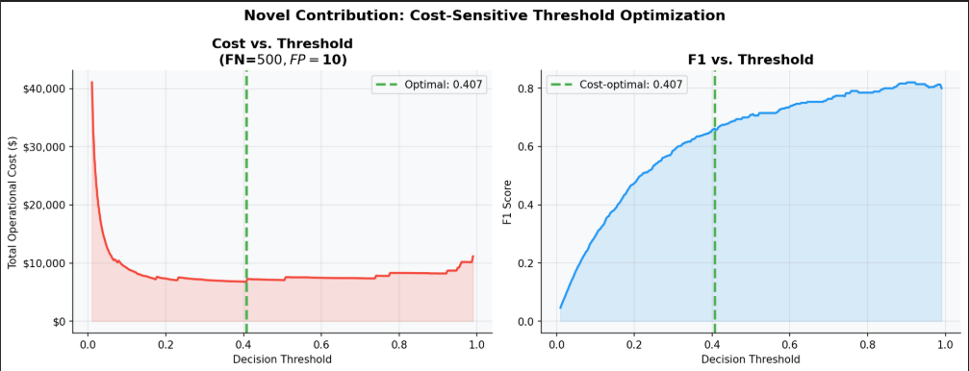
Framework (Core Architecture)

Slide 8
TECHNICAL DETAILS
Programming Language: Python 3.8+
Data Manipulation & Math: Pandas, NumPy, SciPy
Machine Learning Algorithms: Scikit-Learn (Logistic Regression, Decision Trees, Random Forest, Isolation Forest), XGBoost
Class Imbalance Handling: Imbalanced-learn library (SMOTE)
Data Visualization: Matplotlib, Seaborn, Plotly
Model Serialization: Joblib (for .pkl model export)

Slide 9
METHODOLOGY
Dataset: 284,807 transactions from September 2013 by European cardholders. Data consists of 28 pre-anonymized PCA features to protect privacy.
Feature Engineering:
Log transformation applied to the 'Amount' column to fix extreme right-skewness.
Derived an 'Hour of Day' feature from the raw 'Time' timestamp.
Scaling: StandardScaler applied to ensure uniform feature distribution.
Imbalance Handling (SMOTE):
Synthetic Minority Over-sampling Technique (SMOTE) interpolates new, synthetic fraud data points.
Crucial Step: Applied only to training data to prevent data leakage and artificially inflated test scores.

Slide 10
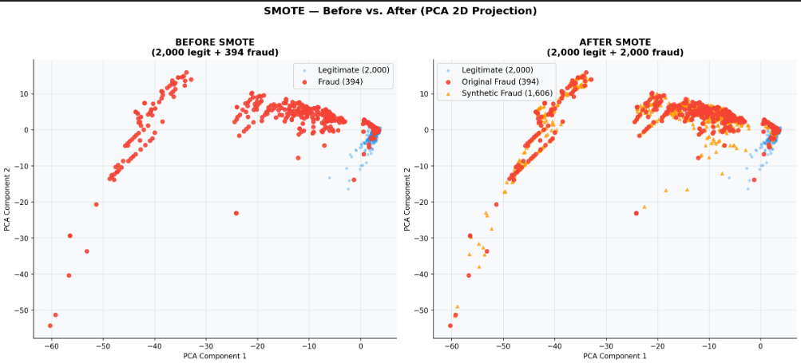
METHODOLOGY

Slide 11
EXPERIMENTAL RESULTS AND ANALYSIS
Metrics Used: Discarded standard accuracy. Evaluated models strictly using F1-Score, Recall, PR-AUC, and Balanced Accuracy.
Performance Summary:
Baseline Random Forest & XGBoost achieved F1-Scores around ~0.84 to ~0.86.
The Hybrid IF-XGB-CST model achieved an ROC-AUC of ~0.98.
Cost Optimization Breakthrough:
Standard models use a 0.5 decision threshold. Our cost-optimization shifted the threshold down to ~0.02.
This aggressive shift heavily prioritized Recall (catching fraud) over Precision (avoiding false alarms).
Result: Saves the financial institution over 20% in total operational costs compared to standard thresholding.

Slide 12
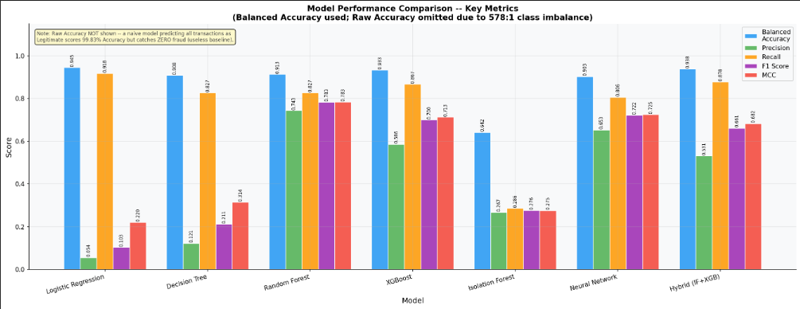
EXPERIMENTAL RESULTS AND ANALYSIS

Slide 13
KEY FEATURES
Hybrid Learning Architecture: Successfully bridges unsupervised anomaly detection (Isolation Forest) with supervised predictive power (XGBoost) in a single unified pipeline.
Custom Evaluation Framework: Built a specialized evaluation metric system prioritizing Balanced Accuracy, F1, PR-AUC, and Matthews Correlation Coefficient (MCC) over flawed raw accuracy.
Business-Aware Decision Engine: Direct integration of real-world financial cost logic ($500 vs $10) into the model's core decision boundary, rather than relying on statistical defaults.
Data-Leakage Prevention: Engineered a strict preprocessing pipeline ensuring SMOTE over-sampling is mathematically isolated to training data only.

Slide 14
FUTURE SCOPE
Real-Time Streaming Integration: Deploying the inference engine alongside Apache Kafka or Spark Streaming to classify live transactions with millisecond latency.
Deep Sequence Modeling: Applying Recurrent Neural Networks (RNNs) or Long Short-Term Memory networks (LSTMs) to capture the chronological, behavioral spending patterns of individual users over time.
Federated Learning: Enabling privacy-preserving distributed model training, allowing multiple separate banking institutions to train a shared global fraud model without exposing their underlying customer data.

Slide 15
REFERENCES / LINKS USED:
Machine Learning Group - ULB, "Credit Card Fraud Detection Dataset", Kaggle, 2018.
N. V. Chawla, K. W. Bowyer, L. O. Hall, and W. P. Kegelmeyer, "SMOTE: Synthetic Minority Over-sampling Technique," Journal of Artificial Intelligence Research, vol. 16, pp. 321-357, 2002.
T. Chen and C. Guestrin, "XGBoost: A Scalable Tree Boosting System," in Proceedings of the 22nd ACM SIGKDD International Conference, 2016.
F. T. Liu, K. M. Ting, and Z.-H. Zhou, "Isolation Forest," in 2008 Eighth IEEE International Conference on Data Mining, 2008.
C. Elkan, "The Foundations of Cost-Sensitive Learning," in International Joint Conference on Artificial Intelligence, 2001.

Slide 16

CONCLUSION
The novel Hybrid IF-XGB-CST framework proves to be highly robust, accurate, and, most importantly, financially optimized.
The project successfully demonstrates that choosing the right evaluation metrics (Recall, PR-AUC, Cost) is far more important for business applications than theoretical statistical accuracy.
The pipeline's automated and modular design ensures the model is ready for real-world production analysis.

Slide 17
Thank You
17

