Slide 1


ALGORITH’S PLAYBOOK: SOCIAL MEDIA
Presenter Name
AABITH Z
PRATHAP J
Notes:
<number>

Slide 2
ALGORITHM
An algorithm is a set of well-defined steps or instructions used to solve a problem or complete a task. It takes an input, processes it according to the steps, and produces an output.

Slide 3
Significance
WHATS APP
INSTAGRAM FEED ALGORITHM
Messages are encrypted using the Signal Protocol, ensuring privacy.
Instagram analyzes your past interactions to predict how much you’ll engage with a new post.
CHATGPT
INSTAGRAM ADS ALGORITHM
ChatGPT is powered by GPT ,a deep learning model that processes and generates human-like text
Instagram tracks user behavior, including likes, follows, comments, shares, saved posts, and time spent on content.

Slide 4

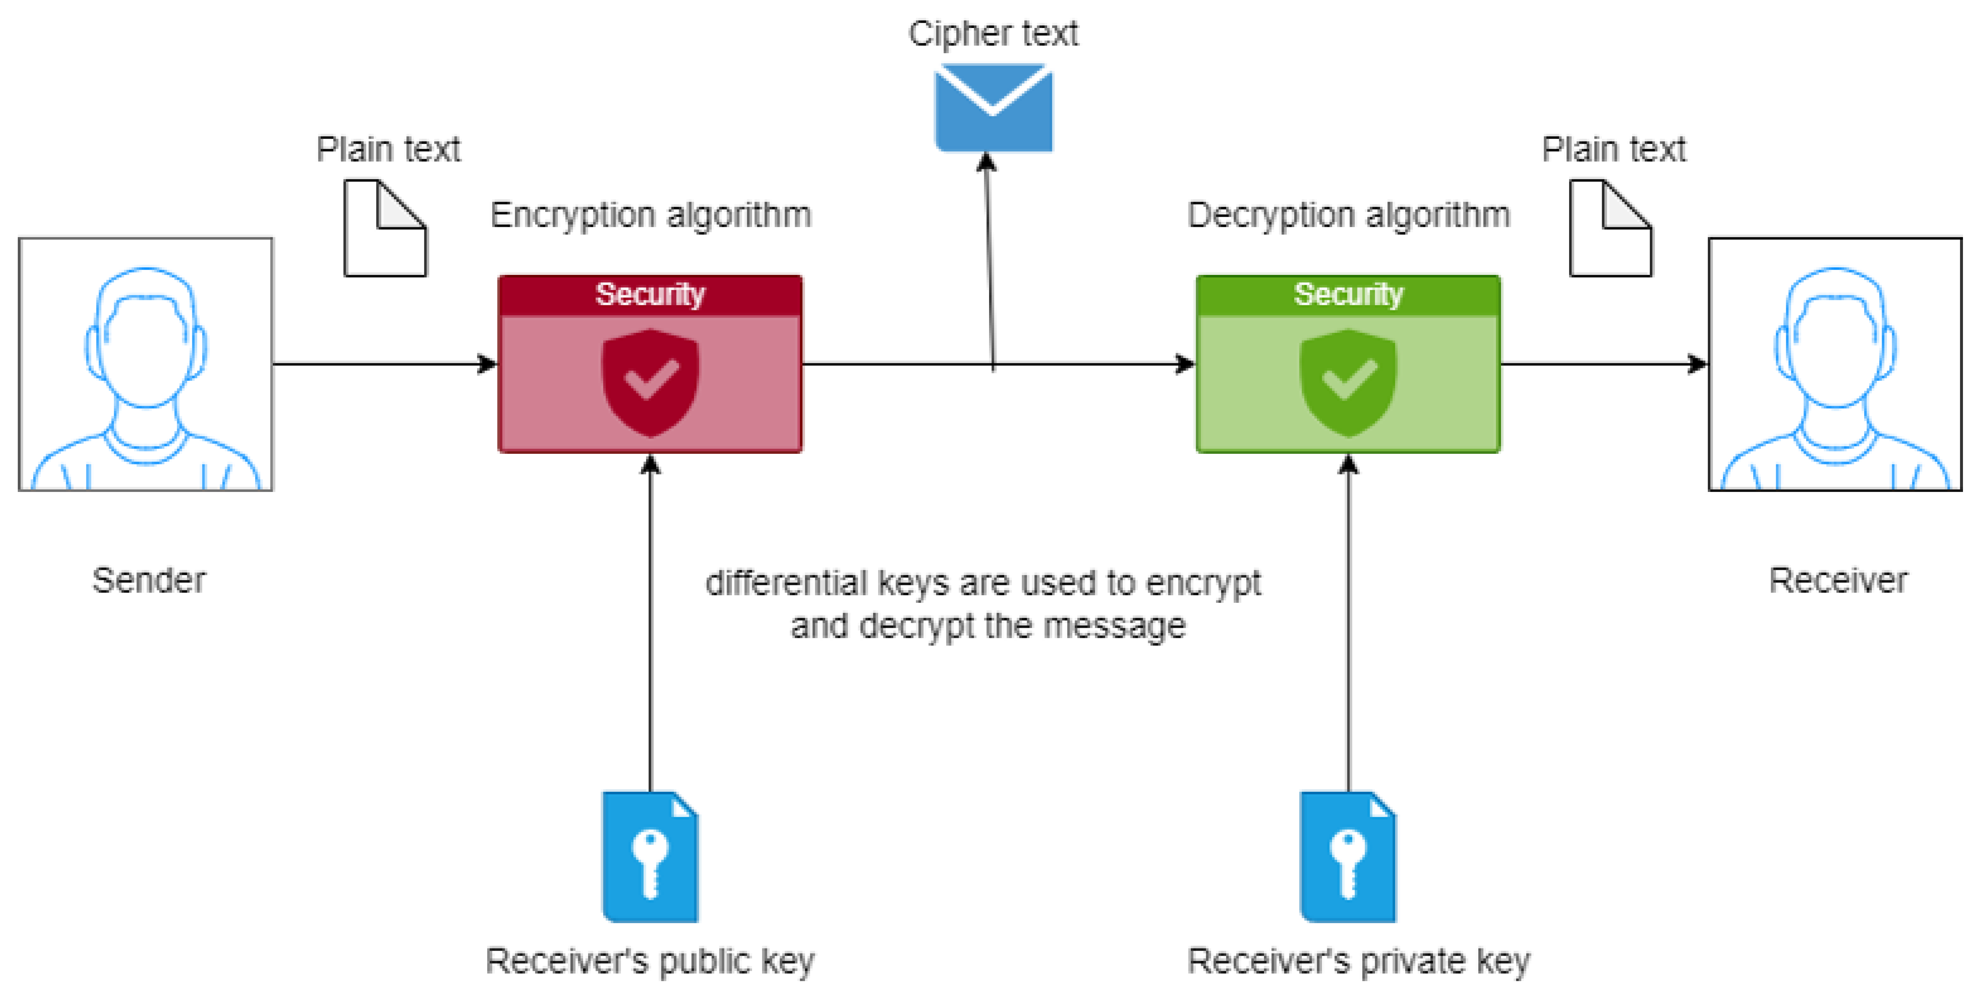
WHATS APP
End-to-End Encryption:
(E2EE) is a security method used to ensure that only the intended recipients of a message can read its content. In simple terms, it means that data is encrypted on the sender's device and only encrypted on the recipient's device, preventing anyone else, including service providers whats app hackers, or third parties, from accessing the content while it’s being transmitted.

Slide 5


INSTAGRAM
User engagement, showing content from accounts you interact with most. It also considers decency, giving more weight to newer posts while balancing relevance and timeliness.
INSTAGRAM FEED ALGORITHM:
INSTAGRAM ADS ALGORITHM:
Instagram's ads algorithm targets users based on their behavior, interests, and interactions across the platform. It uses machine learning to optimize ad placements by predicting which ads are most likely to engage each user.

Slide 6

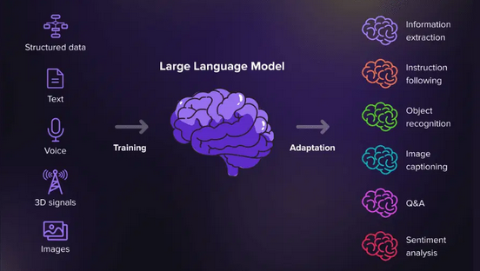
CHAT GPT
TRANSFORMER ARCHITECTURE:
The transformer architecture is a deep learning model designed for processing sequential data, like text, using self-attention mechanisms.

Slide 7
THANK
YOU!!!

