Slide 1
Retail Sales Dashboard
BY
PRATHAP J
2 YEAR CSE
GOVERNMENT COLLEGE OF TIRUNELVELI

Slide 2
INTRODUCTION
This document provides an overview of the python-based retail sales analysis dashboard. The program processes sales data, generate visualizations, and automates powerpoint generation. This approach helps business analyze scales trends and category performance efficiently

Slide 3
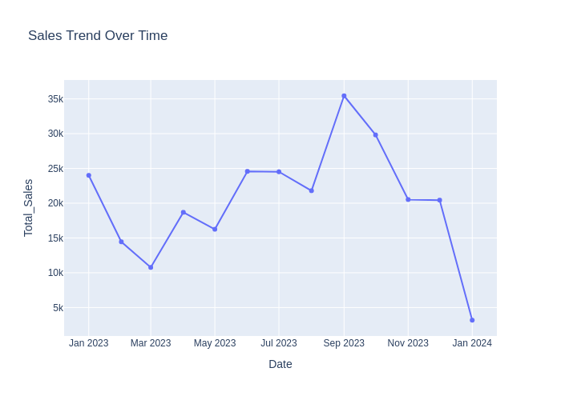
Sales Trend Over Time

Slide 4
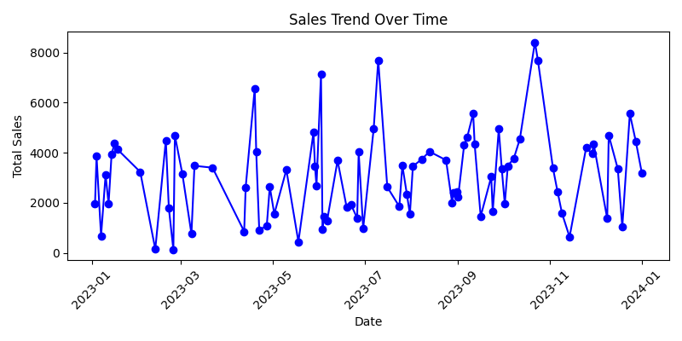
Sales Trend Over Time

Slide 5
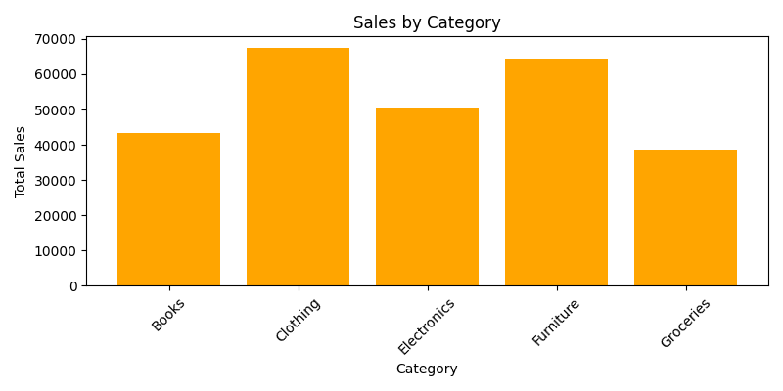
Sales by Product Category1

Slide 6
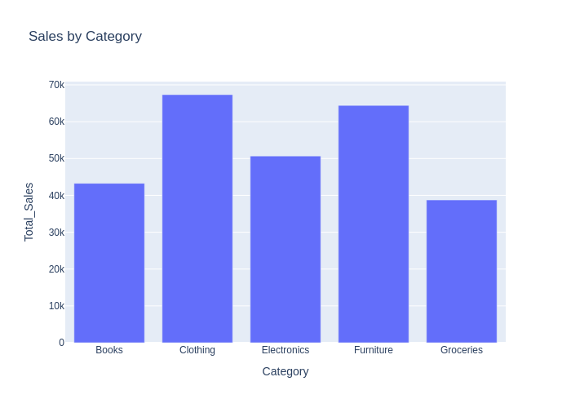
Sales by Product Category2

Slide 7
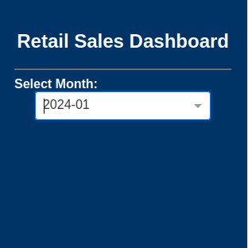
MENUS

Slide 8
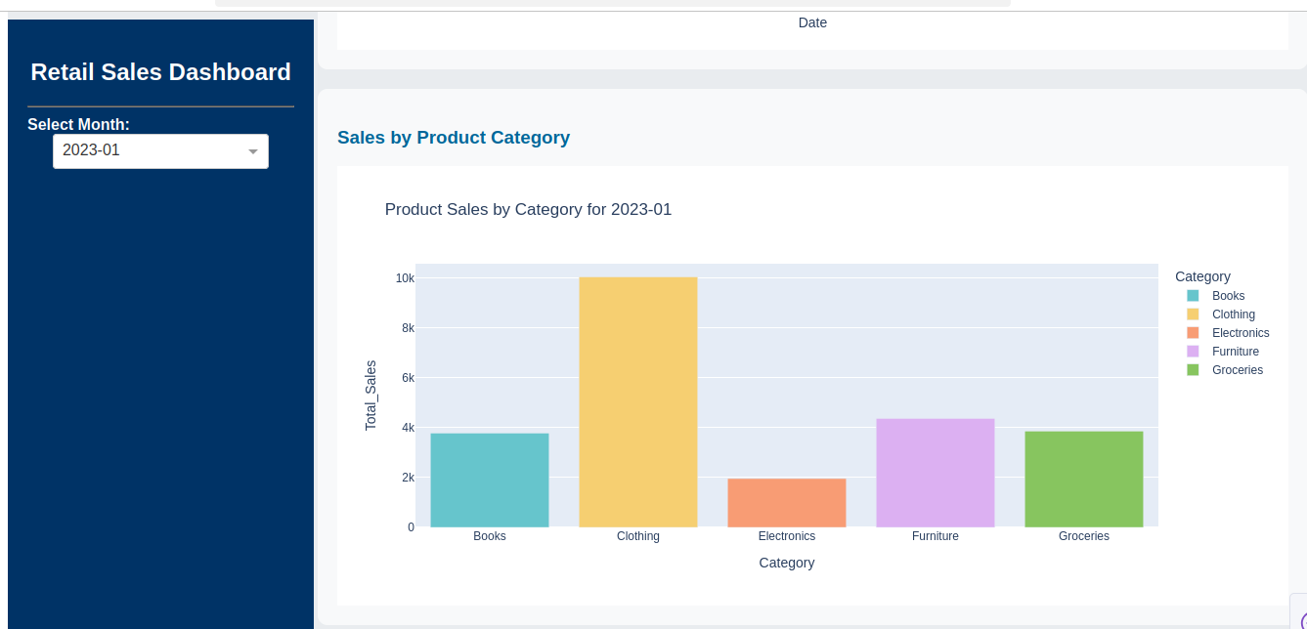

Slide 9


