Slide 1
A SEMINAR ON STATISTICAL FOUNDATIONS
Probability Distributions
Binomial · Poisson · Gaussian (Normal) Distribution
Binomial
Poisson
Gaussian
Discrete · Fixed Trials
Discrete · Event Counts
Continuous · Bell Curve
Counts successes across a fixed number of independent trials.
Counts events occurring in a fixed interval of time or space.
Models continuous data that clusters symmetrically about a mean.
Department of Artificial Intelligence & Data Science • Rajalakshmi Institute of Technology

Slide 2
FOUNDATIONS
What Is a Probability Distribution?
A mathematical function that shows the probability of every possible outcome of a random event — it explains how likely each result is, and how values are spread across a dataset.
IT HELPS ANSWER
What is the chance of getting a particular result?
Discrete vs Continuous, at a Glance
How are values distributed across a dataset?
DISCRETE
CONTINUOUS
How much do outcomes vary around the average?
TWO MAIN TYPES — COVERED TODAY
Discrete
Countable values — Binomial & Poisson
Continuous
Discrete data takes separate, countable values (0, 1, 2 …). Continuous data can take any value within a range, forming a smooth curve.
Measurable values — Gaussian (Normal)
Probability Distributions | Prathiksha | AI & DS
2

Slide 3
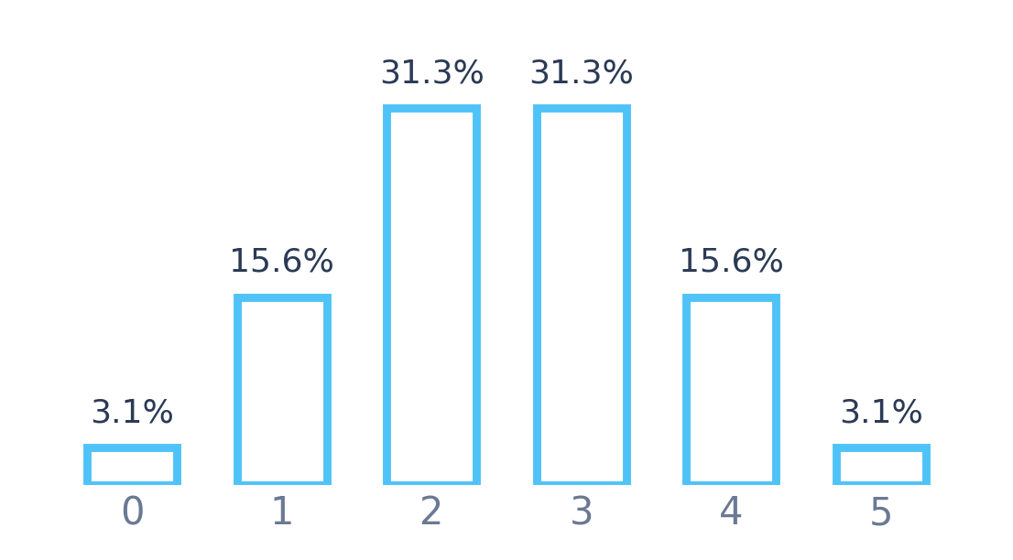
DISCRETE DISTRIBUTION
Binomial Distribution
WHEN IT APPLIES
DISTRIBUTION SHAPE — N = 5, P = 0.5
A fixed number of trials (n)
Only two outcomes: success or failure
Probability of success (p) stays constant
Each trial is independent
P(X=x) = C(n,x) · pˣ · (1−p)ⁿ⁻ˣ
n = number of trials x = number of successes
p = probability of success
Number of Heads (x)
Toss a coin 5 times — probability of exactly 3 heads?
Fixed trials, two outcomes → Binomial. P(X=3) = 31.3%
APPLICATIONS
Ex
QC
Ex
CT
Sv
Quality Control
Pass/Fail Exams
Clinical Trials
Survey Analysis
Probability Distributions | Prathiksha | AI & DS
3

Slide 4
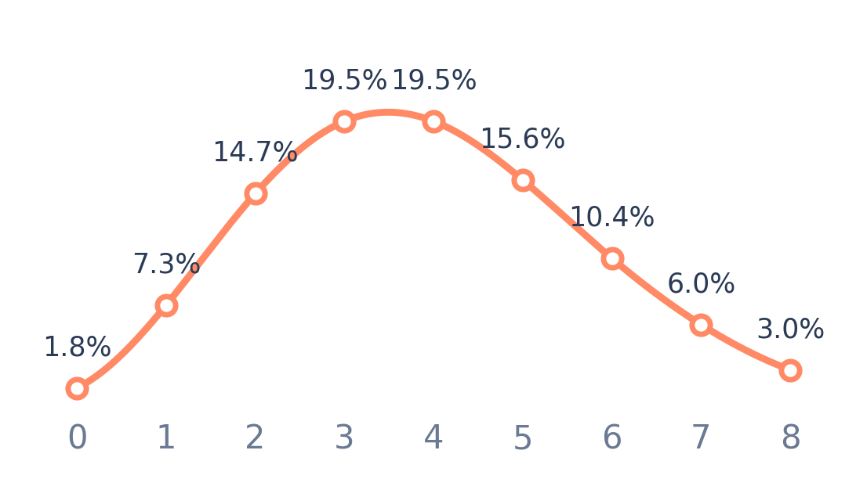
DISCRETE DISTRIBUTION
Poisson Distribution
WHEN IT APPLIES
DISTRIBUTION SHAPE — Λ = 4 CALLS/HOUR
Counts events in a fixed interval
Interval may be time, distance, or area
Events occur independently
Average rate (λ) is known and constant
P(X=x) = (e⁻λ · λˣ) / x!
λ = average number of events
x = number of occurrences
Number of Calls (x)
A hospital receives 4 emergency calls/hour on average — probability of exactly 2 calls next hour?
P(X=2) = 14.7%
APPLICATIONS
Ex
Cu
Tr
Wb
Mf
Customer Arrivals
Traffic Accidents
Website Visits
Machine Failures
Probability Distributions | Prathiksha | AI & DS
4

Slide 5
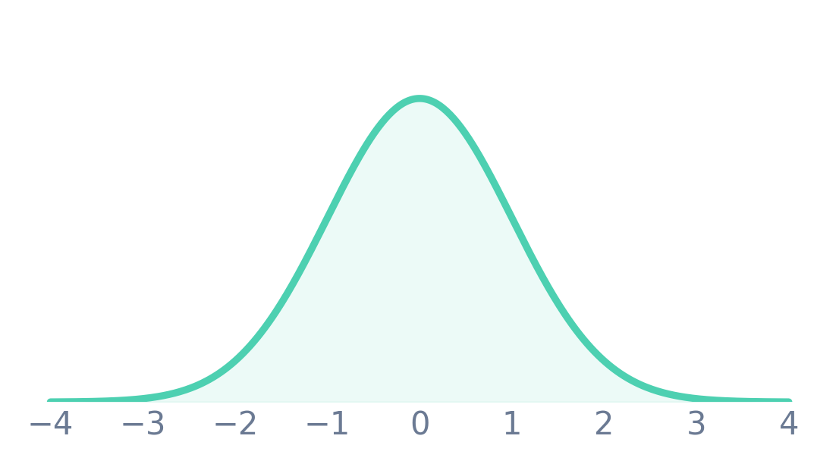
CONTINUOUS DISTRIBUTION
Gaussian (Normal) Distribution
KEY CHARACTERISTICS
THE BELL CURVE — STANDARD NORMAL (Μ = 0, Σ = 1)
Symmetrical, bell-shaped curve
Mean = Median = Mode
Most values lie near the center
Extreme values are rare
f(x) = (1/σ√2π) · e^(−(x−μ)²/2σ²)
μ = mean σ = standard deviation
Standard Deviations from Mean
Human height, student marks, IQ scores, and blood pressure readings all naturally cluster into this bell-shaped pattern.
APPLICATIONS
Ex
ML
DS
Fn
Md
Machine Learning
Data Science
Finance
Medical Research
Probability Distributions | Prathiksha | AI & DS
5

Slide 6
SIDE BY SIDE
Comparing the Three Distributions
Binomial
Poisson
Gaussian
Type
Discrete
Discrete
Continuous
Parameters
n, p
λ (lambda)
μ, σ
Data Nature
Success / Failure
Event Count
Continuous Values
Classic Example
Coin Toss
Phone Calls
Heights
All three answer the same question — “how likely is this outcome?” — but for different kinds of data: fixed-trial counts, event rates, or continuous measurements.
Probability Distributions | Prathiksha | AI & DS
6

Slide 7
WHERE THEY SHOW UP
Real-Life Applications
Binomial
Poisson
Gaussian
El
Election Predictions
Em
Emails Received
AI
Artificial Intelligence
Qt
Product Quality Testing
Ca
Customer Arrivals
Ip
Image Processing
Md
Medical Testing
Nt
Network Traffic
St
Stock Market Analysis
Probability Distributions | Prathiksha | AI & DS
7

Slide 8
WHY IT MATTERS
Advantages of Probability Distributions
01
02
03
Analyze Uncertainty
Better Decisions
Powers AI & ML
Helps quantify and reason about uncertain, real-world events.
Improves decision-making under risk with data-backed probabilities.
Forms the mathematical backbone of Machine Learning and AI models.
From coin tosses to neural networks — the same probability principles scale across every field.
04
05
Enables Prediction
Universally Applied
Supports forecasting and deep data analysis across domains.
Widely used across science, business, healthcare, and engineering.
Probability Distributions | Prathiksha | AI & DS
8

Slide 9
CONCLUSION
Choosing the Right Distribution
Binomial
Poisson
Gaussian
Best for experiments with a fixed number of trials and two possible outcomes.
Best for counting how often events occur over a fixed time or space interval.
Best for continuous data that follows a natural, symmetric bell-shaped pattern.
Together, these three distributions form the statistical foundation behind Machine Learning, Artificial Intelligence, finance, and healthcare analytics — turning uncertainty into measurable, actionable insight.
Thank You
Prathiksha | AI & DS

