Slide 1
R
OPEN SHORTEST PATH FIRST
R
OSPF • Link-State Routing • Dijkstra SPF Algorithm
R
INTRADOMAIN / INTERIOR GATEWAY PROTOCOL
R
R
Seminar focus
Understand OSPF from the idea of link-state routing → cost → LSDB → Dijkstra SPF → OSPF messages → areas, authentication and load balancing.
R
Easy explanation • clear diagrams • packet-format walkthrough
Computer Networks

Slide 2
1. What will we understand?
OVERVIEW
OSPF in one line
Why “Open”?
Why “Shortest Path First”?
A router learns the network map, builds a Link-State Database (LSDB), and uses the shortest-path algorithm to choose routes.
The specification is open and standardized, so equipment from different vendors can implement OSPF.
OSPF calculates the best paths using the Shortest Path First (SPF) algorithm, based on link costs.
• OSPF is an intradomain routing protocol (IGP): it works inside one Autonomous System.
• It is a link-state protocol, unlike RIP which is distance-vector based.
• Routers share link-state information so every router can build a consistent network map.
• Each router independently calculates its best routes.
KEY IDEA: MAP FIRST → CALCULATE BEST PATH → FORWARD PACKETS
OPEN SHORTEST PATH FIRST (OSPF) • Seminar
2

Slide 3
2. Is OSPF an intraconnection protocol?
CONCEPT
Yes — it is intradomain
Not the same as “Internet-wide” routing
Think of a campus
OSPF is an Interior Gateway Protocol (IGP). It routes traffic WITHIN one Autonomous System (AS), such as an organization's network.
OSPF is not used to choose routes between different Autonomous Systems. BGP is commonly used for interdomain routing.
Inside a university/corporate network, OSPF can connect departments, buildings, data centers and WAN links.
AUTONOMOUS SYSTEM (AS)
R2
R4
R1
R3
R5
OSPF operates here
OPEN SHORTEST PATH FIRST (OSPF) • Seminar
3

Slide 4
3. OSPF at a glance — the complete flow
BIG PICTURE
1. Discover
2. Describe
Hello messages find and maintain neighbors.
Database Description messages summarize LSDB contents.
3. Request
4. Update
Routers request missing or newer link-state information.
Link-State Updates carry LSAs and build/synchronize the LSDB.
5. Acknowledge
6. Calculate
LS Acknowledgements confirm reliable delivery.
Each router runs SPF/Dijkstra on its LSDB.
7. Route
Best paths enter the routing table and are used for forwarding.
OPEN SHORTEST PATH FIRST (OSPF) • Seminar
4

Slide 5
4. Metric in OSPF = link cost
METRIC
Example: choose the lower TOTAL cost
What is cost?
B
Cost is the numerical weight assigned to a link. The total path cost is the sum of costs of all links on that path.
2
2
A
D
What can influence it?
A → B → D = 2 + 2 = 4
The material says cost can be based on throughput, round-trip time, reliability, or even hop count if the administrator chooses.
A
D
Different service types
C
OSPF can support different costs for different Type of Service (TOS) requirements, depending on the OSPF version/features being used.
4
1
A → C → D = 4 + 1 = 5
OSPF selects the path with the lowest total cost
OPEN SHORTEST PATH FIRST (OSPF) • Seminar
5

Slide 6
5. What does “link-state” mean?
LINK STATE
Link
State
Advertisement
A connection/interface from one router to another network or router.
Information describing that link: who is connected, what type of connection it is, and its cost/attributes.
A router advertises its link-state information so other routers can learn it.
REAL NETWORK → GRAPH MODEL
R2
R4
5
2
3
R1
R3
1
4
LAN
Router = node
Network/link = edge
Cost = edge weight
OPEN SHORTEST PATH FIRST (OSPF) • Seminar
6

Slide 7
6. Algorithm used: Dijkstra / Shortest Path First (SPF)
ALGORITHM
Why Dijkstra?
• Start at the source router.
• Give the source cost 0; all unknown destinations start at ∞.
• Choose the unvisited node with the smallest known cost.
• Relax/update its neighbors if a cheaper path is found.
• Mark the chosen node as permanent and repeat.
• The resulting shortest-path tree gives the best next hops.
Once the LSDB gives a router the network map, it needs an algorithm to find the least-cost path from itself to every destination. OSPF uses SPF based on Dijkstra's algorithm.
1
2
3
4
5
6
Start
Pick minimum
Update neighbors
Repeat
SPF tree
Routing table
Important: OSPF does NOT simply count hops by default; it minimizes configured link cost.
OPEN SHORTEST PATH FIRST (OSPF) • Seminar
7

Slide 8
7. Dijkstra example — step by step
WORKED EXAMPLE
Source = A
Distance idea
B
E
Initial: A=0, B=∞, C=∞, D=∞, E=∞ From A: B=2, C=5 Pick B (2): C=min(5,2+1)=3 D=2+4=6 Pick C (3): D=min(6,3+2)=5 Pick D (5): E=5+3=8 Final: A→B=2 A→B→C=3 A→B→C→D=5 A→B→C→D→E=8
2
4
3
A
D
1
5
2
C
Shortest path to E = A → B → C → D → E (cost 8)
OPEN SHORTEST PATH FIRST (OSPF) • Seminar
8

Slide 9
8. LSDB: the shared map OSPF builds
LSDB
LSA = Link-State Advertisement
R2
A small piece of information describing a router/link and its state. LSAs are carried in OSPF Link-State Update messages.
R1
R3
LSDB = Link-State Database
The collection of LSAs known for an OSPF area. It represents the topology map used by SPF.
R4
R5
Flooding
Routers propagate new/changed link-state information so neighbors can synchronize their databases.
Each router can build a topology map
Then SPF runs on that map
Result: routing table
OPEN SHORTEST PATH FIRST (OSPF) • Seminar
9

Slide 10
9. OSPF implementation — where does it run?
IMPLEMENTATION
Network layer program
IP protocol number = 89
Why this matters
OSPF is implemented as a routing protocol associated with the network layer. It uses IP to carry OSPF messages.
When an IP datagram carries OSPF, the IP Protocol field is set to 89. This identifies the payload as OSPF.
Routers can recognize that the IP payload is OSPF control information rather than TCP/UDP application data.
OSPF message carried inside IP
IP header
OSPF header
OSPF data
Protocol field = 89
OSPF = routing control traffic, not user application data
OPEN SHORTEST PATH FIRST (OSPF) • Seminar
10

Slide 11
10. OSPF uses five message types
MESSAGES
Type 1
Hello
Discover and maintain neighbors
Type 2
Database Description (DBD)
Summarize LSDB contents / synchronize
Type 3
Link-State Request (LSR)
Ask for specific missing/newer LSAs
Type 4
Link-State Update (LSU)
Carry LSAs to build/update the LSDB
Type 5
Link-State Acknowledgement (LSAck)
Acknowledge LSAs for reliability
Easy memory: H → D → R → U → A
OPEN SHORTEST PATH FIRST (OSPF) • Seminar
11

Slide 12
11. Type 1 — Hello message
MESSAGE 1
Main purpose
A router uses Hello packets to introduce itself, discover neighbors, and maintain neighbor relationships.
HELLO
R1
R2
HELLO
Important fields shown in the figure
R1 says: “I am here.”
R2 says: “I am here too.”
Network mask, Hello interval, Dead interval, Designated Router (DR) IP, Backup DR IP, and Neighbor IP address.
Neighbor relationship maintained by periodic Hellos
Why the Dead interval?
If expected Hello packets are not received within the dead interval, the neighbor may be considered down.
Seminar tip: explain Hello as the “Are you alive and reachable?” message.
OPEN SHORTEST PATH FIRST (OSPF) • Seminar
12

Slide 13
12. Type 2 — Database Description (DBD)
MESSAGE 2
Purpose
DBD summary
Normally exchanged during database synchronization. It gives a summary/list of LSAs known by the router rather than carrying the full topology information.
R1
R2
DBD summary
Why summary first?
The neighbor can compare the summary with its own LSDB and decide which LSAs it actually needs.
Compare
If something is missing/newer → use Type 3 LSR
Flags in the figure
The E, I, M, MS-related flags help control/explain the database-exchange process.
Think: “Here is my table of contents.”
OPEN SHORTEST PATH FIRST (OSPF) • Seminar
13

Slide 14
13. Type 3 — Link-State Request (LSR)
MESSAGE 3
Purpose
LSR: send me this LSA
Used when a router needs a particular link-state advertisement that is missing, incomplete, or newer than the one it has.
R1
R2
What does it request?
LSU carries requested LSA
The figure shows fields such as Link-State Type, Link-State ID and Advertising Router.
Request → Update → Acknowledge
Simple analogy
Type 3 is a request, not the actual LSA data
DBD says “which pages do you have?” LSR says “please send me page 7.”
OPEN SHORTEST PATH FIRST (OSPF) • Seminar
14

Slide 15
14. Type 4 — Link-State Update (LSU)
MESSAGE 4
The main update message
R2
LSU is the OSPF message used to carry one or more LSAs. It is central to building and updating the LSDB.
LSU
R1
What can it contain?
LSU
R3
The figure shows a count of LSAs followed by LSA data. The LSAs can be different kinds depending on the situation.
LSU
When sent?
R4
For synchronization and when link-state information changes and needs to be propagated.
A changed LSA can be propagated to neighbors
OPEN SHORTEST PATH FIRST (OSPF) • Seminar
15

Slide 16
15. Type 5 — Link-State Acknowledgement (LSAck)
MESSAGE 5
Purpose
LSU / LSA
Provides reliability by acknowledging receipt of link-state information.
R1
R2
LSAck
Why is it needed?
OSPF must keep routers' databases synchronized. Acknowledgement helps the sender know the LSA was received.
Five-message sequence
Simple analogy
Hello → DBD → LSR → LSU → LSAck
LSU = “Here is the update.” LSAck = “Received.”
OPEN SHORTEST PATH FIRST (OSPF) • Seminar
16

Slide 17
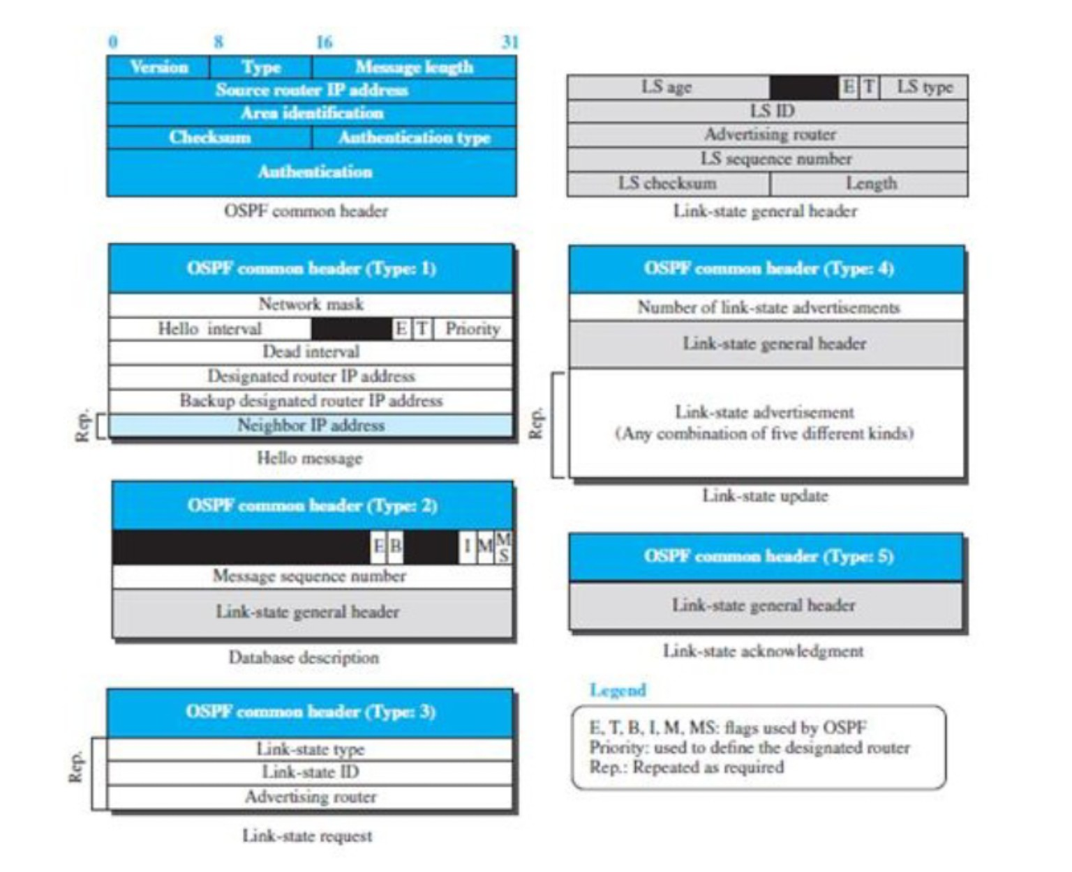
16. Reading the given OSPF packet-format figure
FIGURE WALKTHROUGH
How to read the figure
The top-left is the common OSPF header. The other boxes show message-specific fields for Types 1–5.
Common header
Version, Type, Message Length, Source Router IP address, Area Identification, Checksum, Authentication Type and Authentication.
LS general header
LS Age, LS ID, Advertising Router, LS Sequence Number, LS Checksum and Length identify/version the LSA.
The same picture is attached here so you can explain it directly in the seminar.
OPEN SHORTEST PATH FIRST (OSPF) • Seminar
17

Slide 18
17. Figure explained — Types 1, 2 and 3
PACKET FORMATS
Type 1 — Hello
The figure shows Network Mask, Hello Interval, flags, Priority, Dead Interval, Designated Router IP, Backup DR IP and Neighbor IP address. These support neighbor discovery/maintenance and DR election.
Type 2 — Database Description
Contains a Message Sequence Number and a Link-State General Header. Its job is to summarize LSDB information during synchronization.
Type 3 — Link-State Request
Contains Link-State Type, Link-State ID and Advertising Router. These fields identify the specific LSA being requested.
Read the picture as: discover → compare databases → request what is missing
OPEN SHORTEST PATH FIRST (OSPF) • Seminar
18

Slide 19
18. Figure explained — Types 4 and 5
PACKET FORMATS
Type 4 — Link-State Update
The figure shows the Number of Link-State Advertisements, followed by the Link-State General Header and the Link-State Advertisement(s). This is how OSPF carries actual LSA information.
Type 5 — Link-State Acknowledgement
Contains the Link-State General Header. It confirms receipt of link-state information and supports reliable database synchronization.
General header fields to point out
LS Age • LS ID • Advertising Router • Sequence Number • Checksum • Length
Update carries the information → Acknowledgement confirms it
OPEN SHORTEST PATH FIRST (OSPF) • Seminar
19

Slide 20
19. Common OSPF header — what the top-left box means
HEADER
Version
Type
Which OSPF version format is being used.
Identifies the OSPF message: 1–5.
Message Length
Source Router IP
Total length of the OSPF packet.
IP address of the router sending the OSPF message.
Area ID
Checksum
Identifies the OSPF area in which the packet is used.
Helps detect errors in the OSPF packet.
Authentication Type
Authentication
Indicates whether/how authentication is used.
Authentication-related data.
Seminar shortcut: common header tells “who, what, where, how long, and is it valid?”
OPEN SHORTEST PATH FIRST (OSPF) • Seminar
20

Slide 21
20. OSPF = basic link-state algorithm + powerful features
ADVANCED FEATURES
1. Authentication
2. Hierarchy / Areas
3. Load balancing
OSPF can authenticate routing messages so routers can verify that routing information comes from an acceptable source. This helps protect routing exchanges.
A large OSPF network can be divided into routing areas. This reduces the amount of topology information every router needs to handle.
When multiple routes have the same lowest cost, OSPF can use multiple equal-cost paths, improving utilization and resilience.
Why these features matter
A simple shortest-path algorithm works for a small graph. Real networks need security, scalability and resilience. Authentication protects control traffic; areas control scale; equal-cost multipath uses available capacity.
Remember: OSPF is not just Dijkstra — it is Dijkstra + database synchronization + hierarchy + reliability + security features.
OPEN SHORTEST PATH FIRST (OSPF) • Seminar
21

Slide 22
21. OSPF hierarchy — routing areas and border routers
AREAS
Why divide into areas?
In a large network, keeping every router informed about every topology detail creates overhead. Areas provide hierarchy and limit the scope of detailed link-state information.
AREA 1
AREA 2
AREA 3
Border / ABR idea
R1
R3
ABR
R1
R3
R1
R3
A border router connects areas and can represent/reach information from one area to another. It helps keep area details from exploding across the whole network.
R2
R2
R2
Hierarchy = better scalability
OPEN SHORTEST PATH FIRST (OSPF) • Seminar
22

Slide 23
22. Equal-cost load balancing
ADVANCED
What is it?
B
If two or more routes have the same lowest OSPF cost, the router can keep multiple equal-cost paths.
cost 5
cost 5
A
D
Why useful?
Traffic can be distributed across available paths, while another path can continue to carry traffic if one path fails.
cost 5
C
cost 5
A → B → D = 10
A → C → D = 10
Both are equal-cost → OSPF can use both
OPEN SHORTEST PATH FIRST (OSPF) • Seminar
23

Slide 24
23. OSPF vs RIP — easy comparison
COMPARISON
Feature
OSPF
RIP
Routing type
Link-state
Distance-vector
Main idea
Build a topology map + SPF
Exchange distance/routes with neighbors
Algorithm
Dijkstra / SPF
Bellman-Ford style distance-vector
Metric
Cost (configurable; often based on link characteristics)
Hop count
Scale
Better for large networks
Simpler, smaller networks
Convergence
Generally faster
Generally slower
Hierarchy
Supports areas
No OSPF-style area hierarchy
Load balancing
Equal-cost multipath supported
More limited
Authentication
Supported
Supported in versions/features
OSPF IP protocol
89
RIP uses UDP
One-line memory: RIP asks “how far?”; OSPF builds a “map” and finds the best path.
OPEN SHORTEST PATH FIRST (OSPF) • Seminar
24

Slide 25
24. One complete OSPF story
END-TO-END
Hello
DBD
LSR
LSU
Discover neighbors
Compare database summaries
Request missing/newer LSAs
Send LSAs
LSAck
LSDB
SPF
Routing table
Confirm receipt
Build synchronized topology map
Run Dijkstra
Install best next hops
Result: routers forward packets using the lowest-cost paths known for the OSPF area.
OPEN SHORTEST PATH FIRST (OSPF) • Seminar
25

Slide 26
25. Final recap — what to say in the seminar
TAKEAWAYS
1. OSPF is an IGP
2. It is link-state
3. Cost decides the path
It works inside an Autonomous System.
Routers share link-state information and build an LSDB.
OSPF selects the lowest total link cost.
4. Dijkstra = SPF
5. Five message types
6. Real-world features
The shortest-path tree is calculated from the LSDB.
Hello, DBD, LSR, LSU, LSAck.
Authentication, areas and equal-cost load balancing.
THE SIMPLEST WAY TO EXPLAIN OSPF
“First build a map of the network. Then use Dijkstra to find the cheapest paths. Finally, use those paths to forward packets.”
Thank you
OPEN SHORTEST PATH FIRST (OSPF) • Seminar
26

