Slide 1
MODULE-1 PERSONAL INFORMATION

Slide 2
Briefly introduce yourself
My name is Pratik Parmar.
My Hometown is Rajkot.
I Studied in BE Mechanical from Marwadi University.
After done my study I started my first job in Balaji Multiflex pvt. Ltd. As supervisor. Which is located in Rajkot.
After two years I leave that job some personal issues and some physical injuries.
After leave that job I was searching about IT field and my friends also suggested me for start career in IT filed.
One day I was go at tops technologies and they suggested me, you have to start learning about Frontend Development.
That day I got admission in Tops technologies and I started to learn about Frontend Developing.

Slide 3
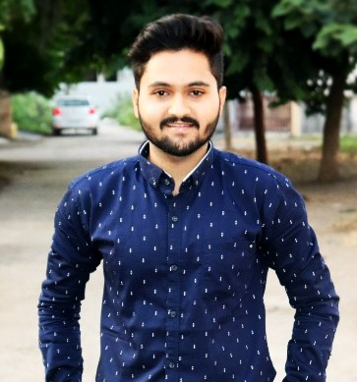
Mention key personality traits
I have positive attitude and I have sincere personality.
I have good concentrator which helps me stay focused while I am doing work.
I am very punctual person ,I done my all work on time.

Slide 4
Explain your interest in technology and why you chose this career path.
I am interested in designing and developing and I also like to do creative work and I feel excited about designing.
I am interested in designing that’s why I started my career in IT field(Frontend).
I chose IT field because IT filed growth is very good and Our personality growth is also good in atmosphere of IT filed.
IT filed gives us value about our work and talent.
So, these are the reasons behind I chose IT filed for my best career.

Slide 5
Thank you
Pratik Parmar
+91-8849478730
parmarpratik617@gmail.com

