Slide 1
LPU CAPSTONE 2026
MACHINE LEARNING
94.12% ACCURACY
LPU Placement Intelligence
Student Placement Readiness Predictor & Skill Gap Analyzer
What is this project?
An AI platform that checks 9 student skills (Coding, CGPA, Projects, Backlogs) and gives a 0-100 Placement Score, shows skill gaps, and creates a step-by-step improvement plan before campus recruitment begins.
Presented By: School of Computer Science & Engineering, Lovely Professional University
Tech Stack: Python 3.12 · Random Forest AI · Flask REST API · React 18 & Vite Dashboard

Slide 2
THE REAL-WORLD PROBLEM
Why We Built This: Problem vs AI Solution
CURRENT CHALLENGES
OUR AI SOLUTION
• Too Late Feedback: Students only find out their weak areas after getting rejected in real placement interviews.
• Only Focused on CGPA: Many students believe high marks are enough, but companies eliminate based on Coding & Backlogs.
• No Clear Guidance: Students don't know whether to focus on LeetCode coding, projects, or aptitude tests.
• Active Backlogs Risk: Even 1 active backlog disqualifies students from 80%+ corporate drives.
• Instant Readiness Score (0-100): Calculates clear placement probability before companies arrive on campus.
• Checks 9 Real Competencies: Evaluates Coding, Technical CS, Aptitude, Communication, Projects, and Backlogs.
• 8-Dimension Skill Gap Matrix: Compares student scores against real company cutoffs and shows green/red badges.
• Step-by-Step Action Roadmap: Gives prioritized remedial advice (e.g., 'Solve 50 DSA problems', 'Clear backlog').

Slide 3
SYSTEM ARCHITECTURE
How It Works: 4-Step Intelligent Pipeline
1. Input Skills
2. Machine Learning
3. Gap Engine
4. Prescriptive Plan
Student Profile
Student inputs 9 simple values: CGPA, Coding %, Tech %, Projects, Backlogs.
Random Forest AI
250 Decision Trees evaluate the student profile & predict readiness score.
Cutoff Comparison
Checks each skill against company benchmarks (e.g. CGPA >= 7.5, Coding >= 75%).
Live Dashboard
Displays circular score gauge, color-coded gap matrix, and personalized action roadmap.
Key Highlight:
Zero Personal Data
Key Highlight:
250 Estimator Trees
Key Highlight:
8 Rule Dimensions
Key Highlight:
Real-Time SVG Gauge

Slide 4
DATASET & FEATURES
The 9 Student Competencies & 4,048 Dataset Records
9 ACTIONABLE COMPETENCY FEATURES
7 DATASETS · 4,048 RECORDS
✔ CGPA (Cutoff >= 7.5): Academic consistency for company eligibility test rounds.
✔ Coding Score (Cutoff >= 75%): DSA & problem-solving ability tested in automated HackerRank tests.
✔ Technical CS (Cutoff >= 75%): Core computer science fundamentals: DBMS, OS, OOP, and Networks.
✔ Active Backlogs (Cutoff == 0): Strict binary eliminator: even 1 backlog disqualifies from 80%+ drives.
✔ Aptitude Score (Cutoff >= 70%): Quantitative reasoning and analytical problem solving.
✔ Internships (Cutoff >= 1): Real industry exposure; massive boost in final interviews.
✔ Projects (Cutoff >= 2): Hands-on software development evaluated during technical interview.
Comprehensive Repository:
1. students.csv (253 rows) — Primary 9-feature LPU model training.
2. college_placement_eng.csv (2,966 rows) — Large engineering dataset.
3. campus_recruitment_kaggle.csv (215 rows) — Historical college marks.
4. job_placement_features.csv (215 rows) — Standardized recruitment data.
5. engineering_skills.csv (99 rows) — 5 Semesters & coding languages.
6. placement_package_salary.csv (200 rows) — CGPA vs LPA regression.
7. placement_iq_academic.csv (100 rows) — Cognitive IQ & CGPA.

Slide 5
MODEL PERFORMANCE
High Accuracy Machine Learning Results
94.12%
Testing Accuracy
48 out of 51 test students predicted accurately
0.9908
ROC-AUC Score
Near-perfect ranking discrimination ability
96.00%
Model Recall
Only 1 false negative (does not miss ready students)
What Drives Placement? (Feature Importance)
CGPA (Academic cutoffs): 25.18% ██████████
Technical Score (Core CS fundamentals): 18.82% ████████
Coding Score (DSA problem solving): 16.76% ███████
Active Backlogs (Direct disqualifier): 12.57% █████
Aptitude / Internships / Projects: 26.67% ██████████
Test Confusion Matrix (51 Students)
• True Negatives (25): Correctly found students needing preparation.
• True Positives (23): Correctly detected placement-ready students.
• False Negatives (Only 1!): Almost zero ready students missed.
• False Positives (2): Minimal over-predictions.

Slide 6
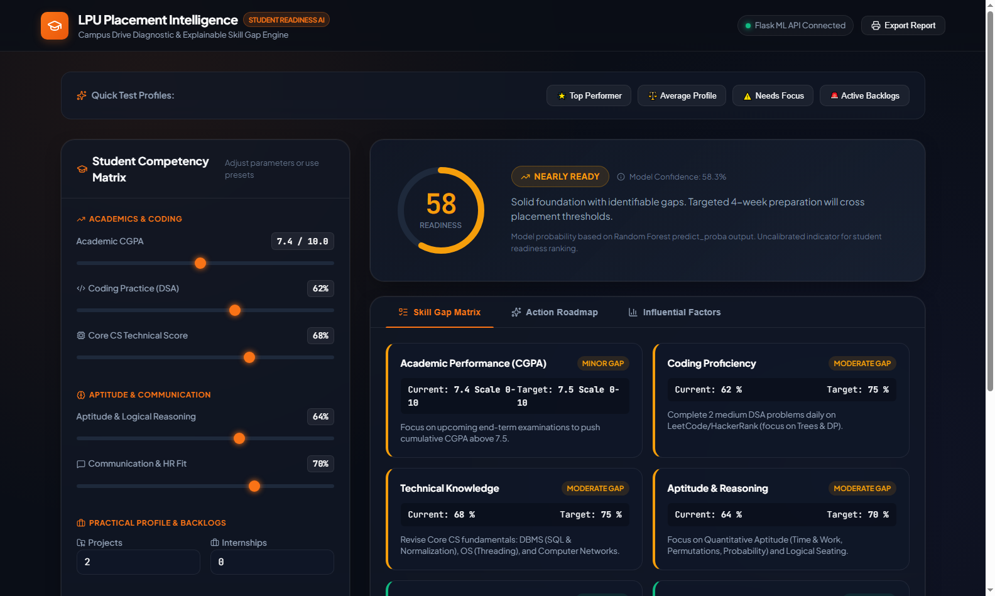
SYSTEM DEMONSTRATION
Live Dashboard & Student Diagnostics
INTERACTIVE FEATURES
★ Real-Time SVG Circular Gauge: Shows animated 0-100 score instantly as student changes sliders.
★ 4 Quick Presets: 1-Click test for Top Performer, Average, Needs Focus, or Backlogs.
★ Skill Gap Matrix: Color-coded chips show exactly which subjects need improvement.
★ Action Roadmap: Step-by-step checklist prioritized by urgency (Critical, High, Medium).
★ Printable Report: Export diagnostic report for counseling sessions.

Slide 7
PROJECT SUMMARY & VIVA
Conclusion & Key Viva Questions
3 KEY PROJECT TAKEAWAYS
VIVA DEFENSE CHEATSHEET
1. Early Warning Diagnostics:
Replaces post-rejection counseling with early 6-to-12 month intervention.
2. Beyond Just Marks:
Proves that Coding, CS fundamentals, and zero backlogs are as critical as CGPA.
3. Production-Ready Platform:
Trained on 4,048 student records with working Flask API and React frontend.
Q: Why Random Forest over Deep Learning?
A: Handles mixed numbers/categories, resists overfitting, and explains which skills matter via Gini importance.
Q: Where did you get the datasets?
A: 7 datasets with 4,048 records from Kaggle & academic repositories. 100% anonymized with zero PII.
Q: Does high score guarantee a job?
A: No, it is a diagnostic tool to guide preparation; actual placement depends on company interviews.

