Slide 1

Classification of Sleep Disorder applying Machine Learning algorithms and using supervised learning algorithms
Presented By
Sd.Shameena (4511-23-862-035)
Under the Guidance of
Dr. D. Sandhya Rani
Assistant Professor
Department of Computer-Science and Informatics,
NALGONDA-508254

Slide 2
contents
Abstract
Introduction
Existing System
Disadvantages
Proposed System
System Architecture
Modules
Algorithms
UML Diagrams
Hardware and software requirements
Results/Outcomes
Conclusion

Slide 3
Abstract
Sleep disorder classification is crucial in improving human quality of life..Evaluates machine learning and deep learning algorithms for classifying sleep disorders. Using the Sleep Health and Lifestyle Dataset. The k-nearest neighbours, support vector machine, decision tree, random forest deep learning algorithms were assessed.The Sleep Health and Lifestyle Dataset is used, which includes features like age, sleep duration, BMI, and stress level. The experimental results reveal significant performance differences between the evaluated algorithms. The proposed algorithms obtained a classification accuracy of 82.98%, 87.23%, 91.49% and ,89.36% respectively.

Slide 4
Introduction
Sleep is vital for physical and mental health. However, disorders like sleep apnea and insomnia impact quality of life. Manual classification methods are prone to error and time-consuming.
This study explores machine learning algorithms to automate and improve sleep disorder diagnosis.

Slide 5
Existing system
Manual evaluation of polysomnography(PSG) is time-intensive an
error–prone.
Time-consuming
Prone to human error
Need for automated, accurate ML systems.
Lack of effective optimization algorithms for high-dimensional datasets.

Slide 6
Disadvantages
High dependency on specialists.
Limited datasets for training and validation.
Challenges in data quality: missing data and noise.
Inefficient feature selection in traditional methods.

Slide 7
Proposed System
Implements genetic algorithm (GA) for hyperparameter optimization.
Automates feature selection to enhance classification performance.
Uses Decision Tree achieving 91.92% accuracy.
Evaluates models using metrics like precision, recall, and F1-score.

Slide 8
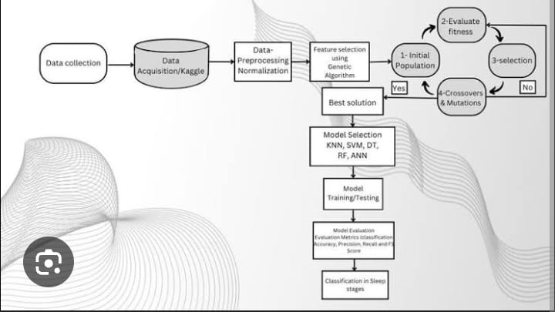
ARCHITECTURE

Slide 9
Data collection: Gather sleep-related data.
Data Acquisition:Get the dataset.
Preprocessing: Normalize the data for better model performance.
Model selection:Choose algorithms like KNN,SVM,DT,RF.
Training/Testing:Train the models and test their accuracy.
Evaluation:Measure performance using metrics like accuracy,etc..
Classification:Use the best model to classify different sleep stages.

Slide 10
MODULES
Data Collection
Feature Selection
Machine Learning Model
Classification
Data Preprocessing

Slide 11
DATA COLLECTION
This modules collects sleep data using polysomnography(PSG).
Use public datasets from sleep labs.
Gathering sleep related data from patients.
Data includes age, gender, sleep duration, BMI, stress level, occupation, and sleep disorder label.

Slide 12
FEATURE SELECTION
Deriving meaningful features such as sleep stages time intervals .
Reduce dimensionality for better performance.
Select most relevant features for classification.

Slide 13
MACHINE LEARNING MODEL
Applies algorithms such as SVM,Decision Trees,Random Forest ,K-NN ,and Naïve Bayes to classify sleep disorders.
It includes model training ,testing, performance evaluation.

Slide 14
CLASSIFICATION
Apply machine learning models that classify sleep disorders
It predicting the type of disorder like:
Insomnia
Sleep apnea
None

Slide 15
DATA PREPROCESSING
Cleaning and normalizing data to remove noise and handle missing values.
Select significant features for model input.
Preprocessing ensures data quality and consistency for the next stages.

Slide 16
ALGORITHMS
Support Vector Machine:
Classify types of sleep disorders It performs well with small data sets.
Helps classify sleep disorder types based on precise boundaries in the dataset.
Works effectively for binary and multi-class classification problems.
Decision Tree:
Builds a tree of decisions based on data features.
It helps to identify decision points for sleep disorder
classification.
It splits the data based on feature values forming a tree
structure

Slide 17
Random Forest:
Builds many trees and combines their results for better accuracy.
In this project, improves the robustness of disorder classification.
Combines the output of all trees to make final prediction.
K-Nearest Neighbors (KNN):
A simple, instance-based learning algorithm.
Classifies a new data point based on the majority class of its k-nearest neighbors.
Useful for small datasets with clearly separated classes.
Distance-based — typically uses Euclidean distance.
In this project: classifies a person’s sleep disorder based on similarity to others.

Slide 18
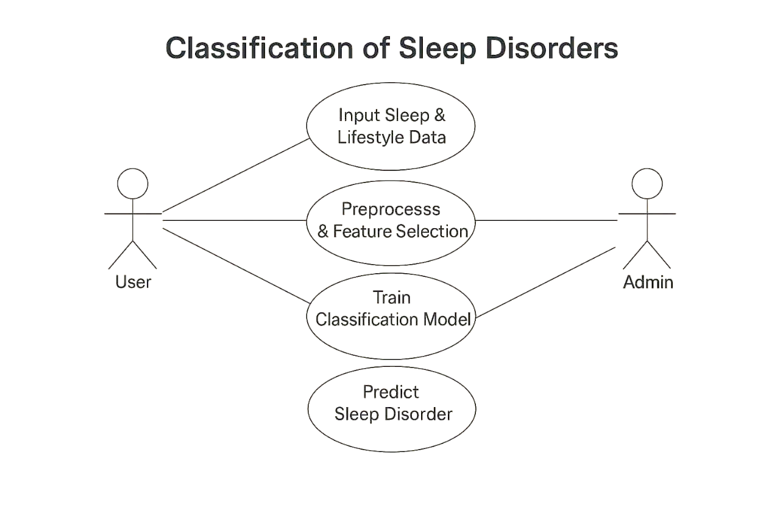
UML DIAGRAMS
USECASE DIAGRAM

Slide 19
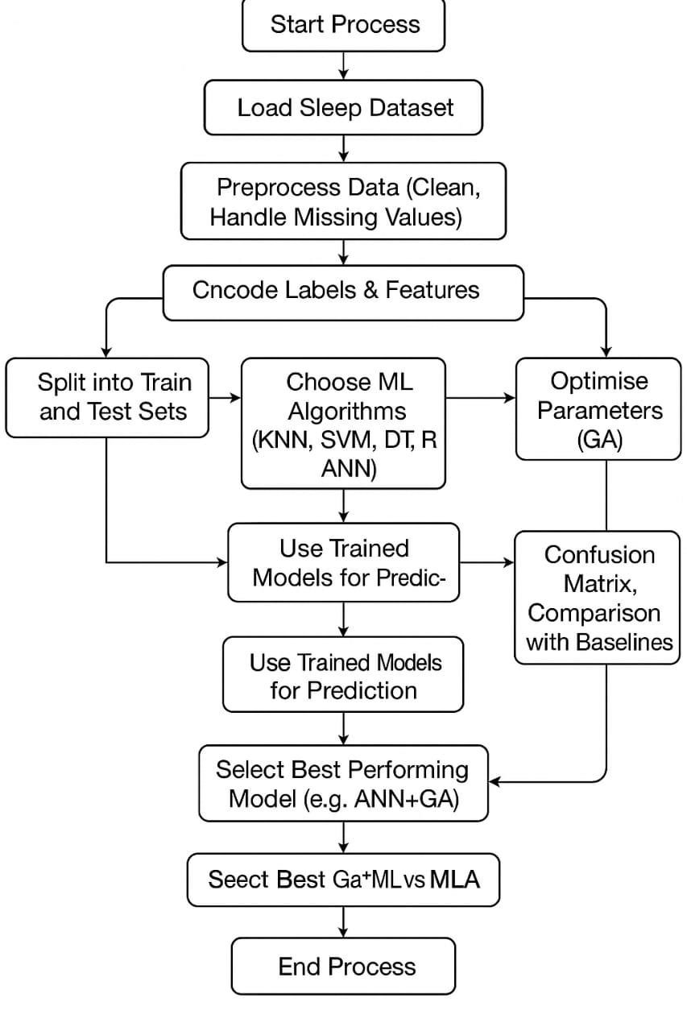
ACTIVITY DIAGRAM

Slide 20
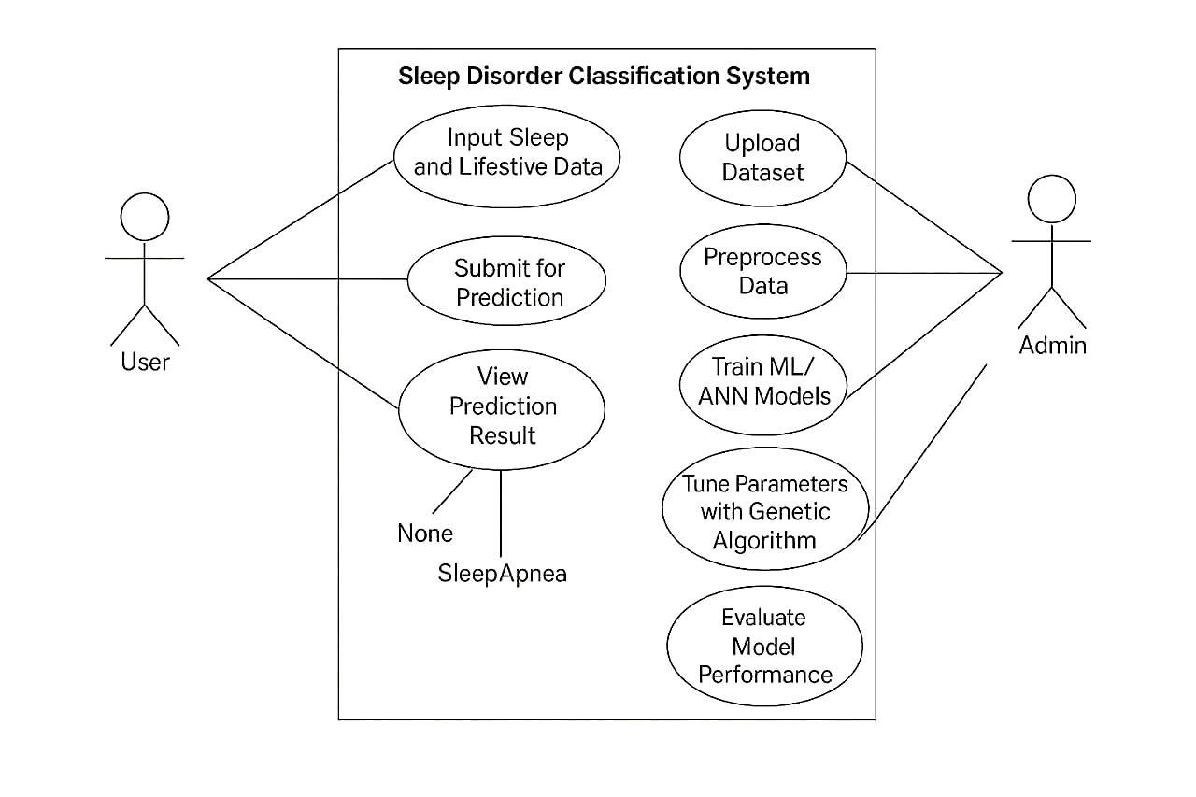
CLASS DIAGRAM

Slide 21
Hardware and software requirements
Hardware:
High-performance GPU, minimum 16GB RAM
Software:
Python, Scikit-learn, TensorFlow/Keras
Dataset:
Sleep Health and Lifestyle Dataset

Slide 22
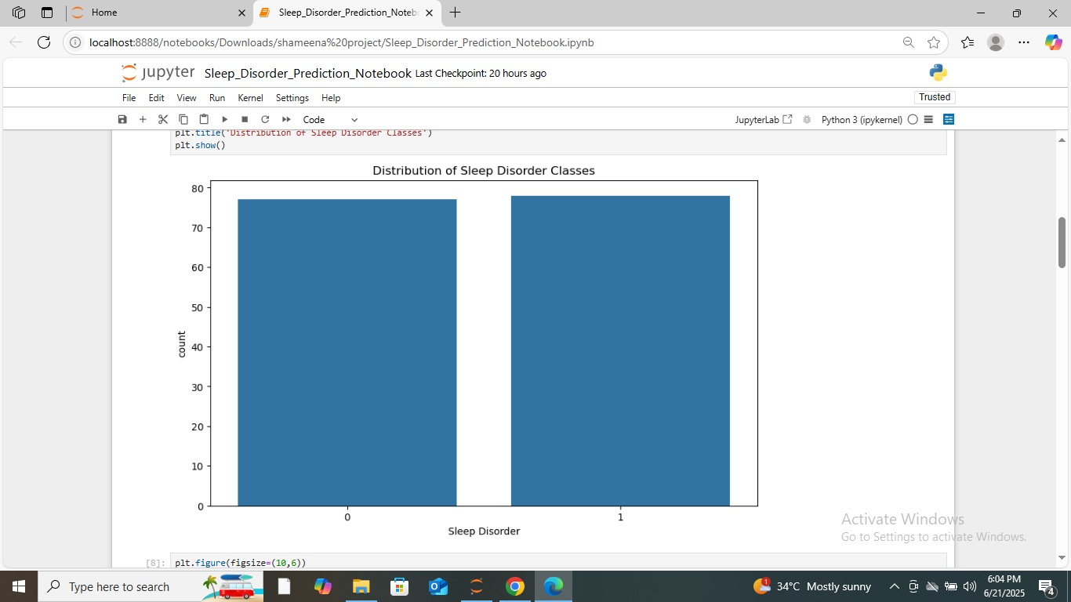
RESULTS/OUTCOMES
The bar chart shows that the dataset has a nearly equal distribution of sleep disorder classes (0 and 1).

Slide 23
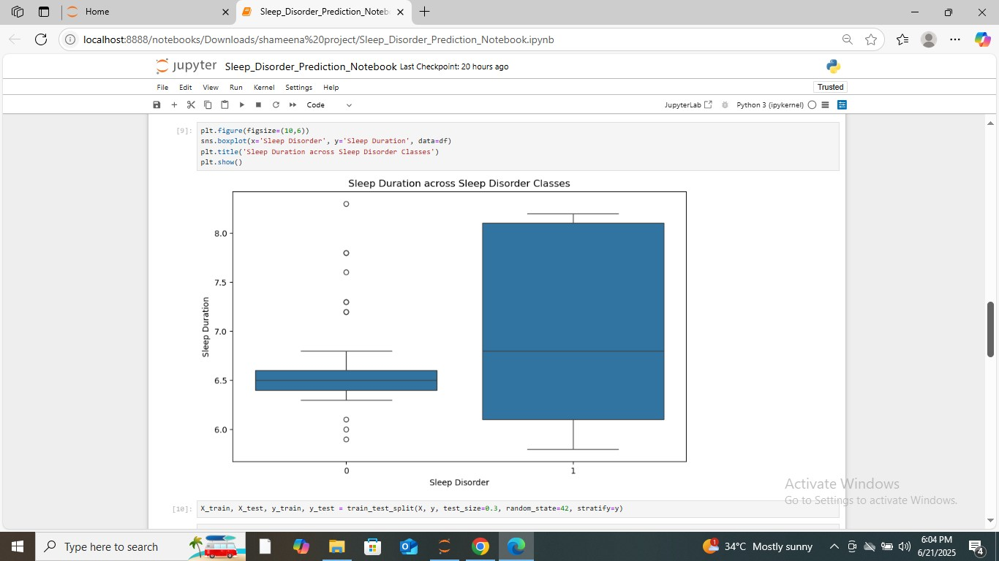
The boxplot shows that individuals with sleep disorders (label 1) generally have a wider and more varied range of sleep durations compared to those without sleep disorders (label 0).

Slide 24
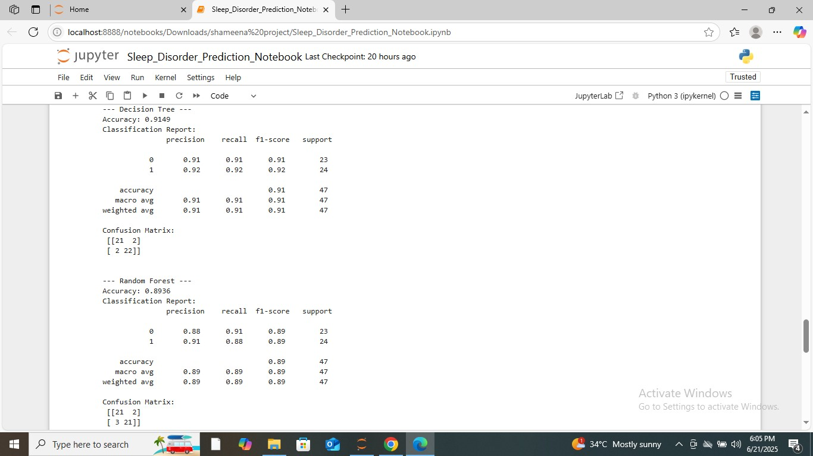
The Decision Tree Achieved height accuracy 91.49%

Slide 25
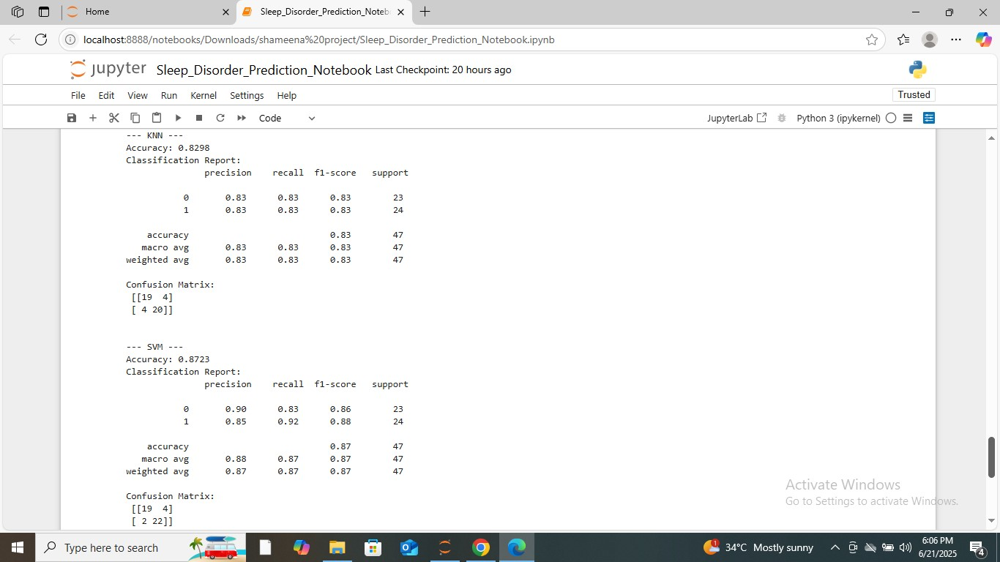

Slide 26
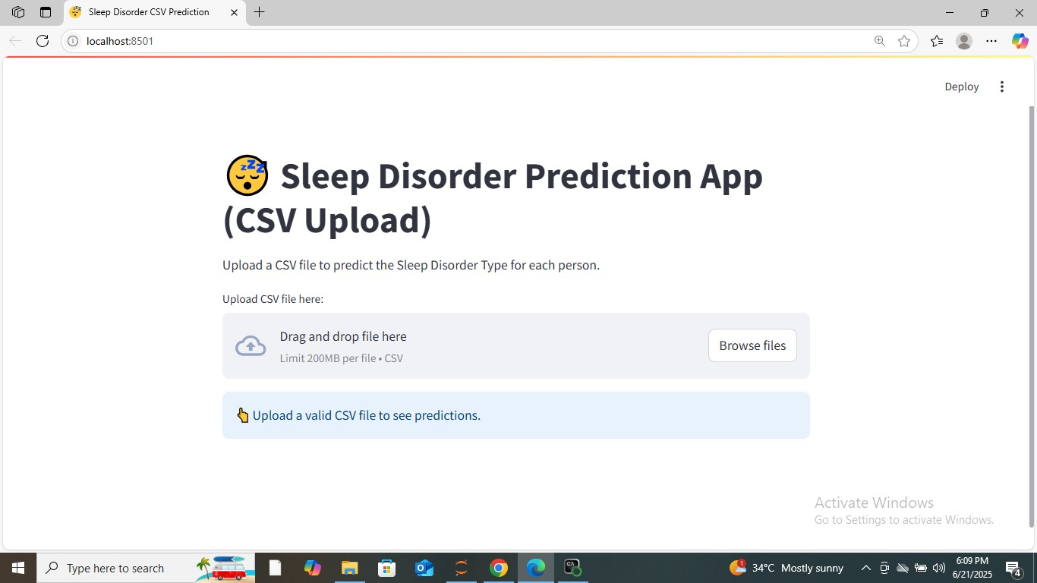

Slide 27
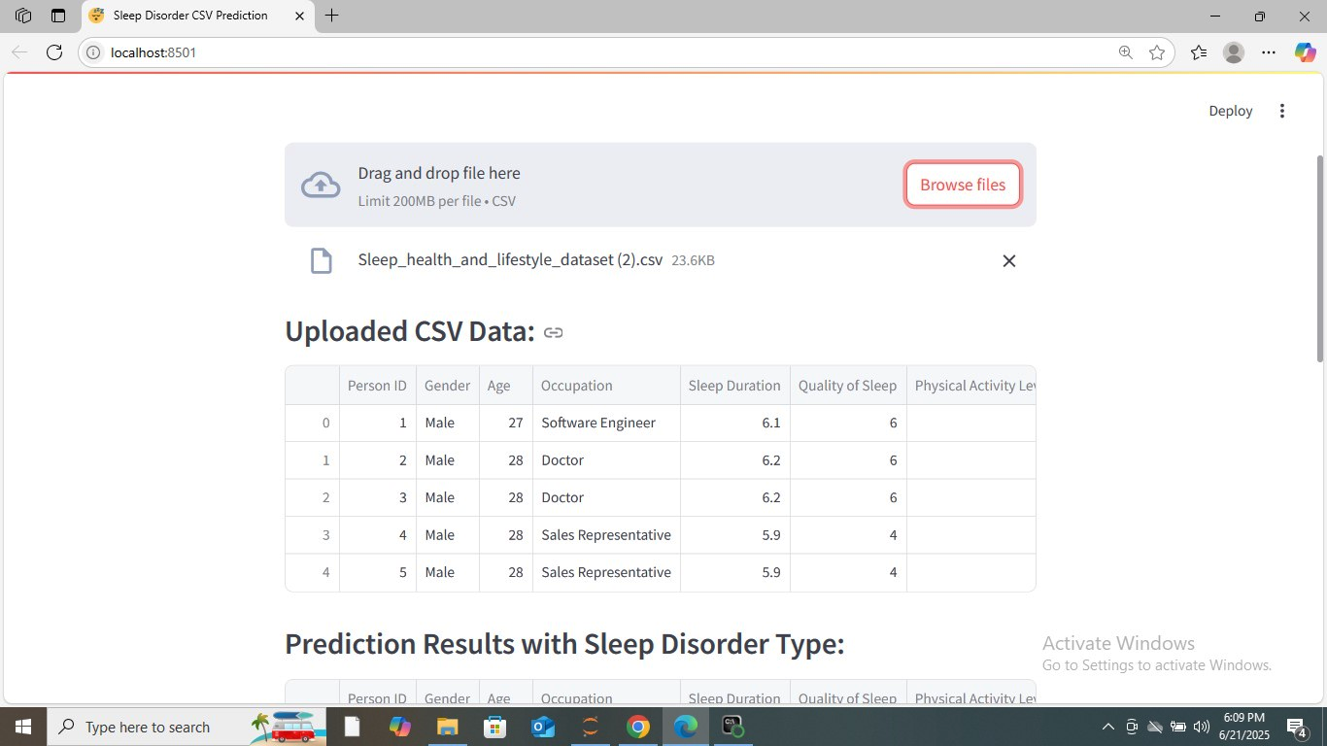

Slide 28
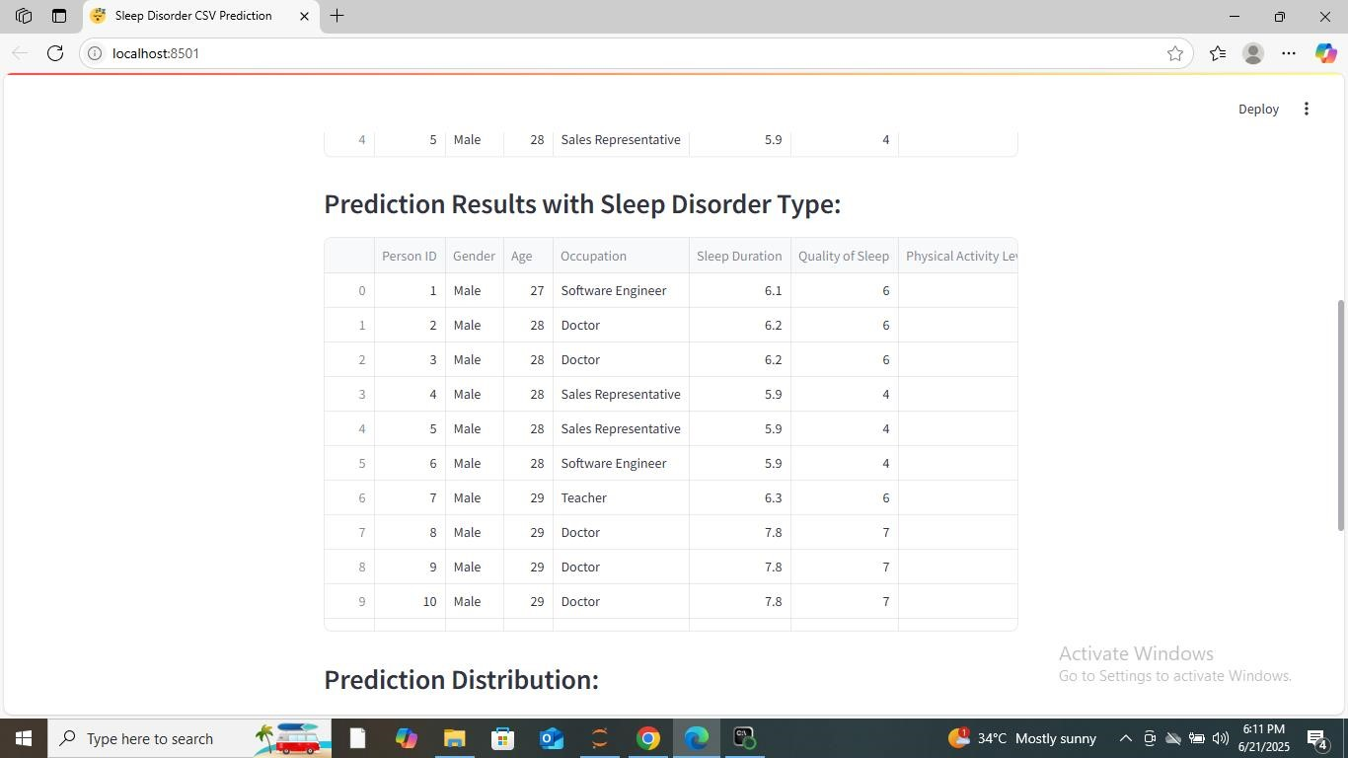

Slide 29
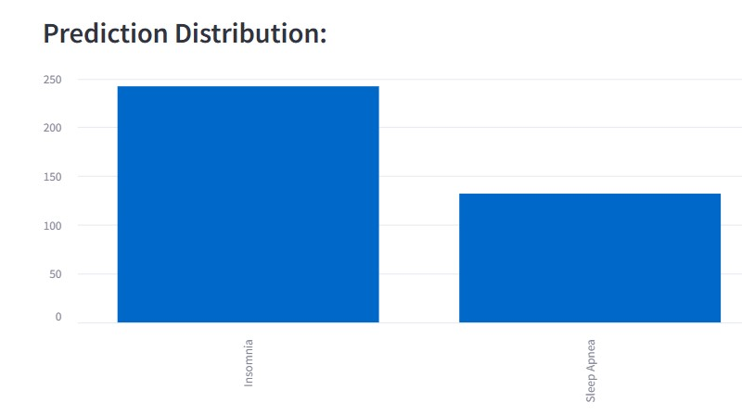
The bar chart shows that the model predicted more cases of Insomnia compared to Sleep Apnea. This indicates Insomnia is the more frequently occurring sleep disorder in the dataset used.

Slide 30
CONCLUSION
This project effectively demonstrates the use of machine learning algorithms to classify sleep disorders such as insomnia and sleep apnoea based on health and lifestyle data. Multiple models were evaluated, and the Decision Tree achieved the highest accuracy of 91.49%, showing excellent performance in predicting sleep disorder types. The proposed system offers a reliable, faster, and low-cost alternative to traditional clinical methods like polysomnography. It can support early diagnosis, reduce medical workload, and improve accessibility to sleep health assessments.

Slide 31
THANK YOU

