Slide 1
NAAN MUDHALVAN
Mern stack course project demo
FREELANCE APPLICATION
PRAVEENA G - 311121205045
HEMASREE K - 311121205302
VIJAY SASAN M - 311121205701
SWETHA S - 311121205057

Slide 2
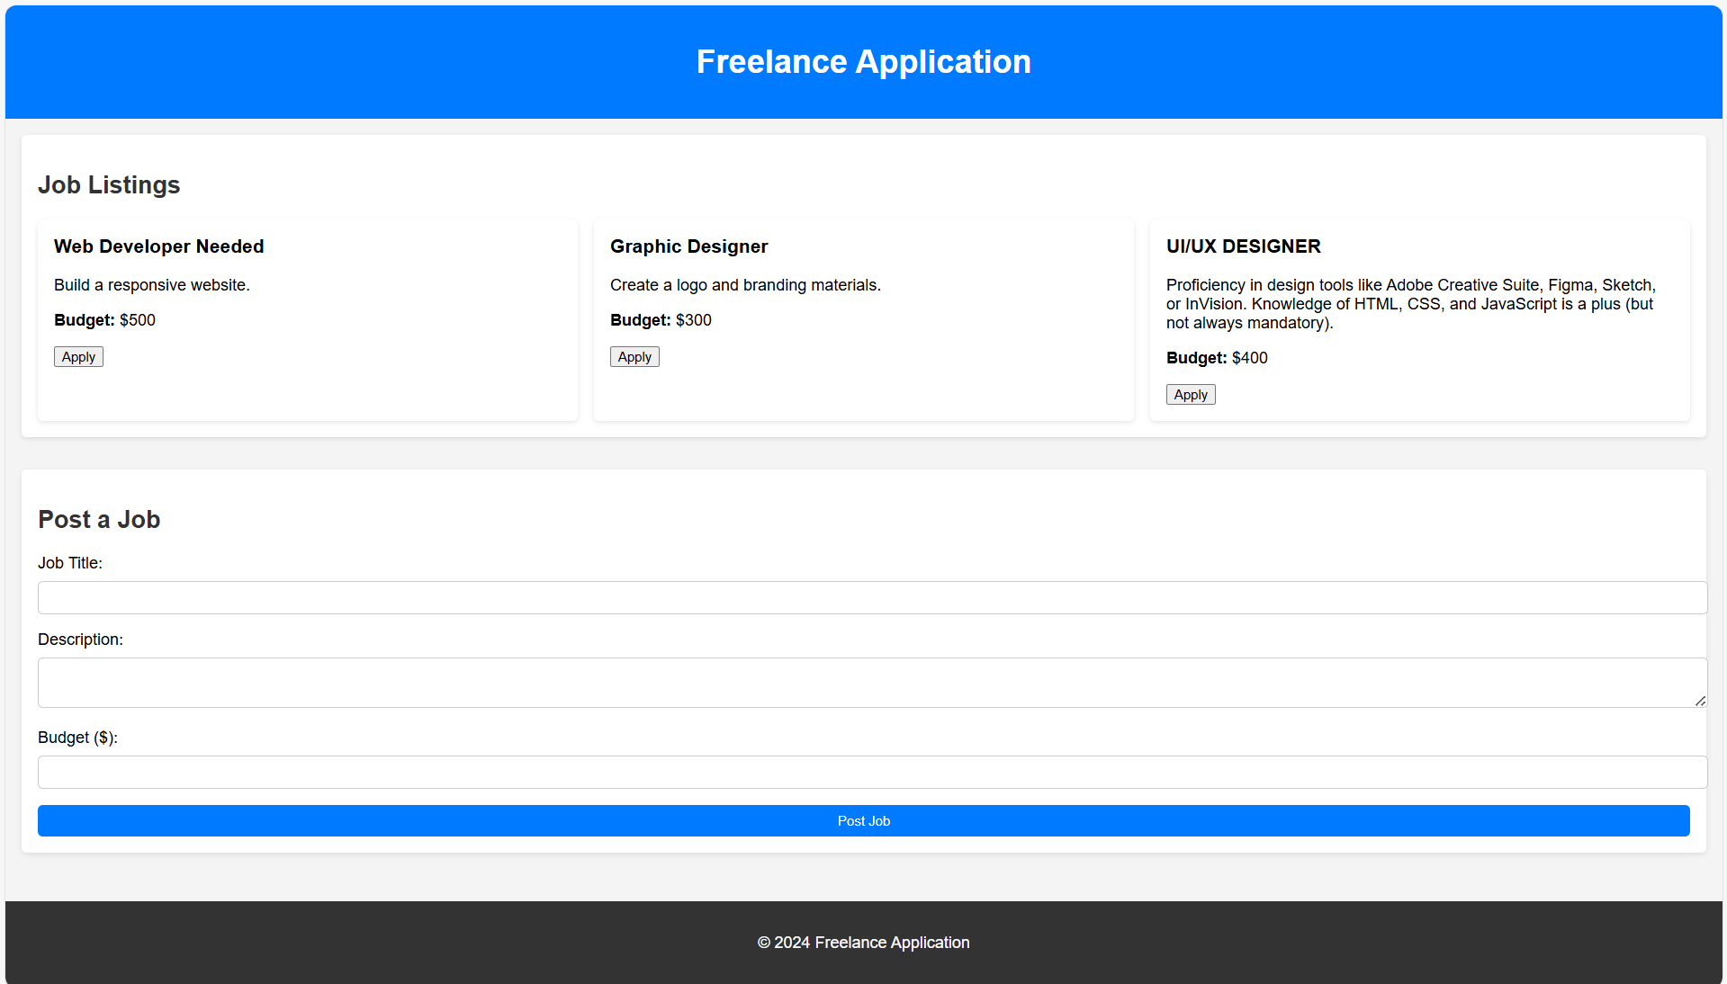
PROJECT
DEMO

Slide 3
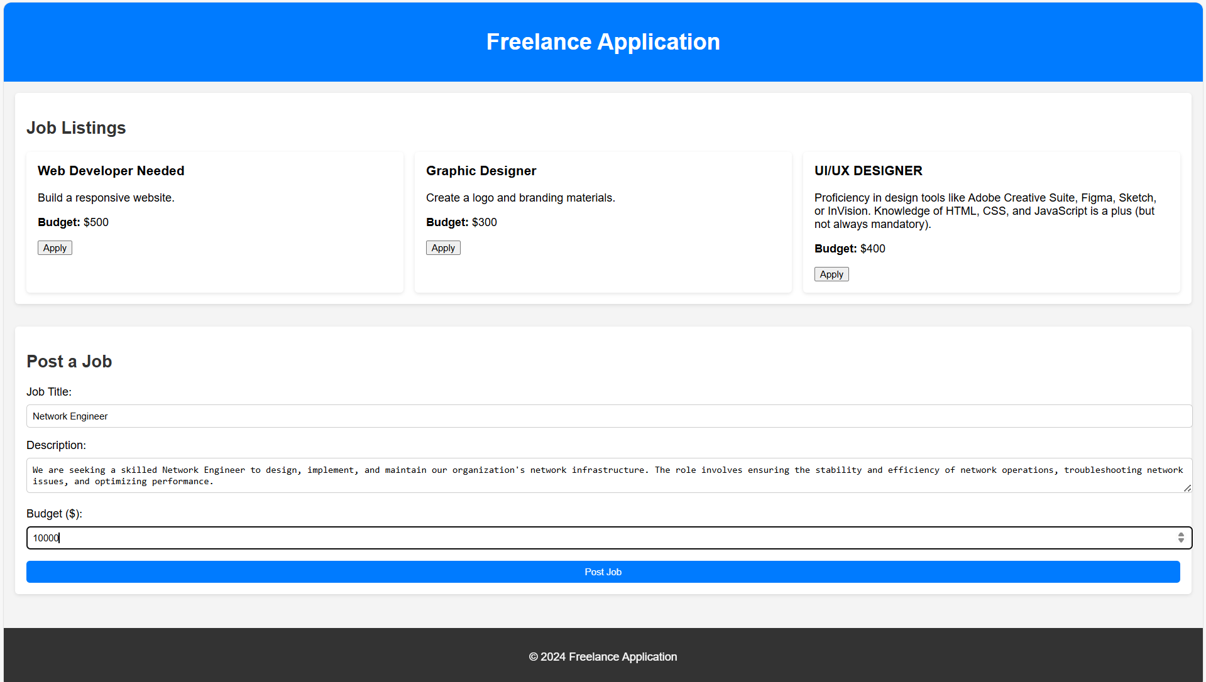

Slide 4
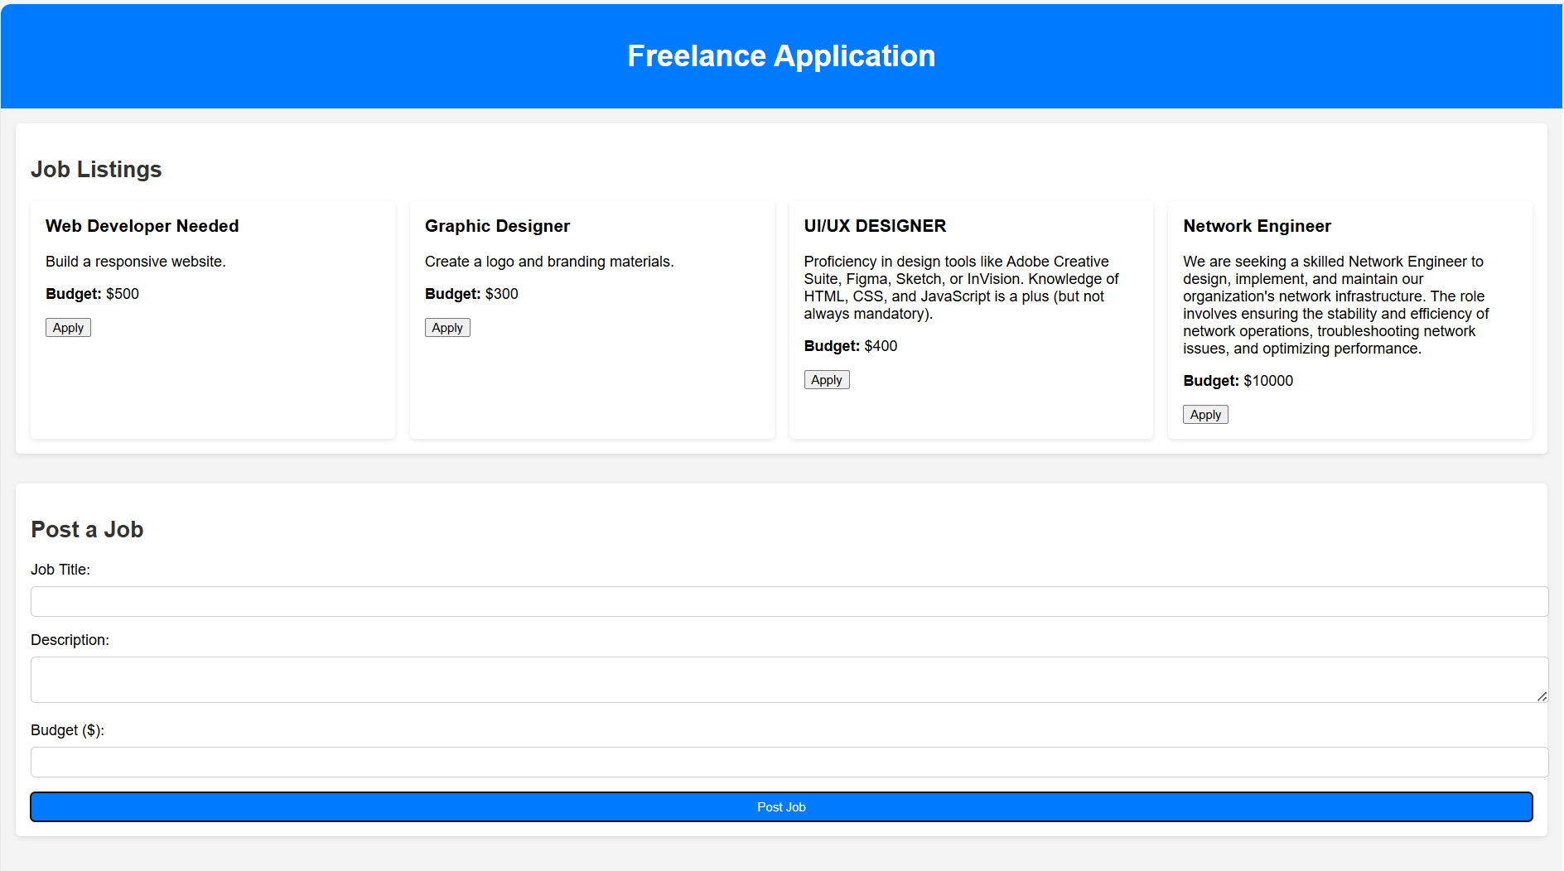

Slide 5
THANK YOU

