Slide 1


MAINTAINING INTEGRITY OF EFFECTIVE COMMUNICATION BASED ON PROXY FIREWALL
Rathinam College of Arts and Science
PRAVEENKUMAR A
Dr. Mohammed Mallik

Slide 2
Problem Statement
The dynamic redistribution of filtering rules between firewalls, which are located in the same network, is a technical solution that can cope with temporary changes in the traffic load processed by the firewalls themselves.
This project presents a novel formal model for networks including multiple cascaded firewalls, that can be leveraged to enable the transfer of a set of rules from a firewall to its downstream neighbours when the changes in the input traffic profile suggest to do so.

Slide 3
Literature Review
Year | Title | Objective | Existing | Future Enhancement
2015 | VNGuard: An NFV/SDN combination framework for provisioning and managing virtual firewalls | Network Function Virtualization (NFV) together with cloud technology enables users to request creating flexible virtual networks (VNs). Users also have specific security requirements to protect their VNs. | VNs require new security features that traditional firewalls fail to provide, because traditional firewalls rely greatly on restricted network topology and entry points to provide effective security protection. | To address this challenge, we propose VNGuard, a framework for effective provision and management of virtual firewalls to safeguard VNs, leveraging features provided by NFV and Software Defined Networking (SDN).

Slide 4
Year | Title | Objective | Existing | Future Enhancement
2016 | Network-wide Virtual Firewall using SDN/OpenFlow | Traditional firewalls are used to enforce network security policies at boundaries within a network. However, this can leave hosts vulnerable to attacks that originate from within the network they are part of. | However, the increasing popularity of networks that allow users to connect their own devices, commonly known as Bring Your Own Device (BYOD) networks means that this assumption no longer holds. For example, an infected BYOD device connected to the internal network is free to attack its neighbours because the firewalls at network perimeter will never see the malicious traffic. | We leverage the flexibility of Software Defined Networking to turn the network infrastructure into a virtual firewall thus improving security across an entire network.

Slide 5
Existing system
The technique proposed in this paper does not rely on the availability of special h/w.. For instance, advanced FWs make use of content-addressable memories (CAMs) or even ternary CAMs (TCAMs) to speed-up their operations.
But they are rarely found in industrial devices which are, by contrast, quite simple and equipped with relatively low-power computing resources, as their design focuses on (mechanical) robustness over performance.
The penalty to be paid to achieve improvements to the load filtering capability of the target FW is an increase in the communication bandwidth usage for links connecting the FW itself to its downstream neighbours

Slide 6
DISADVANTAGE
Cost is high.
Occupies large footprints.
Consumes more power.
Tables updated simultaneously.

Slide 7
Project Goals
This project presents a novel formal model for networks including multiple cascaded firewalls, that can be leveraged to enable the transfer of a set of rules from a firewall to its downstream neighbours when the changes in the input traffic profile suggest to do so.
With respect to other solutions appeared in the literature a formal approach, besides providing unambiguous specifications and mathematical proofs of correctness, also enables the computation of theoretical bounds for the expected performance before the scheme is actually deployed in the target network.

Slide 8
PROPOSED SYSTEM
The proposed methodology is based on a simple formal model which allows the modelling of the data by using encryption of data before uploading the data and uploading through proxy server.
The proxy server which requires a private key for the transfer and private key is generated by using key generation center and after private key is enabled the sever become enable and transfer the data using public cloud server .
A transformation algorithm has been introduced and it is verified by the , its correctness and ability to preserve the security of the network have been formally proven and verified through simulation.

Slide 9
ADAVANTAGES
It uncovers problems quickly because the specification language syntax enforces correctness. It promotes problem-free software because each step is verified or validated along the way.
They help disambiguate system specifications and articulate implicit assumptions.
They also expose flaws in system requirements, and their rigor enables a better understanding of the problem.
Incrementally grows in effective solution after each iteration.
This model does not involve high complexity rate.

Slide 10
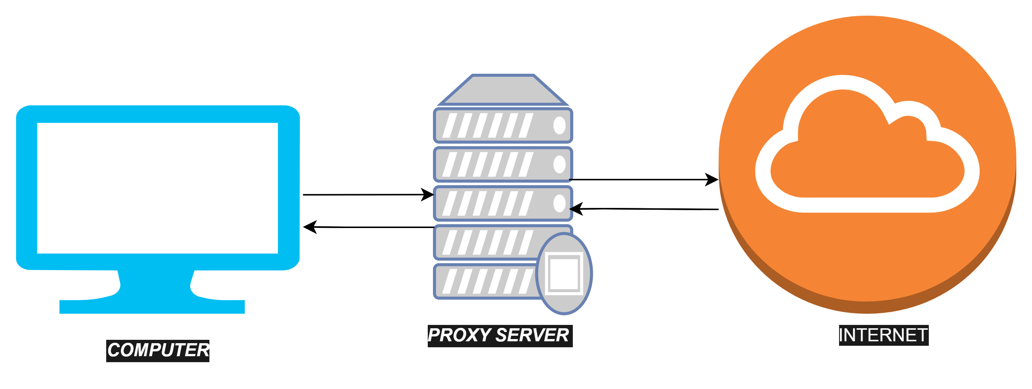
PROXY SERVER SIMULATION TOOL

Slide 11
Summaries the Ultimate Findings of the Project
It uncovers problems quickly because the specification language syntax enforces correctness. It promotes problem-free software because each step is verified or validated along the way.
They help disambiguate system specifications and articulate implicit assumptions.
They also expose flaws in system requirements, and their rigor enables a better understanding of the problem.
Incrementally grows in effective solution after each iteration.
This model does not involve high complexity rate.

Slide 12
Installed Apache web server on cent os
And implemented code for database connectivity and sending
Queries for the database.
Research on implementing a packet filtering firewall
And how the firewall gets in to trouble when there are numerous of packet.

Slide 13
Explanation of Code
50% code is implemented
And it is attached as a word document.
"D:\PROJECT\package identitybasedproxy.java.docx"

