Slide 1




HEALTH CARE DATA ANALYSIS IN EXCEL
STUDENT NAME: PRAVEEN. A
REGISTER NO: 422200018
DEPARTMENT: B. COM[ISM]
COLLEGE:S.I.V.E.T COLLEGE

Slide 2

PROJECT TITLE
HEALTH CARE DATA ANALYSIS

Slide 3

AGENDA
Problem Statement
Project Overview
End Users
Our Solution and Proposition
Dataset Description
Modelling Approach
Results and Discussion
Conclusion
3/21/2024 Annual Review

Slide 4

PROBLEM STATEMENT
Health care analytics is a subset of data analytics that uses both historical and current data to produce actionable insights, improve decision-making, and optimise outcomes within the health care industry.

Slide 5

PROJECT OVERVIEW
Data analytics helps healthcare organizations optimize their operations and resource allocation. By analyzing data on patient flow, resource utilization, and operational processes, hospitals and clinics can identify bottlenecks, streamline workflows, and improve efficiency.

Slide 6

WHO ARE THE END USERS?
On the basis of end users, the healthcare analytics market is segmented into providers (hospitals, physician practices, IDNs, post-acute care organizations, and ambulatory settings), payers (private insurance companies, government agencies, employers, and private exchangers), and ASCOs, HIEs, and TPAs.

Slide 7
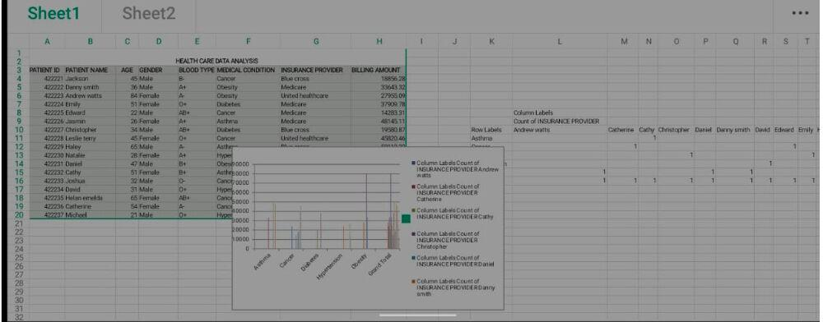
OUR SOLUTION AND ITS VALUE PROPOSITION

Slide 8
Dataset Description
data is necessary to maximize the value of information and promote collaboration among healthcare, providers, and government entities.

Slide 9
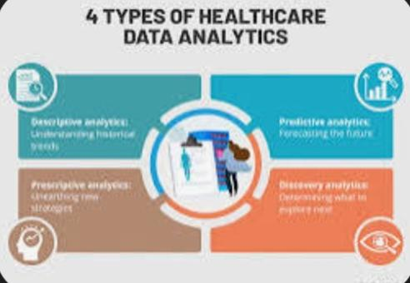
THE "WOW" IN OUR SOLUTION
3/21/2024 Annual Review
9

Slide 10
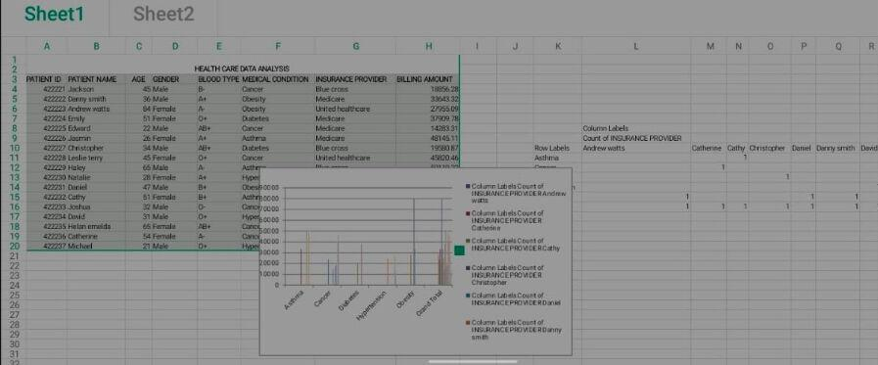
MODELLING
10

Slide 11
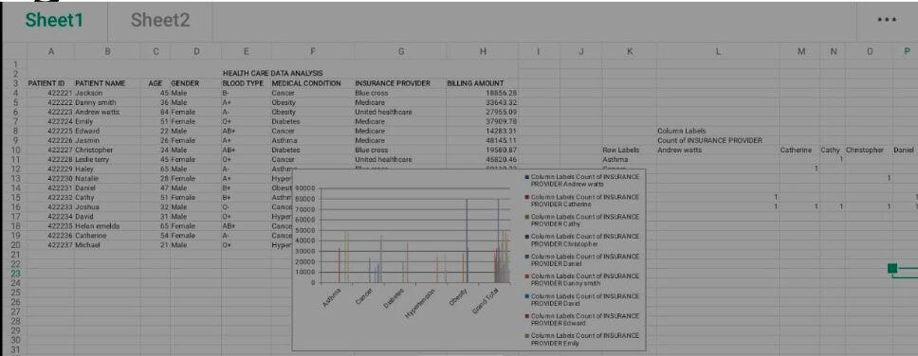
RESULTS
11

Slide 12
conclusion
It assists healthcare organizations in evaluating and developing practitioners, detecting anomalies in scans, and predicting outbreaks of illness.28 May 2024

