Slide 1



TO STUDY AND VERIFY SUPERPOSITION THEOREM AND MAXIMUM POWER TRANSFER THEOREM
Prepared with the Contribution of
To Find the critical frequencies ( Poles and Zeros) of LC Driving Point Impedance
3DEXPERIENCE R2021x

Slide 2



TO STUDY AND VERIFY SUPERPOSITION THEOREM AND MAXIMUM POWER TRANSFER THEOREM
BMS College of Engineering
B.M.S. College of Engineering (BMSCE) is an autonomous engineering college in Basavangudi, Bangalore, India. It was started in 1946 by Bhusanayana Mukundadas Sreenivasaiah and is run by the B.M.S. Educational Trust. It is affiliated with Visvesvaraya Technological University and became autonomous in 2008. BMSCE is located on Bull Temple Road, Basavanagudi, diagonally opposite to the famous Bull Temple.
Student Bio:
Prayag Sridhar
Electrical and Electronics Engineering
Third year
prayag.ee18@bmsce.ac.in
Teacher Bio:

Slide 3
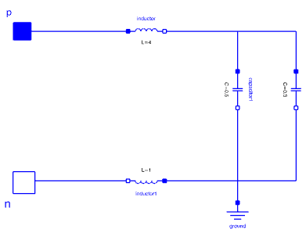
In this experiment, we need to find the critical frequencies (Poles and Zeros) of LC Driving point Impedance. At first we will solve the Problem theoretically and then Compare it with Simulated results.
CIRCUIT DIAGRAM OF LC DRIVING POINT IMPEDANCE
L = 4
Z
C = 0.5
C = 0.3
Eq
L = 1

Slide 4
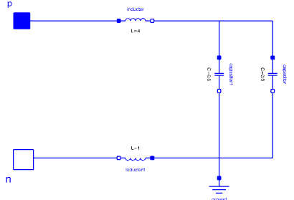
THEORY:
With Reference to Circuit Diagram on the Previous Slide, We need to find Z of the Circuit from which we deduce ‘Poles’ and ‘Zeros’.
Eq
L = 4S
Since, We need to find Z .The problem is solved by using Laplace equivalence of the basic components.
Eq
z
C = 2/S
C = 3.33/S
Eq
L
S * L
C
1 / ( C * S )
L = 1S

Slide 5
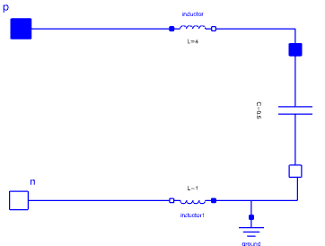
The Capacitance are in parallel Combination, So the C is calculated as
L = 4S
C =
Eq
6.666
5.55 *S
z
Eq
C = 2 x 3.333 _
S x S _
2 + 3.33
S S
Eq
Eq
L = 1S
C = 6.66_____
S X S_____
2S + 3.33S
S X S
Eq
C = 6.66____
5.555 * S
Eq
After Finding The value of Equivalent Capacitance, We find out the Value of Equivalent Impedance
Z = 4S + 1S + 6.666_ = 5S + 6.666 _
5.55*S 5.55*S
Eq

Slide 6



2
2
Zeros
Z = 27.75 * S + 6.66 = 5.045 * S + 1.2
5.55 * S 1* S
Eq
Poles
From the above equation, We get the value of Poles and Zeros
Poles S = 0
Zeros S = 0 + 0.492i & 0 – 0.492i
Sample Graph :
Y
We Plot the Graph where we locate Zeros and Poles on the graph.
Now, We will create LC Driving point Impedance and Find out the Poles and Zeros in Dymola Behavior modeling which is shown in the next slide.
0.492i
Zeros
X
0
Poles
-0.492i
Zeros

Slide 7
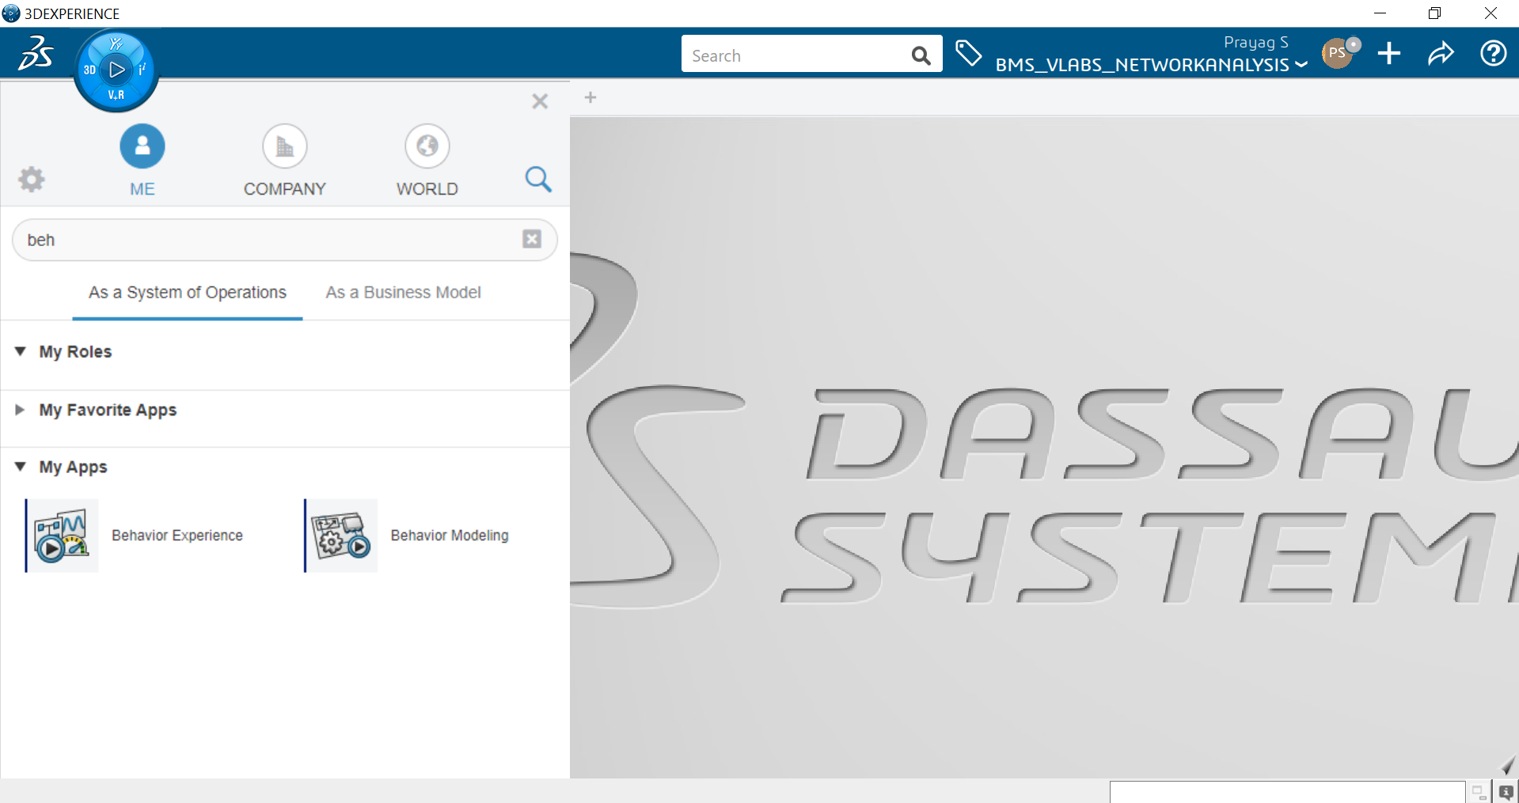
SIMULATION IN 3D EXPERIENCE
1. Open CATIA Dymola Behavior Modeling Application

Slide 8
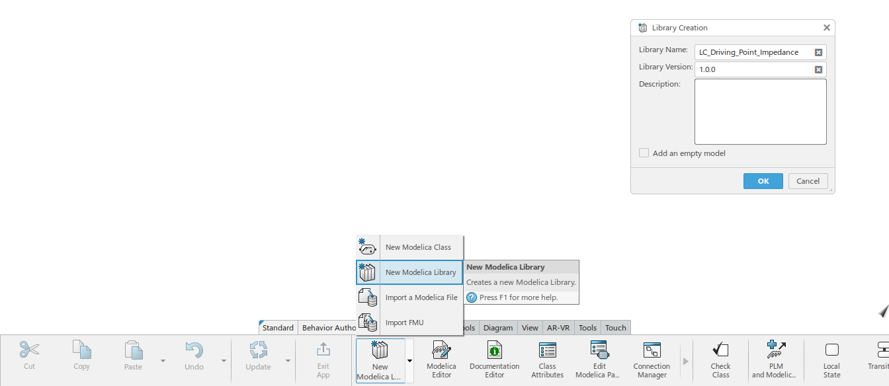
2. Click on Behavior Authoring and Select New Modelica Library
3. Create a new library and name it [LC_Driving_Point_Impedance] and press OK button

Slide 9
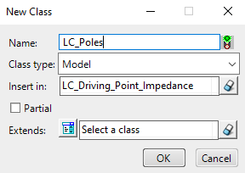

4. Create 2 new classes from Behavior Authoring Section and name it as [LC_Poles], [LC_Zeros] and on insert all the created classes in the already created library [LC_Driving_Point_Impedance] and Press OK

Slide 10

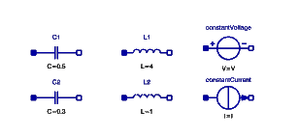
5. The following Library along with their classes will be created in the Package Browser
6. Open the [LC_Zeros] class under the library [LC_Driving_Point_Impedance]
7. Go to Modelica>Electrical>analog and drop 2 Capacitors (C1 = 4F and C2 = 1F) and 2 Inductors(L1 = 0.5H and L2 = 0.3H) and voltage source and current sources( which is found in Modelica>Electrical>Sources).

Slide 11
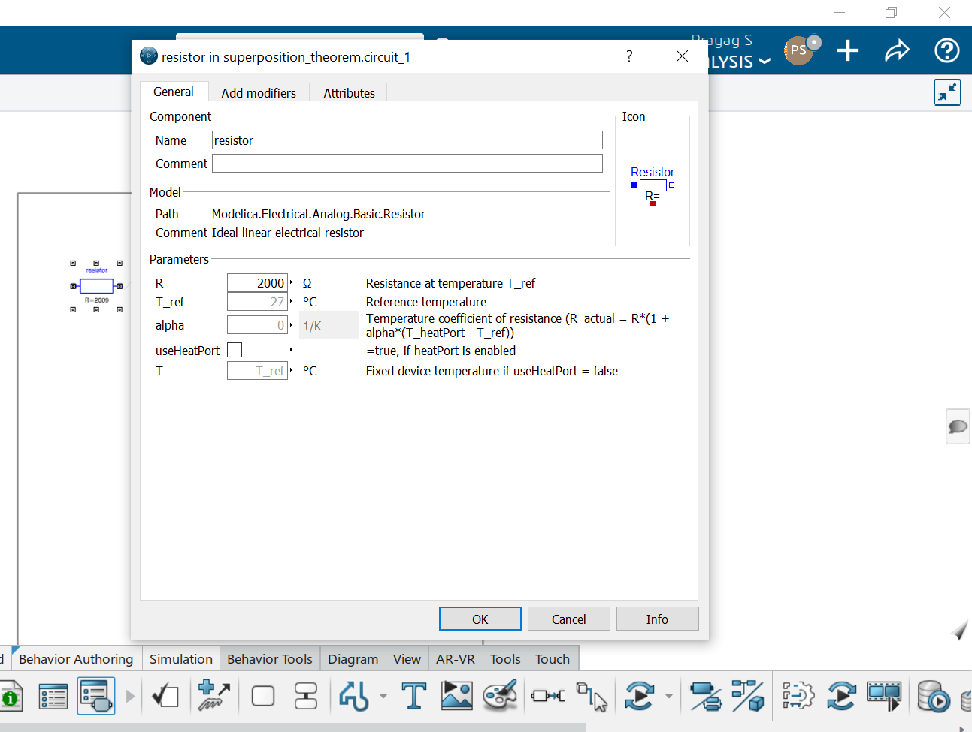
8. For changing the parameters left click twice on the inductor and capacitor components

Slide 12
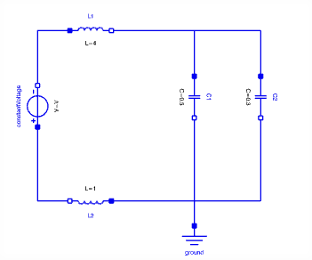
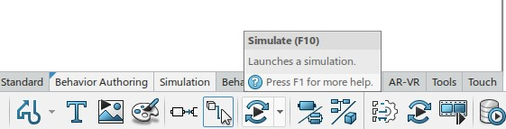
9. Connect all the components to the circuit with voltage source to calculate the zeros shown below and press simulate option.

Slide 13
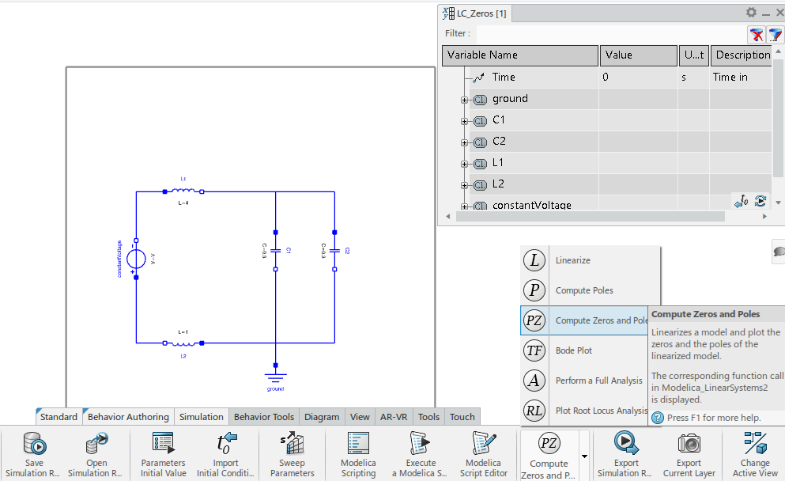
10. When it is in simulation, Go to Simulation > Compute Zeros and Poles and Click on It.
.

Slide 14
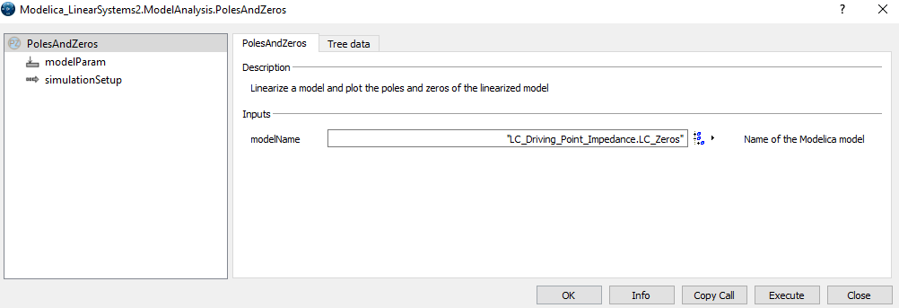
11. After Pressing the Compute Zeros and Poles, We get the window below and Click ‘Ok’ .
.

Slide 15
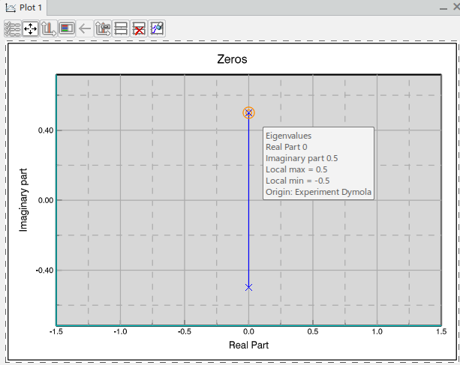
12. When Compute Zeros and Poles are Clicked, The Zeros are Plotted on the Graph with values 0 + 0.5i and 0 - 0.5i

Slide 16
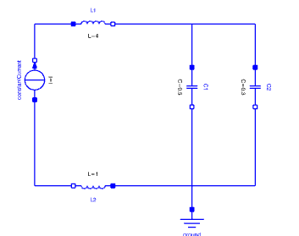
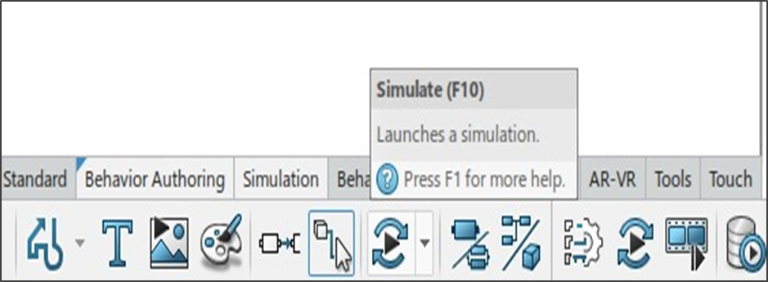
13. Next, We need to Calculate The Poles of the given LC Driving Point Impedance by connecting the current source across the circuit. So, we draw the circuit as shown in the figure below in class [LC_Poles] and Press simulate.

Slide 17
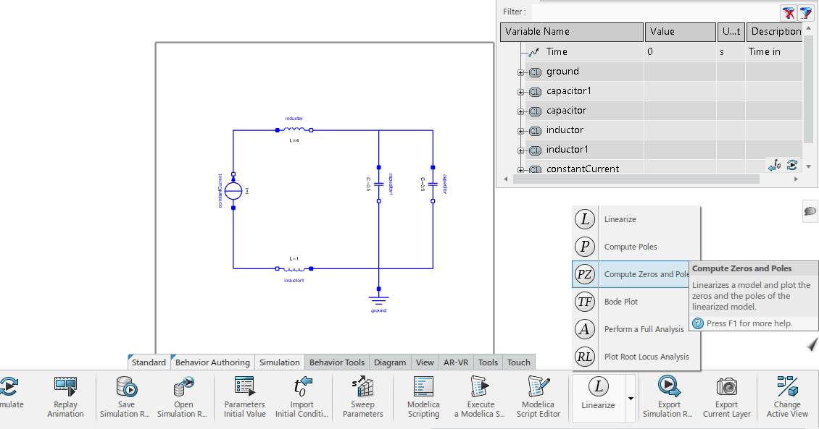
14 . When Simulation is running, Go to Simulation > Compute Poles and Zeros and click on it.

Slide 18
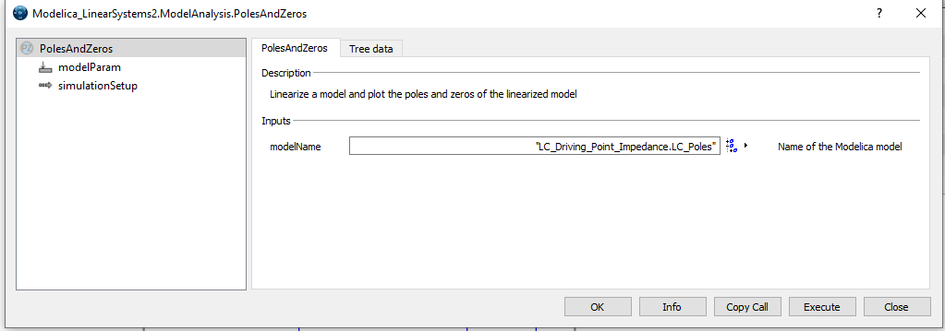
15. After Clicking On simulate, Go to Simulation > Compute Zeros and Poles and Click on it.

Slide 19
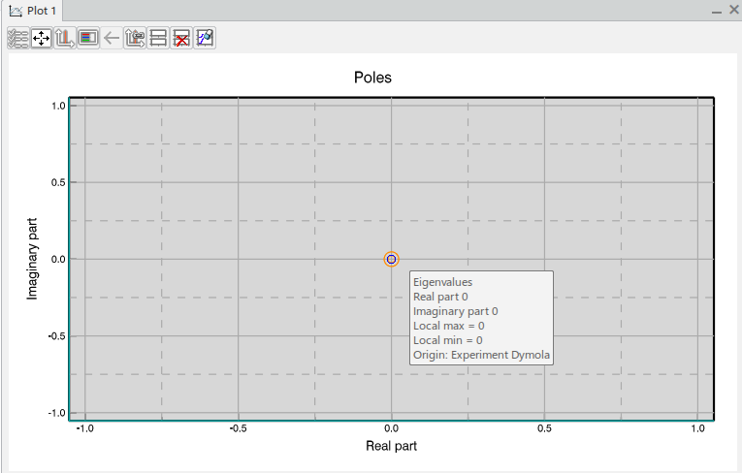
16. The Poles are Plotted on the graph as shown in figure where the value of pole s = 0

Slide 20
Compare the simulated values with the calculated values
DRIVING POINT IMPEDANCE | THEORETICALLY CALCULATED VALUE | SIMULATED VALUE
POLES | S = 0 | S = 0
ZEROS | S = 0 + 0.492i = 0 - 0.492i | S = 0 + 0.5i = 0 – 0.5i

Slide 21

References
NETWORK ANALYSIS BY K.CHANNA VENKATESH, D.GANESH RAO
NETWORK ANALYSIS BY M.E. VAN VALKENBERG
StackOverflow link : https://electronics.stackexchange.com/questions/468329/stability-driving-a-capacitive-load/468341
Youtube video for Poles and Zeros of LC Driving Point Impedance
https://www.youtube.com/watch?v=5FMrf9kS-Go

