Slide 1
Chapter 3
Selections

Slide 2
Outline
  Flow of Control
  Conditional Statements
  The if Statement
  The if-else Statement
  The Conditional operator
  The Switch Statement
  Useful Hints

Slide 3
1. Flow of Control
The order of statement execution is called the flow of control
Unless specified otherwise, the order of statement execution through a method is linear (sequential): one statement after another in sequence
Some programming statements allow us to:
  decide whether or not to execute a particular statement
  execute a statement over and over, repetitively
These selection (decision) statements are based on boolean expressions (or conditions) that evaluate to true or false

Slide 4
2. Selection Statements
A Selection (conditional) statement allows us to choose which statement (or block of statements) will be executed next.
Java selection statements are:
  if statement - allows one option
  if-else statement - allows two options
  switch statement - allows multiple options

Slide 5
3. The if Statement
The if statement has the following syntax:
The condition must be a
boolean expression. It must
evaluate to either true or false.
if is a Java
reserved word
if (condition)
{
statementBlock;
};
If the condition is true, the statementBlock is executed.
If it is false, the statementBlock is skipped.

Slide 6
Logic of if statement
Statement
1 grade = 70;
2 If (grade>= 90)
3 System.out.println("You got an "A");
4 System.out.println("This is line 4");
condition
evaluated
true
false
Statement Block
1 grade = 95;
2 If (grade>= 90)
3 System.out.println("You got an "A");
4 System.out.println("This is line 4");
Statement

Slide 7
Boolean Expressions
A condition often uses one of Java's equality operators or relational operators, which all return boolean results:
      == equal to
      != not equal to
      < less than
      > greater than
      <= less than or equal to
      >= greater than or equal to
Note the difference between the equality operator (==) and the assignment operator (=)

Slide 8
Example - if Statement
An example of an if statement:
if (sum > MAX)
delta = sum - MAX;
System.out.println ("The sum is " + sum);
First, the condition is evaluated -- the value of sum is either greater than the value of MAX, or it is not
If the condition is true, the assignment statement is executed -- if it isn’t (i.e., false), the assignment statement is skipped.
Either way, the call to println is executed next
See Age.java next slide

Slide 9
Example - if Statement
// Age.java
import java.util.Scanner;
public class Age
{
public static void main (String[] args)
{
final int MINOR = 21;
Scanner scan = new Scanner (System.in);
System.out.print ("Enter your age: ");
int age = scan.nextInt();
System.out.println ("You entered: " + age);
if (age < MINOR)
System.out.println ("Youth is a wonderful thing. Enjoy!");
System.out.println ("Age is a state of mind.");
}
}

Slide 10
Indentation
The statement controlled by the if statement is indented to indicate that relationship
The use of a consistent indentation style makes a program easier to read and understand
Although it makes no difference to the compiler, proper indentation is crucial for code readability and debugging

Slide 11
Expressions
What do the following statements do?
if (top >= MAXIMUM)
top = 0;
//next statement starts here
Sets top to zero if the current value of top is greater than or equal to the value of MAXIMUM
if (total != stock + warehouse)
inventoryError = true;
// next statement starts here
Sets a flag to true if the value of total is not equal to the sum of stock and warehouse
Note: the precedence of arithmetic operators is higher than the precedence of equality and relational operators.

Slide 12
Logical Operators
Boolean expressions can also use the following logical operators:
  ! Logical NOT
  && Logical AND
  || Logical OR
  ^ Logical XOR (exclusive OR)
They all take boolean operands and produce boolean results
Logical NOT is a unary operator (it operates on one operand)
Logical AND, OR, and XOR are binary operators (each operates on two operands)

Slide 13
Logical Operators
The logical NOT operation is also called logical negation or logical complement
If some boolean condition a is true, then !a is false; if a is false, then !a is true
Logical expressions can be shown using a truth table
boolean a | !a
true | false
false | true

Slide 14
Logical Operators
The logical AND expression
a && b
is true if both a and b are true, and false otherwise
The logical OR expression
a || b
is true if a or b or both are true, and false otherwise
The logical XOR expression
a ^ b
is true if and only if a and b are different.

Slide 15
Logical Operators
A truth table shows all possible true-false combinations of the terms
Since &&, ||, and ^ each have two operands, there are four possible combinations of conditions a and b (boolean expressions)
a
b
a && b
a || b
a ^ b
true
true
true
true
false
true
false
false
true
true
false
true
false
true
true
false
false
false
false
false

Slide 16
Boolean Expressions
Expressions that use logical operators can form complex conditions
if (total < MAX + 5 && !found)
System.out.println ("Processing…");
Mathematical operators have higher precedence than the Relational and Logical operators
Relational operators have higher precedence than Logical operators

Slide 17
Boolean Expressions
Specific expressions can be evaluated using truth tables
Given X = total < MAX && !found
What is the values of X ?
total < MAX | !found | X = total < MAX && !found
true | true | true
true | false | false
false | true | false
false | false | false

Slide 18
Operator Precedence
var++, var-- Postfix increment
++var, --var Prefix increment
+, - unary operators
(type) Casting and parenthesis
! Not
*, /, % Math operators
+, - Math operators
<, <=, >, >= Relational operators
==, != Relational equality
^ Exclusive OR
&& Logical AND
|| Logical OR
=, +=, -=, *=, /=, %= Assignment operators

Slide 19

Operator Precedence
Applying operator precedence and associativity rule to the expression: 3 + 4 * 4 > 5 * (4 + 3) - 1

Slide 20
4. The if-else Statement
An else clause can be added to an if statement to make an if-else statement
if ( condition )
statementBlock1;
else
statementBlock2;
If the condition is true, statementBlock1 is executed; if the condition is false, statementBlock2 is executed
One or the other will be executed, but not both

Slide 21
Logic of an if-else statement
Statement
condition
evaluated
true
false
StatementBlock1
StatementBlock2
Statement

Slide 22
Trace if-else statement
Suppose score is 70.0
The condition is false
if (score >= 90.0)
System.out.print("A");
else if (score >= 80.0)
System.out.print("B");
else if (score >= 70.0)
System.out.print("C");
else if (score >= 60.0)
System.out.print("D");
else System.out.print("F");

Slide 23
Trace if-else statement
Suppose score is 70.0
The condition is false
if (score >= 90.0)
System.out.print("A");
else if (score >= 80.0)
System.out.print("B");
else if (score >= 70.0)
System.out.print("C");
else if (score >= 60.0)
System.out.print("D");
else System.out.print("F");

Slide 24
Trace if-else statement
Suppose score is 70.0
The condition is true
if (score >= 90.0)
System.out.print("A");
else if (score >= 80.0)
System.out.print("B");
else if (score >= 70.0)
System.out.print("C");
else if (score >= 60.0)
System.out.print("D");
else System.out.print("F");

Slide 25
Trace if-else statement
Suppose score is 70.0
grade is C
if (score >= 90.0)
System.out.print("A");
else if (score >= 80.0)
System.out.print("B");
else if (score >= 70.0)
System.out.print("C");
else if (score >= 60.0)
System.out.print("D");
else System.out.print("F");

Slide 26
Trace if-else statement
Suppose score is 70.0
Exit the if statement
if (score >= 90.0)
System.out.print("A");
else if (score >= 80.0)
System.out.print("B");
else if (score >= 70.0)
System.out.print("C");
else if (score >= 60.0)
System.out.print("D");
else System.out.print("F");
See Wages.java example next slide.

Slide 27
Example
// Wages.java
import java.text.NumberFormat;
import java.util.Scanner;
public class Wages
{
public static void main (String[] args)
{
final double RATE = 8.25; //regular pay rate
final int STANDARD = 40; //weekly hours
Scanner scan = new Scanner (System.in); //scanner object
double pay = 0.0; // initialization
System.out.print ("Enter the number of hours worked: "); //prompt
int hours = scan.nextInt(); //read input value
System.out.println (); //print blank line
// Pay overtime at "time and a half"
if (hours > STANDARD)
pay = STANDARD * RATE + (hours-STANDARD) * (RATE * 1.5);
else
pay = hours * RATE;
NumberFormat fmt = NumberFormat.getCurrencyInstance();//format
System.out.println ("Gross earnings: " + fmt.format(pay));//output
}
}

Slide 28
Indentation - Revisited
Remember that indentation is for the human reader, and is ignored by the computer
if (total > MAX)
System.out.println ("Error!!");
errorCount++;
Despite what is implied by the indentation, the increment will occur whether the condition is true or not

Slide 29
Block Statements
Several statements can be grouped together into a block statement delimited by braces
if (total > MAX)
{
System.out.println ("Error!!");
errorCount++;
// more statements…
}

Slide 30
Block Statements
In an if-else statement, the if portion, or the else portion, or both, could be block statements
if (total > MAX)
{
System.out.println ("Error!!");
errorCount++;
}
else
{
System.out.println ("Total: " + total);
current = total * 2;
}
See Guessing.java next slide.

Slide 31
Example
// Guessing.java
import java.util.*;
public class Guessing
{
public static void main (String[] args)
{
final int MAX = 10;
int answer, guess;
Scanner scan = new Scanner (System.in); //scanner object
Random generator = new Random(); //number generator object
answer = generator.nextInt(MAX) + 1; //generate a number
System.out.print ("I'm thinking of a number between 1"
+ "and " + MAX + ". Guess what it is: ");
guess = scan.nextInt(); //read user input
if (guess == answer)
System.out.println ("You got it! Good guessing!");
else
{
System.out.println ("That is not correct!");
System.out.println ("The number was " + answer);
}
}
}

Slide 32
5. The Conditional Operator
Stop and Record…

Slide 33
5. The Conditional Operator
Java has a conditional operator that uses a boolean condition to determine which of two expressions is evaluated
Its syntax is:
condition ? expression1 : expression2
If the condition is true, expression1 is evaluated; if it is false, expression2 is evaluated
The conditional operator is ternary because it requires three operands

Slide 34
The Conditional Operator
The conditional operator is similar to an if-else statement, except that it is an expression that returns a value
For example:
larger = ((num1 > num2) ? num1 : num2);
If num1 is greater than num2, then num1 is assigned to larger; otherwise, num2 is assigned to larger
Same as if (num1 > num2)
larger = num1;
else
larger = num2;

Slide 35
The Conditional Operator
Another example:
System.out.println ("Your change is " + count +
((count == 1) ? "Dime" : "Dimes"));
If count equals 1, then "Dime" is printed
If count is anything other than 1, then "Dimes" is printed

Slide 36
Nested if Statements
The statement executed as a result of an if statement or else clause could be another if statement
These are called nested if statements
Java Rule: An else clause is matched to the last unmatched if (no matter what the indentation implies)
Braces can be used to specify the if statement to which an else clause belongs
See MinOfThree.java next slide

Slide 37
Example
// MinOfThree.java
import java.util.Scanner;
public class MinOfThree
{
public static void main (String[] args)
{ int num1, num2, num3, min = 0;
Scanner scan = new Scanner (System.in);
System.out.println ("Enter three integers: ");
num1 = scan.nextInt();
num2 = scan.nextInt();
num3 = scan.nextInt();
if (num1 < num2)
if (num1 < num3)
min = num1;
else
min = num3;
else
if (num2 < num3)
min = num2;
else
min = num3;
System.out.println ("Minimum value: " + min);
}
}
if (num1 < num2)
min = num1;
else
min = num2;
if (num3 < min)
min = num3;

Slide 38
6. Switch Statement
The switch statement provides another way to decide which statement to execute next
The switch statement evaluates an expression, then attempts to match the result to one of several possible cases (options)
Each case contains a value and a list of statements
The flow of control transfers to statement associated with the first case value that matches

Slide 39
Syntax
The general syntax of a switch statement is:
switch (expression)
{
case value1:
statement_List1
break;
case value2:
statement_List2
break;
case value3:
statement_List3
break;
case ...
default:
statement_List
}
switch
and
case
are
reserved
words
If expression
matches value2,
control jumps
to here

Slide 40
break Statement
Often a break statement is used as the last statement in each case's statement list
A break statement causes control to transfer to the end of the switch statement
If a break statement is not used, the flow of control will continue into the next case
Sometimes this may be appropriate, but often we want to execute only the statements associated with one case

Slide 41
Trace switch statement
Suppose day is 2:
switch (day) { //day is of type int
case 1:
case 2:
case 3:
case 4:
case 5: System.out.println("Weekday"); break;
case 6:
case 7: System.out.println("Weekend");
}

Slide 42
Trace switch statement
Match case 2
switch (day) {
case 1:
case 2:
case 3:
case 4:
case 5: System.out.println("Weekday"); break;
case 6:
case 7: System.out.println("Weekend");
}

Slide 43
Trace switch statement
Match case 2
switch (day) {
case 1:
case 2:
case 3:
case 4:
case 5: System.out.println("Weekday"); break;
case 6:
case 7: System.out.println("Weekend");
}

Slide 44
Trace switch statement
Fall through case 3
switch (day) {
case 1:
case 2:
case 3:
case 4:
case 5: System.out.println("Weekday"); break;
case 6:
case 7: System.out.println("Weekend");
}

Slide 45
Trace switch statement
Fall through case 4
switch (day) {
case 1:
case 2:
case 3:
case 4:
case 5: System.out.println("Weekday"); break;
case 6:
case 7: System.out.println("Weekend");
}

Slide 46
Trace switch statement
Fall through case 5
switch (day) {
case 1:
case 2:
case 3:
case 4:
case 5: System.out.println("Weekday"); break;
case 6:
case 7: System.out.println("Weekend");
}

Slide 47
Trace switch statement
Printout Weekday
switch (day) {
case 1:
case 2:
case 3:
case 4:
case 5: System.out.println("Weekday"); break;
case 6:
case 7: System.out.println("Weekend");
}

Slide 48
Trace switch statement
Encounter break
switch (day) {
case 1:
case 2:
case 3:
case 4:
case 5: System.out.println("Weekday"); break;
case 6:
case 7: System.out.println("Weekend");
}

Slide 49
Trace switch statement
Exit the statement
switch (day) {
case 1:
case 2:
case 3:
case 4:
case 5: System.out.println("Weekday"); break;
case 6:
case 7: System.out.println("Weekend");
}

Slide 50
Default Case
A switch statement can have an optional default case
The default case has no associated value and simply uses the reserved word default
If the default case is present, control will transfer to the default case if no other case value matches
If there is no default case, and no other value matches, control falls through to the statement after the switch statement

Slide 51
Example
switch (option) //option is of type char
{
case 'A':
aCount = aCount + 1;
break;
case 'B':
bCount = bCount + 1;
break;
case 'C':
cCount = cCount + 1;
break;
default:
System.out.println ("Invalid Option…")
}

Slide 52
Switch Statement Expression
The expression of a switch statement must result in an integer type (byte, short, int, long) or a char type.
It cannot be a boolean value or a floating point value (float or double)
You cannot perform relational checks with a switch statement
See GradeReport.java next slide

Slide 53
Example
import java.util.Scanner;
public class GradeReport
{ public static void main (String[] args)
{ ... Some other code here
grade = scan.nextInt();
category = grade / 10;
System.out.print ("That grade is ");
switch (category)
{
case 10:
System.out.println ("a perfect score, well done.");
break;
case 9:
System.out.println ("well above average. Excellent.");
break;
case 8:
System.out.println ("above average. Nice job.");
break;
case 7:
System.out.println ("average.");
break;
case 6:
System.out.println ("below average. Do better!");
break;
default:
System.out.println ("not passing.");
}
}
}

Slide 54
7. Useful Hints
if i > 0 {
System.out.println("i is positive"); //wrong
}
if (i > 0) {
System.out.println("i is positive"); //correct
}
===================================================
if (i > 0) {
System.out.println("i is positive");
}
Same as
if (i > 0)
System.out.println("i is positive");

Slide 55
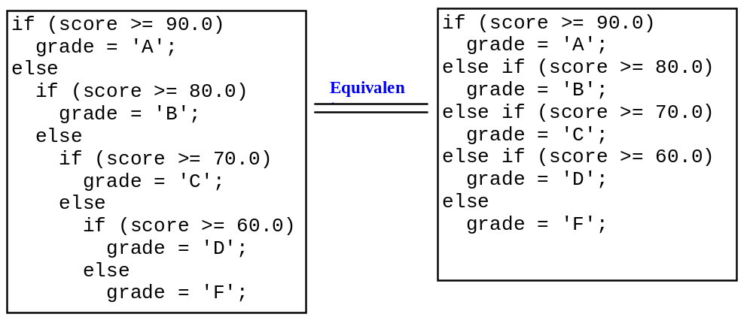
Useful Hints
Nested if statements and style issue.

Slide 56
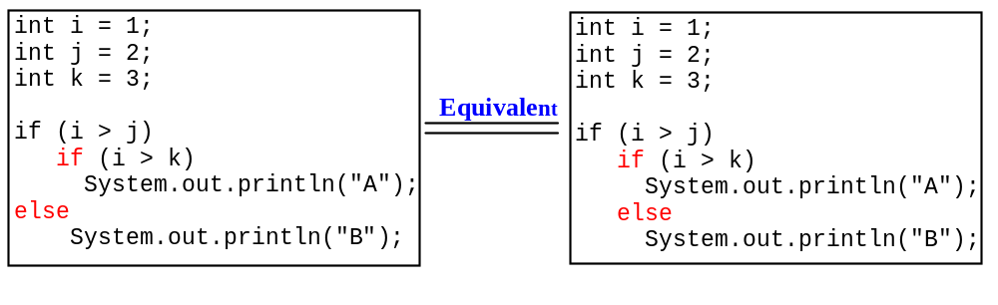
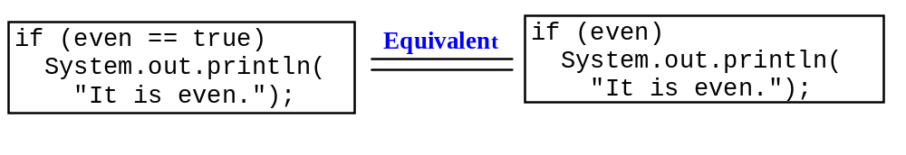
Useful Hints
The else clause matches the most recent if clause in the same block.

Slide 57
Useful Hints
Adding a semicolon at the end of an if clause is a common mistake.
  if (radius >= 0); <=== Wrong
  {
  area = radius*radius*PI;
  System.out.println(
  "The area for the circle of radius " +
  radius + " is " + area);
  }
This mistake is hard to find, because it is not a compilation error or a runtime error, it is a logical error.

Slide 58
End of Chapter 3 Slides

