Slide 1

Chapter 7
Single-Dimensional Arrays

Slide 2
Arrays
Array is a data structure that represents a collection of same-types data elements.
A single-dimensional array is one that stores data elements in one row.
0 1 2 3 4 5 6 7
0 1 2 3 4 5 6 7
6 | 4 | 1 | 9 | 7 | 3 | 2 | 8
myArray:
6 | 4 | 1 | 9 | 7 | 3 | 2 | 8
  Strings are arrays.
  String Name = "John Smith";
  String courseNumber;
  courseNumber = new String ("CS 1301");

Slide 3
Declaring Array Variables
datatype[] arrayRefVar;
Example:
double[] myList; //vs. double myList;
int[] yourList;
boolean[] herList;
char[] hisList;
datatype arrayRefVar[]; // This style is allowed, but not preferred
Example:
double myList[];

Slide 4
Creating Arrays
This is to allocate memory space for the array.
arrayRefVar = new datatype[arraySize];
Example:
myList = new double[10];
yourList = new int[100];
herList = new boolean[20];
hisList = new char[500];
myList[0] references the first element in the array.
myList[9] references the last element in the array.
In one step you can declare and create:
double[] myList = new double[10];

Slide 5
The Length of an Array
Once an array is created, its size is fixed. It cannot be changed. You can find its size using
    arrayRefVar.length; (not length()as with strings)
For example,
    int length = myList.length; // returns 10
int length = yourList.length; // returns 100;
int length = herList.length; // returns 20;
int length = hisList.length; // returns 500;

Slide 6
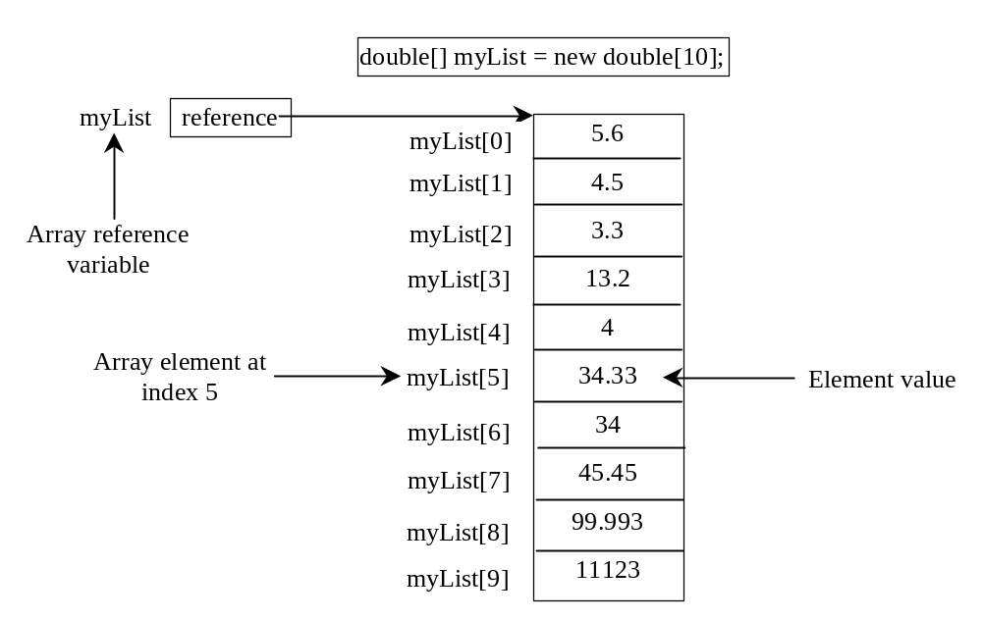
Array Representation

Slide 7
Default Values
When an array is created, its elements are assigned the default value of
  0 for the numeric primitive types (byte, short, int, long)
  0.0 for the numeric primitive data types (float, double)
  '\u0000' for char types (Null value)
  false for boolean type.

Slide 8
Indexed Variables
The array elements are accessed through the index.
The array indices start from 0 to arrayRefVar.length-1
Example:
myList = new double[5];
Array myList holds five double values
The indices are 0 to 4.
Each element in the array is represented using the following syntax, known as an indexed variable:
  arrayRefVar[index];
  myList[0]= 25.7; //value in first element
  double price = myList[0];

Slide 9
Using Indexed Variables
After an array is created, an indexed variable can be used in the same way as a regular variable is used.
Example:
The following code adds the values in the first and second positions in array myList and stores the result in the third position.
  myList[2] = myList[0] + myList[1];
Example:
The following code prints out the content of array myList.
  for (int i = 0; i <= myList.length-1; i++)
  System.out.println("Value in position " + i +
  " = " + myList[i]);

Slide 10
Array Initialization
Declaring, creating, initializing in one step:
double[] myList = {1.9, 2.9, 3.4, 3.5};
int[] numberGrades = {70, 65, 87, 93, 90};
char[] letterGrades = {'C', 'D', 'B', 'A', 'A'};
boolean myFlags = {true, false, true, false};
This shorthand notation is equivalent to the following statements:
double[] myList = new double[4];
myList[0] = 1.9;
myList[1] = 2.9;
myList[2] = 3.4;
myList[3] = 3.5;
Be Careful! This code gives an error. It must be in one statement.
  int[] numberGrades;
  numberGrades = {70, 65, 87, 93, 90};

Slide 11
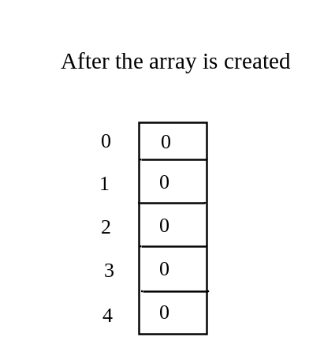
Trace Program with Arrays
animation
Declare array variable values, create an array, and assign its reference to values
public class Test {
public static void main(String[] args) {
int[] values = new int[5];
for (int i = 1; i < 5; i++) {
values[i] = i + values[i-1];
}
values[0] = values[1] + values[4];
}
}

Slide 12
Trace Program with Arrays
animation
i becomes 1
public class Test {
public static void main(String[] args) {
int[] values = new int[5];
for (int i = 1; i < 5; i++) {
values[i] = i + values[i-1];
}
values[0] = values[1] + values[4];
}
}

Slide 13
Trace Program with Arrays
animation
i (=1) is less than 5
public class Test {
public static void main(String[] args) {
int[] values = new int[5];
for (int i = 1; i < 5; i++) {
values[i] = i + values[i-1];
}
values[0] = values[1] + values[4];
}
}

Slide 14
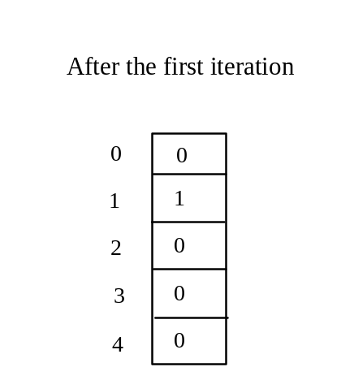
Trace Program with Arrays
animation
After this line is executed, value[1] is 1
public class Test {
public static void main(String[] args) {
int[] values = new int[5];
for (int i = 1; i < 5; i++) {
values[i] = i + values[i-1];
}
values[0] = values[1] + values[4];
}
}

Slide 15
Trace Program with Arrays
animation
After i++, i becomes 2
public class Test {
public static void main(String[] args) {
int[] values = new int[5];
for (int i = 1; i < 5; i++) {
values[i] = i + values[i-1];
}
values[0] = values[1] + values[4];
}
}

Slide 16
Trace Program with Arrays
animation
i (= 2) is less than 5
public class Test {
public static void main(String[] args) {
int[] values = new int[5];
for (int i = 1; i < 5; i++) {
values[i] = i + values[i-1];
}
values[0] = values[1] + values[4];
}
}

Slide 17
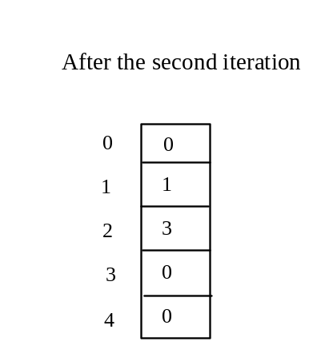
Trace Program with Arrays
animation
After this line is executed,
values[2] is 3 (2 + 1)
public class Test {
public static void main(String[] args) {
int[] values = new int[5];
for (int i = 1; i < 5; i++) {
values[i] = i + values[i-1];
}
values[0] = values[1] + values[4];
}
}

Slide 18
Trace Program with Arrays
animation
After this, i becomes 3.
public class Test {
public static void main(String[] args) {
int[] values = new int[5];
for (int i = 1; i < 5; i++) {
values[i] = i + values[i-1];
}
values[0] = values[1] + values[4];
}
}

Slide 19
Trace Program with Arrays
animation
i (=3) is still less than 5.
public class Test {
public static void main(String[] args) {
int[] values = new int[5];
for (int i = 1; i < 5; i++) {
values[i] = i + values[i-1];
}
values[0] = values[1] + values[4];
}
}

Slide 20
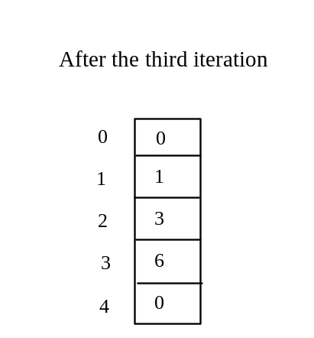
Trace Program with Arrays
animation
After this line, values[3] becomes 6 (3 + 3)
public class Test {
public static void main(String[] args) {
int[] values = new int[5];
for (int i = 1; i < 5; i++) {
values[i] = i + values[i-1];
}
values[0] = values[1] + values[4];
}
}

Slide 21

Trace Program with Arrays
animation
After this, i becomes 4
public class Test {
public static void main(String[] args) {
int[] values = new int[5];
for (int i = 1; i < 5; i++) {
values[i] = i + values[i-1];
}
values[0] = values[1] + values[4];
}
}

Slide 22
Trace Program with Arrays
animation
i (=4) is still less than 5
public class Test {
public static void main(String[] args) {
int[] values = new int[5];
for (int i = 1; i < 5; i++) {
values[i] = i + values[i-1];
}
values[0] = values[1] + values[4];
}
}

Slide 23
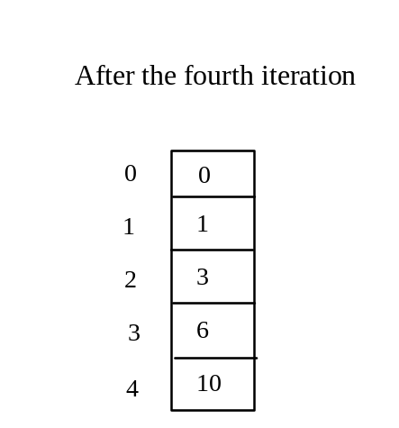
Trace Program with Arrays
animation
After this, values[4] becomes 10 (4 + 6)
public class Test {
public static void main(String[] args) {
int[] values = new int[5];
for (int i = 1; i < 5; i++) {
values[i] = i + values[i-1];
}
values[0] = values[1] + values[4];
}
}

Slide 24
Trace Program with Arrays
animation
After i++, i becomes 5
public class Test {
public static void main(String[] args) {
int[] values = new int[5];
for (int i = 1; i < 5; i++) {
values[i] = i + values[i-1];
}
values[0] = values[1] + values[4];
}
}

Slide 25
Trace Program with Arrays
animation
i ( =5) < 5 is false. Exit the loop
public class Test {
public static void main(String[] args) {
int[] values = new int[5];
for (int i = 1; i < 5; i++) {
values[i] = i + values[i-1];
}
values[0] = values[1] + values[4];
}
}

Slide 26
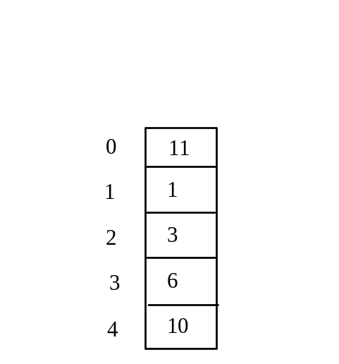
Trace Program with Arrays
animation
After this line, values[0] is 11 (1 + 10)
public class Test {
public static void main(String[] args) {
int[] values = new int[5];
for (int i = 1; i < 5; i++) {
values[i] = i + values[i-1];
}
values[0] = values[1] + values[4];
}
}

Slide 27
Processing Arrays
Some common examples:
(Initializing arrays with input values)
(Initializing arrays with random values)
(Printing arrays)
(Summing all elements)
(Finding the largest element)
(Finding the smallest index of the largest element)
(Random shuffling)
(Shifting elements)

Slide 28
Initializing arrays with input values
... //Some code
double[] myList = new double[5];
java.util.Scanner input = new java.util.Scanner(System.in);
System.out.print("Enter " + myList.length + " double values: ");
for (int i = 0; i < myList.length; i++)
myList[i] = input.nextDouble();
... //other code

Slide 29
Initializing arrays with random values
... //Some code
double[] myList = new double[5];
... //initialize the array
for (int i = 0; i < myList.length; i++)
myList[i] = Math.random() * 100; //double type
... //other code

Slide 30
Printing arrays
... //Some code
double[] myList = new double[5];
... //initialize the array
for (int i = 0; i < myList.length; i++)
System.out.print(myList[i] + " ");
... //other code

Slide 31
Summing all elements
... //Some code
double total = 0;
double[] myList = new double[5];
... //initialize the array
for (int i = 0; i < myList.length; i++)
total = total + myList[i];
... //other code

Slide 32
Finding the largest element
... //Some code
double[] myList = new double[5];
double max = myList[0];
for (int i = 1; i < myList.length; i++)
{
if (myList[i] > max)
max = myList[i];
}
... //other code

Slide 33
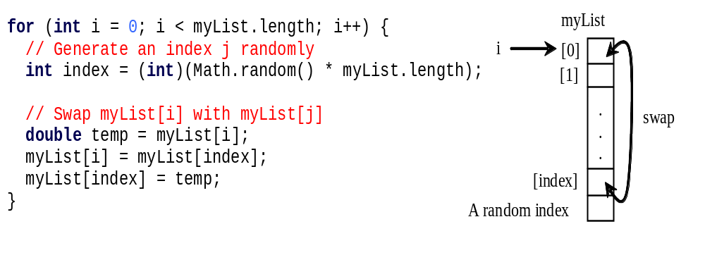
Random shuffling

Slide 34
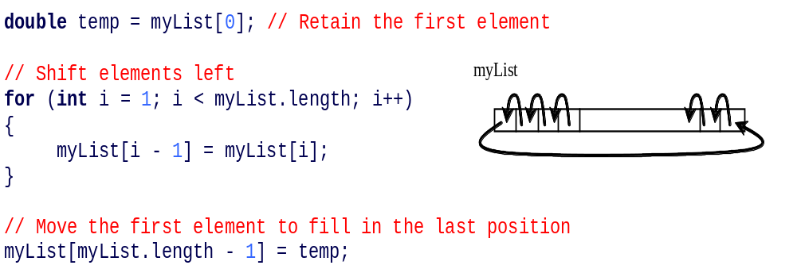
Shifting Elements

Slide 35
Enhanced for Loop (for-each loop)
Stop and Record…

Slide 36
Enhanced for Loop (for-each loop)
JDK 1.5 introduced a new for loop that enables you to traverse the complete array sequentially without using an index variable. For example, the following code displays all elements in the array myList:
  for (double value: myList)
  System.out.println(value);
In general, the syntax is
  For (elementType value: arrayRefVar) {
  // Process the value
  }
You still have to use an index variable if you wish to traverse the array in a different order or change the elements in the array.

Slide 37
Copying Arrays
For object references, an assignment statement copies the memory address NOT the array content:
name1
"Steve Jobs"
Before:
name2
"Steve Wozniak"
name2 = name1;
name1
"Steve Jobs"
After:
name2

Slide 38
Copying Arrays
Use a loop:
int[] sourceArray = {2, 3, 1, 5, 10};
int[] targetArray = new int[sourceArray.length];
for (int i = 0; i < sourceArrays.length; i++)
targetArray[i] = sourceArray[i];

Slide 39
The arraycopy Utility
arraycopy(sourceArray, src_pos, targetArray, tar_pos, length);
Example:
System.arraycopy(sourceArray, 0, targetArray, 0, sourceArray.length);
This will copy every element in sourceArray to targetArray.
Must create targetArray first.
System.arraycopy(sourceArray, 10, targetArray, 10, length);
This will copy every element in sourceArray to targetArray
starting at position 10.
Must create targetArray first.

Slide 40
Passing Arrays to Methods
public static void printArray(int[] array) {
for (int i = 0; i < array.length; i++) {
System.out.print(array[i] + " ");
}
}
Invoke the method:
int[] list = {3, 1, 2, 6, 4, 2};
printArray(list);
Invoke the method again:
printArray(new int[]{3, 1, 2, 6, 4, 2});
Anonymous (nameless) array

Slide 41
Anonymous Array
  The statement
    printArray(new int[]{3, 1, 2, 6, 4, 2});
  creates un-named array and pass it to method printArray().
  There is no explicit reference variable for the this array. Such array is called an anonymous array.

Slide 42
Pass By Value - Revisited
Java uses pass by value to pass arguments to a method. There are important differences between passing a value of variables of primitive data types and passing arrays.
For a parameter of a primitive type value, the actual value is passed. Changing the value of the local parameter inside the method does not affect the value of the variable outside the method.
For a parameter of an array type, the value of the parameter contains a reference to an array; this reference is passed to the method. Any changes to the array that occur inside the method body will affect the original array that was passed as the argument.

Slide 43
Simple Example
public class Test {
public static void main(String[] args)
{
int x = 1; // x represents an int value
int[] y = new int[10]; // y is an array of int values
myMethod(x, y); // Invoke m with arguments x and y
System.out.println("x is " + x);
System.out.println("y[0] is " + y[0]);
}
public static void myMethod(int number, int[] numbers) {
number = 1001; // Assign a new value to number, locally
numbers[0] = 5555; // Assign a new value to numbers[0]
}
}

Slide 44
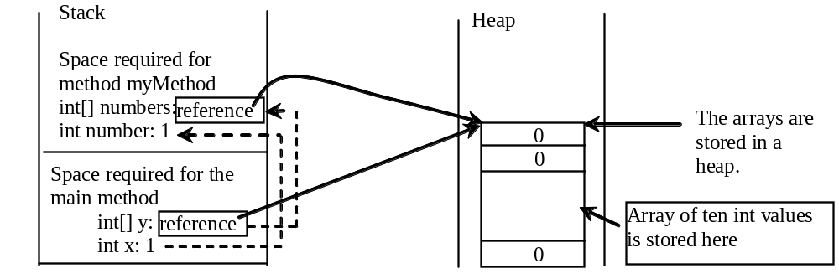
Call (Run-Time) Stack
When invoking myMethod(x, y), the values of x and y are passed to number and numbers. Since y contains the reference value to the array (memory address) , numbers now contains the same reference value to the same array.

Slide 45
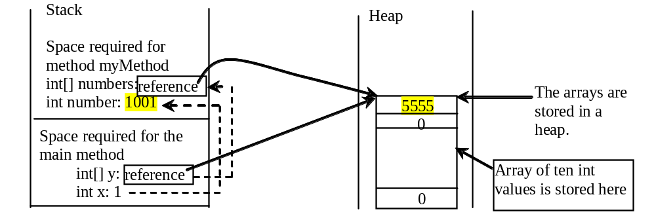
Call (Run-Time) Stack

Slide 46
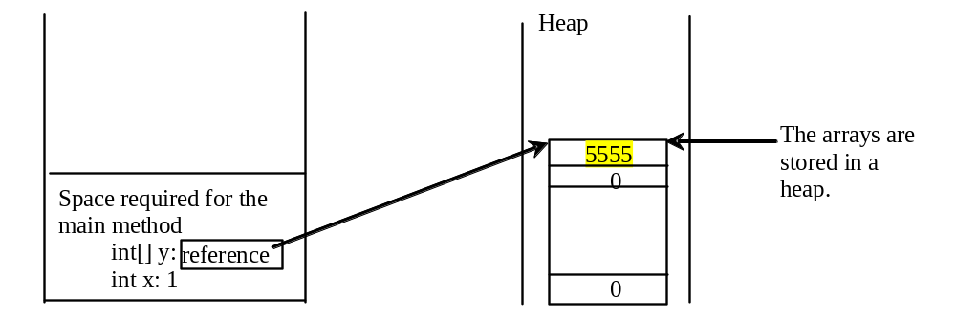
Call (Run-Time) Stack

Slide 47
Variable-Length Parameter List
Java allows a method to take variables number of parameters of the same type. The parameter list is treated as an array.
public class VarArgsDemo {
public static void main (String[] args) {
printMax(50, 29, 19, 2, 98, 16);
printMax(150, 300, 275);
printMax(new int[] {1,2,3,4,5,6});
}
public static void printMax(int... numbers) {
if (numbers.length == 0) {
System.out.println("No arguments passed! ");
return; // to exit the method, not to return a value
}
int result = numbers[0];
for (int i=1; i<numbers.length; i++)
if (numbers[i] > result)
result = numbers[i];
System.out.println("The max value is " + result);
}
}

Slide 48
Searching Arrays
Searching is the process of looking for a specific element in an array. The element may be found or may not.
How? Two commonly used methods are:
- linear search: search all elements in sequence from
first to last.
- binary search: search an ordered array taking into
consideration one-half of the array in
each stop.

Slide 49
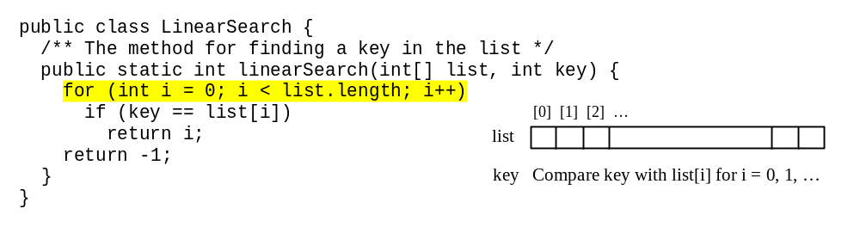
Linear Search
The linear search approach compares the key element, key or target, sequentially with each element in the array list. The method continues to do so until the key matches an element in the list or the list is exhausted without a match being found. If a match is made, the linear search returns the index of the element in the array that matches the key. If no match is found, the search returns -1.

Slide 50
Linear Search Animation
animation
Key
List
3
6 | 4 | 1 | 9 | 7 | 3 | 2 | 8
3
6 | 4 | 1 | 9 | 7 | 3 | 2 | 8
3
6 | 4 | 1 | 9 | 7 | 3 | 2 | 8
3
6 | 4 | 1 | 9 | 7 | 3 | 2 | 8
3
6 | 4 | 1 | 9 | 7 | 3 | 2 | 8
3
6 | 4 | 1 | 9 | 7 | 3 | 2 | 8

Slide 51
Binary Search
For binary search to work, the elements in the array must already be ordered. Without loss of generality, assume that the array is in ascending order.
  e.g.: 2 4 7 10 11 45 50 59 60 66 69 70 79
The binary search first compares the key with the element in the middle of the array.
If the key is less than the middle element, you only need to search
the key in the first half of the array.
If the key is equal to the middle element, the search ends with a
match.
If the key is greater than the middle element, you only need to
search the key in the second half of the array.

Slide 52
Binary Search
animation
Key
List
8
1 | 2 | 3 | 4 | 6 | 7 | 8 | 9
8
1 | 2 | 3 | 4 | 6 | 7 | 8 | 9
8
1 | 2 | 3 | 4 | 6 | 7 | 8 | 9

Slide 53
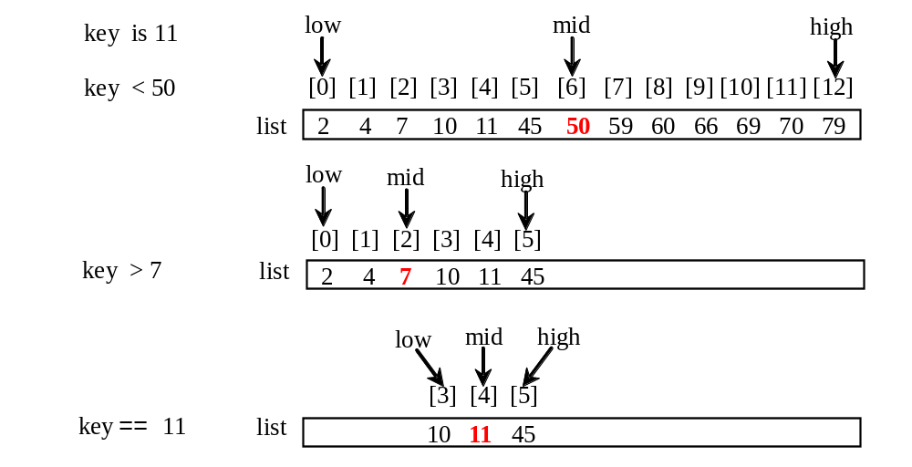
Binary Search, cont.

Slide 54
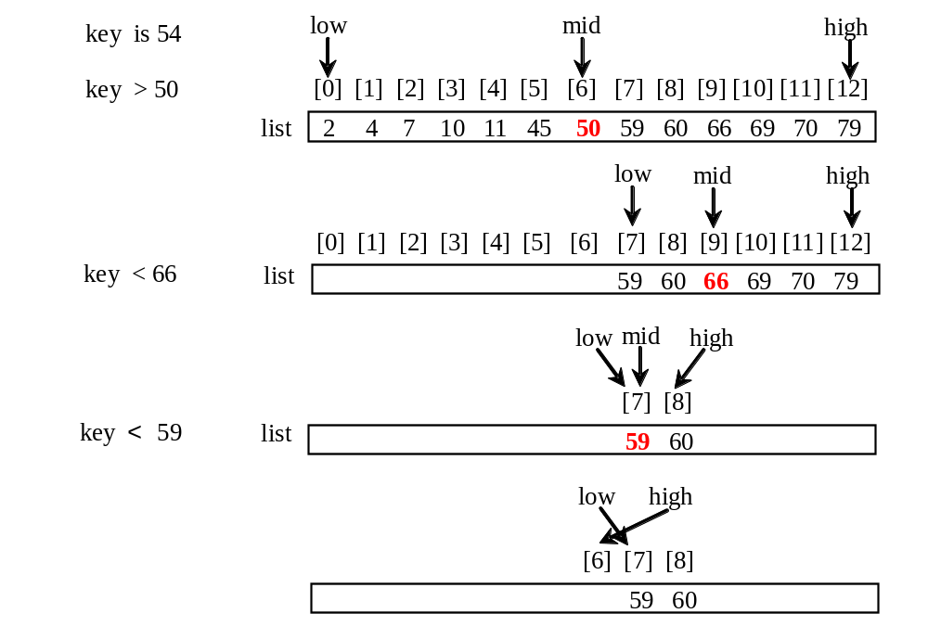
Binary Search, cont.

Slide 55
The Solution
/** Use binary search to find the key in the list */
public static int binarySearch(int[] list, int key) {
int low = 0;
int high = list.length - 1;
while (high >= low) {
int mid = (low + high) / 2; // middle element
if (key < list[mid])
high = mid - 1;
else if (key == list[mid])
return mid; // target is found
else
low = mid + 1;
}
return -1 - low; // target not found!
}

Slide 56
Class Arrays
Since binary search is frequently used in programming, Java provides several overloaded binarySearch methods for searching a key in an array of int, double, char, short, long, and float in the java.util.Arrays class. For example:
  import java.util.*;
  int[] list = {2,4,7,10,11,45,50,59,60,66,69,70,79};
  System.out.println("Index of value 11 is " +
  Arrays.binarySearch(list, 11));
  char[] chars = {'a','c','g','x','y','z'};
  System.out.println("Index of letter t is " +
  Arrays.binarySearch(chars, 't'));
Note: This call returns –4 (insertion point is 3, so return is -3-1)
For the binarySearch method to work, the array must be pre-sorted in increasing order. See section 7.12, page 272, for other methods in class Arrays (sort, equals, fill, toString)

Slide 57
Sorting Arrays
Sorting, like searching, is also a common task in computer programming. Many different algorithms have been developed for sorting.
This section introduces algorithm selection sort.

Slide 58
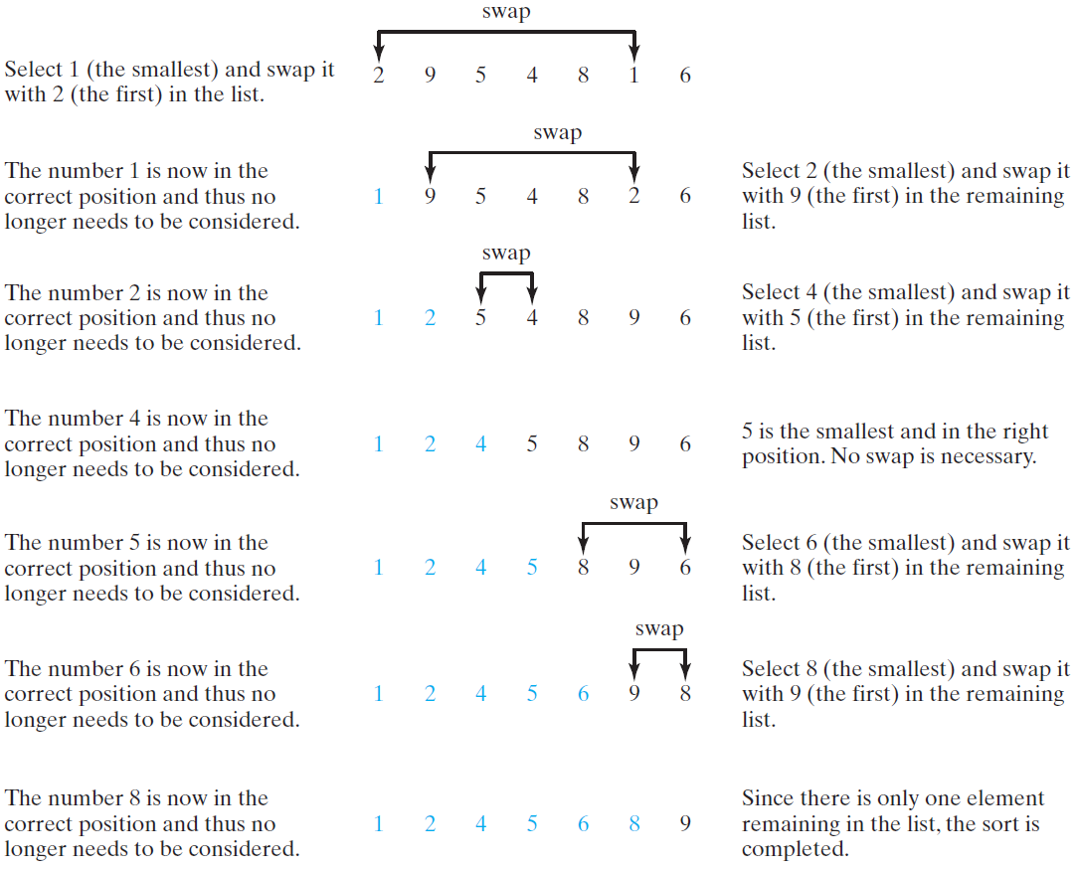
Selection Sort
Selection sort finds the smallest number in the list and places it first. It then finds the smallest number remaining and places it second, and so on until the list contains only a single number.

Slide 59
The Algorithm
for (int i = 0; i < list.length; i++) {
// select the smallest element in list[i..listSize-1];
// swap the smallest with list[i], if necessary;
// list[i] is in its correct position.
// The next iteration apply on list[i..listSize-1]
}
list[0] list[1] list[2] list[3] ... list[10]
list[0] list[1] list[2] list[3] ... list[10]
list[0] list[1] list[2] list[3] ... list[10]
list[0] list[1] list[2] list[3] ... list[10]
list[0] list[1] list[2] list[3] ... list[10]
...
list[0] list[1] list[2] list[3] ... list[10]

Slide 60
The Code
/** The method for sorting the numbers */
public static void selectionSort(double[] list) {
for (int i = 0; i < list.length; i++) {
// Find the minimum in the list[i..list.length-1]
double currentMin = list[i];
int currentMinIndex = i;
for (int j = i + 1; j < list.length; j++) {
if (currentMin > list[j]) {
currentMin = list[j];
currentMinIndex = j;
}
}
// Swap list[i] with list[currentMinIndex] if necessary;
if (currentMinIndex != i) {
list[currentMinIndex] = list[i];
list[i] = currentMin;
}
}
}

Slide 61
Arrays.sort Method
Since sorting is frequently used in programming, Java provides several overloaded sort methods for sorting an array of int, double, char, short, long, and float in the java.util.Arrays class. For example, the following code sorts an array of numbers and an array of characters.
  import java.util.*;
  double[] numbers = {6.0, 4.4, 1.9, 2.9, 3.4, 3.5};
  Arrays.sort(numbers);
  char[] chars = {'a', 'A', '4', 'F', 'D', 'P'};
  Arrays.sort(chars);

Slide 62
Arrays.toString(list) Method
Method Arrays.toString(list) method can be used to return a string representation for the list.
  import java.util.*;
  char[] chars = {'a', 'A', '4', 'F', 'D', 'P'};
  Arrays.sort(chars); //sort the list
  //print the list
  for (int i = 0; i < chars.length; i++)
  System.out.print(chars[i]+ " ");
  System.out.println();
  //convert to string
  String myString = Arrays.toString(chars);
  System.out.println (myString);
  Output:
  4 A D F P a
  [4, A, D, F, P, a]

Slide 63
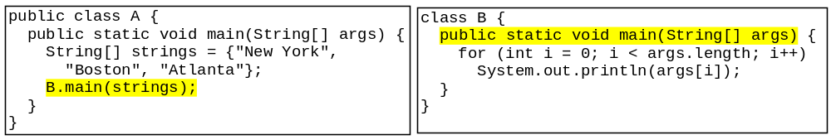
Passing Arguments to Main Method
You can call a regular method by passing actual parameters. Can you pass arguments to main? Of course, yes. For example, the main method in class B is invoked by a method in A, as shown below:

Slide 64
End of Chapter 7

