Slide 1
Chapter 12 Exception Handling and Text IO

Slide 2
Motivations
When a program runs into a runtime error, the program terminates abnormally. How can you handle the runtime error so that the program can continue to run or terminate gracefully? This is the subject we will introduce in this chapter.

Slide 3
Objectives
To get an overview of exceptions and exception handling (§12.2).
To explore the advantages of using exception handling (§12.2).
To distinguish exception types: Error (fatal) vs. Exception (nonfatal) and checked vs. unchecked (§12.3).
To declare exceptions in a method header (§12.4.1).
To throw exceptions in a method (§12.4.2).
To write a try-catch block to handle exceptions (§12.4.3).
To explain how an exception is propagated (§12.4.3).
To obtain information from an exception object (§12.4.4).
To develop applications with exception handling (§12.4.5).
To use the finally clause in a try-catch block (§12.5).
To use exceptions only for unexpected errors (§12.6).
To rethrow exceptions in a catch block (§12.7).
To create chained exceptions (§12.8).
To define custom exception classes (§12.9).
To discover file/directory properties, to delete and rename files/directories, and to create directories using the File class (§12.10).
To write data to a file using the PrintWriter class (§12.11.1).
To use try-with-resources to ensure that the resources are closed automatically (§12.11.2).
To read data from a file using the Scanner class (§12.11.3).
To understand how data is read using a Scanner (§12.11.4).
To develop a program that replaces text in a file (§12.11.5).
To read data from the Web (§12.12).
To develop a Web crawler (§12.13).

Slide 4
Exception-Handling Overview
Show runtime error
Quotient
Run
Fix it using an if statement
QuotientWithIf
Run
With a method
QuotientWithMethod
Run

Slide 5
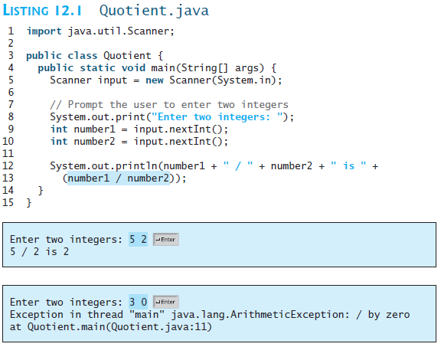

Slide 6
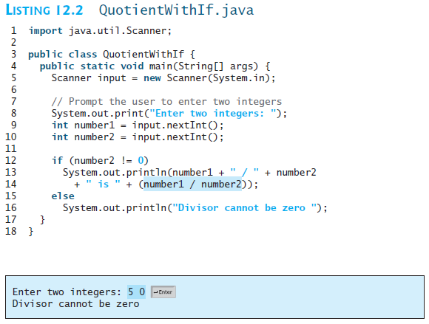

Slide 7
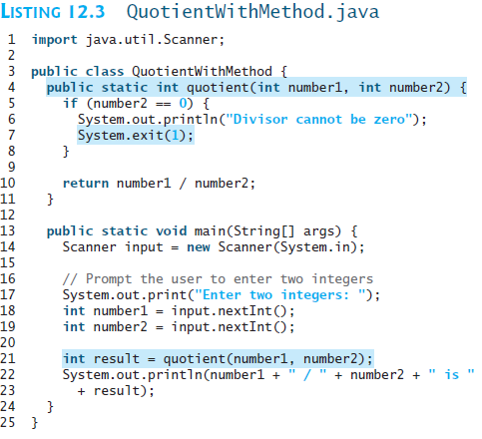
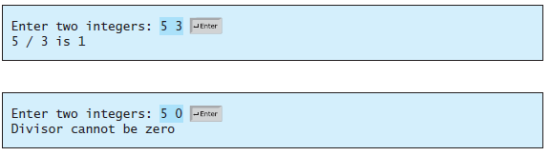

Slide 8
Exception Advantages
QuotientWithException
Run
Now you see the advantages of using exception handling. It enables a method to throw an exception to its caller. Without this capability, a method must handle the exception or terminate the program.

Slide 9
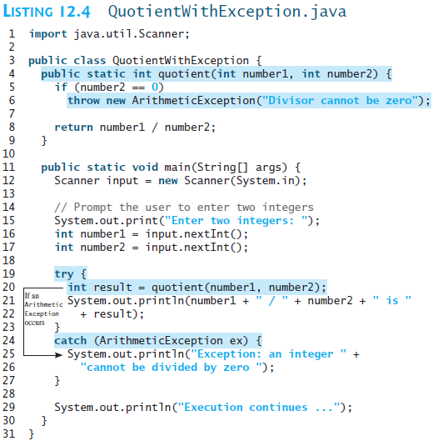

Slide 10



Slide 11
Handling InputMismatchException
InputMismatchExceptionDemo
Run
By handling InputMismatchException, your program will continuously read an input until it is correct.

Slide 12
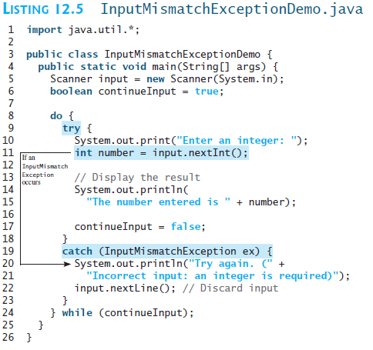


Slide 13

Exception Types

Slide 14
System Errors
System errors are thrown by JVM and represented in the Error class. The Error class describes internal system errors. Such errors rarely occur. If one does, there is little you can do beyond notifying the user and trying to terminate the program gracefully.

Slide 15
Exceptions
Exception describes errors caused by your program and external circumstances. These errors can be caught and handled by your program.

Slide 16
Runtime Exceptions
RuntimeException is caused by programming errors, such as bad casting, accessing an out-of-bounds array, and numeric errors.

Slide 17
Checked Exceptions vs. Unchecked Exceptions
RuntimeException, Error and their subclasses are known as unchecked exceptions. All other exceptions are known as checked exceptions, meaning that the compiler forces the programmer to check and deal with the exceptions.

Slide 18
Unchecked Exceptions
In most cases, unchecked exceptions reflect programming logic errors that are not recoverable. For example, a NullPointerException is thrown if you access an object through a reference variable before an object is assigned to it; an IndexOutOfBoundsException is thrown if you access an element in an array outside the bounds of the array. These are the logic errors that should be corrected in the program. Unchecked exceptions can occur anywhere in the program. To avoid cumbersome overuse of try-catch blocks, Java does not mandate you to write code to catch unchecked exceptions.

Slide 19
Unchecked Exceptions
Unchecked exception.

Slide 20

Declaring, Throwing, and Catching Exceptions

Slide 21
Declaring Exceptions
Every method must state the types of checked exceptions it might throw. This is known as declaring exceptions.
public void myMethod()
throws IOException
public void myMethod()
throws IOException, OtherException

Slide 22
Throwing Exceptions
When the program detects an error, the program can create an instance of an appropriate exception type and throw it. This is known as throwing an exception. Here is an example,
throw new TheException();
TheException ex = new TheException();
throw ex;

Slide 23
Throwing Exceptions Example
/** Set a new radius */
public void setRadius(double newRadius)
throws IllegalArgumentException {
if (newRadius >= 0)
radius = newRadius;
else
throw new IllegalArgumentException(
"Radius cannot be negative");
}

Slide 24
Catching Exceptions
try {
statements; // Statements that may throw exceptions
}
catch (Exception1 exVar1) {
handler for exception1;
}
catch (Exception2 exVar2) {
handler for exception2;
}
...
catch (ExceptionN exVar3) {
handler for exceptionN;
}

Slide 25

Catching Exceptions

Slide 26
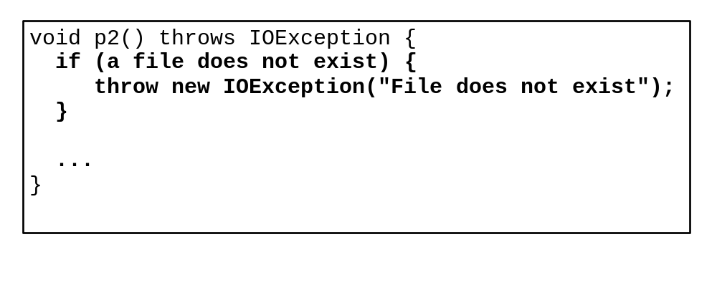
Catch or Declare Checked Exceptions
Suppose p2 is defined as follows:

Slide 27
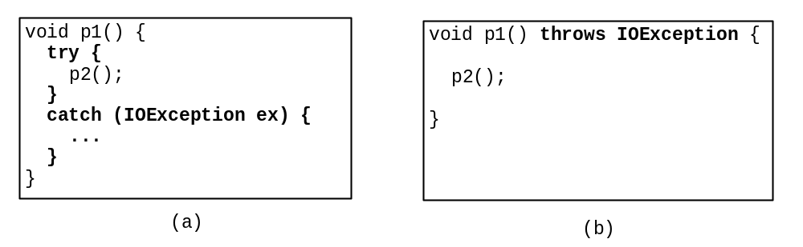
Catch or Declare Checked Exceptions
Java forces you to deal with checked exceptions. If a method declares a checked exception (i.e., an exception other than Error or RuntimeException), you must invoke it in a try-catch block or declare to throw the exception in the calling method. For example, suppose that method p1 invokes method p2 and p2 may throw a checked exception (e.g., IOException), you have to write the code as shown in (a) or (b).

Slide 28
Example: Declaring, Throwing, and Catching Exceptions
Objective: This example demonstrates declaring, throwing, and catching exceptions by modifying the setRadius method in the Circle class defined in Chapter 8. The new setRadius method throws an exception if radius is negative.
TestCircleWithException
CircleWithException
Run

Slide 29
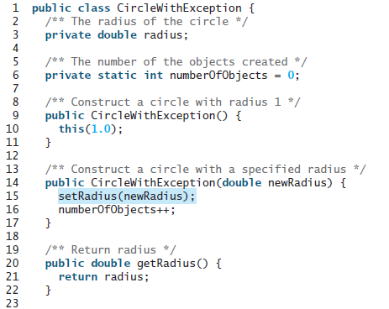

Slide 30
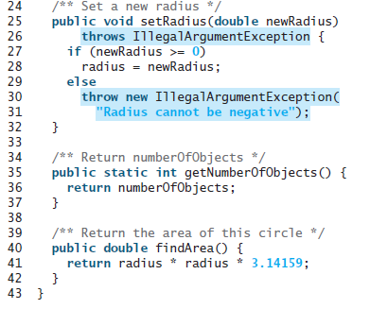

Slide 31
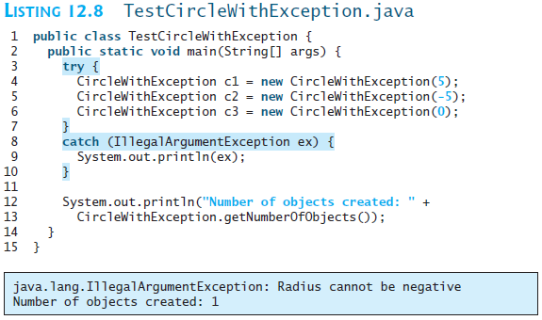

Slide 32
Rethrowing Exceptions
try {
statements;
}
catch(TheException ex) {
perform operations before exits;
throw ex;
}

Slide 33
The finally Clause
try {
statements;
}
catch(TheException ex) {
handling ex;
}
finally {
finalStatements;
}

Slide 34
Trace a Program Execution
animation
Suppose no exceptions in the statements
try {
statements;
}
catch(TheException ex) {
handling ex;
}
finally {
finalStatements;
}
Next statement;

Slide 35
Trace a Program Execution
animation
The final block is always executed
try {
statements;
}
catch(TheException ex) {
handling ex;
}
finally {
finalStatements;
}
Next statement;

Slide 36
Trace a Program Execution
animation
Next statement in the method is executed
try {
statements;
}
catch(TheException ex) {
handling ex;
}
finally {
finalStatements;
}
Next statement;

Slide 37
Trace a Program Execution
animation
try {
statement1;
statement2;
statement3;
}
catch(Exception1 ex) {
handling ex;
}
finally {
finalStatements;
}
Next statement;
Suppose an exception of type Exception1 is thrown in statement2

Slide 38
Trace a Program Execution
animation
try {
statement1;
statement2;
statement3;
}
catch(Exception1 ex) {
handling ex;
}
finally {
finalStatements;
}
Next statement;
The exception is handled.

Slide 39
Trace a Program Execution
animation
try {
statement1;
statement2;
statement3;
}
catch(Exception1 ex) {
handling ex;
}
finally {
finalStatements;
}
Next statement;
The final block is always executed.

Slide 40
Trace a Program Execution
animation
try {
statement1;
statement2;
statement3;
}
catch(Exception1 ex) {
handling ex;
}
finally {
finalStatements;
}
Next statement;
The next statement in the method is now executed.

Slide 41
Trace a Program Execution
animation
try {
statement1;
statement2;
statement3;
}
catch(Exception1 ex) {
handling ex;
}
catch(Exception2 ex) {
handling ex;
throw ex;
}
finally {
finalStatements;
}
Next statement;
statement2 throws an exception of type Exception2.

Slide 42
Trace a Program Execution
animation
try {
statement1;
statement2;
statement3;
}
catch(Exception1 ex) {
handling ex;
}
catch(Exception2 ex) {
handling ex;
throw ex;
}
finally {
finalStatements;
}
Next statement;
Handling exception

Slide 43
Trace a Program Execution
animation
try {
statement1;
statement2;
statement3;
}
catch(Exception1 ex) {
handling ex;
}
catch(Exception2 ex) {
handling ex;
throw ex;
}
finally {
finalStatements;
}
Next statement;
Execute the final block

Slide 44
Trace a Program Execution
animation
try {
statement1;
statement2;
statement3;
}
catch(Exception1 ex) {
handling ex;
}
catch(Exception2 ex) {
handling ex;
throw ex;
}
finally {
finalStatements;
}
Next statement;
Rethrow the exception and control is transferred to the caller

Slide 45
Cautions When Using Exceptions
Exception handling separates error-handling code from normal programming tasks, thus making programs easier to read and to modify. Be aware, however, that exception handling usually requires more time and resources because it requires instantiating a new exception object, rolling back the call stack, and propagating the errors to the calling methods.

Slide 46
When to Throw Exceptions
An exception occurs in a method. If you want the exception to be processed by its caller, you should create an exception object and throw it. If you can handle the exception in the method where it occurs, there is no need to throw it.

Slide 47
When to Use Exceptions
When should you use the try-catch block in the code? You should use it to deal with unexpected error conditions. Do not use it to deal with simple, expected situations. For example, the following code
try {
System.out.println(refVar.toString());
}
catch (NullPointerException ex) {
System.out.println("refVar is null");
}

Slide 48
When to Use Exceptions
is better to be replaced by
if (refVar != null)
System.out.println(refVar.toString());
else
System.out.println("refVar is null");

Slide 49
Defining Custom Exception Classes
Use the exception classes in the API whenever possible.
Define custom exception classes if the predefined classes are not sufficient.
Define custom exception classes by extending Exception or a subclass of Exception.

Slide 50
Custom Exception Class Example
In Listing 13.8, the setRadius method throws an exception if the radius is negative. Suppose you wish to pass the radius to the handler, you have to create a custom exception class.
InvalidRadiusException
CircleWithRadiusException
TestCircleWithRadiusException
Run

Slide 51
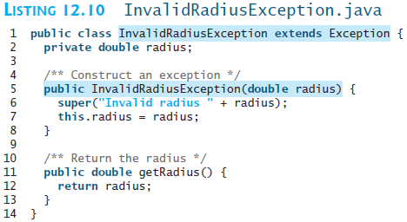

Slide 52
CircleWithRadiusException
CircleWithRadiusException.java ???

Slide 53
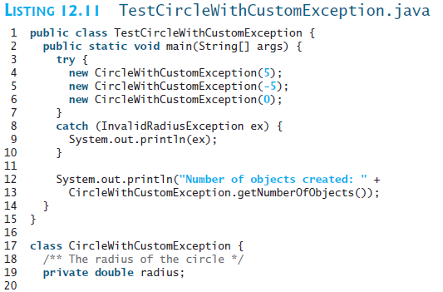

Slide 54
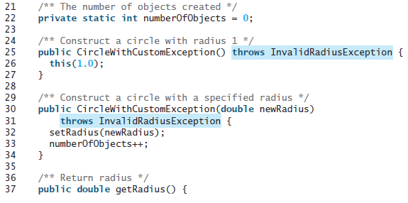


Slide 55
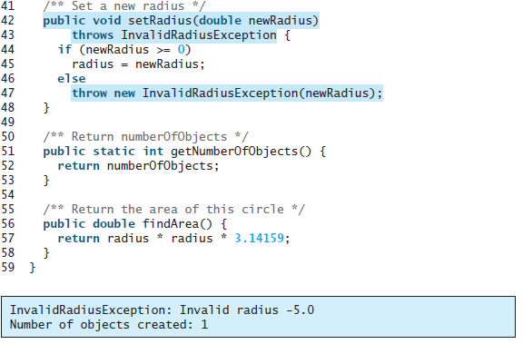

Slide 56
Assertions
Companion Website
An assertion is a Java statement that enables you to assert an assumption about your program. An assertion contains a Boolean expression that should be true during program execution. Assertions can be used to assure program correctness and avoid logic errors.

Slide 57
Declaring Assertions
Companion Website
An assertion is declared using the new Java keyword assert in JDK 1.4 as follows:
assert assertion; or
assert assertion : detailMessage;
where assertion is a Boolean expression and detailMessage is a primitive-type or an Object value.

Slide 58
Executing Assertions
Companion Website
When an assertion statement is executed, Java evaluates the assertion. If it is false, an AssertionError will be thrown. The AssertionError class has a no-arg constructor and seven overloaded single-argument constructors of type int, long, float, double, boolean, char, and Object.
For the first assert statement with no detail message, the no-arg constructor of AssertionError is used. For the second assert statement with a detail message, an appropriate AssertionError constructor is used to match the data type of the message. Since AssertionError is a subclass of Error, when an assertion becomes false, the program displays a message on the console and exits.

Slide 59
Executing Assertions Example
Companion Website
public class AssertionDemo {
public static void main(String[] args) {
int i; int sum = 0;
for (i = 0; i < 10; i++) {
sum += i;
}
assert i == 10;
assert sum > 10 && sum < 5 * 10 : "sum is " + sum;
}
}

Slide 60
Compiling Programs with Assertions
Companion Website
Since assert is a new Java keyword introduced in JDK 1.4, you have to compile the program using a JDK 1.4 compiler. Furthermore, you need to include the switch –source 1.4 in the compiler command as follows:
javac –source 1.4 AssertionDemo.java
NOTE: If you use JDK 1.5, there is no need to use the –source 1.4 option in the command.

Slide 61
Running Programs with Assertions
Companion Website
By default, the assertions are disabled at runtime. To enable it, use the switch –enableassertions, or –ea for short, as follows:
java –ea AssertionDemo
Assertions can be selectively enabled or disabled at class level or package level. The disable switch is –disableassertions or –da for short. For example, the following command enables assertions in package package1 and disables assertions in class Class1.
java –ea:package1 –da:Class1 AssertionDemo

Slide 62
Using Exception Handling or Assertions
Companion Website
Assertion should not be used to replace exception handling. Exception handling deals with unusual circumstances during program execution. Assertions are to assure the correctness of the program. Exception handling addresses robustness and assertion addresses correctness. Like exception handling, assertions are not used for normal tests, but for internal consistency and validity checks. Assertions are checked at runtime and can be turned on or off at startup time.

Slide 63
Using Exception Handling or Assertions, cont.
Companion Website
Do not use assertions for argument checking in public methods. Valid arguments that may be passed to a public method are considered to be part of the method’s contract. The contract must always be obeyed whether assertions are enabled or disabled. For example, the following code in the Circle class should be rewritten using exception handling.
public void setRadius(double newRadius) {
assert newRadius >= 0;
radius = newRadius;
}

Slide 64
Using Exception Handling or Assertions, cont.
Companion Website
Use assertions to reaffirm assumptions. This gives you more confidence to assure correctness of the program. A common use of assertions is to replace assumptions with assertions in the code.

Slide 65
Using Exception Handling or Assertions, cont.
Companion Website
Another good use of assertions is place assertions in a switch statement without a default case. For example,
switch (month) {
case 1: ... ; break;
case 2: ... ; break;
...
case 12: ... ; break;
default: assert false : "Invalid month: " + month
}

Slide 66
The File Class
The File class is intended to provide an abstraction that deals with most of the machine-dependent complexities of files and path names in a machine-independent fashion. The filename is a string. The File class is a wrapper class for the file name and its directory path.

Slide 67
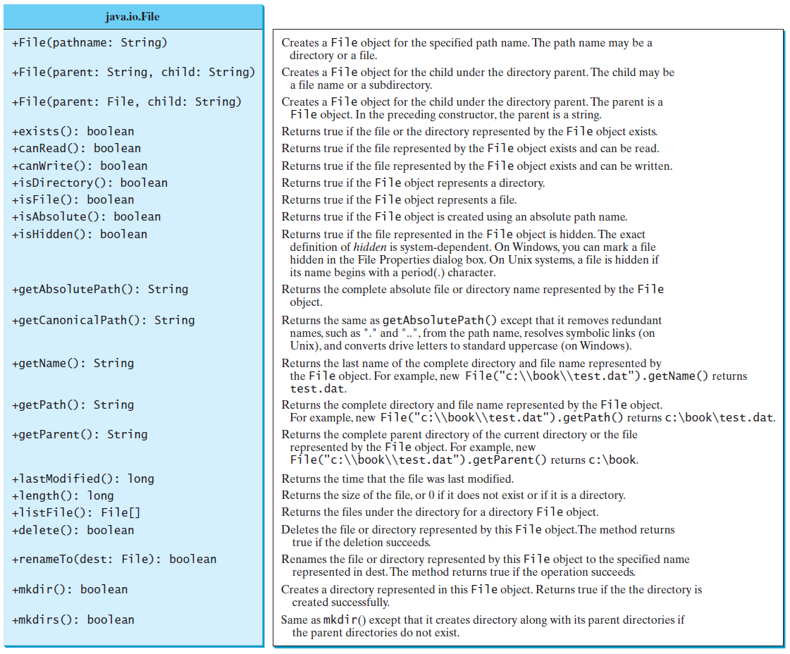
Obtaining file properties and manipulating file

Slide 68


Problem: Explore File Properties
Objective: Write a program that demonstrates how to create files in a platform-independent way and use the methods in the File class to obtain their properties. The following figures show a sample run of the program on Windows and on Unix.
TestFileClass
Run

Slide 69
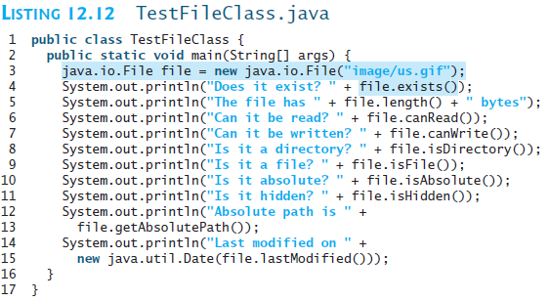

Slide 70
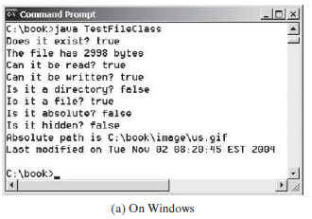
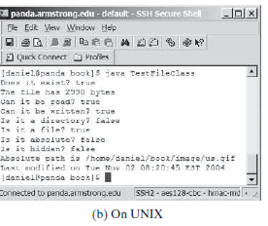

Slide 71
Text I/O
A File object encapsulates the properties of a file or a path, but does not contain the methods for reading/writing data from/to a file. In order to perform I/O, you need to create objects using appropriate Java I/O classes. The objects contain the methods for reading/writing data from/to a file. This section introduces how to read/write strings and numeric values from/to a text file using the Scanner and PrintWriter classes.

Slide 72

Writing Data Using PrintWriter
WriteData
Run

Slide 73
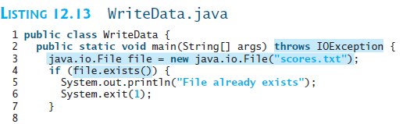
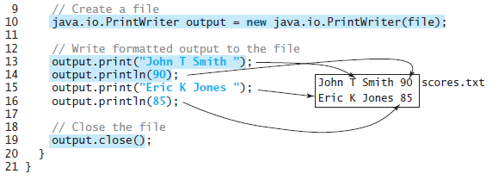

Slide 74
Try-with-resources
Programmers often forget to close the file. JDK 7 provides the followings new try-with-resources syntax that automatically closes the files.
try (declare and create resources) {
Use the resource to process the file;
}
WriteDataWithAutoClose
Run

Slide 75
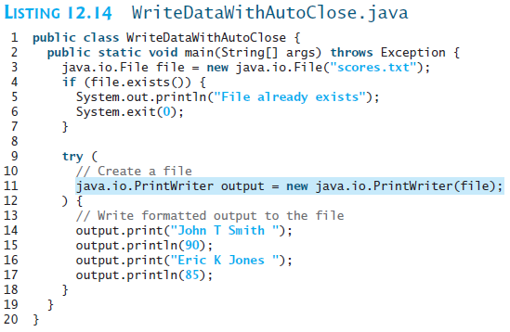

Slide 76
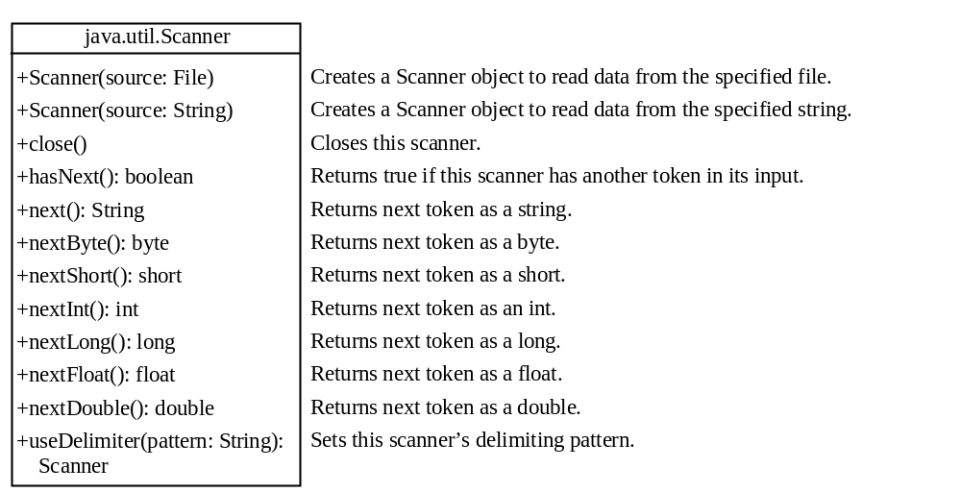
Reading Data Using Scanner
ReadData
Run

Slide 77
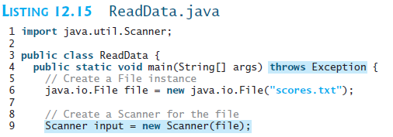
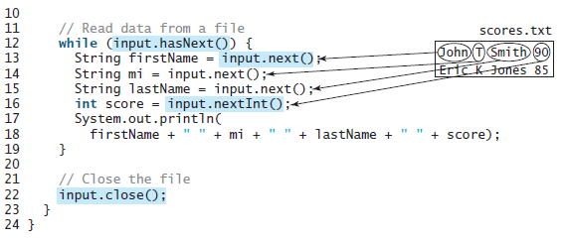

Slide 78
Problem: Replacing Text
Write a class named ReplaceText that replaces a string in a text file with a new string. The filename and strings are passed as command-line arguments as follows:
  java ReplaceText sourceFile targetFile oldString newString
For example, invoking
  java ReplaceText FormatString.java t.txt StringBuilder StringBuffer
replaces all the occurrences of StringBuilder by StringBuffer in FormatString.java and saves the new file in t.txt.
ReplaceText
Run

Slide 79

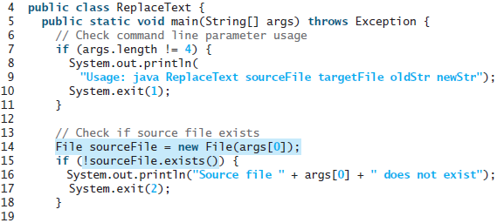

Slide 80
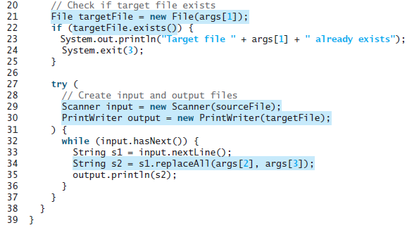

Slide 81
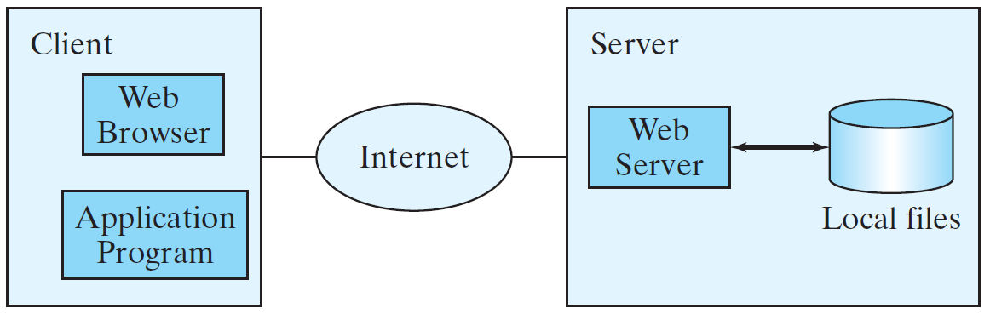
Reading Data from the Web
Just like you can read data from a file on your computer, you can read data from a file on the Web.

Slide 82
Reading Data from the Web
URL url = new URL("www.google.com/index.html");
After a URL object is created, you can use the openStream() method defined in the URL class to open an input stream and use this stream to create a Scanner object as follows:
Scanner input = new Scanner(url.openStream());
ReadFileFromURL
Run

Slide 83
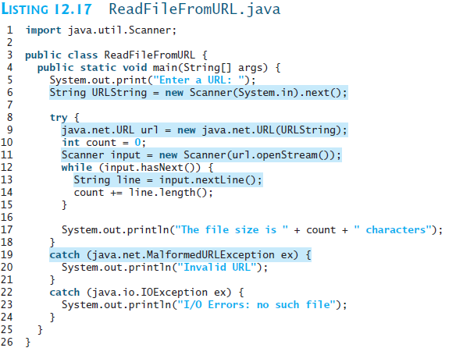
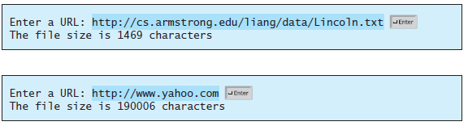

Slide 84
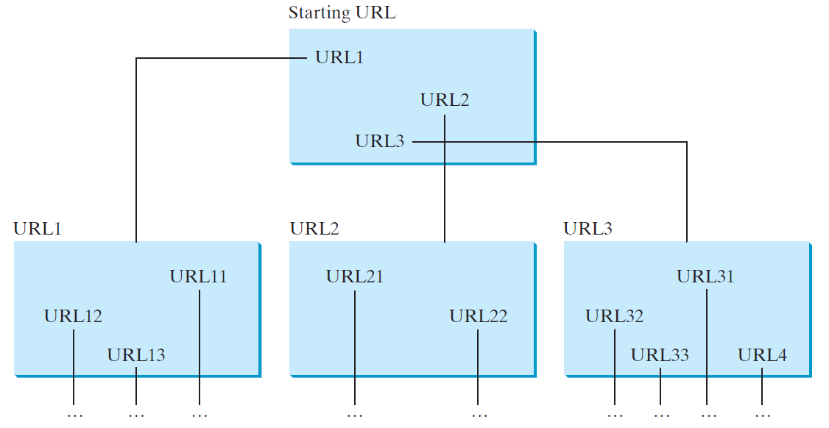
Case Study: Web Crawler
This case study develops a program that travels the Web by following hyperlinks.

Slide 85
Case Study: Web Crawler
The program follows the URLs to traverse the Web. To avoid that each URL is traversed only once, the program maintains two lists of URLs. One list stores the URLs pending for traversing and the other stores the URLs that have already been traversed. The algorithm for this program can be described as follows:

Slide 86
Case Study: Web Crawler
Add the starting URL to a list named listOfPendingURLs;
while listOfPendingURLs is not empty {
Remove a URL from listOfPendingURLs;
if this URL is not in listOfTraversedURLs {
Add it to listOfTraversedURLs;
Display this URL;
Exit the while loop when the size of S is equal to 100.
Read the page from this URL and for each URL contained in the page {
Add it to listOfPendingURLs if it is not is listOfTraversedURLs;
}
}
}
WebCrawler
Run

Slide 87
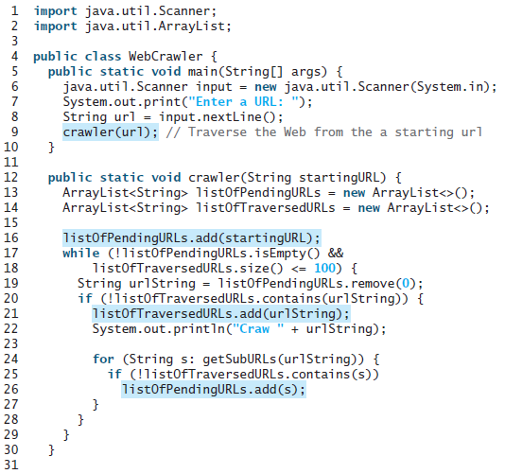

Slide 88
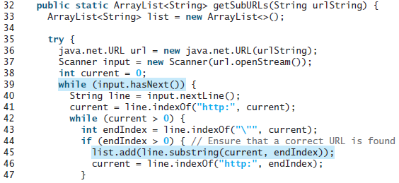
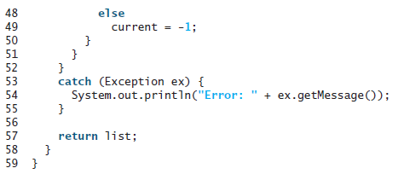

Slide 89
