Slide 1
Chapter 13 Abstract Classes and Interfaces

Slide 2
Motivations
You have learned how to write simple programs to create and display GUI components. Can you write the code to respond to user actions, such as clicking a button to perform an action?
In order to write such code, you have to know about interfaces. An interface is for defining common behavior for classes (including unrelated classes). Before discussing interfaces, we introduce a closely related subject: abstract classes.

Slide 3
Objectives
    To design and use abstract classes (§13.2).
    To generalize numeric wrapper classes, BigInteger, and BigDecimal using the abstract Number class (§13.3).
    To process a calendar using the Calendar and GregorianCalendar classes (§13.4).
    To specify common behavior for objects using interfaces (§13.5).
    To define interfaces and define classes that implement interfaces (§13.5).
    To define a natural order using the Comparable interface (§13.6).
    To make objects cloneable using the Cloneable interface (§13.7).
    To explore the similarities and differences among concrete classes, abstract classes, and interfaces (§13.8).
    To design the Rational class for processing rational numbers (§13.9).
    To design classes that follow the class-design guidelines (§13.10).

Slide 4
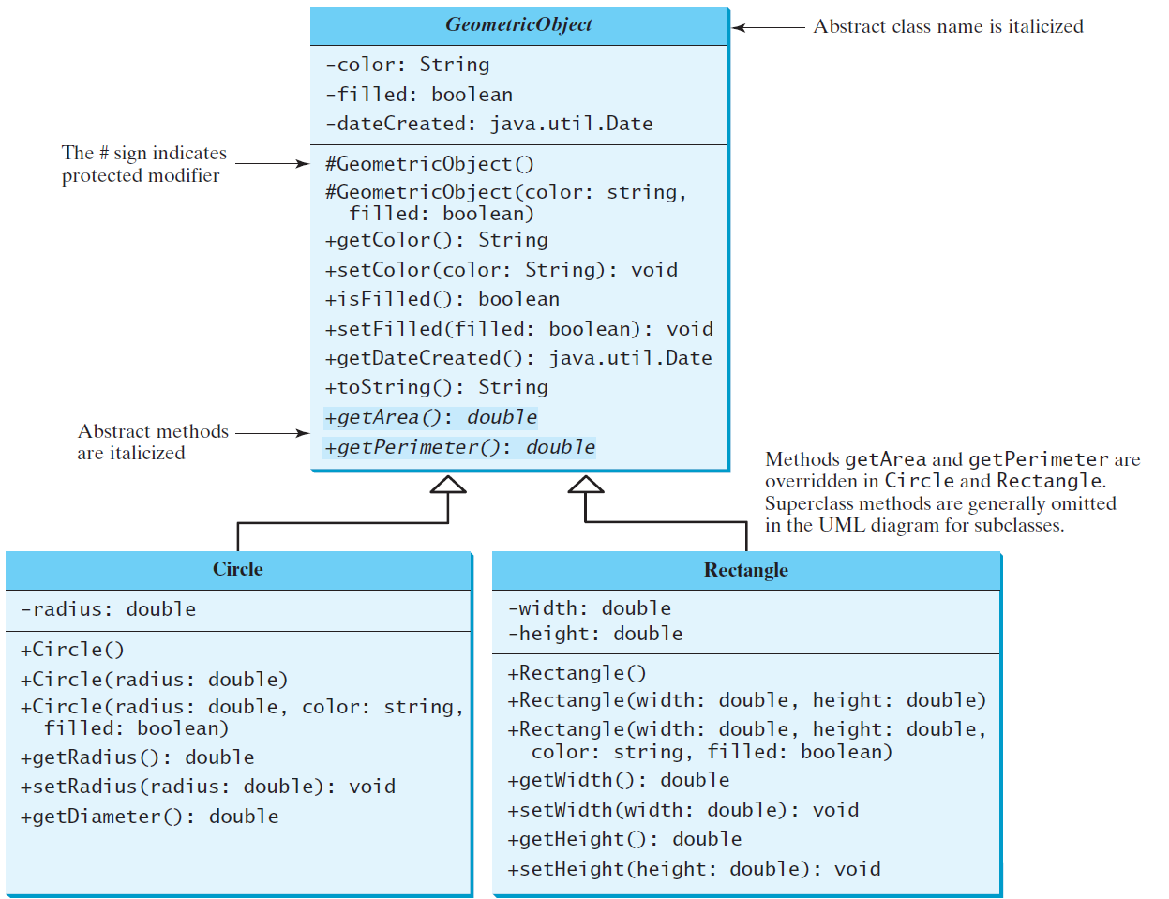
Abstract Classes and Abstract Methods
GeometricObject
Circle
Rectangle
TestGeometricObject
Run

Slide 5
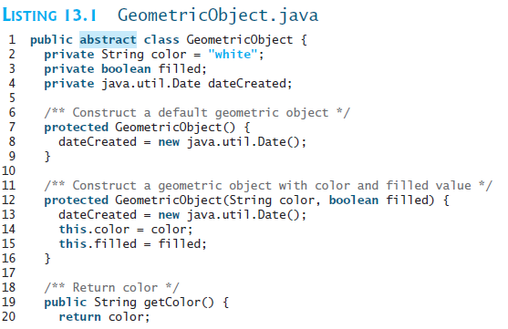

Slide 6

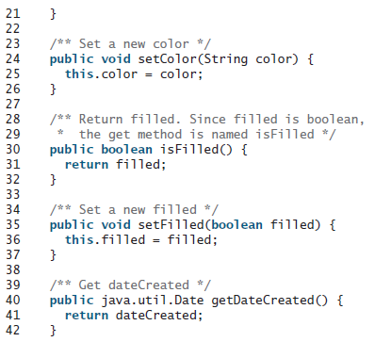
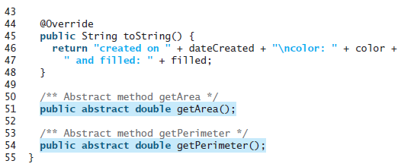

Slide 7
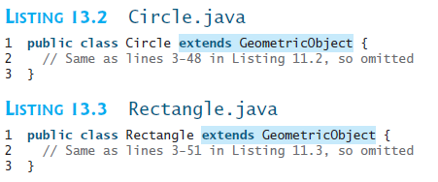

Slide 8
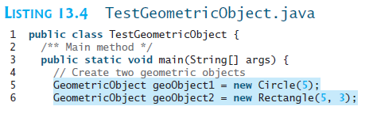
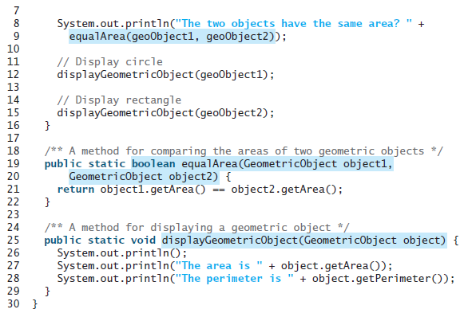

Slide 9
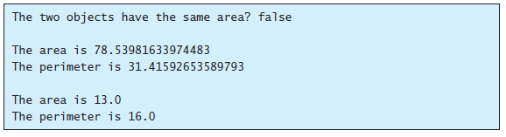

Slide 10
abstract method in abstract class
An abstract method cannot be contained in a nonabstract class. If a subclass of an abstract superclass does not implement all the abstract methods, the subclass must be defined abstract. In other words, in a nonabstract subclass extended from an abstract class, all the abstract methods must be implemented, even if they are not used in the subclass.

Slide 11
object cannot be created from abstract class
An abstract class cannot be instantiated using the new operator, but you can still define its constructors, which are invoked in the constructors of its subclasses. For instance, the constructors of GeometricObject are invoked in the Circle class and the Rectangle class.

Slide 12
abstract class without abstract method
A class that contains abstract methods must be abstract. However, it is possible to define an abstract class that contains no abstract methods. In this case, you cannot create instances of the class using the new operator. This class is used as a base class for defining a new subclass.

Slide 13
superclass of abstract class may be concrete
A subclass can be abstract even if its superclass is concrete. For example, the Object class is concrete, but its subclasses, such as GeometricObject, may be abstract.

Slide 14
concrete method overridden to be abstract
A subclass can override a method from its superclass to define it abstract. This is rare, but useful when the implementation of the method in the superclass becomes invalid in the subclass. In this case, the subclass must be defined abstract.

Slide 15
abstract class as type
You cannot create an instance from an abstract class using the new operator, but an abstract class can be used as a data type. Therefore, the following statement, which creates an array whose elements are of GeometricObject type, is correct.
GeometricObject[] geo = new GeometricObject[10];

Slide 16
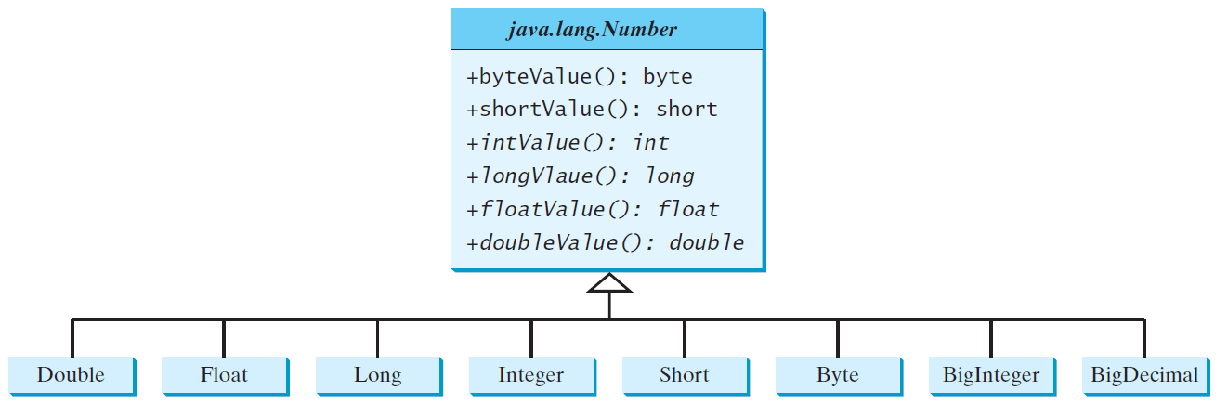
Case Study: the Abstract Number Class
LargestNumbers
Run

Slide 17
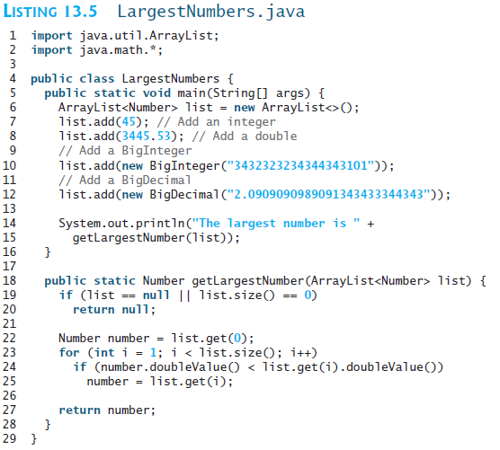

Slide 18
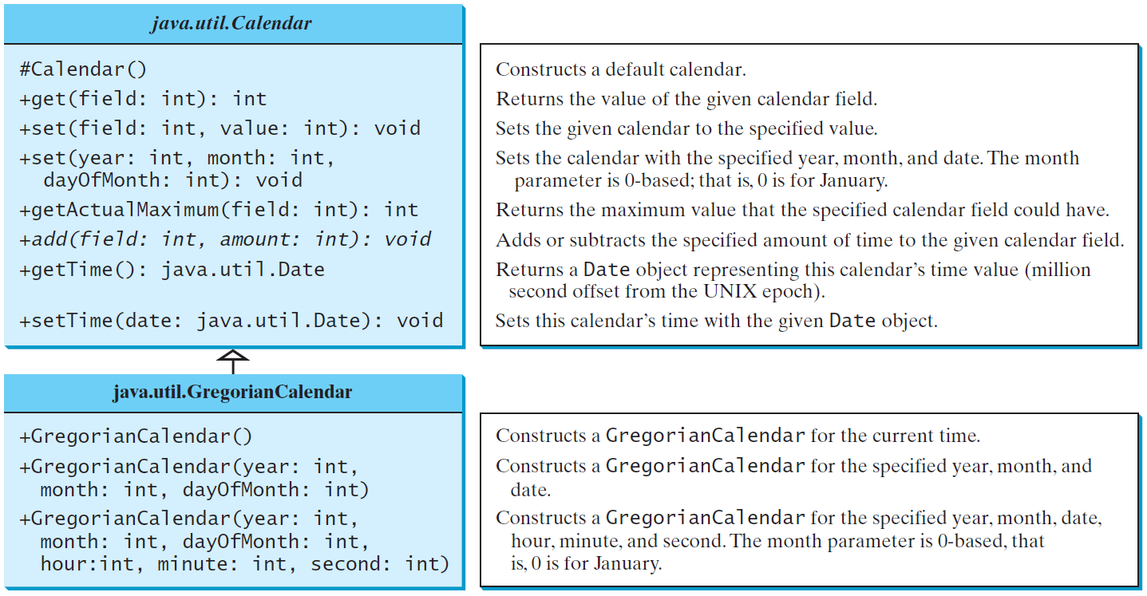
The Abstract Calendar Class and Its GregorianCalendar subclass

Slide 19
The Abstract Calendar Class and Its GregorianCalendar subclass
An instance of java.util.Date represents a specific instant in time with millisecond precision. java.util.Calendar is an abstract base class for extracting detailed information such as year, month, date, hour, minute and second from a Date object. Subclasses of Calendar can implement specific calendar systems such as Gregorian calendar, Lunar Calendar and Jewish calendar. Currently, java.util.GregorianCalendar for the Gregorian calendar is supported in the Java API.

Slide 20
The GregorianCalendar Class
You can use new GregorianCalendar() to construct a default GregorianCalendar with the current time and use new GregorianCalendar(year, month, date) to construct a GregorianCalendar with the specified year, month, and date. The month parameter is 0-based, i.e., 0 is for January.

Slide 21
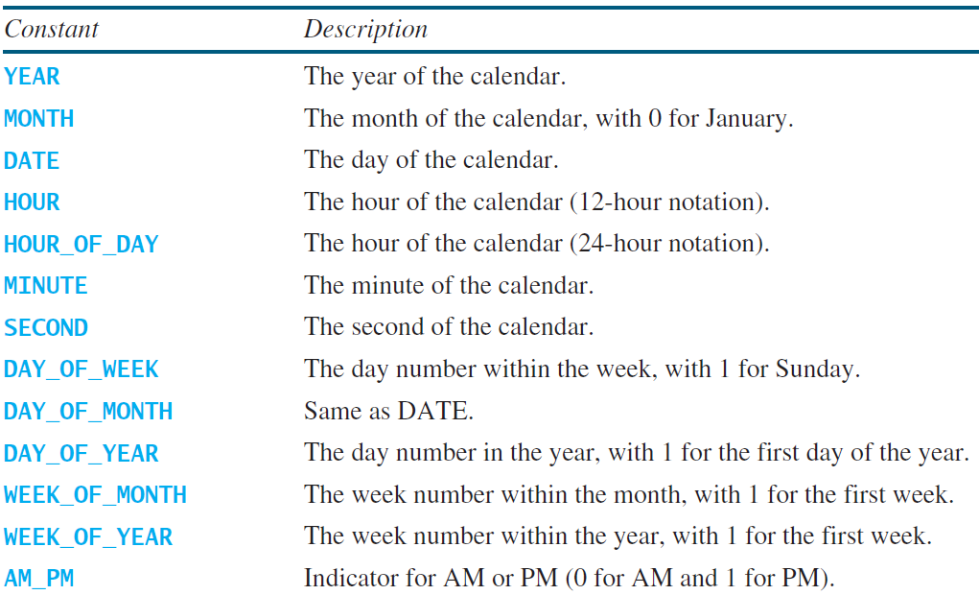
The get Method in Calendar Class
The get(int field) method defined in the Calendar class is useful to extract the date and time information from a Calendar object. The fields are defined as constants, as shown in the following.

Slide 22
Getting Date/Time Information from Calendar
TestCalendar
Run

Slide 23
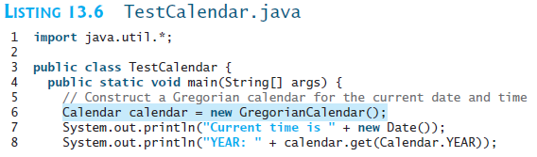
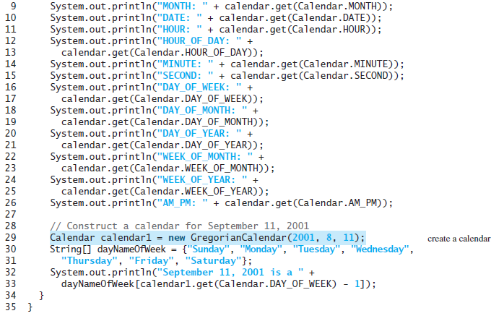

Slide 24
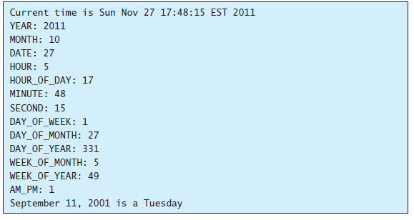

Slide 25
Interfaces
What is an interface?
Why is an interface useful?
How do you define an interface?
How do you use an interface?

Slide 26
What is an interface?
Why is an interface useful?
An interface is a classlike construct that contains only constants and abstract methods. In many ways, an interface is similar to an abstract class, but the intent of an interface is to specify common behavior for objects. For example, you can specify that the objects are comparable, edible, cloneable using appropriate interfaces.

Slide 27
Define an Interface
To distinguish an interface from a class, Java uses the following syntax to define an interface:
public interface InterfaceName {
constant declarations;
abstract method signatures;
}
Example:
public interface Edible {
/** Describe how to eat */
public abstract String howToEat();
}

Slide 28
Interface is a Special Class
An interface is treated like a special class in Java. Each interface is compiled into a separate bytecode file, just like a regular class. Like an abstract class, you cannot create an instance from an interface using the new operator, but in most cases you can use an interface more or less the same way you use an abstract class. For example, you can use an interface as a data type for a variable, as the result of casting, and so on.

Slide 29
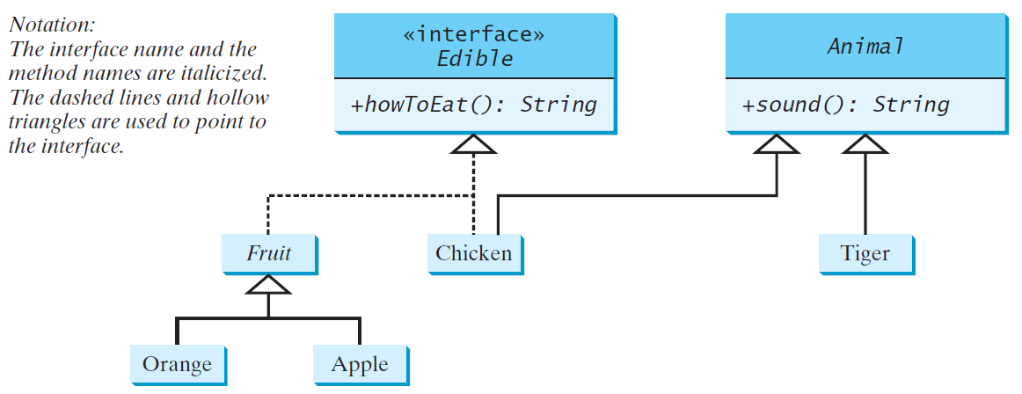
Example
You can now use the Edible interface to specify whether an object is edible. This is accomplished by letting the class for the object implement this interface using the implements keyword. For example, the classes Chicken and Fruit implement the Edible interface (See TestEdible).
Edible
TestEdible
Run

Slide 30

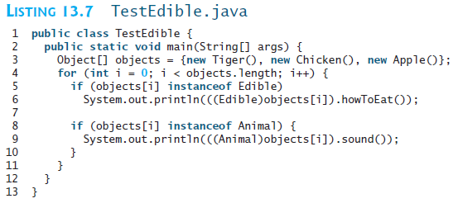
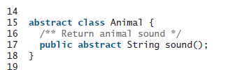

Slide 31

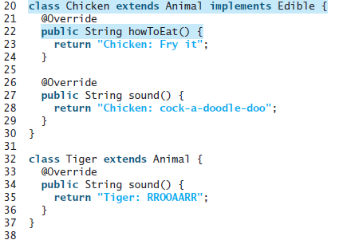

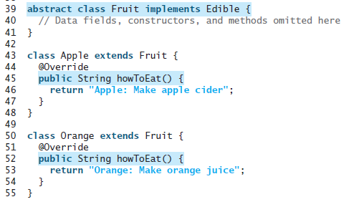

Slide 32
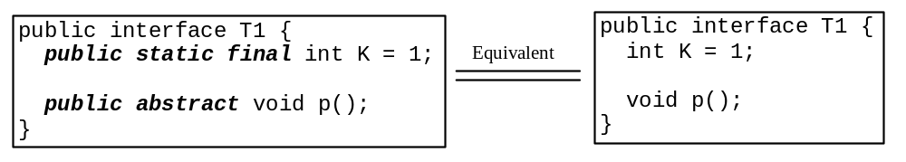
Omitting Modifiers in Interfaces
  All data fields are public final static and all methods are public abstract in an interface. For this reason, these modifiers can be omitted, as shown below:
  A constant defined in an interface can be accessed using syntax InterfaceName.CONSTANT_NAME (e.g., T1.K).

Slide 33
Example: The Comparable Interface
// This interface is defined in
// java.lang package
package java.lang;
public interface Comparable<E> {
public int compareTo(E o);
}

Slide 34
The toString, equals, and hashCode Methods
Each wrapper class overrides the toString, equals, and hashCode methods defined in the Object class. Since all the numeric wrapper classes and the Character class implement the Comparable interface, the compareTo method is implemented in these classes.

Slide 35
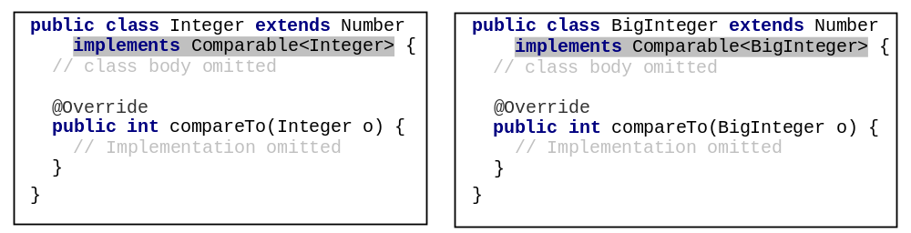
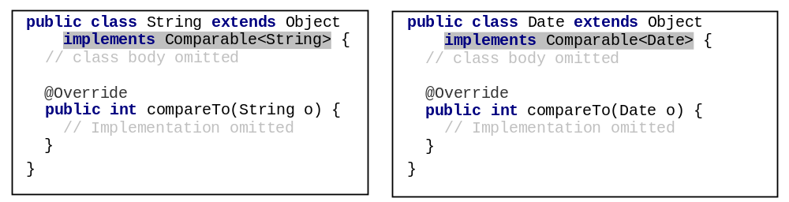
Integer and BigInteger Classes
String and Date Classes

Slide 36
Example
1 System.out.println(new Integer(3).compareTo(new Integer(5)));
2 System.out.println("ABC".compareTo("ABE"));
3 java.util.Date date1 = new java.util.Date(2013, 1, 1);
4 java.util.Date date2 = new java.util.Date(2012, 1, 1);
5 System.out.println(date1.compareTo(date2));

Slide 37
Generic sort Method
Let n be an Integer object, s be a String object, and d be a Date object. All the following expressions are true.
The java.util.Arrays.sort(array) method requires that the elements in an array are instances of Comparable<E>.
SortComparableObjects
Run

Slide 38
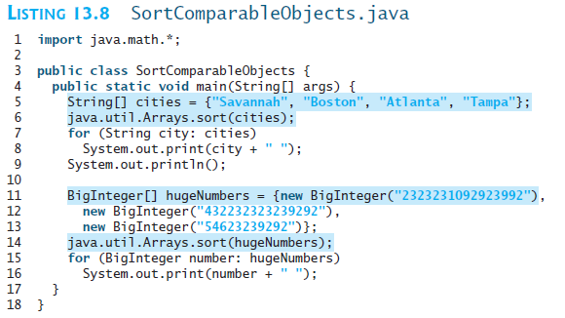


Slide 39
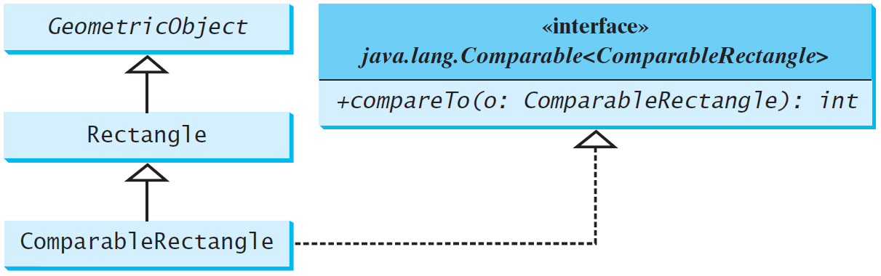
Defining Classes to Implement Comparable
ComparableRectangle
SortRectangles
Run

Slide 40
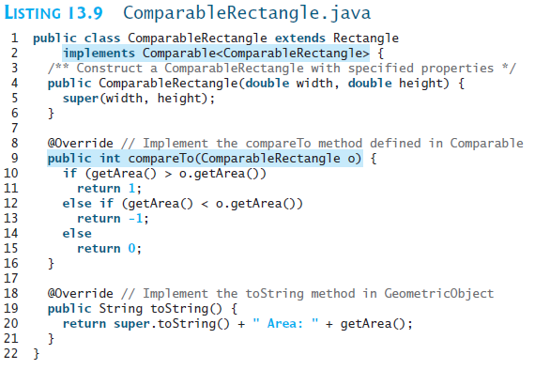

Slide 41
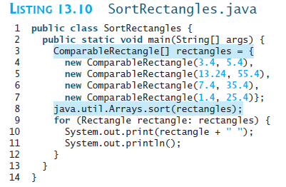


Slide 42
The Cloneable Interfaces
  Marker Interface: An empty interface.
  A marker interface does not contain constants or methods. It is used to denote that a class possesses certain desirable properties. A class that implements the Cloneable interface is marked cloneable, and its objects can be cloned using the clone() method defined in the Object class.
  package java.lang;
  public interface Cloneable {
  }

Slide 43
Examples
Many classes (e.g., Date and Calendar) in the Java library implement Cloneable. Thus, the instances of these classes can be cloned. For example, the following code
  Calendar calendar = new GregorianCalendar(2003, 2, 1);
  Calendar calendarCopy = (Calendar)calendar.clone();
  System.out.println("calendar == calendarCopy is " +
  (calendar == calendarCopy));
  System.out.println("calendar.equals(calendarCopy) is " +
  calendar.equals(calendarCopy));
displays
  calendar == calendarCopy is false
  calendar.equals(calendarCopy) is true

Slide 44
Implementing Cloneable Interface
To define a custom class that implements the Cloneable interface, the class must override the clone() method in the Object class. The following code defines a class named House that implements Cloneable and Comparable.
House

Slide 45
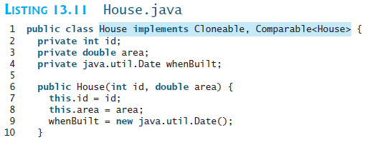
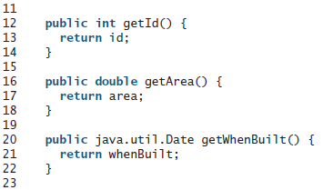

Slide 46
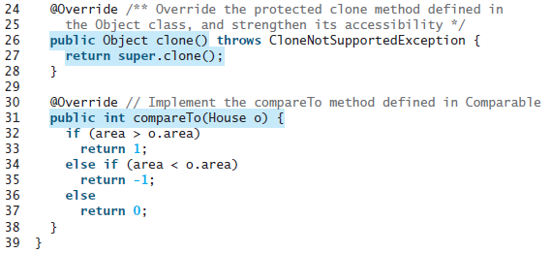

Slide 47
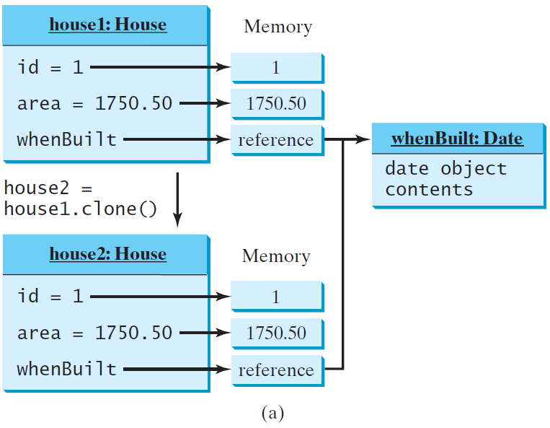
Shallow vs. Deep Copy
House house1 = new House(1, 1750.50);
House house2 = (House)house1.clone();
Shallow Copy

Slide 48
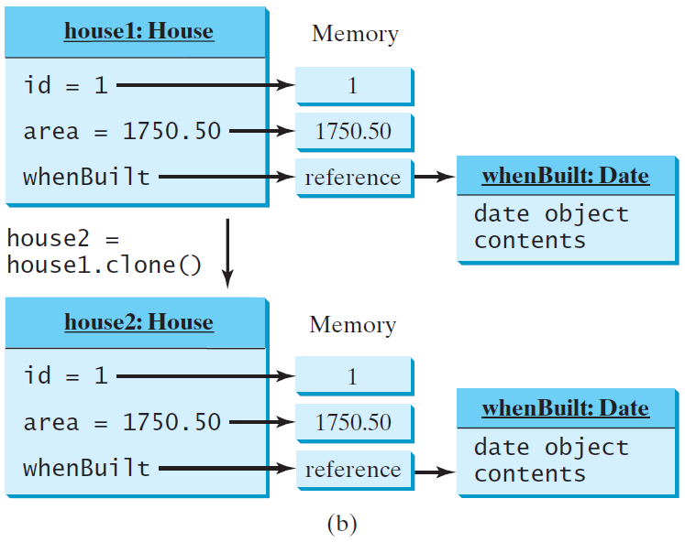
Shallow vs. Deep Copy
House house1 = new House(1, 1750.50);
House house2 = (House)house1.clone();
Deep Copy

Slide 49
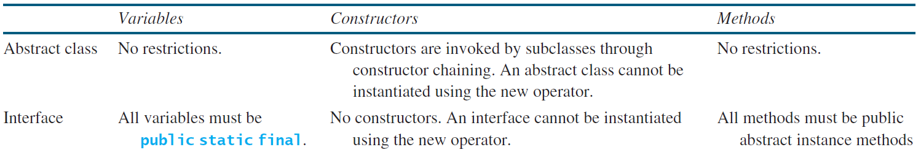
Interfaces vs. Abstract Classes
  In an interface, the data must be constants; an abstract class can have all types of data.
  Each method in an interface has only a signature without implementation; an abstract class can have concrete methods.

Slide 50
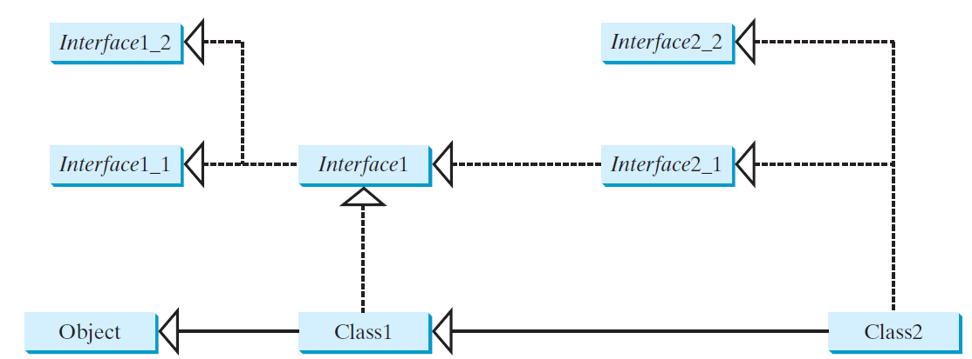
Interfaces vs. Abstract Classes, cont.
  All classes share a single root, the Object class, but there is no single root for interfaces. Like a class, an interface also defines a type. A variable of an interface type can reference any instance of the class that implements the interface. If a class extends an interface, this interface plays the same role as a superclass. You can use an interface as a data type and cast a variable of an interface type to its subclass, and vice versa.
  Suppose that c is an instance of Class2. c is also an instance of Object, Class1, Interface1, Interface1_1, Interface1_2, Interface2_1, and Interface2_2.

Slide 51
Caution: conflict interfaces
  In rare occasions, a class may implement two interfaces with conflict information (e.g., two same constants with different values or two methods with same signature but different return type). This type of errors will be detected by the compiler.

Slide 52
Whether to use an interface or a class?
  Abstract classes and interfaces can both be used to model common features. How do you decide whether to use an interface or a class? In general, a strong is-a relationship that clearly describes a parent-child relationship should be modeled using classes. For example, a staff member is a person. A weak is-a relationship, also known as an is-kind-of relationship, indicates that an object possesses a certain property. A weak is-a relationship can be modeled using interfaces. For example, all strings are comparable, so the String class implements the Comparable interface. You can also use interfaces to circumvent single inheritance restriction if multiple inheritance is desired. In the case of multiple inheritance, you have to design one as a superclass, and others as interface.

Slide 53
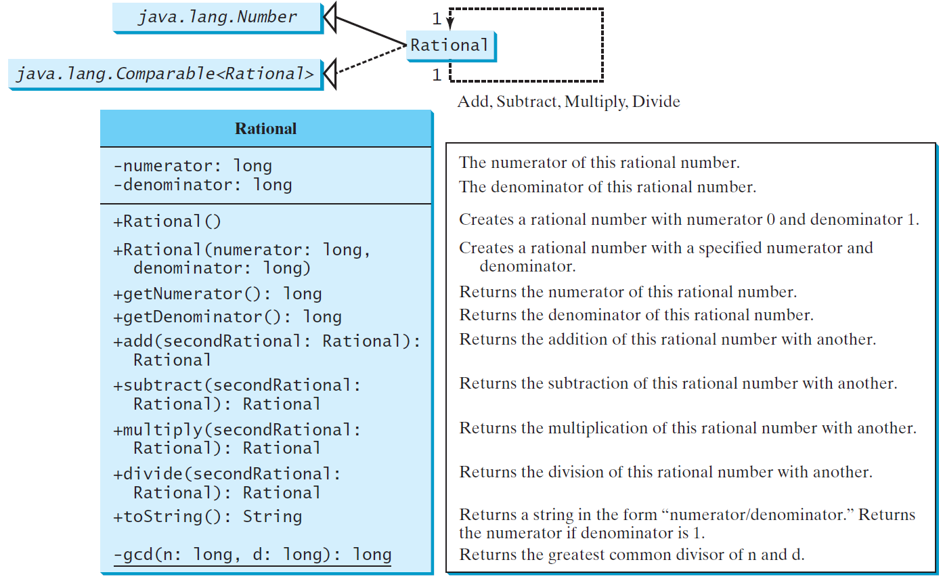
The Rational Class
Rational
TestRationalClass
Run

Slide 54
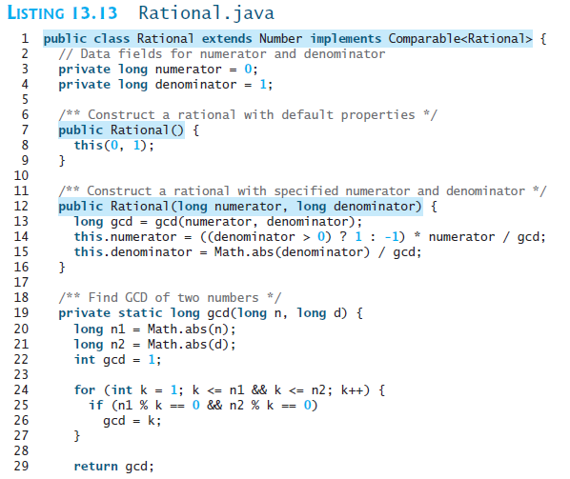

Slide 55

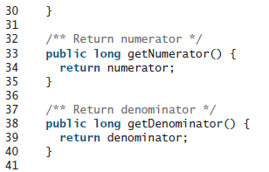
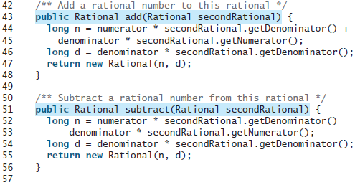

Slide 56
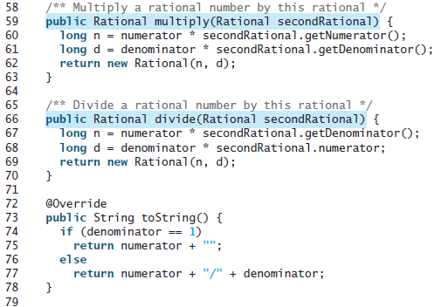
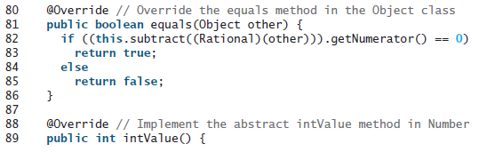

Slide 57
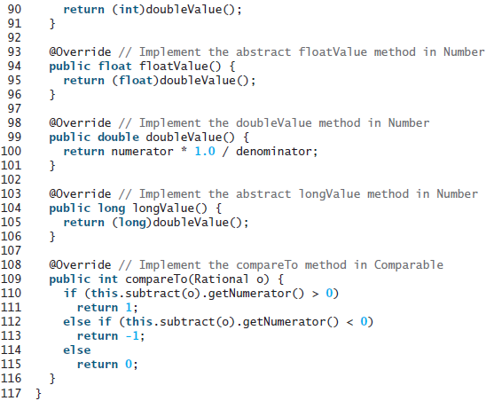

Slide 58
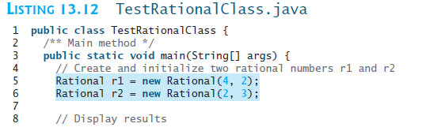
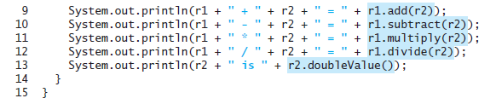
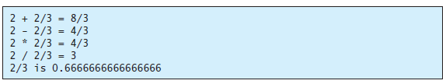

Slide 59
Designing a Class
(Coherence) A class should describe a single entity, and all the class operations should logically fit together to support a coherent purpose. You can use a class for students, for example, but you should not combine students and staff in the same class, because students and staff have different entities.

Slide 60
Designing a Class, cont.
(Separating responsibilities) A single entity with too many responsibilities can be broken into several classes to separate responsibilities. The classes String, StringBuilder, and StringBuffer all deal with strings, for example, but have different responsibilities. The String class deals with immutable strings, the StringBuilder class is for creating mutable strings, and the StringBuffer class is similar to StringBuilder except that StringBuffer contains synchronized methods for updating strings.

Slide 61
Designing a Class, cont.
Classes are designed for reuse. Users can incorporate classes in many different combinations, orders, and environments. Therefore, you should design a class that imposes no restrictions on what or when the user can do with it, design the properties to ensure that the user can set properties in any order, with any combination of values, and design methods to function independently of their order of occurrence.

Slide 62
Designing a Class, cont.
Provide a public no-arg constructor and override the equals method and the toString method defined in the Object class whenever possible.

Slide 63
Designing a Class, cont.
Follow standard Java programming style and naming conventions. Choose informative names for classes, data fields, and methods. Always place the data declaration before the constructor, and place constructors before methods. Always provide a constructor and initialize variables to avoid programming errors.

Slide 64
Using Visibility Modifiers
Each class can present two contracts – one for the users of the class and one for the extenders of the class. Make the fields private and accessor methods public if they are intended for the users of the class. Make the fields or method protected if they are intended for extenders of the class. The contract for the extenders encompasses the contract for the users. The extended class may increase the visibility of an instance method from protected to public, or change its implementation, but you should never change the implementation in a way that violates that contract.

Slide 65
Using Visibility Modifiers, cont.
A class should use the private modifier to hide its data from direct access by clients. You can use get methods and set methods to provide users with access to the private data, but only to private data you want the user to see or to modify. A class should also hide methods not intended for client use. The gcd method in the Rational class is private, for example, because it is only for internal use within the class.

Slide 66
Using the static Modifier
A property that is shared by all the instances of the class should be declared as a static property.

