Slide 1
Chapter 17 Binary I/O

Slide 2
Motivations
Data stored in a text file is represented in human-readable form. Data stored in a binary file is represented in binary form. You cannot read binary files. They are designed to be read by programs. For example, Java source programs are stored in text files and can be read by a text editor, but Java classes are stored in binary files and are read by the JVM. The advantage of binary files is that they are more efficient to process than text files.

Slide 3
Objectives
To discover how I/O is processed in Java (§17.2).
To distinguish between text I/O and binary I/O (§17.3).
To read and write bytes using FileInputStream and FileOutputStream (§17.4.1).
To read and write primitive values and strings using DataInputStream/DataOutputStream (§17.4.3).
To store and restore objects using ObjectOutputStream and ObjectInputStream, and to understand how objects are serialized and what kind of objects can be serialized (§17.6).
To implement the Serializable interface to make objects serializable (§17.6.1).
To serialize arrays (§17.6.2).
To read and write the same file using the RandomAccessFile class (§17.7).

Slide 4
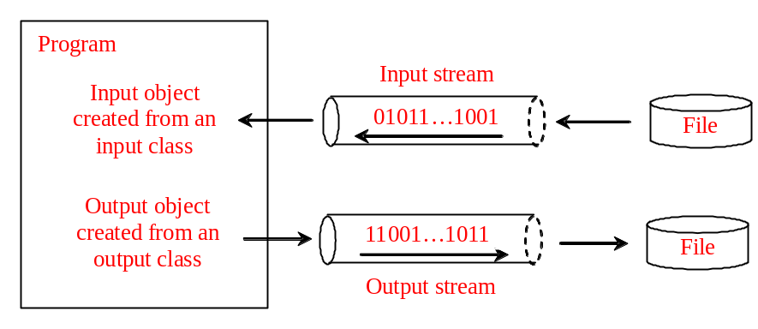
How is I/O Handled in Java?
A File object encapsulates the properties of a file or a path, but does not contain the methods for reading/writing data from/to a file. In order to perform I/O, you need to create objects using appropriate Java I/O classes.
Scanner input = new Scanner(new File("temp.txt"));
System.out.println(input.nextLine());
PrintWriter output = new PrintWriter("temp.txt");
output.println("Java 101");
output.close();

Slide 5
Text File vs. Binary File
Data stored in a text file are represented in human-readable form. Data stored in a binary file are represented in binary form. You cannot read binary files. Binary files are designed to be read by programs. For example, the Java source programs are stored in text files and can be read by a text editor, but the Java classes are stored in binary files and are read by the JVM. The advantage of binary files is that they are more efficient to process than text files.
Although it is not technically precise and correct, you can imagine that a text file consists of a sequence of characters and a binary file consists of a sequence of bits. For example, the decimal integer 199 is stored as the sequence of three characters: '1', '9', '9' in a text file and the same integer is stored as a byte-type value C7 in a binary file, because decimal 199 equals to hex C7.

Slide 6
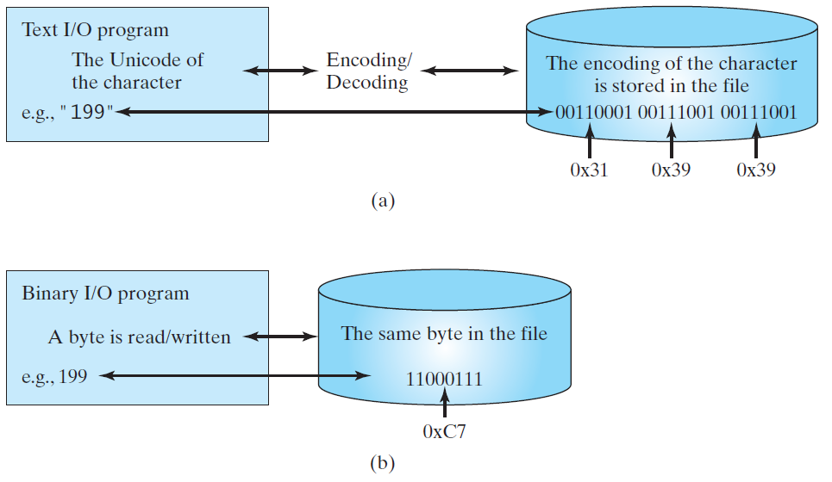
Binary I/O
Text I/O requires encoding and decoding. The JVM converts a Unicode to a file specific encoding when writing a character and coverts a file specific encoding to a Unicode when reading a character. Binary I/O does not require conversions. When you write a byte to a file, the original byte is copied into the file. When you read a byte from a file, the exact byte in the file is returned.

Slide 7
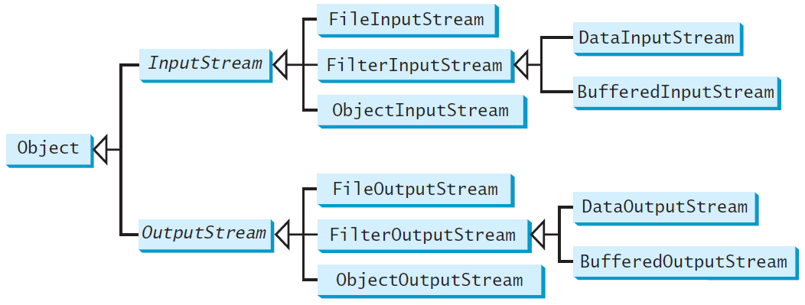
Binary I/O Classes

Slide 8
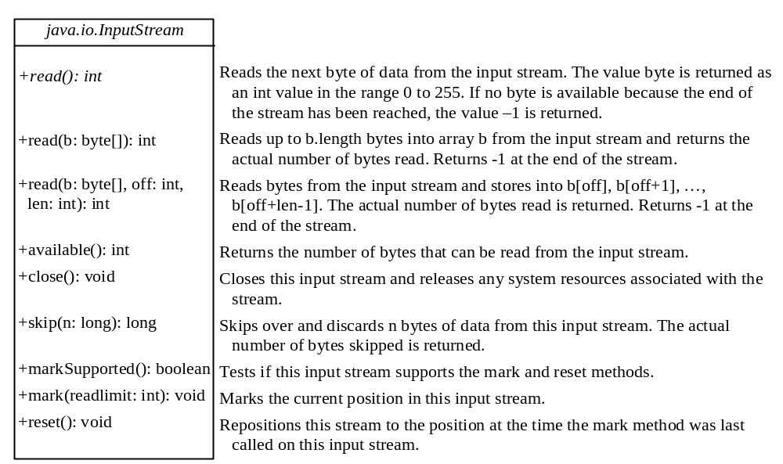
InputStream
The value returned is a byte as an int type.

Slide 9
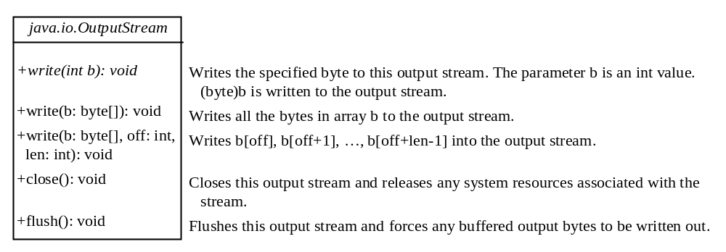
OutputStream
The value is a byte as an int type.

Slide 10
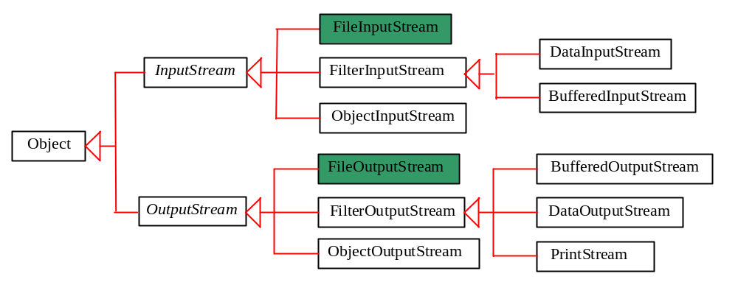
FileInputStream/FileOutputStream
FileInputStream/FileOutputStream associates a binary input/output stream with an external file. All the methods in FileInputStream/FileOuptputStream are inherited from its superclasses.

Slide 11
FileInputStream
To construct a FileInputStream, use the following constructors:
  public FileInputStream(String filename)
  public FileInputStream(File file)
  A java.io.FileNotFoundException would occur if you attempt to create a FileInputStream with a nonexistent file.

Slide 12
FileOutputStream
To construct a FileOutputStream, use the following constructors:
  public FileOutputStream(String filename)
  public FileOutputStream(File file)
  public FileOutputStream(String filename, boolean append)
  public FileOutputStream(File file, boolean append)
If the file does not exist, a new file would be created. If the file already exists, the first two constructors would delete the current contents in the file. To retain the current content and append new data into the file, use the last two constructors by passing true to the append parameter.
TestFileStream
Run

Slide 13
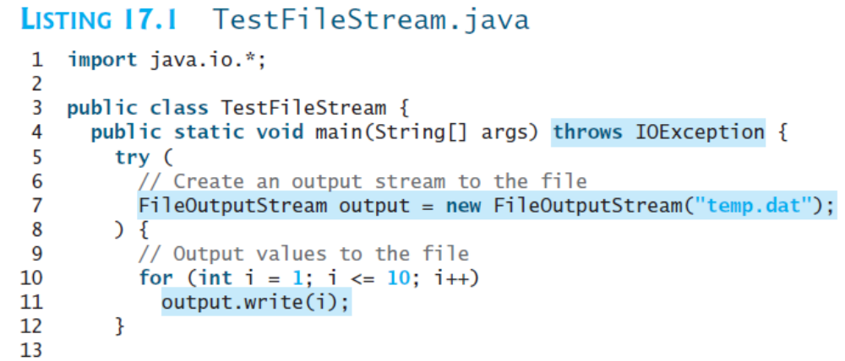

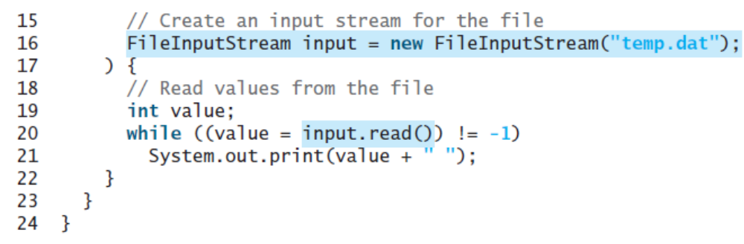

Slide 14
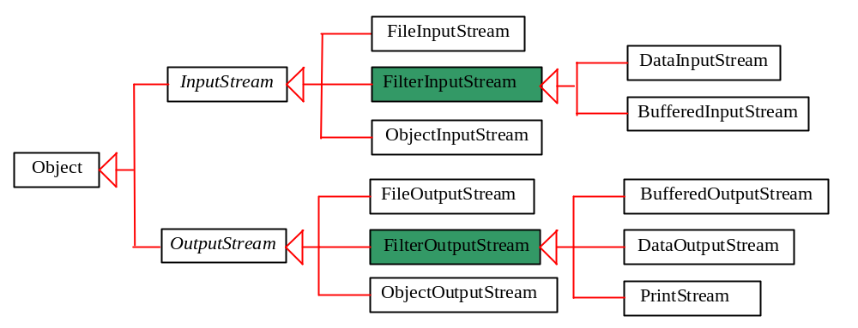
FilterInputStream/FilterOutputStream
Filter streams are streams that filter bytes for some purpose. The basic byte input stream provides a read method that can only be used for reading bytes. If you want to read integers, doubles, or strings, you need a filter class to wrap the byte input stream. Using a filter class enables you to read integers, doubles, and strings instead of bytes and characters. FilterInputStream and FilterOutputStream are the base classes for filtering data. When you need to process primitive numeric types, use DatInputStream and DataOutputStream to filter bytes.

Slide 15
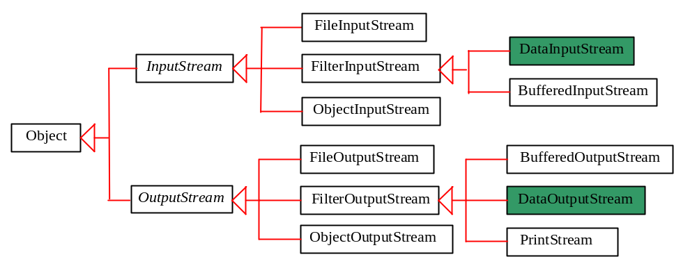
DataInputStream/DataOutputStream
DataInputStream reads bytes from the stream and converts them into appropriate primitive type values or strings.
DataOutputStream converts primitive type values or strings into bytes and output the bytes to the stream.

Slide 16
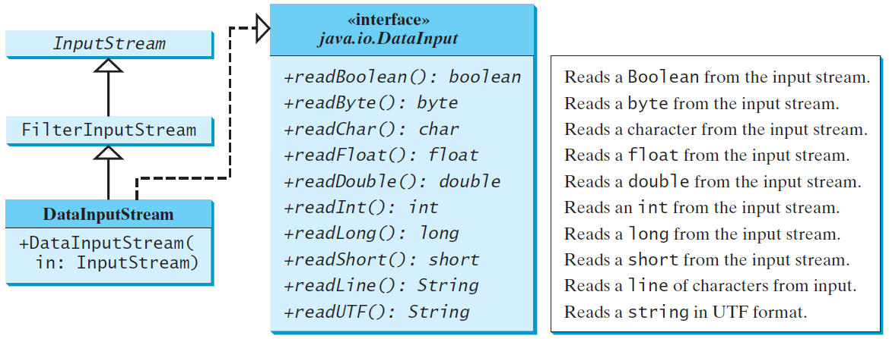
DataInputStream
DataInputStream extends FilterInputStream and implements the DataInput interface.

Slide 17
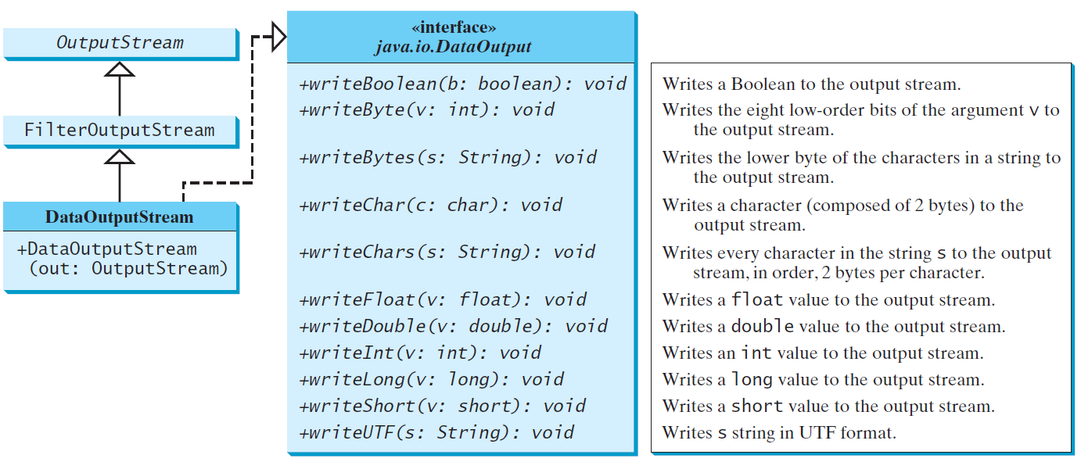
DataOutputStream
DataOutputStream extends FilterOutputStream and implements the DataOutput interface.

Slide 18
Characters and Strings in Binary I/O
A Unicode consists of two bytes. The writeChar(char c) method writes the Unicode of character c to the output. The writeChars(String s) method writes the Unicode for each character in the string s to the output.
Why UTF-8? What is UTF-8?
UTF-8 is a coding scheme that allows systems to operate with both ASCII and Unicode efficiently. Most operating systems use ASCII. Java uses Unicode. The ASCII character set is a subset of the Unicode character set. Since most applications need only the ASCII character set, it is a waste to represent an 8-bit ASCII character as a 16-bit Unicode character. The UTF-8 is an alternative scheme that stores a character using 1, 2, or 3 bytes. ASCII values (less than 0x7F) are coded in one byte. Unicode values less than 0x7FF are coded in two bytes. Other Unicode values are coded in three bytes.

Slide 19
Using DataInputStream/DataOutputStream
Data streams are used as wrappers on existing input and output streams to filter data in the original stream. They are created using the following constructors:
  public DataInputStream(InputStream instream)
  public DataOutputStream(OutputStream outstream)
The statements given below create data streams. The first statement creates an input stream for file in.dat; the second statement creates an output stream for file out.dat.
  DataInputStream infile =
  new DataInputStream(new FileInputStream("in.dat"));
  DataOutputStream outfile =
  new DataOutputStream(new FileOutputStream("out.dat"));
TestDataStream
Run

Slide 20
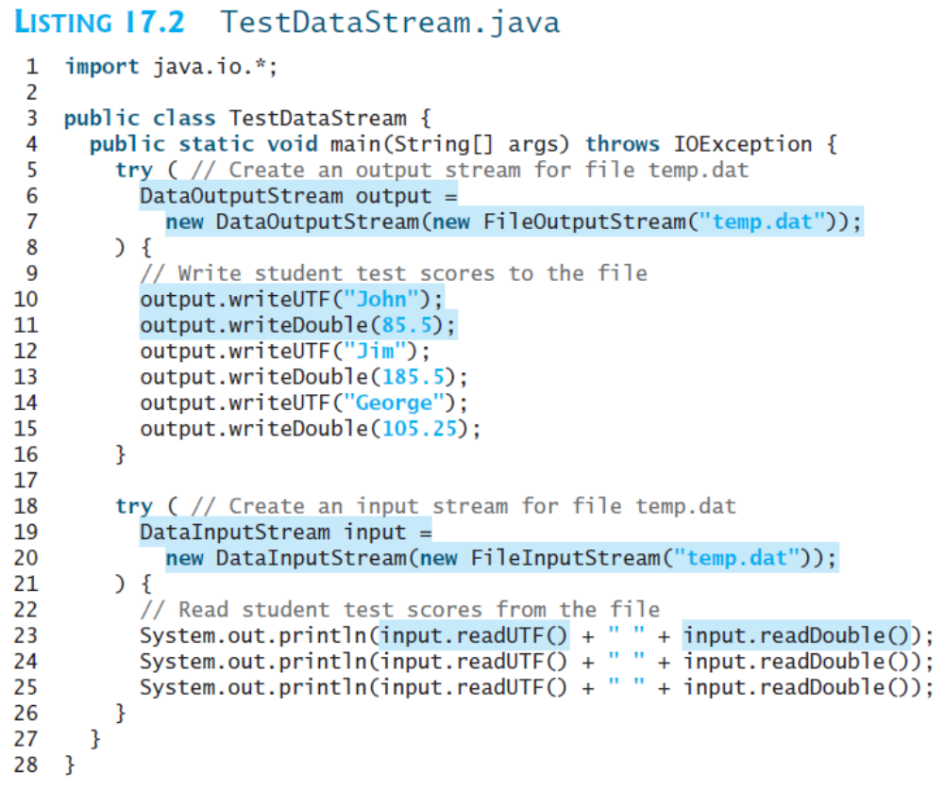

Slide 21
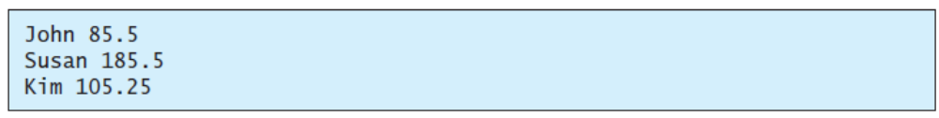

Slide 22
Checking End of File
Order and Format
CAUTION: You have to read the data in the same order and same format in which they are stored. For example, since names are written in UTF-8 using writeUTF, you must read names using readUTF.
TIP: If you keep reading data at the end of a stream, an EOFException would occur. So how do you check the end of a file? You can use input.available() to check it. input.available() == 0 indicates that it is the end of a file.

Slide 23
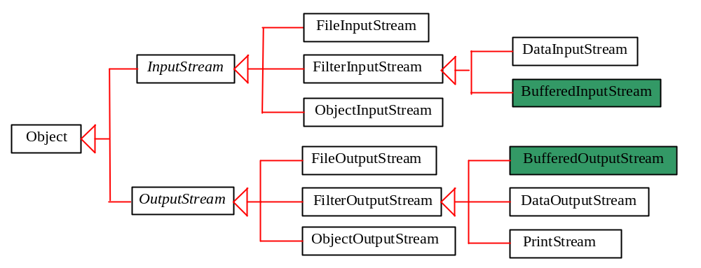
BufferedInputStream/
BufferedOutputStream
Using buffers to speed up I/O
BufferedInputStream/BufferedOutputStream does not contain new methods. All the methods BufferedInputStream/BufferedOutputStream are inherited from the InputStream/OutputStream classes.

Slide 24
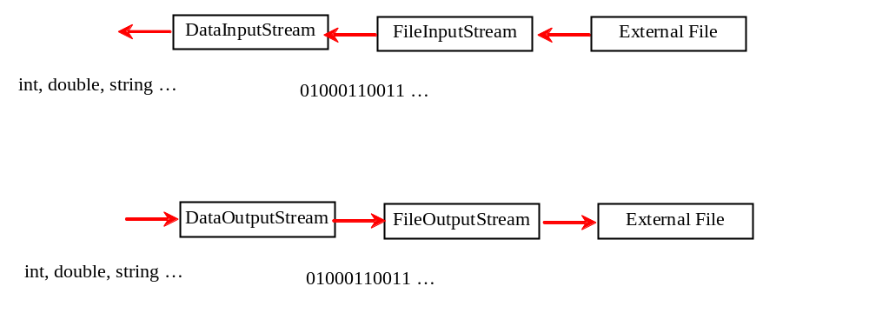
Concept of pipe line

Slide 25
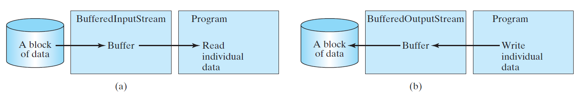
Constructing BufferedInputStream/BufferedOutputStream
  // Create a BufferedInputStream
  public BufferedInputStream(InputStream in)
  public BufferedInputStream(InputStream in, int bufferSize)
  // Create a BufferedOutputStream
  public BufferedOutputStream(OutputStream out)
  public BufferedOutputStream(OutputStreamr out, int bufferSize)

Slide 26
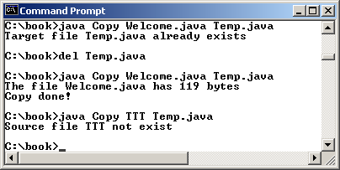
Case Studies: Copy File
  This case study develops a program that copies files. The user needs to provide a source file and a target file as command-line arguments using the following command:
    java Copy source target
  The program copies a source file to a target file and displays the number of bytes in the file. If the source does not exist, tell the user the file is not found. If the target file already exists, tell the user the file already exists.
Copy
Run

Slide 27
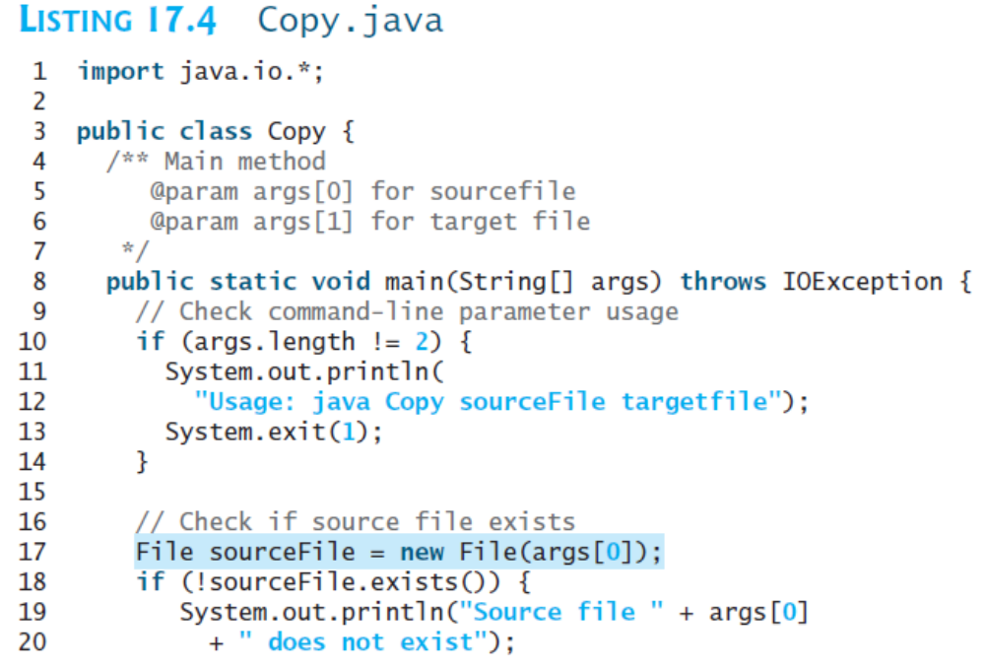
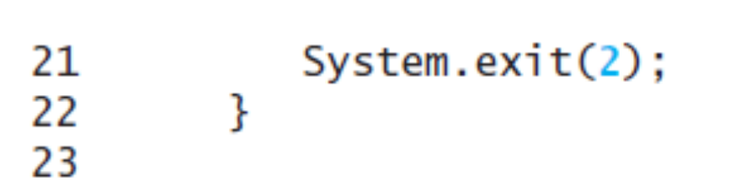

Slide 28
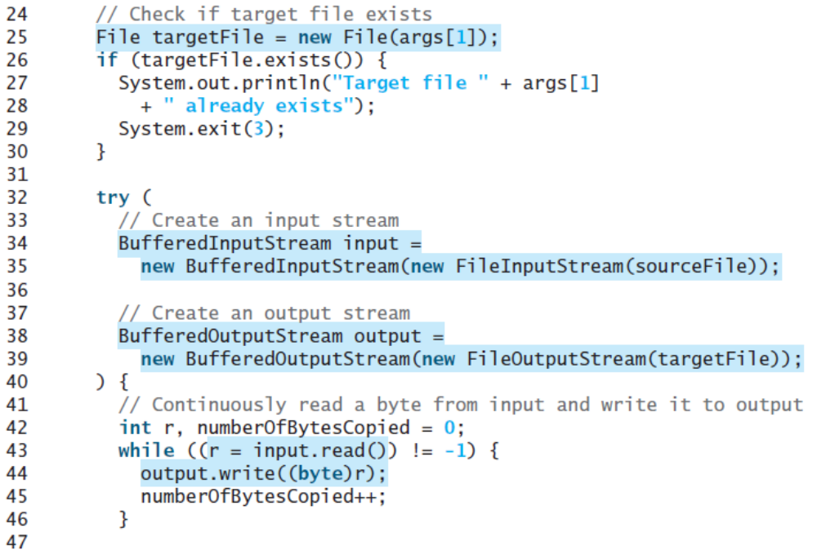
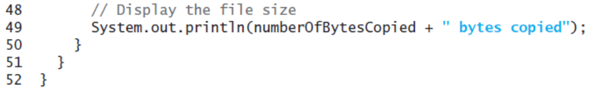

Slide 29
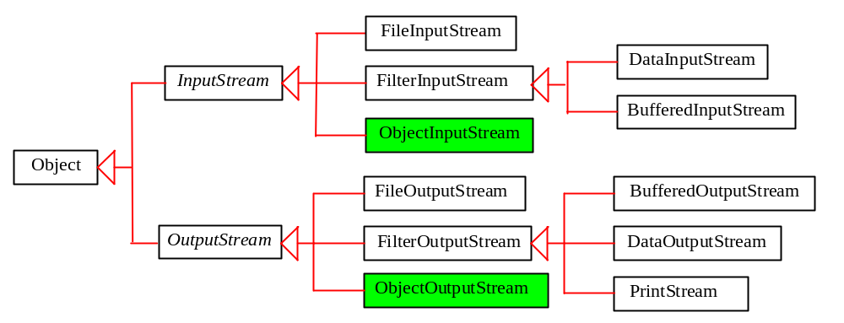
Object I/O
Optional
DataInputStream/DataOutputStream enables you to perform I/O for primitive type values and strings. ObjectInputStream/ObjectOutputStream enables you to perform I/O for objects in addition for primitive type values and strings.

Slide 30
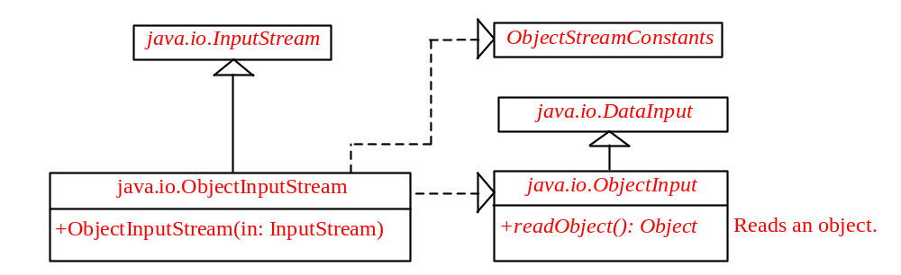
ObjectInputStream
ObjectInputStream extends InputStream and implements ObjectInput and ObjectStreamConstants.

Slide 31
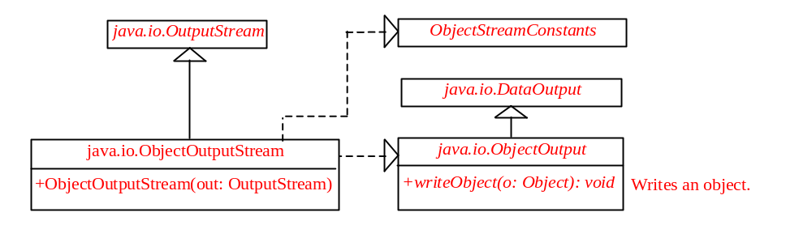
ObjectOutputStream
ObjectOutputStream extends OutputStream and implements ObjectOutput and ObjectStreamConstants.

Slide 32
Using Object Streams
You may wrap an ObjectInputStream/ObjectOutputStream on any InputStream/OutputStream using the following constructors:
  // Create an ObjectInputStream
  public ObjectInputStream(InputStream in)
  // Create an ObjectOutputStream
  public ObjectOutputStream(OutputStream out)
TestObjectOutputStream
Run
TestObjectInputStream
Run

Slide 33
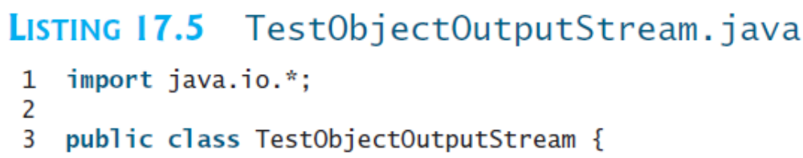
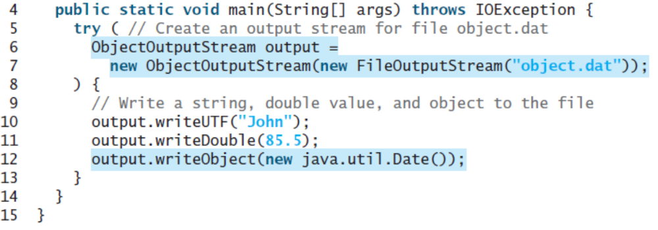

Slide 34
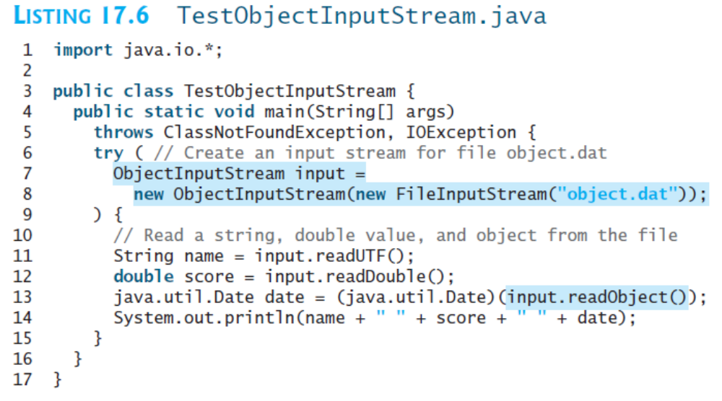

Slide 36
The Serializable Interface
Not all objects can be written to an output stream. Objects that can be written to an object stream is said to be serializable. A serializable object is an instance of the java.io.Serializable interface. So the class of a serializable object must implement Serializable.
The Serializable interface is a marker interface. It has no methods, so you don't need to add additional code in your class that implements Serializable.
Implementing this interface enables the Java serialization mechanism to automate the process of storing the objects and arrays.

Slide 37
The transient Keyword
If an object is an instance of Serializable, but it contains non-serializable instance data fields, can the object be serialized? The answer is no. To enable the object to be serialized, you can use the transient keyword to mark these data fields to tell the JVM to ignore these fields when writing the object to an object stream.

Slide 38
The transient Keyword, cont.
Consider the following class:
public class Foo implements java.io.Serializable {
private int v1;
private static double v2;
private transient A v3 = new A();
}
class A { } // A is not serializable
When an object of the Foo class is serialized, only variable v1 is serialized. Variable v2 is not serialized because it is a static variable, and variable v3 is not serialized because it is marked transient. If v3 were not marked transient, a java.io.NotSerializableException would occur.

Slide 39
Serializing Arrays
An array is serializable if all its elements are serializable. So an entire array can be saved using writeObject into a file and later restored using readObject. Here is an example that stores an array of five int values and an array of three strings, and reads them back to display on the console.
TestObjectStreamForArray
Run

Slide 40
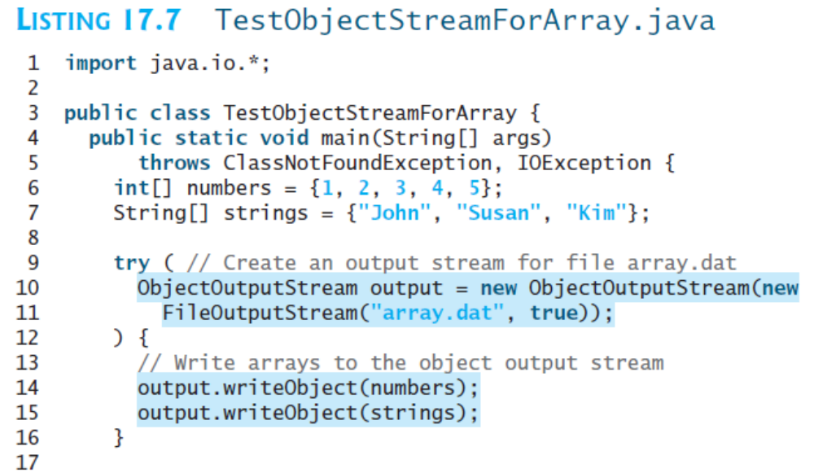

Slide 41
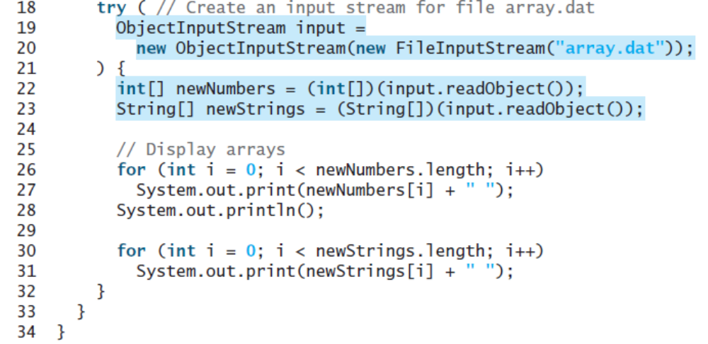

Slide 42
Random Access Files
All of the streams you have used so far are known as read-only or write-only streams. The external files of these streams are sequential files that cannot be updated without creating a new file. It is often necessary to modify files or to insert new records into files. Java provides the RandomAccessFile class to allow a file to be read from and write to at random locations.

Slide 43
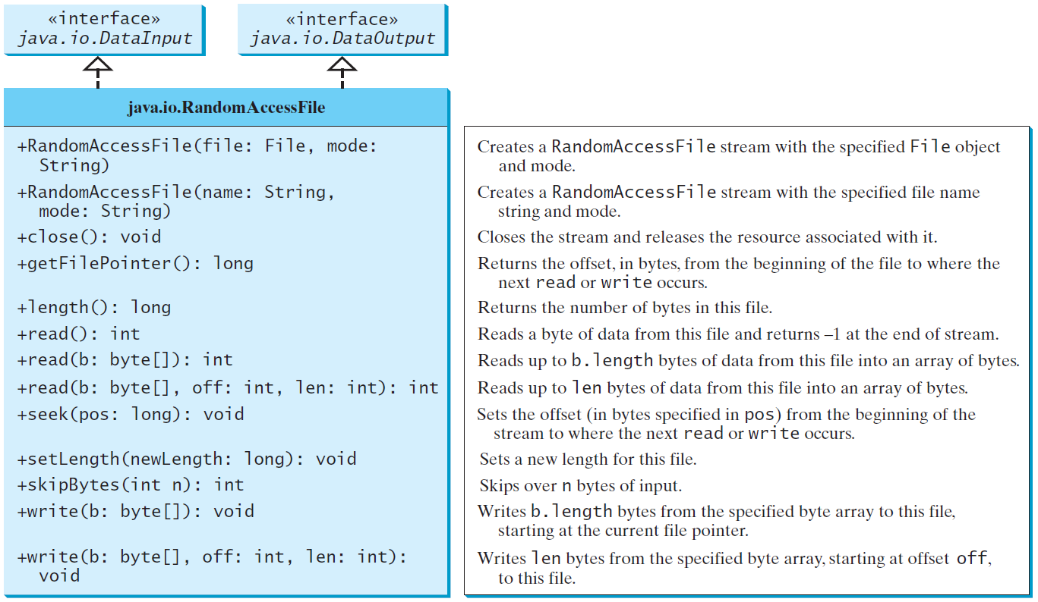
RandomAccessFile

Slide 44
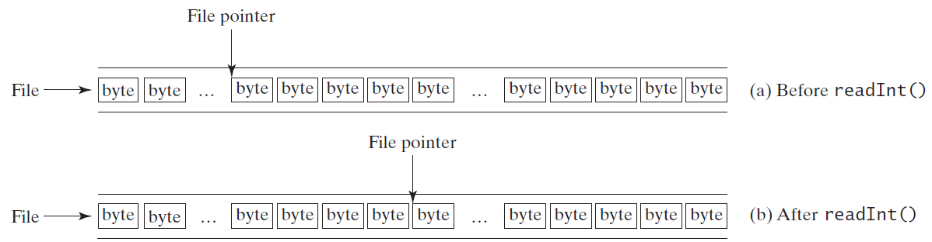
File Pointer
A random access file consists of a sequence of bytes. There is a special marker called file pointer that is positioned at one of these bytes. A read or write operation takes place at the location of the file pointer. When a file is opened, the file pointer sets at the beginning of the file. When you read or write data to the file, the file pointer moves forward to the next data. For example, if you read an int value using readInt(), the JVM reads four bytes from the file pointer and now the file pointer is four bytes ahead of the previous location.

Slide 45
RandomAccessFile Methods
Many methods in RandomAccessFile are the same as those in DataInputStream and DataOutputStream. For example, readInt(), readLong(), writeDouble(), readLine(), writeInt(), and writeLong() can be used in data input stream or data output stream as well as in RandomAccessFile streams.

Slide 46
RandomAccessFile Methods, cont.
void seek(long pos) throws IOException;
Sets the offset from the beginning of the RandomAccessFile stream to where the next read
or write occurs.
long getFilePointer() IOException;
Returns the current offset, in bytes, from the
beginning of the file to where the next read
or write occurs.

Slide 47
RandomAccessFile Methods, cont.
long length()IOException
Returns the length of the file.
final void writeChar(int v) throws IOException
Writes a character to the file as a two-byte Unicode, with the high byte written first.
final void writeChars(String s)
throws IOException
Writes a string to the file as a sequence of
characters.

Slide 48
RandomAccessFile Constructor
RandomAccessFile raf =
new RandomAccessFile("test.dat", "rw"); // allows read and write
RandomAccessFile raf =
new RandomAccessFile("test.dat", "r"); // read only

Slide 49
A Short Example on RandomAccessFile
TestRandomAccessFile
Run

Slide 50
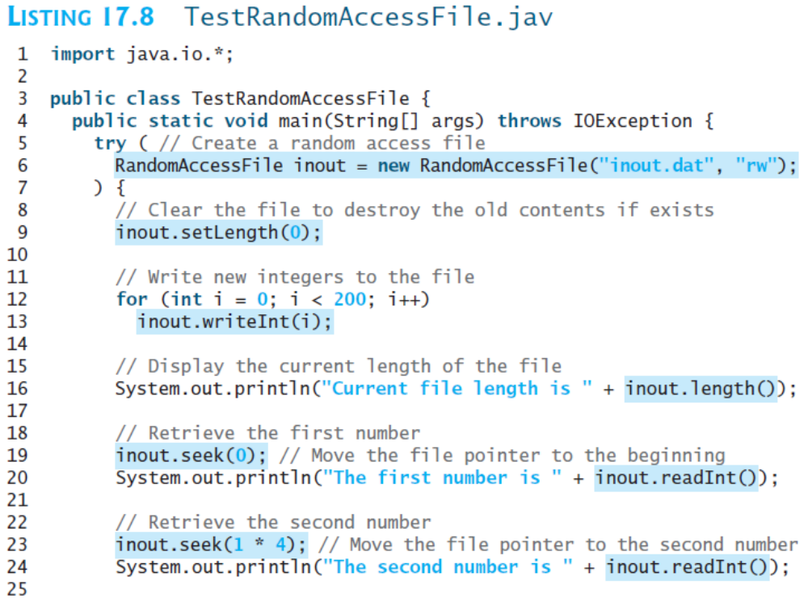

Slide 51
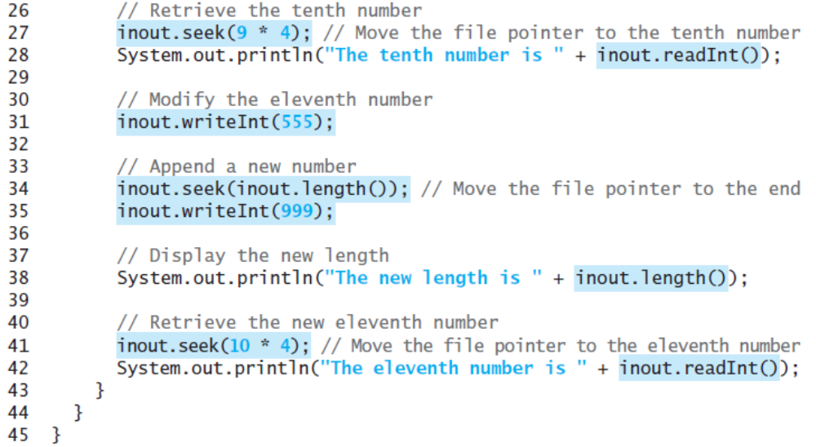
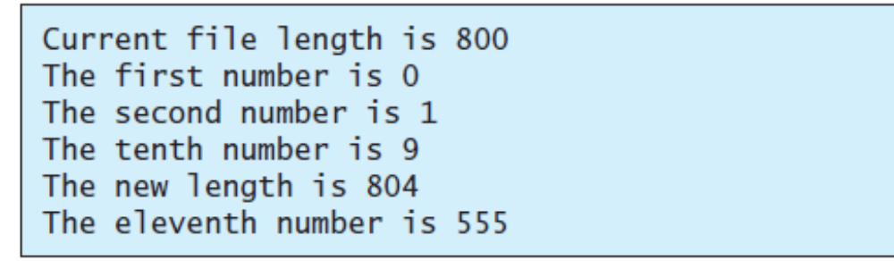

Slide 52
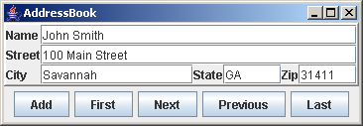
Case Studies: Address Book
Companion Website
NOT REQUIRED
Now let us use RandomAccessFile to create a useful project for storing and viewing and address book. The Add button stores a new address to the end of the file. The First, Next, Previous, and Last buttons retrieve the first, next, previous, and last addresses from the file, respectively.

Slide 53
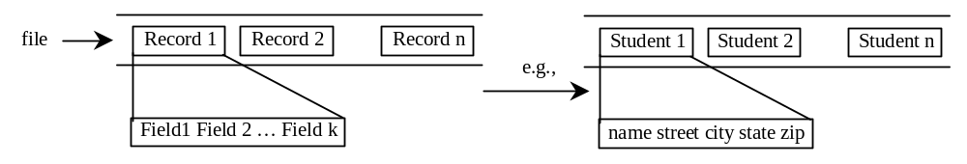
Fixed Length String I/O
Companion Website
NOT REQUIRED
Random access files are often used to process files of records. For convenience, fixed-length records are used in random access files so that a record can be located easily. A record consists of a fixed number of fields. A field can be a string or a primitive data type. A string in a fixed-length record has a maximum size. If a string is smaller than the maximum size, the rest of the string is padded with blanks.
FixedLengthStringIO

Slide 54
Address Implementation
Companion Website
NOT REQUIRED
The rest of the work can be summarized in the following steps:
Create the user interface.
Add a record to the file.
Read a record from the file.
Write the code to implement the button actions.
AddressBook
Run

