Slide 1
Chapter 30
Multithreading / Concurrency

Slide 2
Thread
Thread: single sequential flow of control within a program
Single-threaded program can handle one task at any time.
Multitasking allows single processor to run several concurrent threads.
Most modern operating systems support multitasking.

Slide 3
Advantages of Multithreading
Reactive systems – constantly monitoring
More responsive to user input – GUI application can interrupt a time-consuming task
Server can handle multiple clients simultaneously
Can take advantage of parallel processing

Slide 4
Characteristics of a thread
Different processes do not share memory space.
A thread can execute concurrently with other threads within a single process.
All threads managed by the JVM share memory space and can communicate with each other.

Slide 5

Threads Concept
Multiple threads on multiple CPUs
Multiple threads sharing a single CPU

Slide 6
Threads in Java
Creating threads in Java:
Extend java.lang.Thread class
OR
Implement java.lang.Runnable interface

Slide 7
Threads in Java
Creating threads in Java:
Extend java.lang.Thread class
  run() method must be overridden (similar to main method of sequential program)
  run() is called when execution of the thread begins
  A thread terminates when run() returns
  start() method invokes run()
  Calling run() does not create a new thread
Implement java.lang.Runnable interface

Slide 8
Threads in Java
Creating threads in Java:
Extend java.lang.Thread class
Implement java.lang.Runnable interface
  If already inheriting another class (i.e., JApplet)
  Single method: public void run()
  Thread class implements Runnable.

Slide 9
Thread termination
A thread becomes Not Runnable when one of these events occurs:
Its sleep method is invoked.
The thread calls the wait method to wait for a specific condition to be satisifed.
The thread is blocking on I/O.

Slide 10
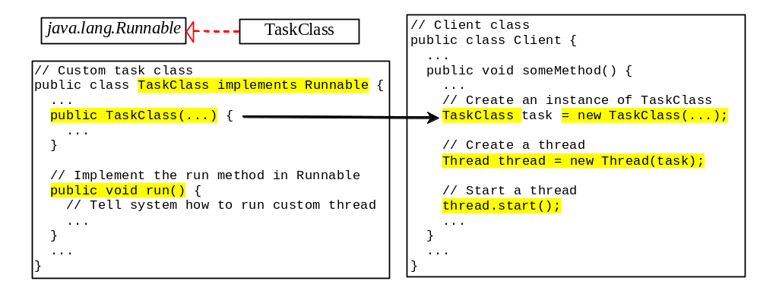
Creating Tasks and Threads

Slide 11
Example:
Using the Runnable Interface to Create and Launch Threads
Objective: Create and run three threads:
  The first thread prints the letter a 100 times.
  The second thread prints the letter b 100 times.
  The third thread prints the integers 1 through 100.
TaskThreadDemo
Run

Slide 12
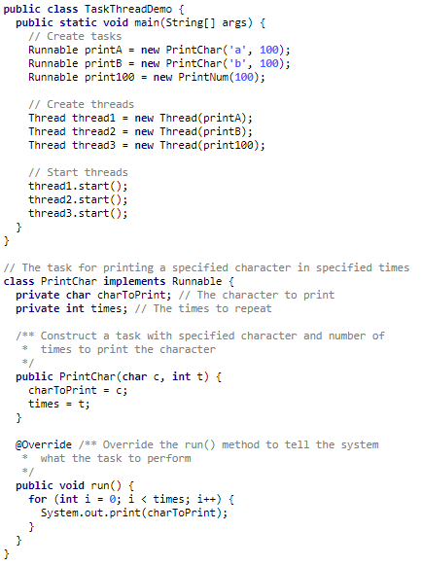


Slide 13
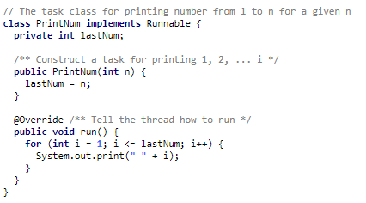

Slide 14
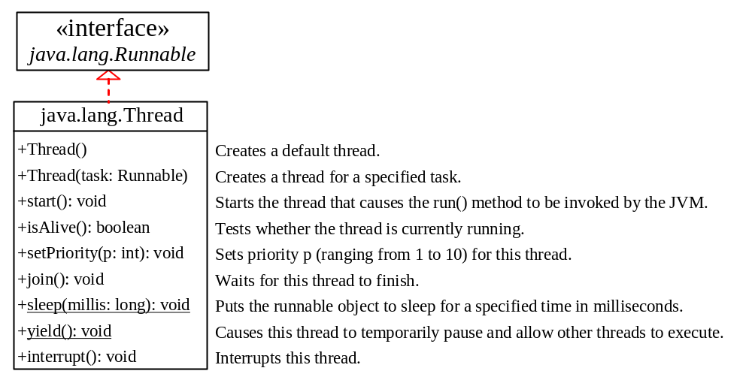
The Thread Class

Slide 15
The Static yield() Method
You can use the yield() method to temporarily release time for other threads. For example, suppose you modify the code in Lines 53-57 in TaskThreadDemo.java as follows:
  public void run() {
  for (int i = 1; i <= lastNum; i++) {
  System.out.print(" " + i);
  Thread.yield();
  }
  }
Every time a number is printed, the print100 thread is yielded. So, the numbers are printed after the characters.

Slide 16
The Static sleep(milliseconds) Method
The sleep(long mills) method puts the thread to sleep for the specified time in milliseconds. For example, suppose you modify the code in Lines 53-57 in TaskThreadDemo.java as follows:
  public void run() {
  for (int i = 1; i <= lastNum; i++) {
  System.out.print(" " + i);
  try {
  if (i >= 50) Thread.sleep(1);
  }
  catch (InterruptedException ex) {
  }
  }
  }
Every time a number (>= 50) is printed, the print100 thread is put to sleep for 1 millisecond.

Slide 17
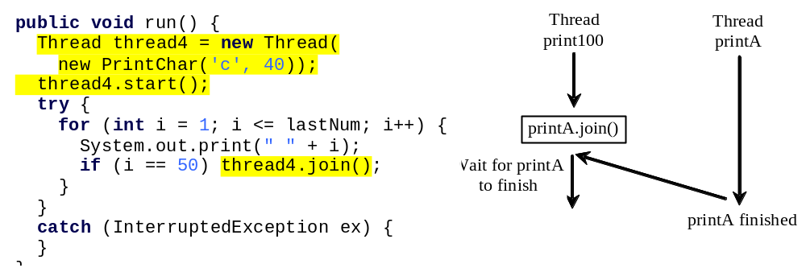
The join() Method
You can use the join() method to force one thread to wait for another thread to finish. For example, suppose you modify the code in Lines 53-57 in TaskThreadDemo.java as follows:
The numbers after 50 are printed after thread printA is finished.

Slide 18
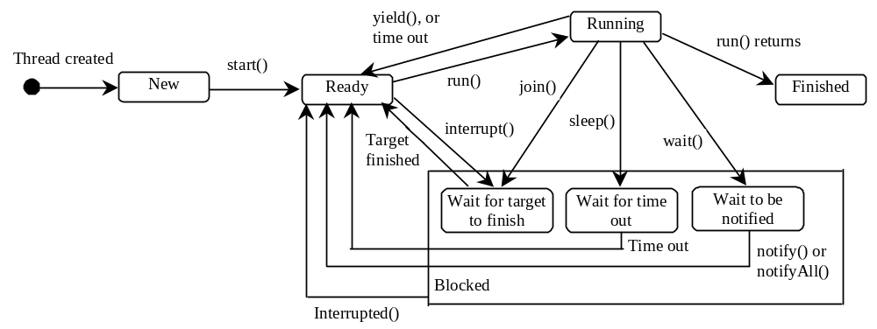
Thread States
A thread can be in one of five states: New, Ready, Running, Blocked, or Finished.

Slide 19
Thread methods
isAlive()
method used to find out the state of a thread.
returns true: thread is in the Ready, Blocked, or Running state
returns false: thread is new and has not started or if it is finished.
interrupt()
f a thread is currently in the Ready or Running state, its interrupted flag is set; if a thread is currently blocked, it is awakened and enters the Ready state, and an java.io.InterruptedException is thrown.
The isInterrupt() method tests whether the thread is interrupted.

Slide 20
The deprecated stop(), suspend(), and resume() Methods
NOTE: The Thread class also contains the stop(), suspend(), and resume() methods. As of Java 2, these methods are deprecated (or outdated) because they are known to be inherently unsafe. You should assign null to a Thread variable to indicate that it is stopped rather than use the stop() method.

Slide 21
Thread Priority
Each thread is assigned a default priority of Thread.NORM_PRIORITY (constant of 5). You can reset the priority using setPriority(int priority).
Some constants for priorities include Thread.MIN_PRIORITY Thread.MAX_PRIORITY Thread.NORM_PRIORITY
By default, a thread has the priority level of the thread that created it.

Slide 22
Thread Scheduling
An operating system’s thread scheduler determines which thread runs next.
Most operating systems use timeslicing for threads of equal priority.
Preemptive scheduling: when a thread of higher priority enters the running state, it preempts the current thread.
Starvation: Higher-priority threads can postpone (possible forever) the execution of lower-priority threads.

Slide 23


Example: Flashing Text
FlashingText
Run

Slide 24
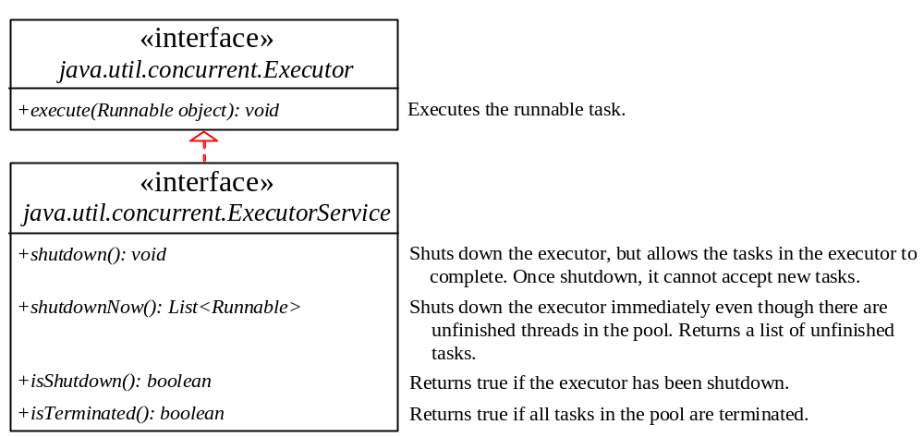
Thread Pools
Starting a new thread for each task could limit throughput and cause poor performance.
A thread pool is ideal to manage the number of tasks executing concurrently.
Executor interface for executing Runnable objects in a thread pool
ExecutorService is a subinterface of Executor.

Slide 25
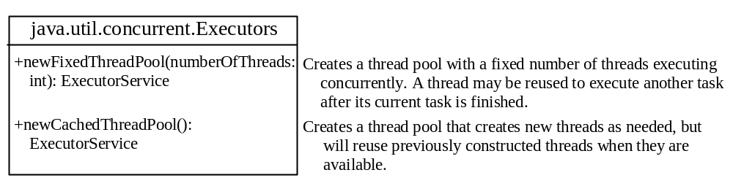
Creating Executors
To create an Executor object, use the static methods in the Executors class.
ExecutorDemo
Run

Slide 26
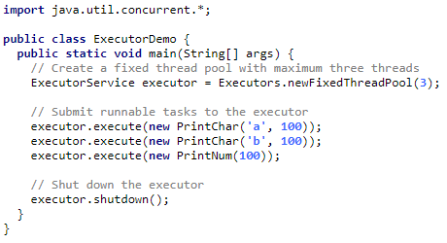

Slide 27
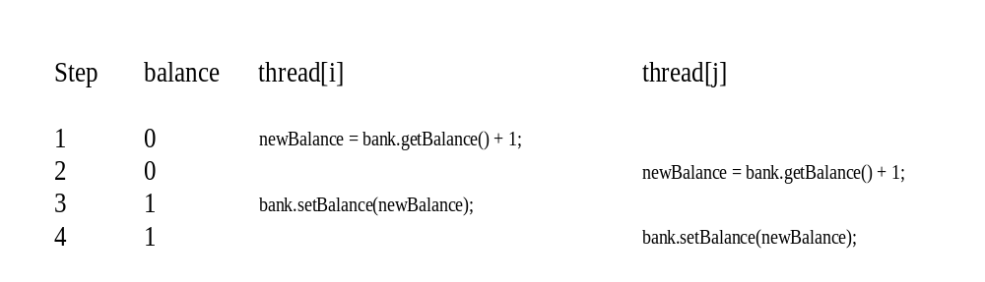
Thread Synchronization
A shared resource may be corrupted if it is accessed simultaneously by multiple threads.
Example: two unsynchronized threads accessing the same bank account may cause conflict.

Slide 28
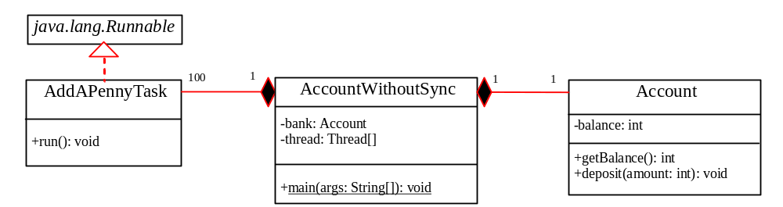
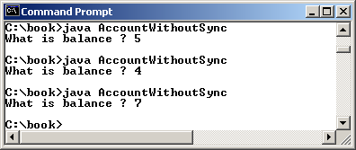
Example: Showing Resource Conflict
Objective: Write a program that demonstrates the problem of resource conflict. Suppose that you create and launch one hundred threads, each of which adds a penny to an account. Assume that the account is initially empty.
AccountWithoutSync
Run

Slide 29
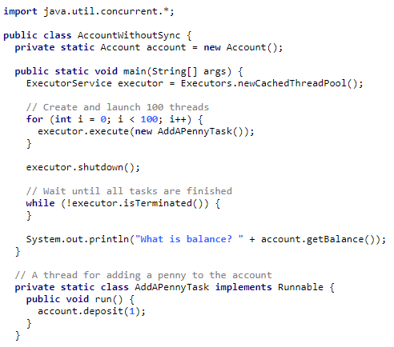
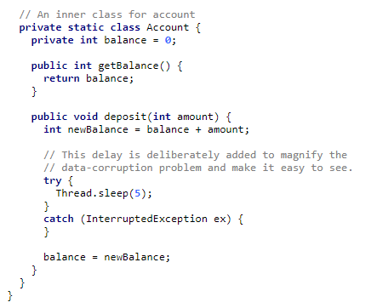

Slide 30
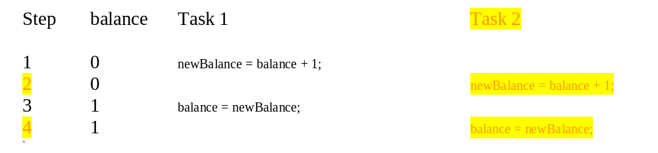
Race Condition
What, then, caused the error in the example? Here is a possible scenario:
Effect: Task 1 did nothing (in Step 4 Task 2 overrides the result)
Problem: Task 1 and Task 2 are accessing a common resource in a way that causes conflict.
Known as a race condition in multithreaded programs.
A thread-safe class does not cause a race condition in the presence of multiple threads.
The Account class is not thread-safe.

Slide 31
synchronized
Problem: race conditions
Solution: give exclusive access to one thread at a time to code that manipulates a shared object.
Synchronization keeps other threads waiting until the object is available.
The synchronized keyword synchronizes the method so that only one thread can access the method at a time.
The critical region in the Listing 29.7 is the entire deposit method.
One way to correct the problem in Listing 29.7: make Account thread-safe by adding the synchronized keyword in deposit:
  public synchronized void deposit(double amount)

Slide 32
Synchronizing Instance Methods and Static Methods
A synchronized method acquires a lock before it executes.
Instance method: the lock is on the object for which it was invoked.
Static method: the lock is on the class.
If one thread invokes a synchronized instance method (respectively, static method) on an object, the lock of that object (respectively, class) is acquired, then the method is executed, and finally the lock is released.
Another thread invoking the same method of that object (respectively, class) is blocked until the lock is released.

Slide 33
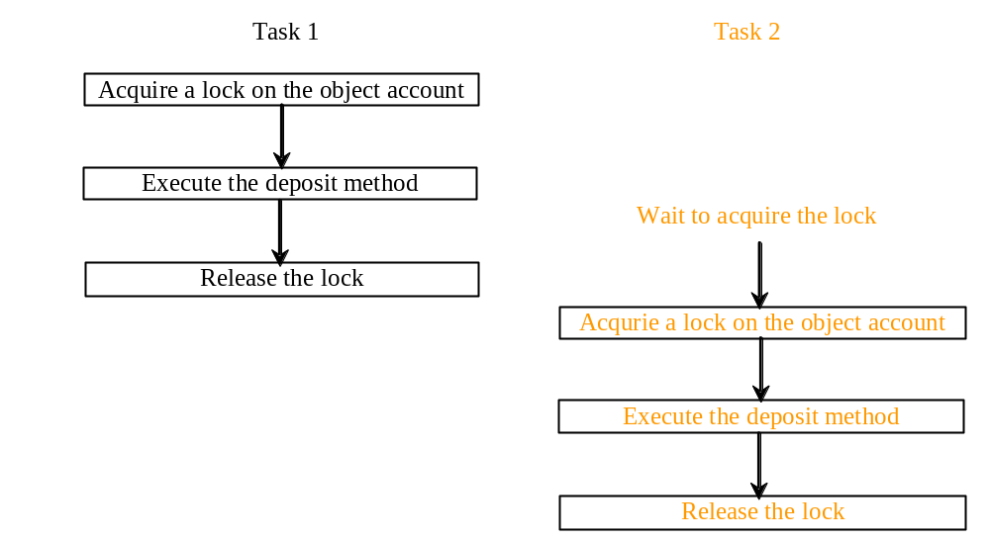
Synchronizing Instance Methods and Static Methods
With the deposit method synchronized, the preceding scenario cannot happen. If Task 2 starts to enter the method, and Task 1 is already in the method, Task 2 is blocked until Task 1 finishes the method.

Slide 34
Synchronizing Statements
Invoking a synchronized instance method of an object acquires a lock on the object.
Invoking a synchronized static method of a class acquires a lock on the class.
A synchronized block can be used to acquire a lock on any object, not just this object, when executing a block of code.
  synchronized (expr) {
  statements;
  }
expr must evaluate to an object reference.
If the object is already locked by another thread, the thread is blocked until the lock is released.
When a lock is obtained on the object, the statements in the synchronized block are executed, and then the lock is released.

Slide 35
Synchronizing Statements vs. Methods
Any synchronized instance method can be converted into a synchronized statement. Suppose that the following is a synchronized instance method:
  public synchronized void xMethod() {
  // method body
  }
This method is equivalent to
  public void xMethod() {
  synchronized (this) {
  // method body
  }
  }

Slide 36
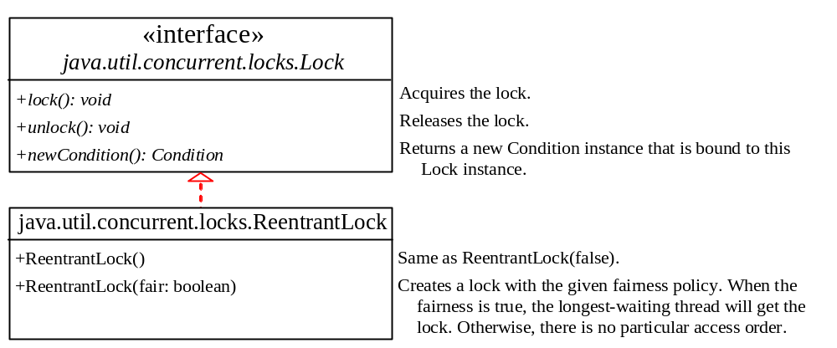
Synchronization Using Locks
A synchronized instance method implicitly acquires a lock on the instance before it executes the method.
You can use locks explicitly to obtain more control for coordinating threads.
A lock is an instance of the Lock interface, which declares the methods for acquiring and releasing locks.
newCondition() method creates Condition objects, which can be used for thread communication.

Slide 37
Fairness Policy
ReentrantLock:concrete implementation of Lock for creating mutually exclusive locks.
Create a lock with the specified fairness policy.
True fairness policies guarantee the longest-wait thread to obtain the lock first.
False fairness policies grant a lock to a waiting thread without any access order.
Programs using fair locks accessed by many threads may have poor overall performance than those using the default setting, but have smaller variances in times to obtain locks and guarantee lack of starvation.

Slide 38
Example: Using Locks
This example revises AccountWithoutSync.java in Listing 29.7 to synchronize the account modification using explicit locks.
AccountWithSyncUsingLock
Run

Slide 39
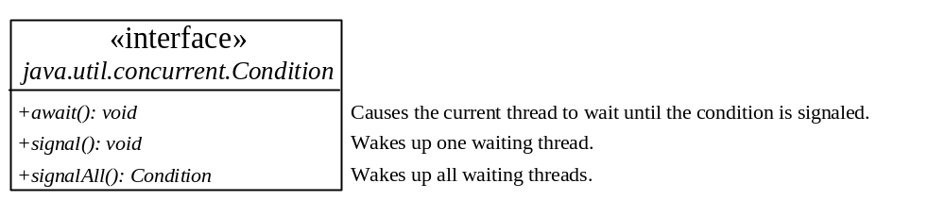
Cooperation Among Threads
Conditions can be used for communication among threads.
A thread can specify what to do under a certain condition.
newCondition() method of Lock object.
Condition methods:
  await() current thread waits until the condition is signaled
  signal() wakes up a waiting thread
  signalAll() wakes all waiting threads

Slide 40
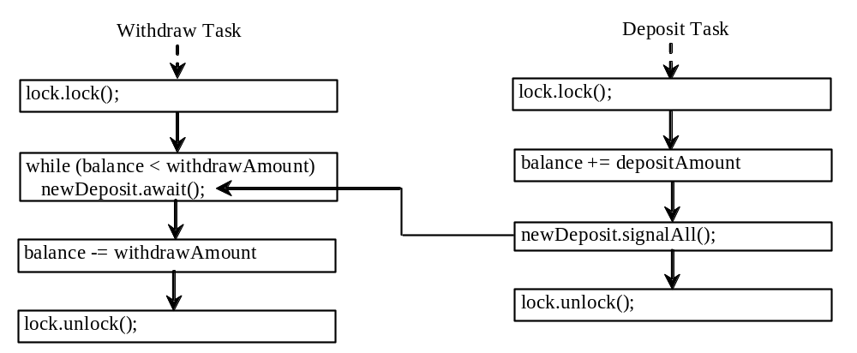
Cooperation Among Threads
Lock with a condition to synchronize operations: newDeposit
If the balance is less than the amount to be withdrawn, the withdraw task will wait for the newDeposit condition.
When the deposit task adds money to the account, the task signals the waiting withdraw task to try again.
Interaction between the two tasks:

Slide 41
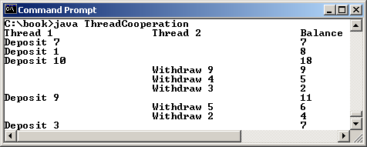
Example: Thread Cooperation
Write a program that demonstrates thread cooperation. Suppose that you create and launch two threads, one deposits to an account, and the other withdraws from the same account. The second thread has to wait if the amount to be withdrawn is more than the current balance in the account. Whenever new fund is deposited to the account, the first thread notifies the second thread to resume. If the amount is still not enough for a withdrawal, the second thread has to continue to wait for more fund in the account. Assume the initial balance is 0 and the amount to deposit and to withdraw is randomly generated.
ThreadCooperation
Run

Slide 42
Java’s Built-in Monitors (Optional)
Locks and conditions are new in Java 5.
Prior to Java 5, thread communications were programmed using object’s built-in monitors.
Locks and conditions are more powerful and flexible than the built-in monitor.
A monitor is an object with mutual exclusion and synchronization capabilities.
Only one thread can execute a method at a time in the monitor.
A thread enters the monitor by acquiring a lock (synchronized keyword on method / block) on the monitor and exits by releasing the lock.
A thread can wait in a monitor if the condition is not right for it to continue executing in the monitor.
Any object can be a monitor. An object becomes a monitor once a thread locks it.

Slide 43
wait(), notify(), and notifyAll()
Use the wait(), notify(), and notifyAll() methods to facilitate communication among threads.
The wait(), notify(), and notifyAll() methods must be called in a synchronized method or a synchronized block on the calling object of these methods. Otherwise, an IllegalMonitorStateException would occur.
The wait() method lets the thread wait until some condition occurs. When it occurs, you can use the notify() or notifyAll() methods to notify the waiting threads to resume normal execution. The notifyAll() method wakes up all waiting threads, while notify() picks up only one thread from a waiting queue.

Slide 44
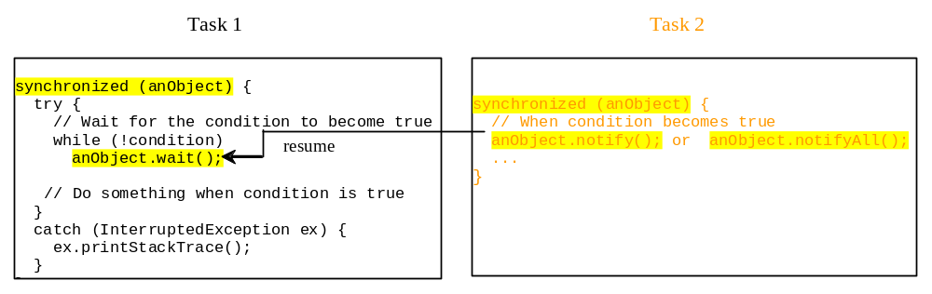
Example: Using Monitor
The wait(), notify(), and notifyAll() methods must be called in a synchronized method or a synchronized block on the receiving object of these methods. Otherwise, an IllegalMonitorStateException will occur.
When wait() is invoked, it pauses the thread and simultaneously releases the lock on the object. When the thread is restarted after being notified, the lock is automatically reacquired.
The wait(), notify(), and notifyAll() methods on an object are analogous to the await(), signal(), and signalAll() methods on a condition.

Slide 45
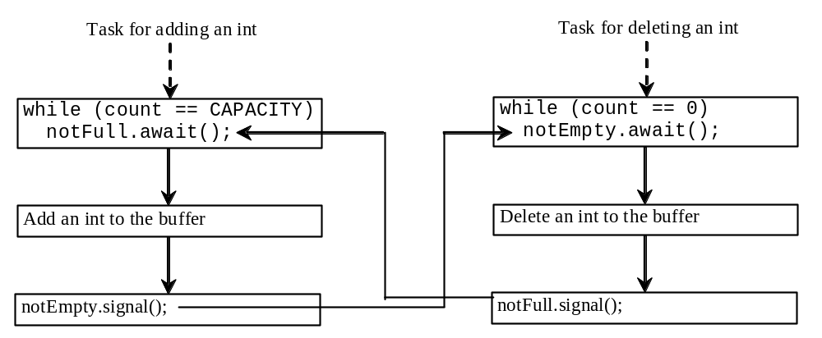
Case Study: Producer/Consumer (Optional)
Consider the classic Consumer/Producer example. Suppose you use a buffer to store integers. The buffer size is limited. The buffer provides the method write(int) to add an int value to the buffer and the method read() to read and delete an int value from the buffer. To synchronize the operations, use a lock with two conditions: notEmpty (i.e., buffer is not empty) and notFull (i.e., buffer is not full). When a task adds an int to the buffer, if the buffer is full, the task will wait for the notFull condition. When a task deletes an int from the buffer, if the buffer is empty, the task will wait for the notEmpty condition. The interaction between the two tasks is shown in Figure 29.19.

Slide 46
Case Study: Producer/Consumer (Optional)
Listing 29.10 presents the complete program. The program contains the Buffer class (lines 43-89) and two tasks for repeatedly producing and consuming numbers to and from the buffer (lines 15-41). The write(int) method (line 58) adds an integer to the buffer. The read() method (line 75) deletes and returns an integer from the buffer.
For simplicity, the buffer is implemented using a linked list (lines 48-49). Two conditions notEmpty and notFull on the lock are created in lines 55-56. The conditions are bound to a lock. A lock must be acquired before a condition can be applied. If you use the wait() and notify() methods to rewrite this example, you have to designate two objects as monitors.
ConsumerProducer
Run

Slide 47
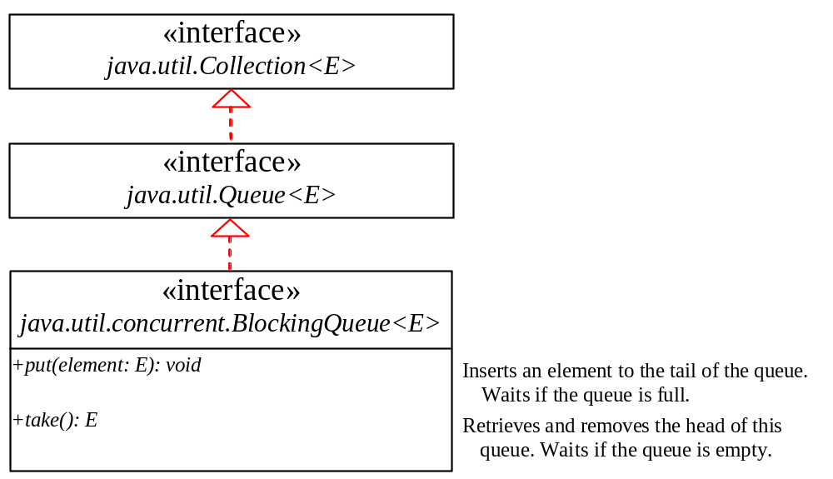
Blocking Queues (Optional)
§22.8 introduced queues and priority queues. A blocking queue causes a thread to block when you try to add an element to a full queue or to remove an element from an empty queue.

Slide 48
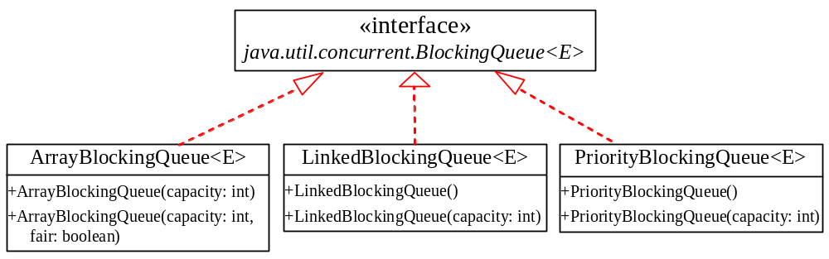
Concrete Blocking Queues
Three concrete blocking queues ArrayBlockingQueue, LinkedBlockingQueue, and PriorityBlockingQueue are supported in JDK 1.5, as shown in Figure 29.22. All are in the java.util.concurrent package. ArrayBlockingQueue implements a blocking queue using an array. You have to specify a capacity or an optional fairness to construct an ArrayBlockingQueue. LinkedBlockingQueue implements a blocking queue using a linked list. You may create an unbounded or bounded LinkedBlockingQueue. PriorityBlockingQueue is a priority queue. You may create an unbounded or bounded priority queue.

Slide 49
Producer/Consumer Using Blocking Queues
Listing 29.11 gives an example of using an ArrayBlockingQueue to simplify the Consumer/Producer example in Listing 29.11.
ConsumerProducerUsingBlockingQueue
Run

Slide 50
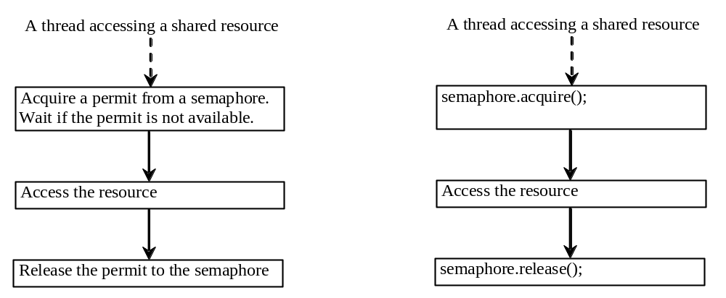
Semaphores (Optional)
Semaphores can be used to restrict the number of threads that access a shared resource. Before accessing the resource, a thread must acquire a permit from the semaphore. After finishing with the resource, the thread must return the permit back to the semaphore, as shown in Figure 29.29.

Slide 51
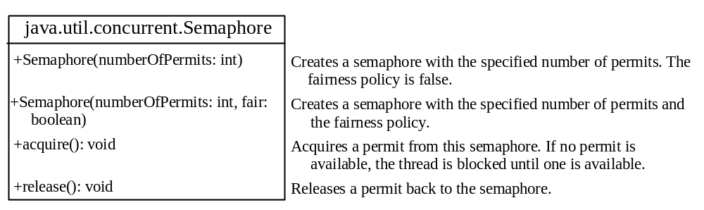
Creating Semaphores
To create a semaphore, you have to specify the number of permits with an optional fairness policy, as shown in Figure 29.29. A task acquires a permit by invoking the semaphore’s acquire() method and releases the permit by invoking the semaphore’s release() method. Once a permit is acquired, the total number of available permits in a semaphore is reduced by 1. Once a permit is released, the total number of available permits in a semaphore is increased by 1.

Slide 52
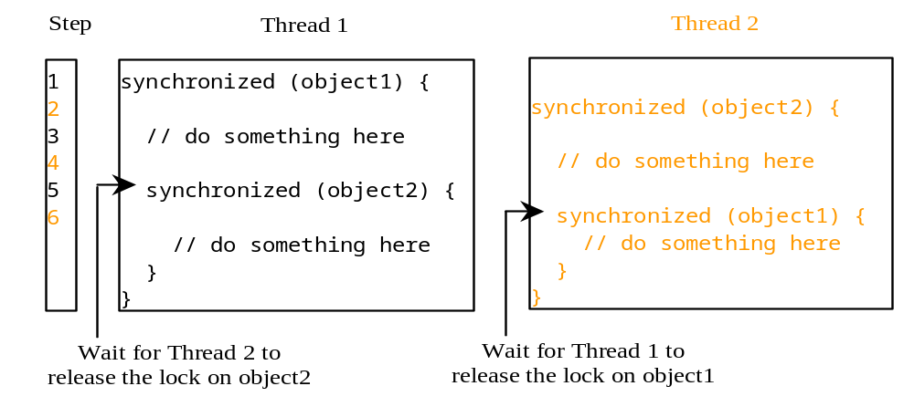
Deadlock
Sometimes two or more threads need to acquire the locks on several shared objects.
This could cause deadlock, in which each thread has the lock on one of the objects and is waiting for the lock on the other object.
In the figure below, the two threads wait for each other to release the in order to get a lock, and neither can continue to run.

Slide 53
Preventing Deadlock
Deadlock can be easily avoided by resource ordering.
With this technique, assign an order on all the objects whose locks must be acquired and ensure that the locks are acquired in that order.
How does this prevent deadlock in the previous example?

Slide 54
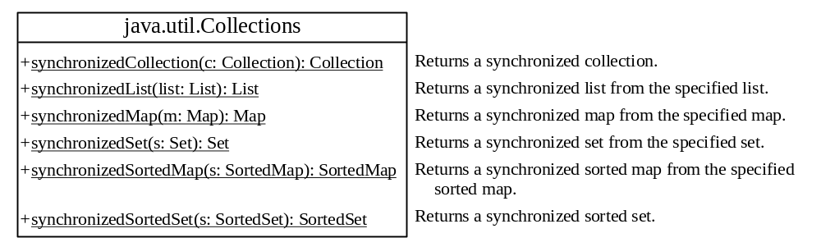
Synchronized Collections
The classes in the Java Collections Framework are not thread-safe.
Their contents may be corrupted if they are accessed and updated concurrently by multiple threads.
You can protect the data in a collection by locking the collection or using synchronized collections.
The Collections class provides six static methods for creating synchronization wrappers.

Slide 55
Vector, Stack, and Hashtable
Invoking synchronizedCollection(Collection c) returns a new Collection object, in which all the methods that access and update the original collection c are synchronized. These methods are implemented using the synchronized keyword. For example, the add method is implemented like this:
  public boolean add(E o) {
  synchronized (this) { return c.add(o); }
  }
The synchronized collections can be safely accessed and modified by multiple threads concurrently.
The methods in java.util.Vector, java.util.Stack, and Hashtable are already synchronized. These are old classes introduced in JDK 1.0. In JDK 1.5, you should use java.util.ArrayList to replace Vector, java.util.LinkedList to replace Stack, and java.util.Map to replace Hashtable. If synchronization is needed, use a synchronization wrapper.

Slide 56
Fail-Fast
The synchronization wrapper classes are thread-safe, but the iterator is fail-fast. This means that if you are using an iterator to traverse a collection while the underlying collection is being modified by another thread, then the iterator will immediately fail by throwing java.util.ConcurrentModificationException, which is a subclass of RuntimeException. To avoid this error, you need to create a synchronized collection object and acquire a lock on the object when traversing it. For example, suppose you want to traverse a set, you have to write the code like this:
  Set hashSet = Collections.synchronizedSet(new HashSet());
  synchronized (hashSet) { // Must synchronize it
  Iterator iterator = hashSet.iterator();
  while (iterator.hasNext()) {
  System.out.println(iterator.next());
  }
  }
Failure to do so may result in nondeterministic behavior, such as ConcurrentModificationException.

Slide 57
GUI Event Dispatcher Thread
GUI event handling and painting code executes in a single thread, called the event dispatcher thread. This ensures that each event handler finishes executing before the next one executes and the painting isn’t interrupted by events.

Slide 58
invokeLater and invokeAndWait
In certain situations, you need to run the code in the event dispatcher thread to avoid possible deadlock. You can use the static methods, invokeLater and invokeAndWait, in the javax.swing.SwingUtilities class to run the code in the event dispatcher thread. You must put this code in the run method of a Runnable object and specify the Runnable object as the argument to invokeLater and invokeAndWait. The invokeLater method returns immediately, without waiting for the event dispatcher thread to execute the code. The invokeAndWait method is just like invokeLater, except that invokeAndWait doesn't return until the event-dispatching thread has executed the specified code.

Slide 59
Launch Application from Main Method
So far, you have launched your GUI application from the main method by creating a frame and making it visible. This works fine for most applications. In certain situations, however, it could cause problems. To avoid possible thread deadlock, you should launch GUI creation from the event dispatcher thread as follows:
  public static void main(String[] args) {
  SwingUtilities.invokeLater(new Runnable() {
  public void run() {
  // Place the code for creating a frame and setting it properties
  }
  });
  }

Slide 60
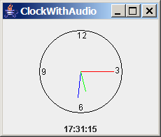
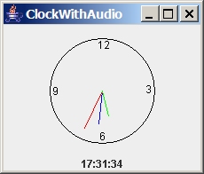
Case Study: Clock with Audio (Optional)
The example creates an applet that displays a running clock and announces the time at one-minute intervals. For example, if the current time is 6:30:00, the applet announces, "six o’clock thirty minutes a.m." If the current time is 20:20:00, the applet announces, "eight o’clock twenty minutes p.m." Also add a label to display the digital time.
ClockWithAudio
Run

Slide 61
Run Audio on Separate Thread
When you run the preceding program, you will notice that the second hand does not display at the first, second, and third seconds of the minute. This is because sleep(1500) is invoked twice in the announceTime() method, which takes three seconds to announce the time at the beginning of each minute. Thus, the next action event is delayed for three seconds during the first three seconds of each minute. As a result of this delay, the time is not updated and the clock was not repainted for these three seconds. To fix this problem, you should announce the time on a separate thread. This can be accomplished by modifying the announceTime method.
ClockWithAudioOnSeparateThread
Run

Slide 62
SwingWorker
As discussed in §29.6, all Swing GUI events are processed in a single event dispatch thread. If an event requires a long time to process, the thread cannot attend to other tasks in the queue. To solve this problem, you should run the time-consuming task for processing the event in a separate thread. Java 6 introduced SwingWorker. SwingWorker is an abstract class that implements Runnable. You can define a task class that extends SwingWorker, run the time-consuming task in the task, and update the GUI using the results produced from the task. Figure 29.28 defines SwingWorker.

Slide 63
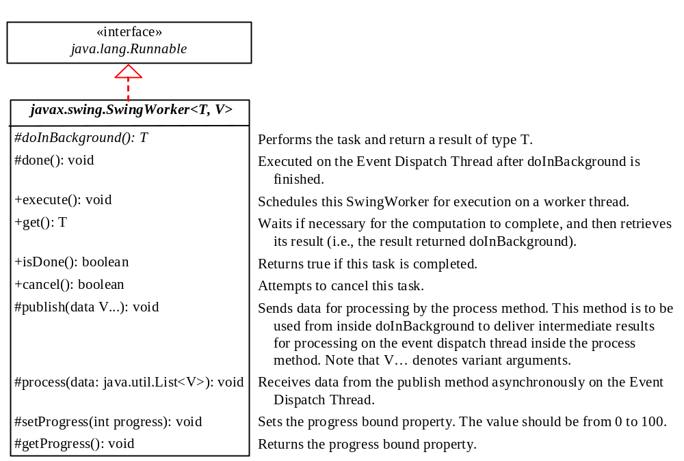
SwingWorker

Slide 64
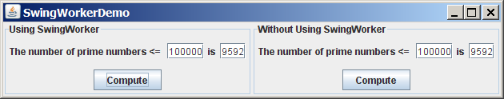
SwingWorker Demo
SwingWorkerDemo
Run

Slide 65
TIP
Two things to remember when writing Swing GUI programs,
Time-consuming tasks should be run in SwingWorker.
Swing components should be accessed from the event dispatch thread only.

Slide 66
Tutorial
http://www.deitel.com/articles/java_tutorials/20051126/JavaMultithreading_Tutorial_Part1.html

