Slide 1
Campus Lost & Found
DevOps Final Capstone: one small three-tier app, taken from git push to a monitored Kubernetes cluster on AWS
Code
CI
Scan
GHCR
Helm
EKS
Observe
Prateek Singh · Roll No. 24BCS10082 · Scaler School of Technology
Notes:
Campus Lost and Found, the DevOps final capstone by Prateek Singh, roll number 24 B C S 10082, Scaler School of Technology. The application is deliberately simple, so that every DevOps layer around it can be shown end to end: code, continuous integration, security scanning, a container registry, Helm, Kubernetes on Amazon E K S, and observability.

Slide 2
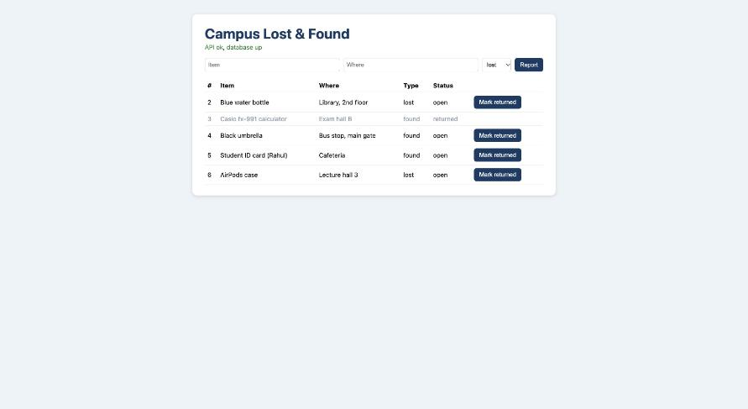
The application
M1
Frontend
1
React 18 + Vite on nginx-unprivileged; proxies /api to the backend
Backend
2
FastAPI, Python 3.12, psycopg 3, Alembic migrations, /metrics
Database
Running locally with docker compose at localhost:3000
3
PostgreSQL 16, items table with check constraints
CRUD on /api/items · /api/live · /api/health (503 if DB down) · /metrics
Notes:
The app lets students report items they have lost or found on campus and mark them as returned. It has three tiers. A React front end built with Vite and served by an unprivileged nginx, which also proxies the API. A FastAPI back end in Python 3.12, with Prometheus metrics and Alembic migrations that run on start up. And PostgreSQL 16. The REST API covers create, read, update, patch and delete for items, plus separate liveness and readiness endpoints, and a metrics endpoint.

Slide 3
Architecture end to end
git push
GitHub Actions
Trivy gate
GHCR push
helm upgrade
Kubernetes on AWS EKS (Terraform: VPC, 2 public subnets, EKS 1.31, node group)
frontend ×2
nginx + React
ServiceMonitor scrapes /metrics
Prometheus
Alertmanager
/
Ingress (nginx)
backend ×2–5 (HPA)
FastAPI
PostgreSQL
StatefulSet + PVC
Grafana dashboard
/api
Notes:
Here is the whole system. A git push triggers GitHub Actions. The pipeline lints, tests, builds both images, scans them with Trivy and pushes them to the GitHub Container Registry, tagged with the commit SHA. Continuous delivery then runs helm upgrade install with that exact tag. In the cluster, an nginx ingress sends slash A P I to the backend service and everything else to the front end. The backend runs two to five replicas under a horizontal pod autoscaler and talks to PostgreSQL in a stateful set with a persistent volume. A service monitor lets Prometheus scrape the backend, with Alertmanager and a Grafana dashboard on top. The cluster itself is provisioned with Terraform on AWS.

Slide 4
Tests and containers
M2–M4
9
87%
3
pytest tests over 6 endpoints
coverage, CI gate at 80%
Python versions in the test matrix
Docker
docker compose
Backend: python:3.12-slim, runs as uid 10001, HEALTHCHECK on /api/live
Frontend: multi-stage, node:20 builds, nginx-unprivileged serves on 8080
db → backend → frontend start order gated on healthchecks
Two networks: the frontend cannot reach Postgres
Named volume pgdata keeps data across restarts
Notes:
Testing. Nine pytest tests cover six endpoints. They run against an in-memory fake of the database connection, so no real database is touched. Coverage is 87 percent, and the build fails below 80. For Docker, the backend image runs as a non-root user with a health check, and the front end uses a multi-stage build: node builds the bundle and only the dist folder goes into an unprivileged nginx image. Docker compose wires the three tiers with health-checked start up order and two separate networks, so the front end cannot reach the database directly.

Slide 5
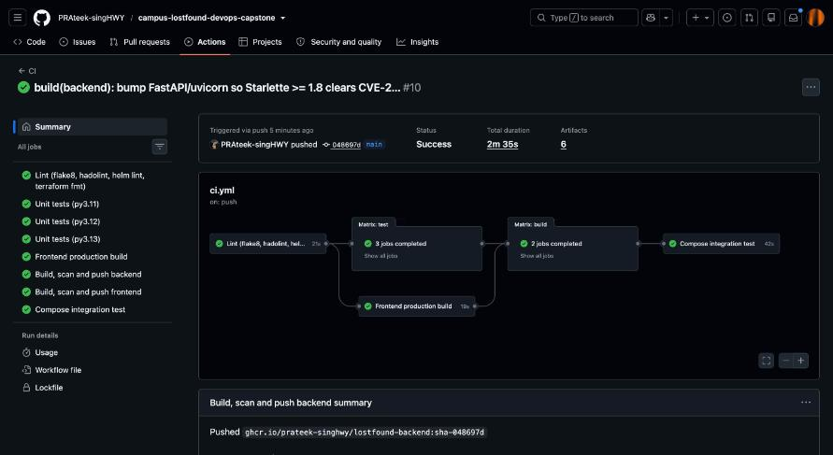
CI pipeline on every push
M5
1
lint
flake8 · hadolint · helm lint · terraform validate
2
test
pytest on 3.11 / 3.12 / 3.13, 80% gate
3
frontend-build
npm run build
4
build
buildx → Trivy → push to GHCR
A green CI run: every job passed and both images were pushed
5
integration
compose up from pushed images + smoke test
Notes:
The C I workflow runs on every push and pull request to main. Lint runs flake8, hadolint on both Dockerfiles, helm lint and terraform validate. Tests run on Python 3.11, 3.12 and 3.13 with the coverage gate. The front end build checks the React bundle. Then a matrix job builds the backend and front end images, scans each with Trivy, and pushes them to G H C R tagged with the short commit SHA. Finally an integration job starts docker compose from the images it just pushed, and runs the smoke test against them.

Slide 6
DevSecOps: the Trivy gate fired
M6
What the gate did
CRITICAL
CVE-2026-31789
severity HIGH,CRITICAL · exit-code 1 · ignore-unfixed
Found both CVEs in nginx-unprivileged:1.27-alpine
Blocked the build: no image was pushed
OpenSSL heap buffer overflow in libcrypto3 / libssl3 3.3.3
HIGH
CVE-2026-33630
The fix
Use-after-free in c-ares
Base image moved to 1.29-alpine + apk upgrade
Backend got the matching apt-get upgrade
Next run green; images pushed to GHCR
Notes:
Security scanning is a real gate, not a report. Trivy fails the build on any HIGH or CRITICAL vulnerability that has a fix available. On the first full run it did exactly that. The nginx unprivileged 1.27 alpine base image carried a critical OpenSSL heap buffer overflow, and a high severity use after free in c-ares. The build was blocked and nothing was pushed. The fix was to move to the 1.29 alpine tag and run apk upgrade in the Dockerfile, with the matching apt-get upgrade for the backend. After that, the pipeline went green.

Slide 7
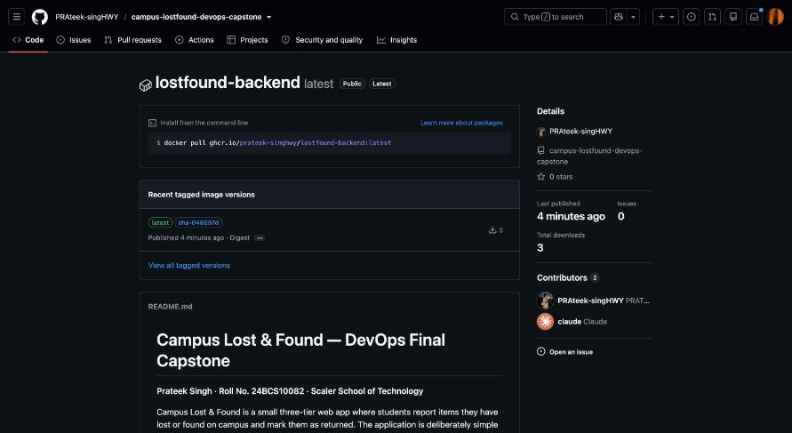
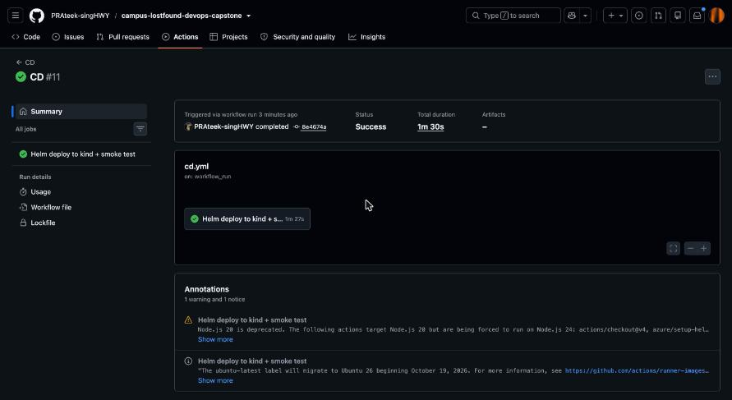
Delivery traced to a commit
M5
GHCR: images tagged sha-<commit>
CD: helm upgrade --install on kind, then smoke test
image.tag = sha-<commit> → any release can be reproduced, and helm rollback returns to a known image
Notes:
Continuous delivery runs when C I is green on main. It creates a kind cluster, installs the Prometheus operator custom resources, and runs helm upgrade install with the image tag set to sha dash the commit. It then smoke tests through the front end service and prints the helm history. Because every image tag is a commit SHA, every deployment is traceable, and helm rollback always returns to a known image.

Slide 8
Terraform on AWS
M7
26
AWS resources applied, then destroyed
network.tf
VPC 10.50.0.0/16, two public subnets tagged for ELB, IGW, routes
eks.tf
IAM roles, EKS control plane, node group 1–3, EBS CSI + metrics-server add-ons
2
t3.small workers (Free Tier)
storage.tf
Encrypted, versioned S3 bucket for pg_dump backups
1.31
EKS version, ap-southeast-2
provider.tf
use_localstack=true points every call at LocalStack for CI
Notes:
The infrastructure is Terraform. It builds a VPC with two public subnets across availability zones, an internet gateway, I A M roles, an E K S 1.31 control plane and a managed node group, plus the E B S C S I driver and metrics server add-ons. It was applied for real in the capstone account in Sydney, with two t3 small worker nodes, and later destroyed: 26 resources. In CI, a separate Terraform workflow runs format, validate, tflint, and a plan, apply and destroy against LocalStack, so the code is exercised on every change without cloud credentials.

Slide 9
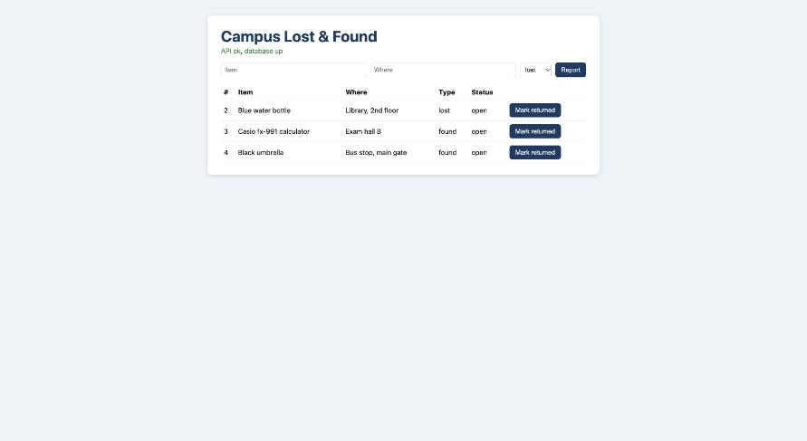
Kubernetes and Helm on EKS
M8
Secret + ConfigMap
Postgres StatefulSet + PVC
Deployments ×2, maxUnavailable 0
Startup / readiness / liveness probes
Ingress: /api → backend, / → frontend
HPA at 60% CPU
The app on EKS, served through an AWS load balancer
ServiceMonitor + PrometheusRule
values-dev / values-prod / values-eks
Notes:
One Helm chart deploys everything: a secret for the database credentials, a config map, a PostgreSQL stateful set with a persistent volume claim, back end and front end deployments with two replicas each, rolling updates with max unavailable zero, startup, readiness and liveness probes, non-root security contexts, cluster IP services, an ingress, a horizontal pod autoscaler at 60 percent CPU, and a service monitor and Prometheus rule. The same chart targets minikube and E K S through values files. On E K S, the app was reachable through an AWS load balancer and the smoke test passed through that URL.

Slide 10
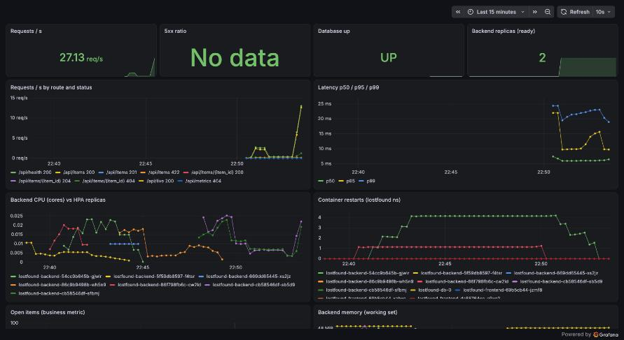
Observability
M9
Metrics on /metrics
http_requests_total
http_request_duration_seconds
lostfound_db_up · lostfound_items_open
5 alerts
5xx ratio high · p95 > 500 ms
Database down
Pod restarting · pod not ready
Grafana: Campus Lost & Found dashboard
Notes:
For observability, the back end exposes request counts by method, path and status, a latency histogram, a database up gauge and the number of open items. Prometheus discovers both back end pods through the chart's service monitor. Five alerts ship with the chart: high 5 x x ratio, p95 latency over 500 milliseconds, database down, pod restarting and pod not ready. Grafana loads a dashboard showing request rate, latency percentiles, error ratio, database health, CPU against H P A replicas, restarts, memory and open items.

Slide 11
Real incidents, real fixes
Free Tier rejected t3.medium
EBS CSI crash-loop on EKS
Cause Node group failed to launch
Cause Controller could not reach IMDS for credentials
Fix Switched workers to t3.small
Fix Launch template with IMDSv2 hop limit 2
Backend restart on first install
Prometheus had no target
Cause Postgres init outlasted the 15 × 2 s retry budget
Cause ServiceMonitor label did not match the release
Fix DB_RETRIES 30 + socket wait in entrypoint
Fix Added the release label in the chart
Notes:
Several real incidents came up while building this, and each is written up in the troubleshooting runbook. On AWS, the Free Tier account rejected t3 medium nodes, so the node group moved to t3 small. The E B S C S I controller then crash looped because it could not get credentials; managed nodes need an I M D S v2 hop limit of two, which is now set in a launch template. On the cluster, the back end restarted once on first install because Postgres took longer than the retry budget, so the retries were raised. And Prometheus showed no target until the missing release label was added to the service monitor.

Slide 12
From one commit to production
github.com/PRAteek-singHWY/campus-lostfound-devops-capstone
1
Edit and push a commit
2
CI: lint, test, Trivy, push sha tag
3
CD: Helm deploys that exact tag
4
helm rollback to any revision
Notes:
To sum up the demo flow. Edit something visible and push a commit. C I lints, tests, scans with Trivy and pushes images tagged with that commit. C D deploys that exact tag with Helm and prints the history, and helm rollback returns to any earlier revision. All of the code, evidence, screenshots and the troubleshooting runbook are in the repository on GitHub. Thank you.

