Slide 1
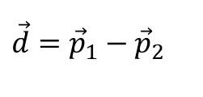
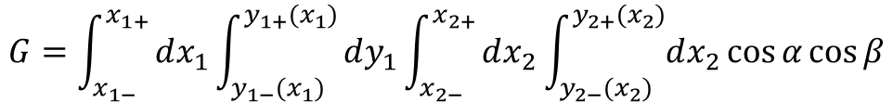
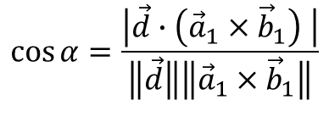
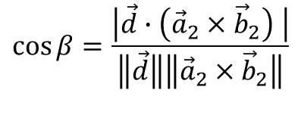
b
Basic approach for geometric factor:
Start with polygons and ellipses
Break polygons into triangles
Triangle defined by vectors:
p: offset of anchor corner from origin
a: vector from anchor corner to 2nd corner
b: vector from anchor corner to 3rd corner
x is parallel to a
y is parallel to b-(b.a)a
Ellipse:
p: offset of center from origin
a: semimajor axis
b: semiminor axis
x is parallel to a
y is parallel to b
Each object can provide x limits in its own coordinates
Each object also returns y limits for any given x, in it is own coordinates
Quadruple integral over x1,y1,x2,y2, with appropriate cosine weighting (two cosine factors)
p
a
b
a
p
$$\vec{d}={\vec{p}}_{1}−{\vec{p}}_{2}$$
$$\cos{α}=\frac{\left|\vec{d}∙\left({\vec{a}}_{1}×{\vec{b}}_{1}\right) \right|}{\left\|\vec{d}\right\|\left\|{\vec{a}}_{1}×{\vec{b}}_{1}\right\|}$$
$$\cos{β}=\frac{\left|\vec{d}∙\left({\vec{a}}_{2}×{\vec{b}}_{2}\right) \right|}{\left\|\vec{d}\right\|\left\|{\vec{a}}_{2}×{\vec{b}}_{2}\right\|}$$
$$G=\int_{x_{1−}}^{x_{1+}}{dx_{1}\int_{y_{1−}(x_{1})}^{y_{1+}(x_{1})}{dy_{1}\int_{x_{2−}}^{x_{2+}}{dx_{2}\int_{y_{2−}(x_{2})}^{y_{2+}(x_{2})}{dx_{2}\cos{α}\cos{β}}}}}$$

Slide 2
Basic approach for angular response:
Start with polygons and ellipses
Break polygons into triangles
For a given theta,phi, define unit vector q that gives orientation of rays
Rotate triangles and ellipses into plane perpendicular to q. Still triangles and ellipses.
Compute area overlap as if rotated elements were coplanar.
Define overlap region from all points of intersection between boundaries of two shapes
This is a patch object with either straight or curve (arc of ellipse chord) sides
For curved edges, chop off to polygon, and compute leftover pieces as ellipse chord-arc areas
For polygons, break into triangles
Compute A+B as ellipse sector area.
Compute A as triangle area.
B = (A+B)-A
A
B
https://math.stackexchange.com/questions/114371/deriving-the-area-of-a-sector-of-an-ellipse

