Slide 1


Mine sweeper

Slide 2

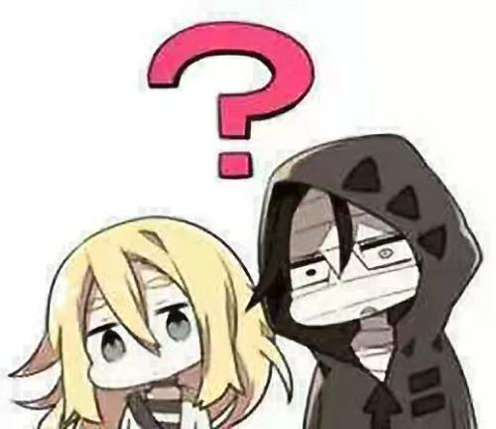
How to design a mine sweeper?

Slide 3
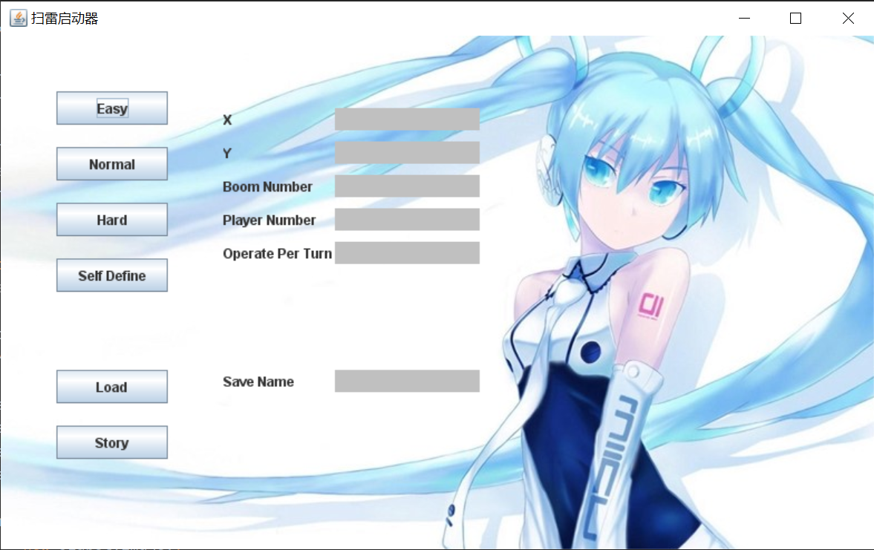
The most important thing we need to do is rational layout

Slide 4
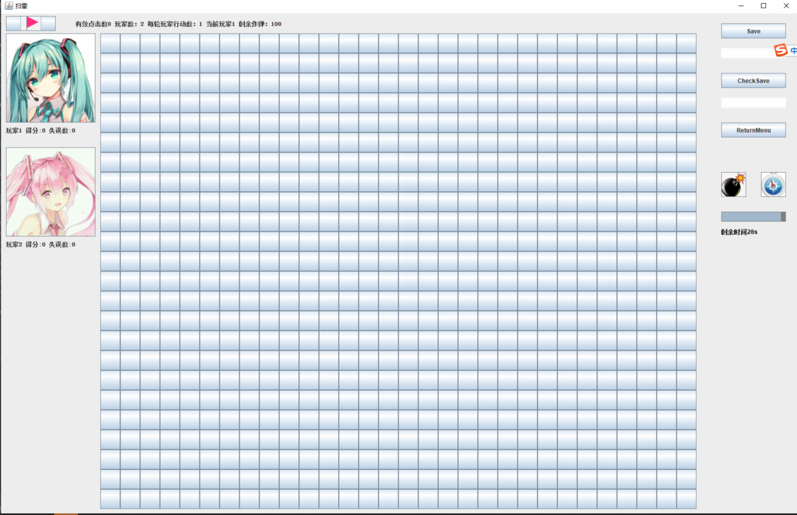
Hard pattern

Slide 5
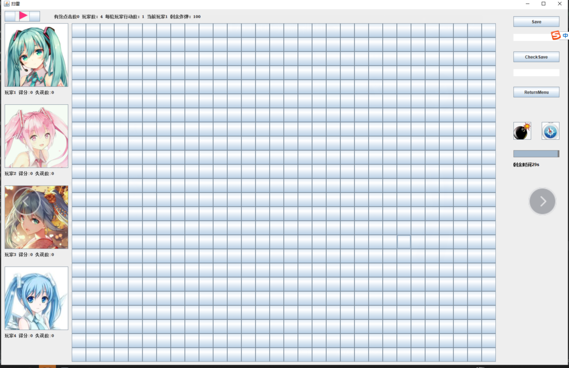
Multiplayer

Slide 6
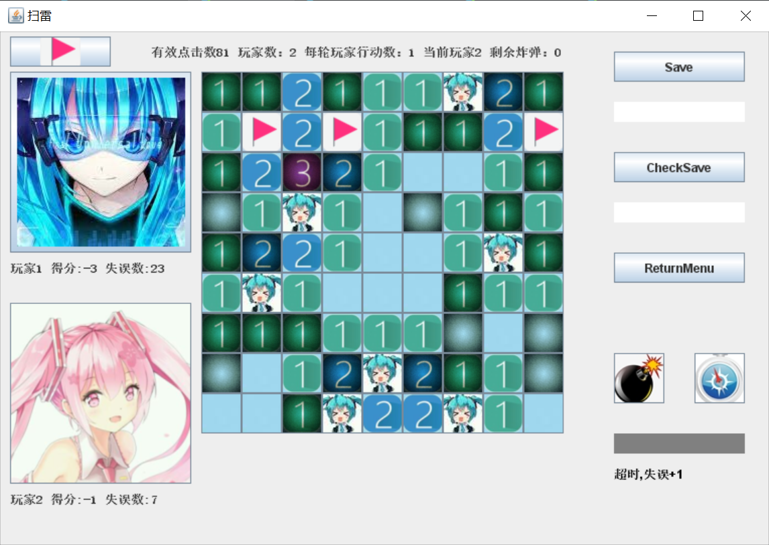
人机对战

Slide 7
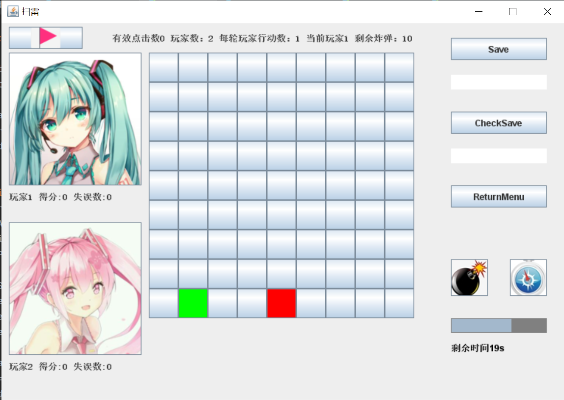
Use props

