Slide 1
PLAY PREDICTION ON THE BASIS OF CLIMATE USING MACHINE LEARNING ALGORITHM
SUBMITTED TO:
MR KAILASH JOSHI
NIELIT Haridwar
CREATED BY:
YASH SHARMA
MLP Batch 26

Slide 2
Contents
Objective of the research
Problem Definition
Scope of work
Methodology
Result Analysis
Conclusion

Slide 3
Objective of the project
Possibility of the play depends upon weather conditions .Weather conditions depend on many small factors, using different factors, e.g. temperature, humidity, weather, wind speed, etc., will help predict the weather conditions more accurately to judge the play.
Using a rich and large numerical dataset of a small region. Predicting the weather in a smaller area will produce better outcomes than predicting the weather in a larger area.
Using different machine learning algorithms, e.g. KNN ,Linear Regression , Logistic Regression etc. and comparing the results to develop the best possible algorithm to predict the possibility of play.

Slide 4
Objective of the project
Comparing the results of these machine learning algorithms to develop the best possible algorithm to predict the Play.
There have been previous researches done on Play prediction. But most of their accuracy is not satisfactory. This research’s main goal is to predict the possibility of play accurately and in the shortest time possible.
This research aims to find the most efficient and accurate machine learning model to predict event (play) possibility .

Slide 5
Problem Definition
The weather has a significant impact on the play and because of that, being able to predict it helps a player in their day-to-day decisions such as how to plan training schedule , practice etc.
A sport organizing company needs you to help them host an event on a particular day, save resources and ensure the smooth functioning of the event.
To achieve these things, the company needs to have an accurate weather prediction algorithm that will improve their decision-making on typical sport activities such as event planning , venue setup ,volunteer management etc.

Slide 6
Scope of work
Play Prediction Model has a main objective in prediction of the possibility of play in a specific region or division in advance by using various machine learning algorithm and find out which one is best for prediction.
This model also helps the player as well as event organizer to decide and analyze the most suited day to host a sport event.

Slide 7
Methodology
The raw climate dataset is cleaned and preprocessed. Missing value assignment, outlier detection, and feature scaling are all part of this process.
Three (2 classifier and 1 regression) models are built and implemented on the training dataset.
After the training part is done, the models are tested.
All three models were compared with each other based on their respective metric scores.

Slide 8
CLASSIFICATION ALGORITHMS
Classification algorithms are used for predicting discrete categorical labels or classes. Examples include logistic regression, Knn , support vector machines (SVM), decision trees, random forests, and neural networks for classification.

Slide 9
K- NEAREST NEIGHBOR
KNN stands for k-Nearest Neighbors, and it is a popular and simple machine learning algorithm used for both classification and regression tasks. KNN is a type of instance-based learning, where the algorithm memorizes the entire training dataset and makes predictions based on the similarity between the input data point and its k-nearest neighbors.

Slide 10
LOGISTIC REGRESSION
Logistic Regression is a popular statistical and machine learning algorithm used for binary classification tasks. Despite its name, it is primarily used for classification rather than regression. The algorithm is commonly employed when the dependent variable (the one being predicted) is categorical and has only two possible outcomes, often labeled as 0 and 1. For example, it can be used to predict whether an email is spam or not (binary outcome) based on various features of the email.

Slide 11
ACCURACY SCORE
Accuracy score is a common evaluation metric used to measure the performance of a classification model. It provides a simple and intuitive way to understand how well the model is making correct predictions.
Accuracy score is defined as the ratio of correctly predicted instances to the total number of instances in the dataset. It is calculated using the following formula:
Accuracy = (Number of Correct Predictions) / (Total Number of Predictions)

Slide 12
REGRESSION ALGORITHMS
Regression Algorithms: These algorithms are used for predicting continuous numerical values. Linear regression and polynomial regression are examples of regression algorithms.

Slide 13
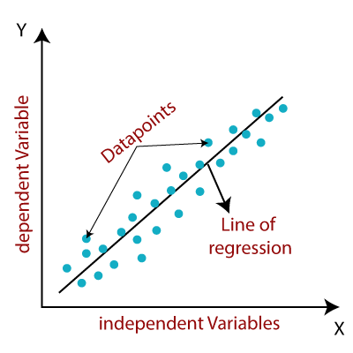
Linear Regression (LR)
Linear regression algorithm shows a linear relationship between a dependent (y) and one or more independent (y) variables, hence called as linear regression. Since linear regression shows the linear relationship, which means it finds how the value of the dependent variable is changing according to the value of the independent variable.

Slide 14

Mean Absolute Error (MAE)
The MAE is the simplest straightforward metric for calculating regression error. The absolute value of the distances between the predicted value and the regression line are used to accomplish this. The MAE is calculated using the following equation,
Here, the number of observations is N, the predicted value is y, and the actual value is x.

Slide 15
Result Analysis
Model | Algo Score | Algo Metric
KNN | 0.866666666666666 | (Accuracy Score ) 0.866666666666666
Logistic Regression | 0.933333333333333 | (Accuracy Score ) 0.933333333333333
Linear Regression | 0.5946120801200767 | (Mean Absolute Error ) 0.28088263202387725

Slide 16
Conclusion
In this research paper, our goal was to find how different machine learning algorithms perform to achieve more accuracy with faster and efficient prediction results. In this study three widely used machine learning algorithms were compared on test sets to predict the possibility of the play. In closing the Logistic Regression model performed better than the Linear Regression (LR) model to achieve finer prediction.

Slide 17


