Slide 1

KEYLOGGER & SECURITY
ADITYA COLLEGE OF ENGINEERING & TECHNOLOGY
DEPARTMENT OF CSE – AIML
CYBER SECURITY WITH KALI LINUX
NAME : GUNNAM PREETHI ASHRITHA
ROLL NO : 22P31A4215
GUIDE NAME : Dr B. S. N. V. RAMANA MURTHY M. Tech(Ph. D)
COLLEGE NAME : Aditya College Of Engineering & Technology
BRANCH : CSE-AIML

Slide 2
INDEX
INTERNSHIP CERTIFICATE 3
INTRO TO ORGANIZATION 4
ROLES & RESPONSIBILITIES 5
WEEKLY OVERVIEW 6-11
OUTCOMES & PHOTOS 12-14
QUERIES 15
THANK YOU 16

Slide 3
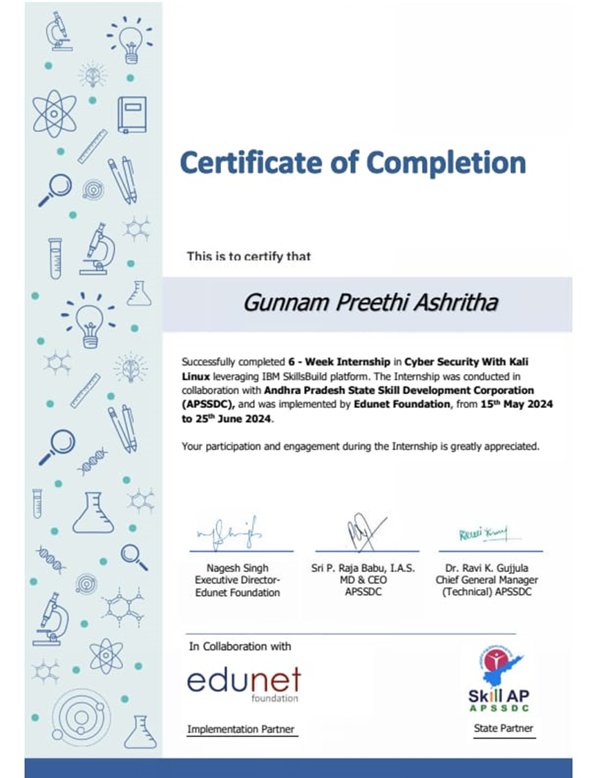

Slide 4
INTRO TO ORGANIZATION
Andhra Pradesh State Skill Development Corporation (APSSDC) is a government organization that helps people in Andhra Pradesh get the skills they need for good jobs.
APSSDC offers training in many areas like IT, manufacturing and healthcare to make sure people are ready for the workforce.
Its main goal is to provide training that prepares people for the real-world needs of industries, ensuring they are ready for employment or entrepreneurship.
APSSDC partners with schools, colleges, industries and various other groups to make skill training available to everyone in the state.

Slide 5
ROLES & RESPONSIBILITIES
Training Department: Employees create and run training programs. They make sure that what people learn is useful and relevant to the job market.
Operations Department: These employees handle the scheduling, organizing, and smooth running of training sessions and projects.
Finance Department: Employees here manage the organization's money, making sure funds are used wisely for different programs and expenses.
Human Resources Department: HR employees take care of hiring, onboarding, and supporting the staff. They also make sure, the team is happy and productive.

Slide 6
WEEKLY OVERVIEW
WEEK – 1 (From 15-05-24 to 21-05-24)
Objective of the Activity Done: Skills Build Orientation
Detailed Report: In the first week, participants are introduced to the IBM SkillsBuild platform, where they set up their profiles and explore available resources like courses and certifications. They learn about different career paths in cybersecurity and get familiar with the platform’s tools. By midweek, they connect with other learners and the SkillsBuild community to start building a network. The week wraps up with a clear explanation of the course structure, deadlines, and expectations, helping participants feel ready to begin their learning journey.

Slide 7
WEEK – 2 (From 22-05-24 to 28-05-24)
Objective of the Activity Done: Introduction & Basic Networking
Detailed Report: In Week 2, participants dive into the basics of cybersecurity and networking. They start by learning key cybersecurity concepts, such as common threats and how to defend against them. Next, they explore networking fundamentals, including the OSI model and how data moves through networks. Throughout the week, they also get introduced to important tools like firewalls, encryption methods, and VPNs to secure networks. By the end of the week, participants practice using network security tools and review everything with a quiz, reinforcing their understanding of these foundational topics.

Slide 8
WEEK – 3 (From 29-05-24 to 04-06-24)
Objective of the Activity Done: Explanation on Kali Linux
Detailed Report: In Week 3, participants focus on Kali Linux, a key tool for cybersecurity tasks. They begin by learning what Kali Linux is and why it’s important in the field. After that, they install the software and get familiar with the basic commands used in Linux systems. As the week progresses, participants explore some of Kali Linux’s powerful tools, like Nmap and Wireshark, which are used for network scanning and traffic analysis. The week ends with a hands-on activity where participants perform a basic network scan using these tools, giving them practical experience in real-world cybersecurity operations.

Slide 9
WEEK – 4 (From 05-06-24 to 11-06-24)
Objective of the Activity Done: Social Engineering attacks and Project Work
Detailed Report: In Week 4, participants explore social engineering attacks, including phishing, baiting, and pretexting. They examine real-life case studies to understand the impact of these attacks on organizations. Midweek, they start a Key Logger Project, where they learn how key loggers work and set one up in a controlled environment to see how data can be captured. They then analyze the collected data and discuss the ethical implications of using such tools. The week wraps up with presentations of the key logger project results and a discussion on how to defend against key logger attacks, reinforcing both technical skills and ethical awareness.

Slide 10
WEEK – 5 (From 12-06-24 to 18-06-24)
Objective of the Activity Done: System Hacking
Detailed Report: In Week 5, participants delve into system hacking techniques, starting with an overview of methods like password cracking and privilege escalation. They engage in practical demonstrations of brute-force attacks, learning how hackers attempt to break into systems by guessing passwords. As the week progresses, they focus on privilege escalation, understanding how attackers gain unauthorized access to higher levels of system control. Participants also explore ethical hacking practices, using penetration testing tools to identify system vulnerabilities responsibly. The week concludes with a discussion on defensive strategies to protect systems from these hacking techniques, equipping participants with both offensive and defensive cybersecurity skills.

Slide 11
WEEK – 6 (From 19-06-24 to 25-06-24)
Objective of the Activity Done: Secure data to prevent Hackers & Project Submission
Detailed Report: In Week 6, participants focus on data security, learning about the importance of encryption, backups, and access control in protecting sensitive information. They start with a practical session on encrypting files and setting up secure backups to safeguard data. Midweek, they finalize their Key Logger Project, analyzing the results and preparing their findings for submission. The week culminates in presentations where participants showcase their key logger projects, discussing the implications of their findings and how to defend against such attacks. Finally, the course wraps up with feedback sessions and discussions on key takeaways, helping participants reflect on their learning and identify future steps in their cybersecurity journey.

Slide 12
OUTCOMES
The program fostered a collaborative atmosphere where interns frequently interacted with each other and instructors, encouraging open dialogue and question-asking. This interaction promoted a sense of community and support among participants. Mentors were approachable, providing valuable insights and guidance, making it easier for interns to seek help when needed.
Access to online platforms for lectures and hands-on sessions was well-maintained and user friendly. Virtual labs allowed interns to practice their skills in a safe environment, ensuring they could apply theoretical knowledge effectively. The overall infrastructure supported a seamless learning experience.

Slide 13
Job roles and expectations were clearly defined at the outset, enabling interns to focus on their individual learning objectives. This clarity helped interns understand their responsibilities, ensuring a structured approach to their work and learning tasks. Regular feedback on performance further reinforced role clarity.
The program adhered to a structured curriculum, blending theoretical and practical components that facilitated comprehensive learning. Interns were expected to follow specific protocols during practical sessions, which instilled discipline and a professional approach to cybersecurity practices. Timelines and deadlines encouraged effective time management.

Slide 14
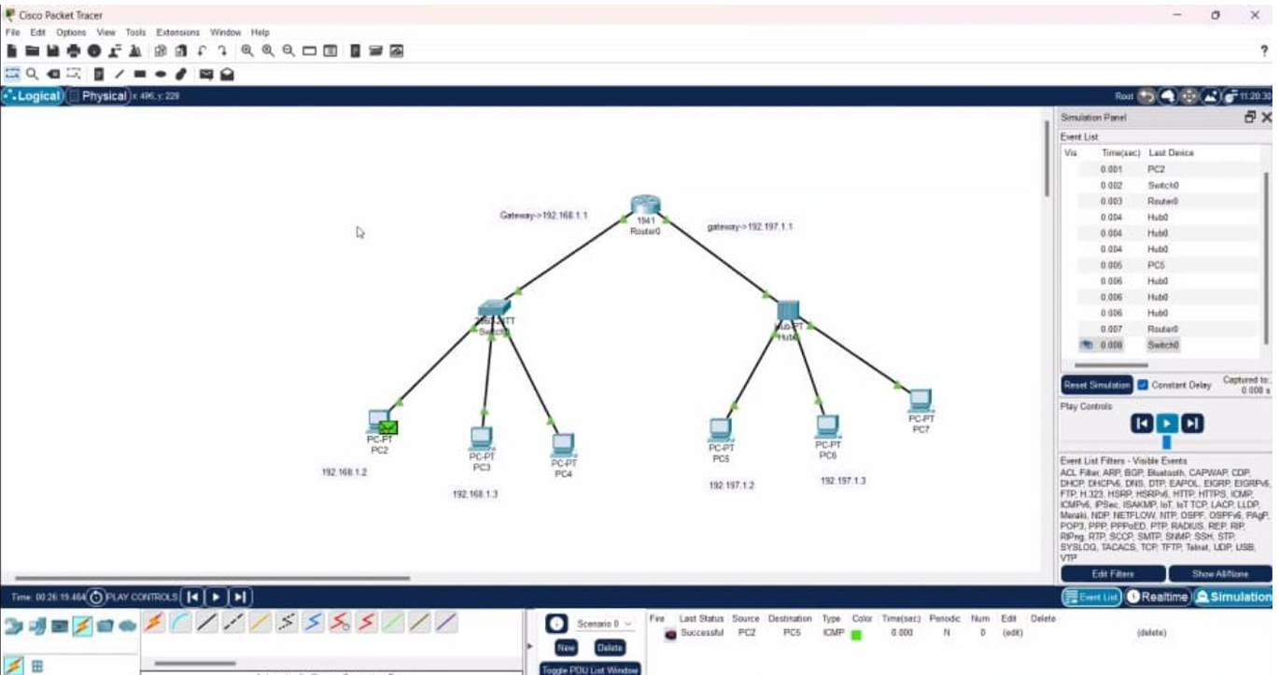
PHOTOS

Slide 15
ANY QUERIES ?

Slide 16
THANK YOU !

