Slide 1



Slide 2
Forecasting the Prices of Cocoa Using Python Modules
by
Darko, Francis Owusu
School of Computing, Applied Science, and Engineering
Carolina University, U.S.A

Slide 3
Data set for the for the project:
https://ca.finance.yahoo.com/quote/CC%3DF/history/
Downloaded from Yahoo finance

Slide 4
Some Python Libraries used for the Project
pandas as pd
numpy as np
matplotlib.pyplot as plt
seaborn as sns
scipy
statsmodels.graphics.tsaplots import plot_acf, plot_pacf
statsmodels.tsa.arima.model import ARIMA

Slide 5
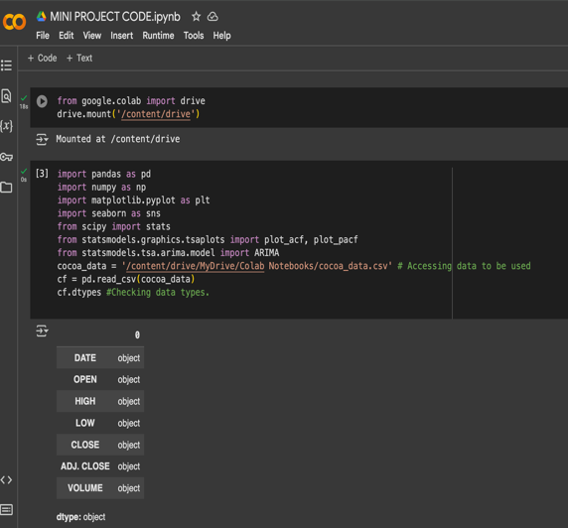
Data Type
A Phyton function run on the data set reveals the data is object

Slide 6
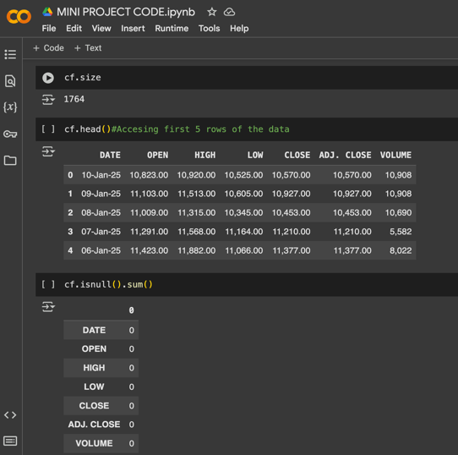
Data Size and Check
A Python function run on the data shows a data with 7 columns and 252 rows making 1764 entries.
The data has no missing value.

Slide 7
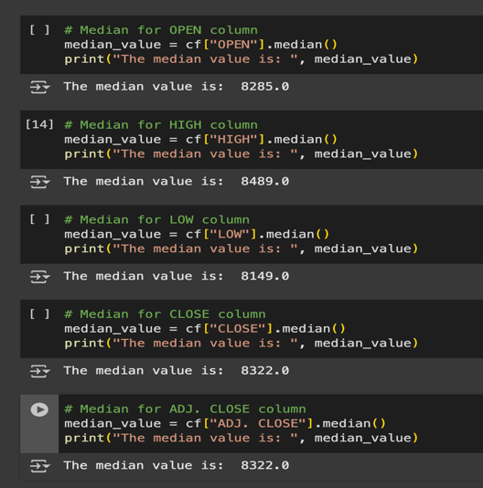
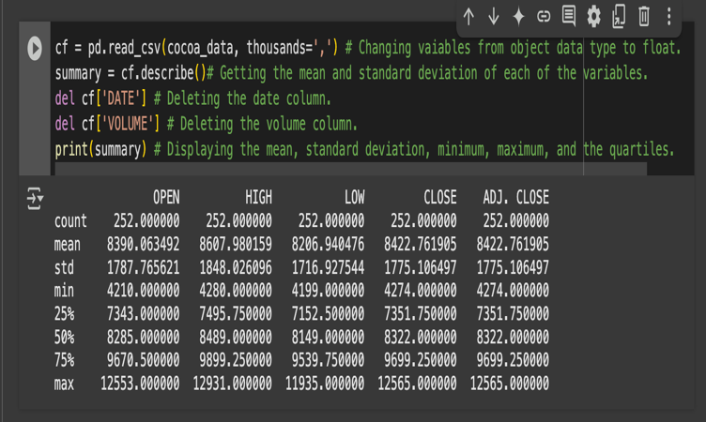
Statistical Description of Data

Slide 8
Statistical Description of Data Analysis
The mean of the “HIGH” column is significantly high and different from the other columns might be the presence of outliers.
The standard deviation of the closing price is 1775.10, which is still high, suggesting significant cocoa price fluctuation over the period.
The price more than tripled from its lowest point to its highest, suggesting a colossal range of price movement.
The percentiles indicate a considerable portion of the prices is between 7000 – 9000.
The median for the close is below the mean, which indicates the distribution of the prices skews to the right.

Slide 9
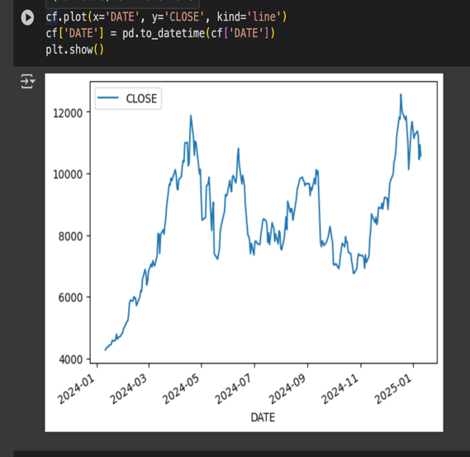
Line plot for “CLOSE PRICE”
The price shows both upward and downward trends over a year period indicating fluctuation in cocoa prices.

Slide 10
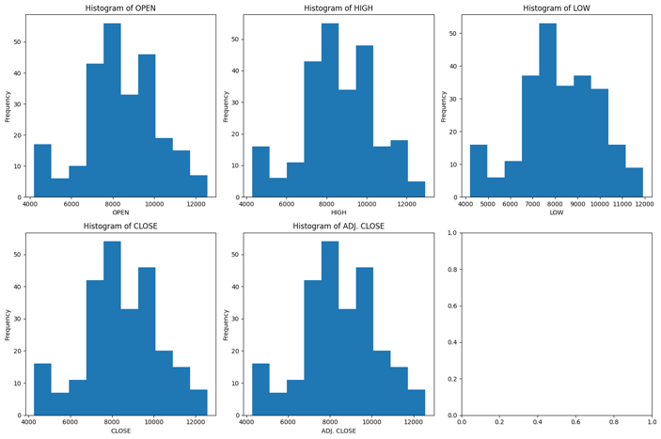
Histogram Plot
All histograms show right-skewed direction which suggests there are many lower prices, but some high values push the distribution in the right direction. This indicate the data is not normally distributed.
The histograms did not show the presence of any outliers.

Slide 11
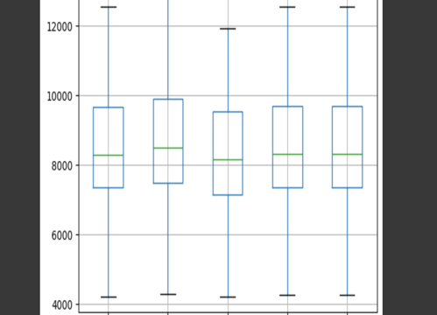
Box Plot
The box plot shows the absence of outliers, which suggests that price fluctuations or instability remained within a typical and expected range.

Slide 12
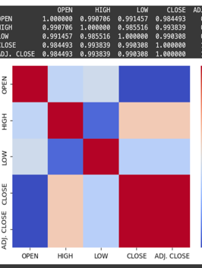
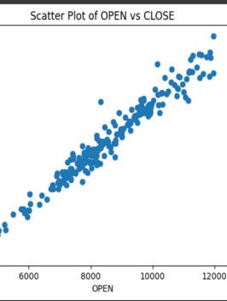
Scatter Plot and Correlation Matrices
The Scatter Plot and Correlation Matrices show a strong positive correlation between the opening and closing prices, and an upward trend for prices.

Slide 13
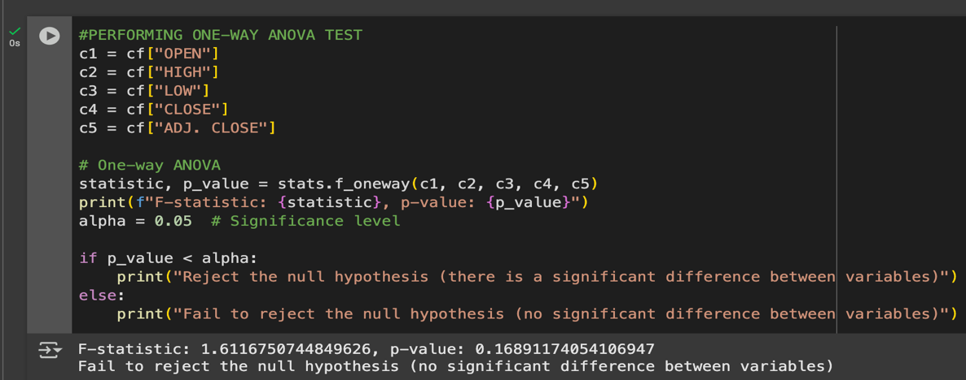
One-Way ANOVA Test
Ho = The price trend shows no significant change over the observed period.
The p-value>0.05 suggests no statistically significant difference between the variables, hence failure to reject the null hypothesis, suggesting the prices of Cocoa follow a particular trend or pattern.

Slide 14
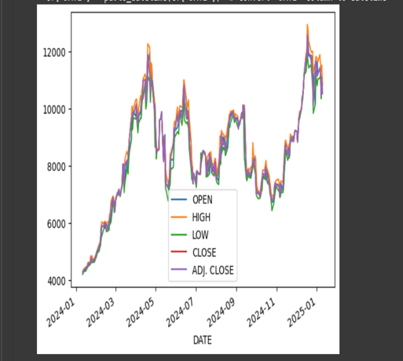
Time Series Plot
The time series plot of the data indicates an upward pattern with high volatility, indicating non-stationary because of the changing variance across sectors of the time series.

Slide 15
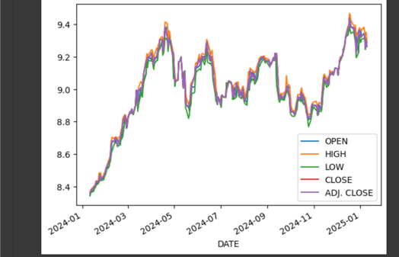
Transformed Time Series Plot
The transformed time series plot shows less variance(around 2024-11) compared to the original. However, the trend still indicates non-stationarity.

Slide 16
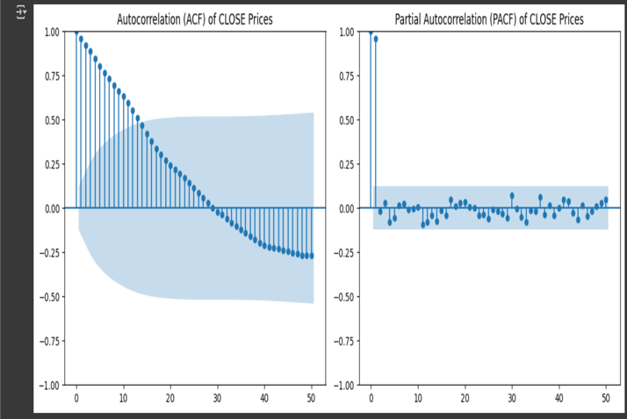
ACF and PACF Plots
The plot shows the ACF starts with a high value at lag 1 (close to 1) and then shows a gradual, exponential decay toward zero, with most values falling within the confidence interval, which indicates non-stationary data.
The PACF shows a significant spike at lag 1 (outside the confidence interval, close to 1) and then cuts off sharply, with subsequent lags falling within the confidence interval, indicating non-stationary

Slide 17
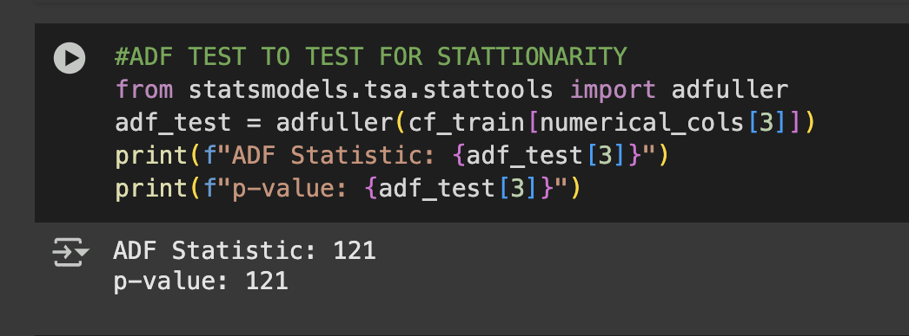
ADF(Augmented Dickey-Fuller) test
The high p-value of the ADF test suggests that the null hypothesis at a significance level of 0.05 can be rejected, meaning the presence of a unit root, indicating that it is non-stationary.

Slide 18
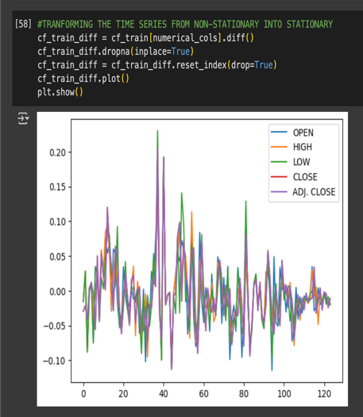
Time Series Plot after Differencing
Differencing was performed on the training data set to transform the non-stationary time series into a stationary time series by removing changes in the levels of the series. The new time series plot shows a stationary output as it fluctuates randomly around a mean of zero with constant variance and no trend or seasonality.

Slide 19
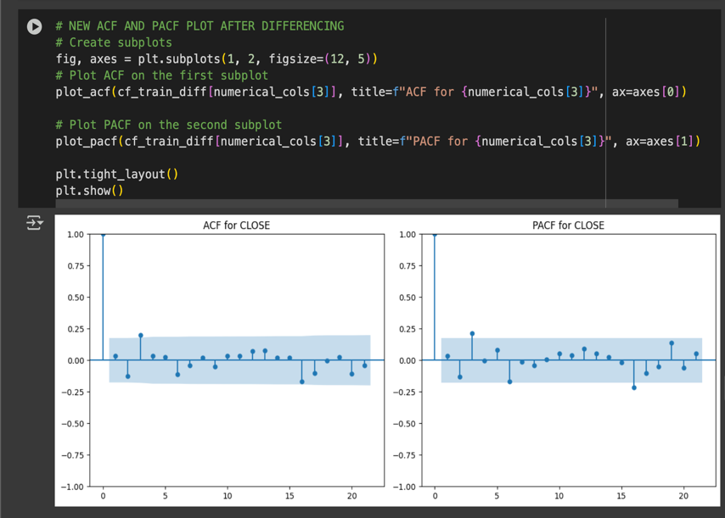
ACF AND PACF Plots for Differenced data set
A new ACF for the time series shows sharp decay or drops in value more quickly, indicating the time series is less correlated to its lag, with all the lags falling with the confidence interval. The PACF plot shows a strong spike at lag one after the first differencing. These signs suggest the stationarity of the time series.

Slide 20
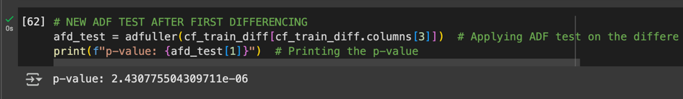
ADF test on Differenced Data
ADF test performed after differencing gave a p<0.05, indicating the null hypothesis can be rejected, indicating a unit root is absent and supporting the series is stationary.

Slide 21
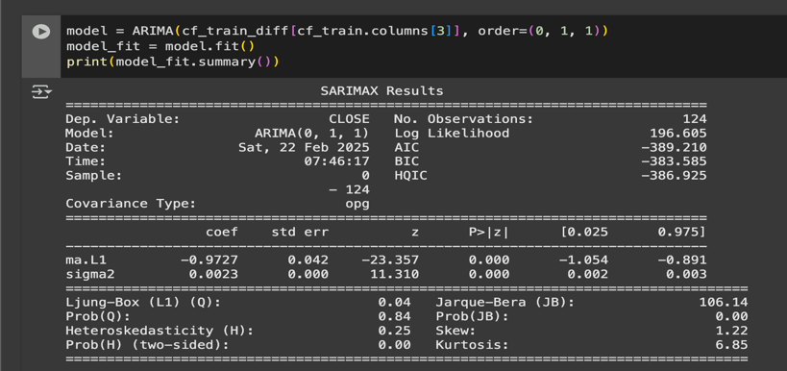
ARIMA MODEL
The simpler Arima model was set as (0,1,1)
The Ljung-Box p-value of 0.84 indicates no significant autocorrelation; hence, the models capture dependencies.
JB test, which assesses the normality distribution of the residuals, produces a p-value> 0.05, suggesting the residuals are not normally distributed, indicating the presence of outliers in the residuals that can affect the accuracy of the model and the forecasting.
Heteroskedasticity(H) test for checking constant variance in residuals shows a value of 0.25(<1) and a p-value of 0.00, indicating the significance of the heteroskedasticity in the residuals, which suggests the variance of the residuals changes over time affecting the model's reliability.

Slide 22
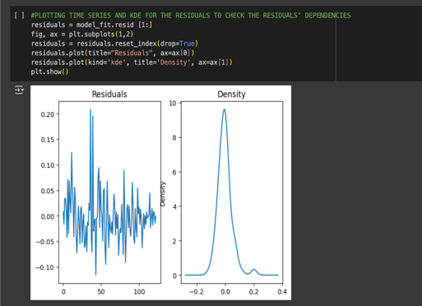
Time Series Prediction
The residual plot shows a random and general, known as white noise, time series with no clear trend, and the density looks normally distributed with the mean around zero

Slide 23
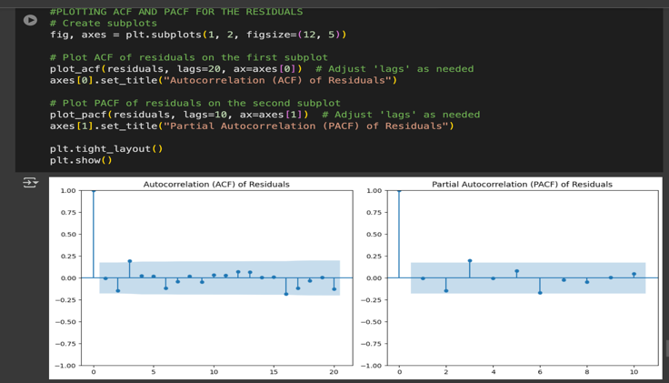
ACF and PACF Plots for Residuals
The values of both the ACF and PACF plots all fall within the confidence interval, indicating no significant autocorrelation at any lag, suggesting the residuals are uncorrelated and hence behave like white noise, suggesting the data do not follow a particular trend or systematic pattern or dependence.

Slide 24
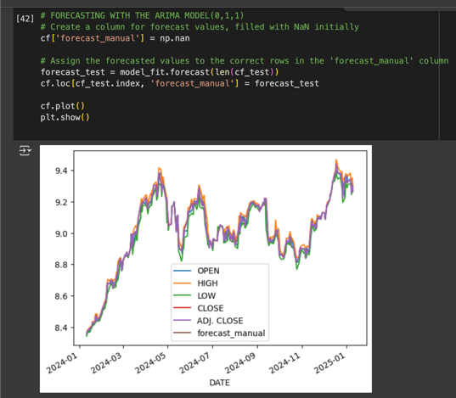
Forecasting with ARIMA(0,1,1)
Python function calculates and plots the prediction with the actual time series, including the test set.
The results show that the prediction (forecast_manual) follows the same momentum, with an upward trend and volatility of the historical data.

Slide 25
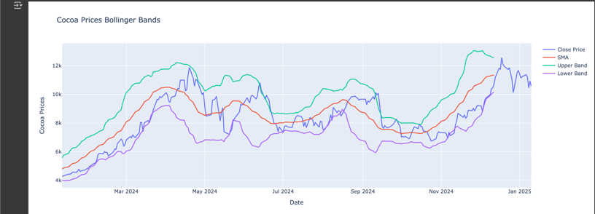
Bollinger Band for “Cocoa Prices”
The chart shows the Bollinger Bands from Cocoa prices for a year (from January 2024 to January 2025). A noticeable increase is observed from January 12, 2024, to April 19, 2024, when the prices got much closer to the upper band, signifying an overbought season. Prices fluctuate from May 2024 to September 2024 as the closing band touches both the upper and lower bands, suggesting a period of consolidation due to volatility.
Another uptrend price movement is observed from September 2024 to December 2024, with prices approaching the upper band, indicating another overbought condition leading into the early.

Slide 26
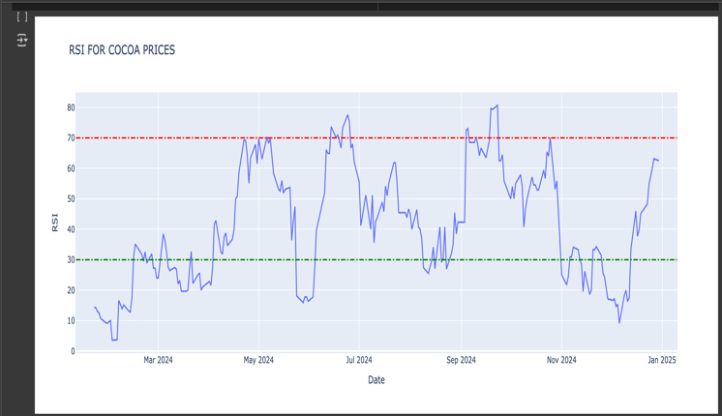
Relative Strength Index(RSI)
The chart shows the RSI plot for Cocoa prices based on historical data for one year (from January 2024 to January 2025). From January 23, 2024, to March 4, 2024, a noticeable gradual trend was observed as it moved across the RSI =30 mark.
A downward trend is observed from March 2024 to April 2024. A steady uptrend movement of the price of Cocoa is seen from April to May, hitting the RSI = 70 mark, signifying an overbought period. Again, there are several peaks above the overbought level, particularly noticeable around June 2024 and September 2024, which could have been points where traders might expect a price correction.

Slide 27
CONCLUSION
Future Cocoa price trends do not depend on any variable. Cocoa prices are expected to maintain an uptrend with periods of consolidation and volatility, driven by external factors such as climate challenges, supply shortages, and rising demand. However, persistent supply chain issues could lead to a break in the trend by 2025.
The price movement follows cycles of overbought and oversold conditions, with January 2025 showing strong momentum near RSI = 70, indicating a potential price increase before facing resistance.

Slide 28
SOME REFERENCES
ICCO. (2013). Origins Of Cocoa and Its Spread Around The World[online]. Available: https://www.icco.org/about-cocoa/growing-cocoa.html
E. Poelmans, & J. Swinnen. A Brief Economic History of Chocolate. In M. P. Squicciarini & J. Swinnen (Eds.), The economics of chocolate. University Press: Oxford, 2016, pp. 11-42.
FAOStat. (2018). Food and Agriculture Organization[online]. Available: http://www.fao.org/faostat/en/#data
K. Sukiyono, M. Nabiu, B. Sumantri, R.R. Novanda, et. al., “Selecting an Accurate Cacao Price Forecasting Model,” IOP Conf. Series: Journal of Physics, vol. 1114, pp.1-7, 2018.
F.A. Arshad and M. Zainalabidin, Price discovery through crude palm oil futures market: An economic evaluation, pp.73-92, 1994.
Justin (2023). How to build ARIMA models in Python for time series forecasting [Online]. Available: https://www.youtube.com/watch?v=-aCF0_wfVwY

