Slide 1
FINANCIAL ANALYTICS
submitted by : priyamjeet kumar

Slide 2
INTRODUCTION
In this project, I have performed an in depth analysis of the financial performance of top 500 companies in India which is based on market cap, sales qtr in which all the mentioned amount is in crores . The goal is to uncover key metrics, identify significant trends and also will establish the meaning relationship between the attributes

Slide 3


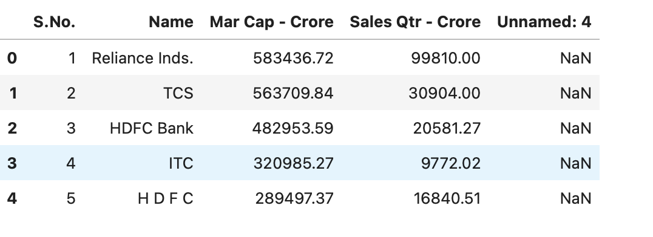
DATASET OVERVIEW
The dataset consist of following columns:
Name: Name of the company
Mar Cap-crore: Market Capitalization in Crores
Sales Qtr-crore: Quarterly sales in crore
Unnamed: As nothing is mentioned and only data is provided so it can be assumed that it is probably containing missing data of “Sales Qtr column”

Slide 4
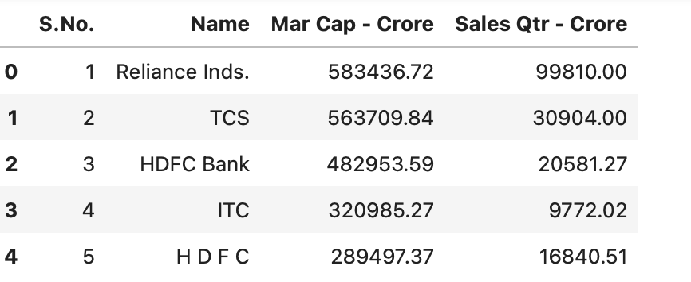
DATA CLEANING AND PRE-PROCESSING
NOW LOOK AT DATA POST SHIFTING
For this I have done following things which are:
Shifting of unnamed data to column sales qtr
Removal of unnecesaary columns(removal of missing values)
Check for missing values and handling them
Conversion of data type to ensure consistency.

Slide 5
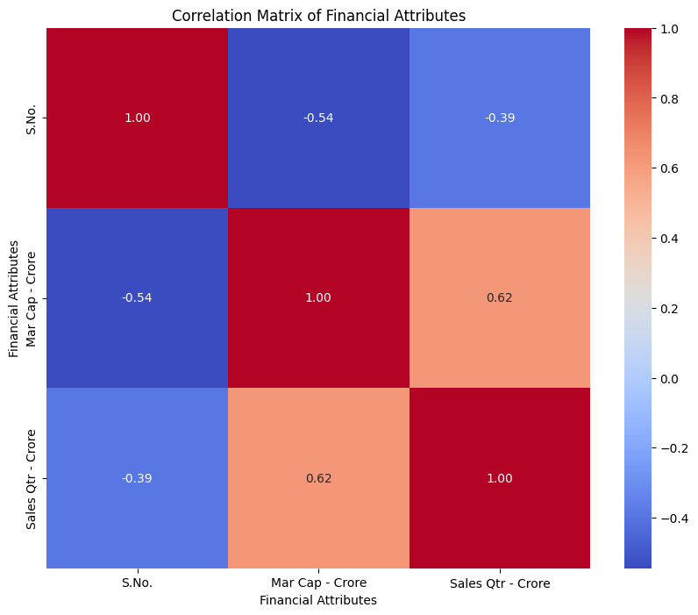
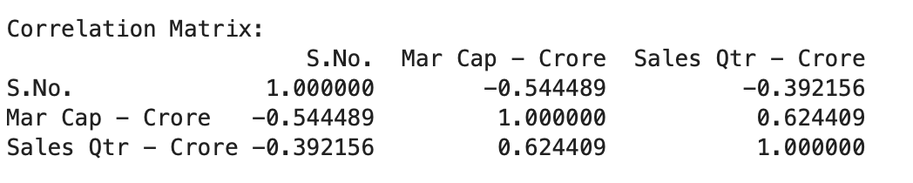
EXPLORATORY DATA ANALYSIS
The Correlation Matrix shows a strong positive correlation which is (0.6240) between Market cap and Sales Qtr crore .This indicates that companies with higher market cap tend to have higher quarterly sales.

Slide 6
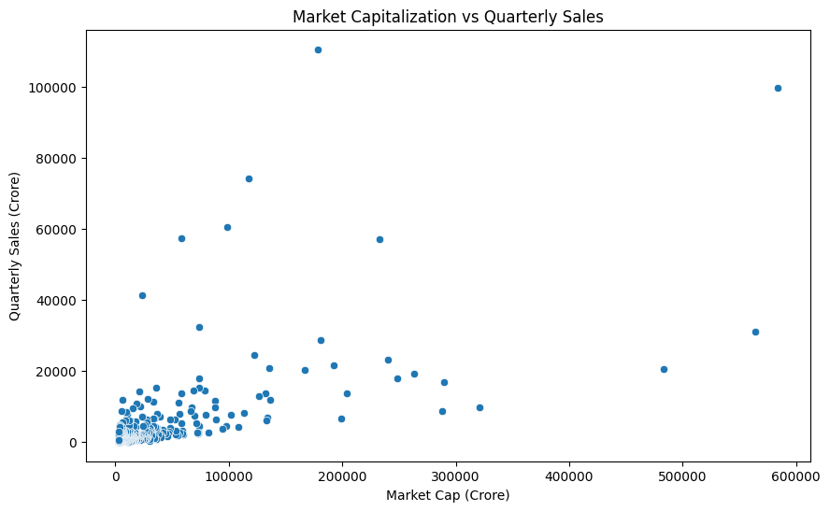
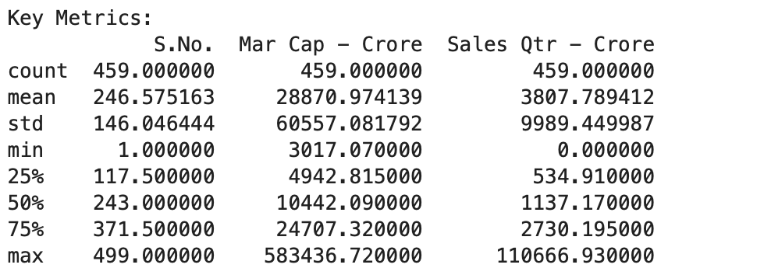
SCATTER PLOT ANALYSIS
The Scatter Plot of Market Cap vs Quarterly Sales visually confirms the positive correlation between them . Companies with large market caps show higher quarterly sales but there are some exceptions in which there is high market caps but relatively lowers sales and vice versa.

Slide 7
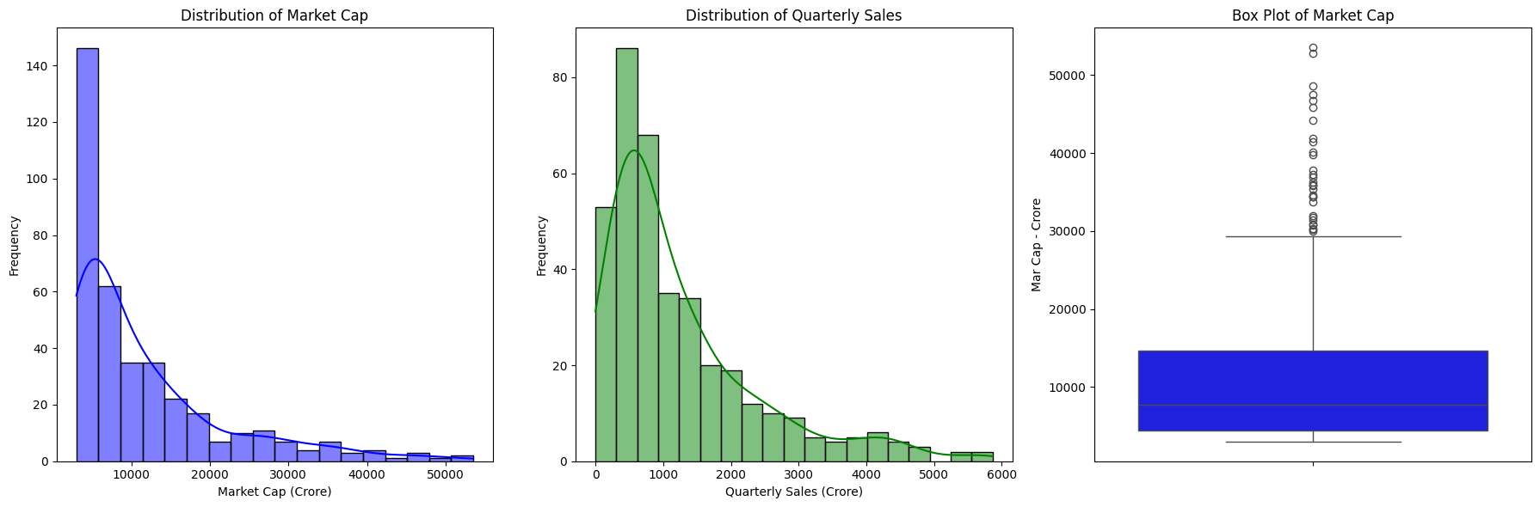
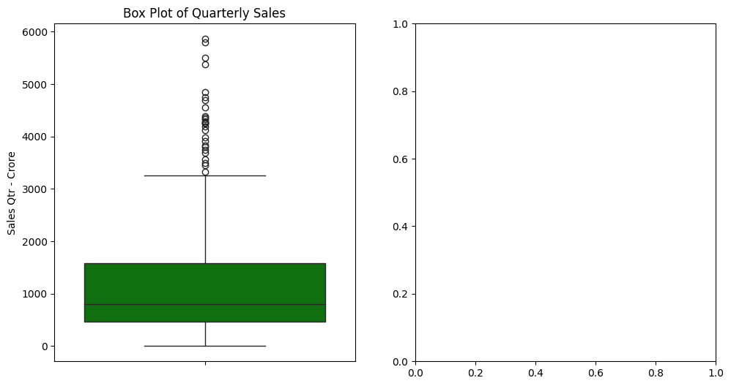
Outlier Detection and removal
Outliers were identified and removed using IQR method. Graph post removal are:

Slide 8
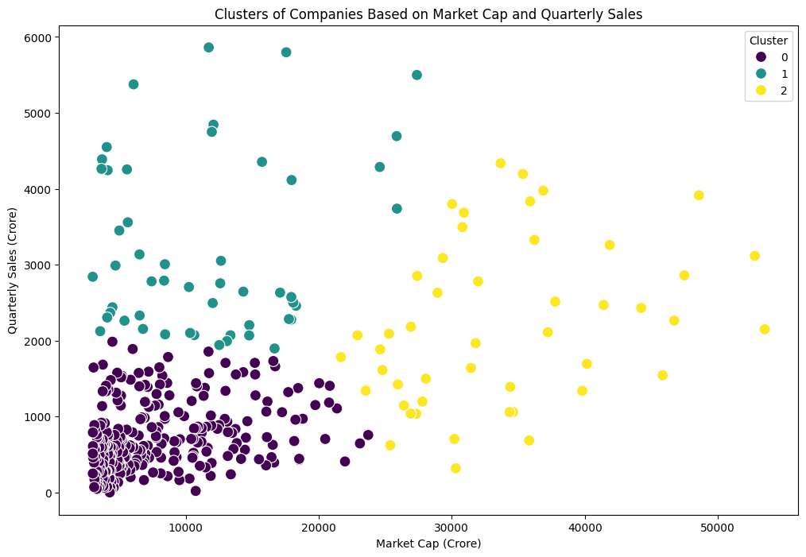
CLUSTERING ANALYSIS
Clustering Analysis:
Companies were clustered or divided into 3 different groups which were based on their MARKET CAP and QUARTERLY SALES . This helps in identifying distinct patterns and groups .
CLUSTER 0: Companies with relatively lower market cap and sales.
CLUSTER 1: Companies with moderate market cap and sales.
ClUSTER 2: Companies with high market cap and sales.

Slide 9
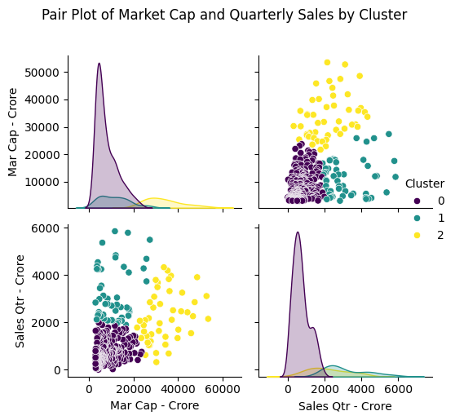
PAIR PLOT
Pair plots visualize the relationship between market cap and quarterly sales, segmented by clusters, providing insights into potential groupings or patterns.

Slide 10
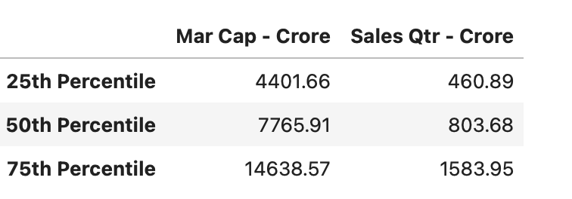
TREND ANALYSIS
Now the analysis of market cap and quarterly sales over different percentiles depicts that these percentile values provide insights for the distribution of market cap and sales which in turn help us to understand the typical range and identify significant trends among the different companies.

Slide 11
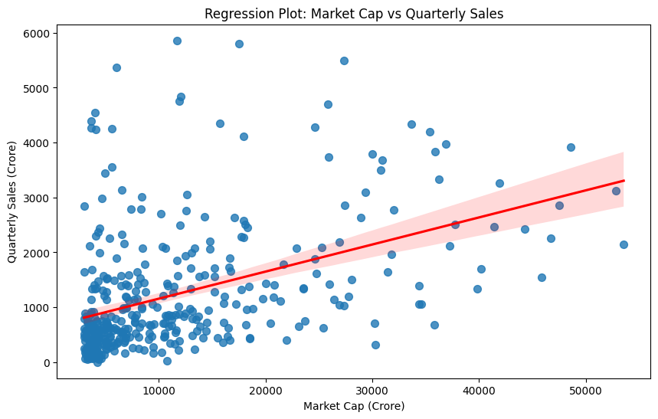
REGRESSION ANALYSIS
This Regression plot between MARKET CAP and QUARTERLY SALES shows a clear positive linear relationship which indicates that as the market cap increases, the quarterly sales also tend to increase as well which can be seen as directly proportional relation between them. So in this figure, red regression line highlights the trend.

Slide 12
CONCLUSION
Overall, the analysis effectively uses various statistical and visualization techniques to uncover patterns, relationships, and potential insights within the financial data of companies, providing a comprehensive understanding of market capitalization and quarterly sales dynamics.

