Slide 1
U.S. Government Printing Office
Packaging and Metadata
PREMIS Implementers Panel
Library of Congress
June 13, 2007

Slide 2
Challenges to GPO’s Mission
Access to government published information is now widely expected to be electronic.
Digital information needs to be authentic and verified to be the correct version.
Digital information needs to be available for access almost immediately.
Information needs to be preserved, making it available for generations to come.

Slide 3
FDsys Capability Overview
FDsys will automate the collection and dissemination of electronic information from all three branches of government.
Information will be:
  permanently available in electronic format
  authenticated and versioned
  accessible for Web searching, viewing, downloading and printing
  available for conventional and on-demand printing

Slide 4
FDsys Release Schedule
8/06
12/07
Release 1
Release 1:
Accept digital information from all three branches of the Federal Government
Update to GPO Access
Information storage to support permanent public access
Authentication of information received and delivered
Version tracking of publications
9/07
7/08
Release 2
Release 2 and 3:
Preservation processing of information to support access into the future
Information harvesting tools to collect information on agency websites
Automated version tools
Extended storage to support harvested and legacy publications as required.
Enhanced information authentication
5/08
12/08
Release 3

Slide 5
FDsys Program Status
Release 1B, the internal pilot, is in the development phase – detailed internal testing will start in late May.
Initial Release 1B functionality has been demonstrated in early April.
Beta testing of Release 1B is planned for this summer.
The System Design Review for Release 1C, the first public launch, will be completed May 8th.

Slide 6
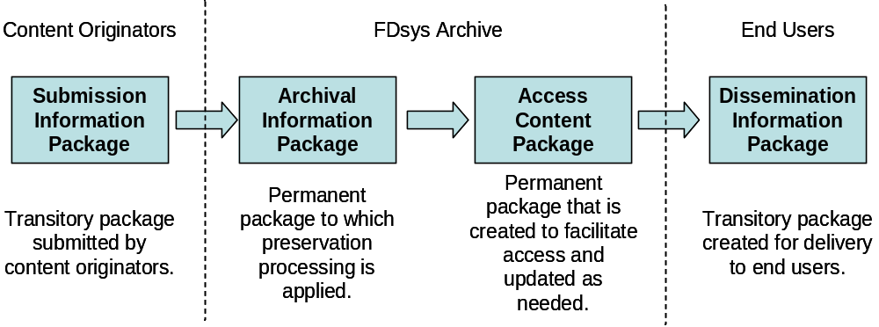
Information Package Lifecycle

Slide 7
A content package represents a single publication.
Content
Package
Key:
XML
Wrapper
directory
The XML wrapper is a table of contents for the package.
Digital Object
Folders & Files
content
Digital Object A
XML File
Rendition 1
Digital Object B
Rendition 1
Rendition 2
Digital Object …
Rendition …
metadata
Rendition 1
Representation
Information
Descriptive
Preservation
Technical
Administrative
Rendition 2
Rendition …

Slide 8
Questions and Answers
Contact us by email pmo@gpo.gov
Visit the FDsys Website http://www.gpo.gov/projects/fdsys.htm

