Slide 1
PREMIS at the Swedish National Archives
Karin Bredenberg 2008-09-26

Slide 2
Two different approaches
In our own archival database (in use)
For our suppliers (in progress)
Notes:
En tanke internt en tanke externt.

Slide 3
In our database
Incorporated in the archival database ARKIS2
Connected with the archival object of type born digital
Also used for image files from our scanning projects
Notes:
Inbakat i vår databas
Hänger ihop med arkivobjektet
Allt ska premisas

Slide 4
ARKIS2
A Swedish archival management system
Own development
All metadata about archives regardless of storage media. (paper as well as digital)

Slide 5
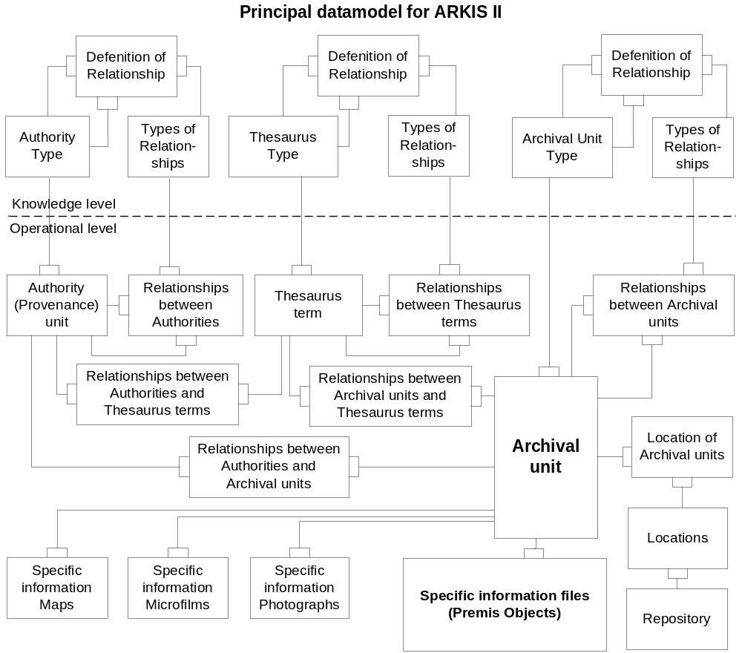
Notes:
datamodellen

Slide 6
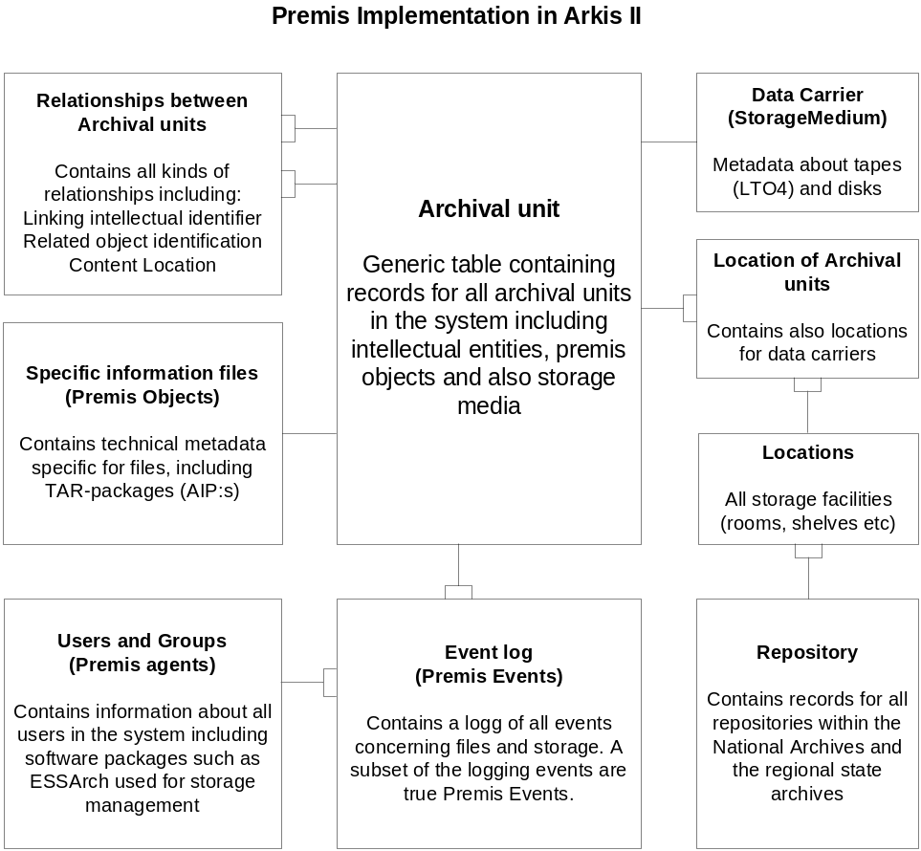
PREMIS implementation

Slide 7
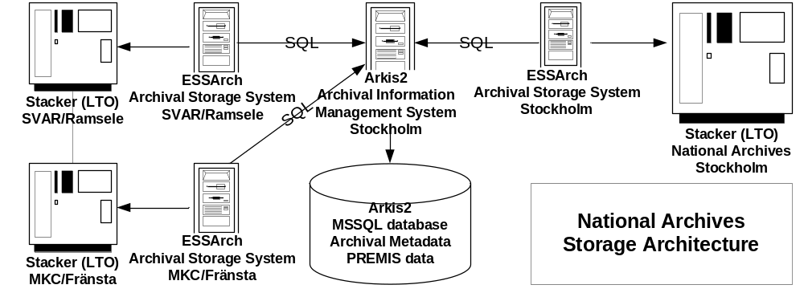
Storage Architecture

Slide 8
For our suppliers
A way of letting them describe the digital objects history before we receive it.
XML included in the AIP.
A predefined set of taggs that we require.
Eventually a full PREMIS-file

Slide 9
Suppliers cont.
Level of accuracy depends on decisions of destruction of the data history (e.g. is data about creation, upgrading and so on going to be saved)
METS to be used as package information.
PREMIS inside METS or own file not yet decided
Notes:
Gallrings beslut??? (destruction se ISO15489)

