Slide 1

PREMIS in the Federal Archives Germany
–
We Did it our Way
PREMIS Tutorial, 26.09.2008
Berlin
Karsten Huth, Bundesarchiv Koblenz

Slide 2
PREMIS and XBARCH
How do we use XBARCH
Differences of XBARCH/PREMIS and PREMIS 1.0

Slide 3
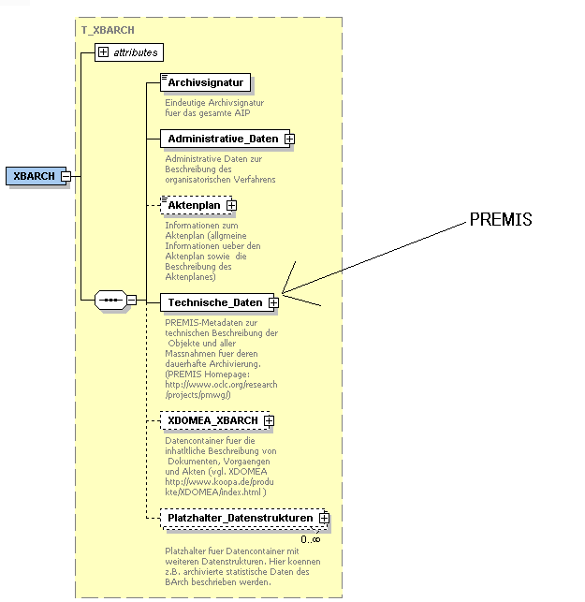
PREMIS and XBARCH
PREMIS schema.xsd is a part of XBARCH schema.xsd.

Slide 4
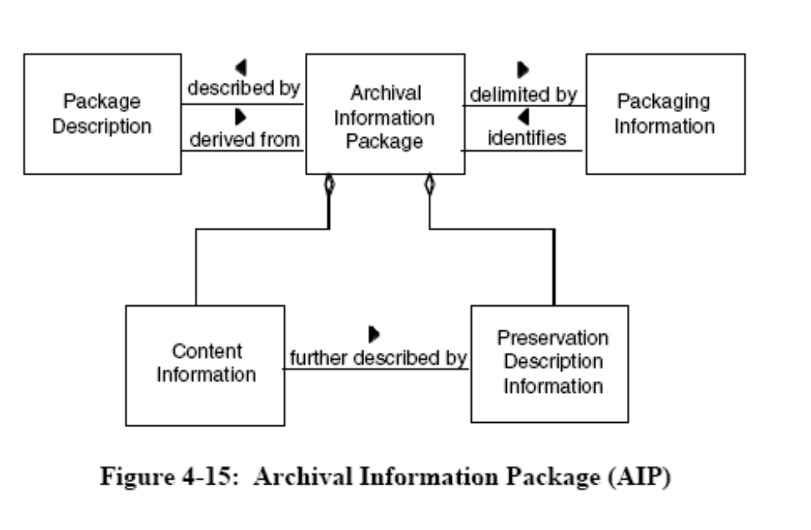
How do we use XBARCH
XBARCH
XBARCH

Slide 5
How do we use XBARCH
XBARCH is the Backbone of our AIP
XBARCH contents Representation Information, Provenance Inf., Reference etc.
XBARCH is used for electronic records
XBARCH is not intended for data exchange with other archives

Slide 6

How do we use XBARCH
One XBARCH for each record in a TAR-file.
One record with two documents saved as PDF/A files.

Slide 7
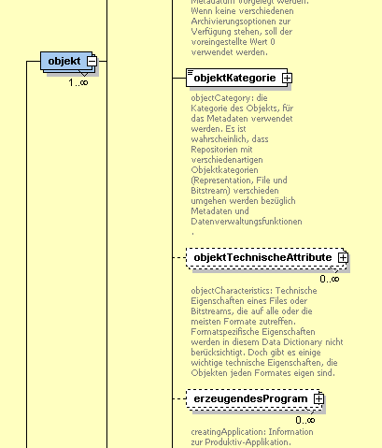
Differences of XBARCH/PREMIS and PREMIS 1.0
We translated each semantic entity

Slide 8
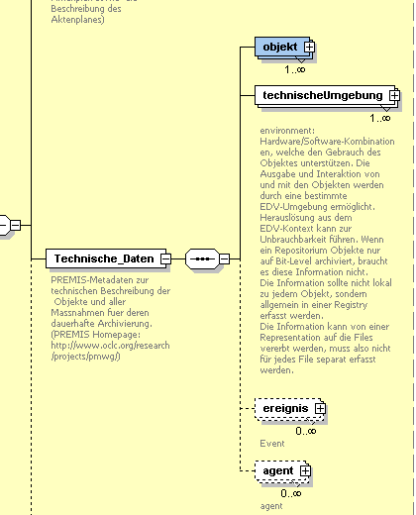
Differences of XBARCH/PREMIS and PREMIS 1.0
Environment is an entity

Slide 9
Differences of XBARCH/PREMIS and PREMIS 1.0
Environment is an entity
Converter tool
Event/migration

Slide 10
HOUSE-Rules
Event is only used for migration
No Agents
No Object/Representation only Files
resctricted values for some entities

Slide 11
Thank You and good by

