Slide 1
Implementor’s Panel:
BL’s eJournal Archiving solution using METS, MODS and PREMIS
Markus Enders, British Library
DC2008, Berlin

Slide 2
Using METS, PREMIS and MODS for Archiving EJournals
Digital Library System Program
  Development of a system for ingest, storage and preservation of digital content
  eJournals are the first content stream
  Developing a common format for the eJournal AIP
Metadata needs:
  Need to understand business processes and data structures
  Structurally complex
    (issues relased in intervals, contain varying number of articles / other publishing matter, submitted in various formats – might vary from article to article within the same issue)
  Production of eJournals is out of control of the digital repository
    No standards for structure of submission packages, file formats, metadata formats, vocabulary

Slide 3
Using METS, PREMIS and MODS for Archiving EJournals
Ingest workflow
  SIP (usually packed as zip or tar)
    Contain content files, descriptive metadata files, manifest listings, hashing information for files
    May contain one or several issues; articles for one or several journals
  Structure is different than AIP structure
    File naming conventions representing structure and relationships

Slide 4
Using METS, PREMIS and MODS for Archiving EJournals
Ingest workflow: main steps
  Unpack
    Unzip / untar the submitted archive
  Virus check
    Virus check all files
  Normalize
    Normalize content files: NLM.DTD
  Metadata extraction
    create AIP description: descriptive, technical and preservation metadata
  Validation
Notes:
Metadata extraction:
Extract information from metadata files provided by the publisher
Extract information from content files (), extract format information (PRONOM database), creating application (if provided)

Slide 5
Using METS, PREMIS and MODS for Archiving EJournals
Standardized AIP structure
  Structural relationships, metadata & content is standardized
  Structure depends on technical infrastructure of preservation system
    Metadata Management Component: contains operational metadata
    Archival Store: Write once – supports archival authenticity and track the objects’ provenance
    AIP is stored in the Archival Store
Notes:
Structural relationship: title – Issue - article
Uniform search across all digital objects
Guarantee the sustainability of formats, data and structural relationships

Slide 6
Using METS, PREMIS and MODS for Archiving EJournals
Granularity of AIP
Update of AIP: add new package; generations of AIPs need to be managed
Reasons for updates:
  Migration of content files
  Updates to descriptive metadata
  Updates of other information systems might affect information stored in AIP
  Correction of corrupt content files
Notes:
Generation: update to an object
Try to avoid version or edition: overloaded in the library community
Descriptive metadata corrections: small scale (typo), large scale

Slide 7
Using METS, PREMIS and MODS for Archiving EJournals
Split logical separated metadata subsets
  Journal, issue, article: one AIP for each
  Can be updated independently
Structural information is separated from files
  Files are stored in a manifestations (normalized files)
  Five different metadata AIPs representing different kinds of objects
  Each AIP is a separate METS file
Notes:
Journal, issue and article AIP only contain metadata: descriptive and administrative metadata
Links between those files
Submission is kept and stored
5 kinds of objects: journals, issues, articles, manifestations, submissions

Slide 8
Using METS, PREMIS and MODS for Archiving EJournals
Identifiers
  MMC-ID
  Identifier of metadata management component
  identifies the intellectual entity
  exposed to the outside / external systems
  Stored in MODS record
  MMC-ID+
  generation dependent MMC-ID,
  needed to store relationships between specific generations in a PREMIS record
  DOMID
  Identifies a file in the Archival Storage
  Identifer stored in Premis record
Notes:
MMC-ID:
Used for linking with ILS
MMC-ID+:
Used in PREMIS records to link to versions

Slide 9
Using METS, PREMIS and MODS for Archiving EJournals
Submission
  Describes one submission event
  Records all activities performed during ingest
  Original data as it was provided by the publisher
Manifestation
  All files necessary for one rendition of an article
Relationships between those METS files are stored in METS files themselves as well as in Metadata Management Component
Notes:
Submission: one submissione vent
All tarred and zipped files
Activities during ingest: submission (transfer), virus check, unpacking
Manifestation: not to be mistaken for FRBR’s definition of a manifestation

Slide 10
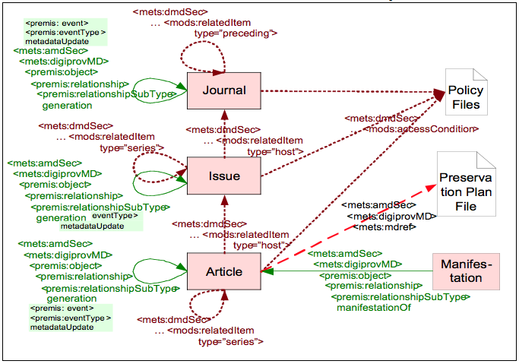
Using METS, PREMIS and MODS for Archiving EJournals
Notes:
Journal – issue – Article relationships:
MODS metadata records: <mods:relatedItem type=“host”>
Expressing hierarchical relationships
Journal -> Journal relationships:
<mods:relatedItem type=“preceding”>
Link to predecessor
Issue -> Issue / Article -> Article: relationships:
<mods:relatedItem type=“series”>
Article is part of a series; other parts can be published in other issues (even in other journals)

Slide 11
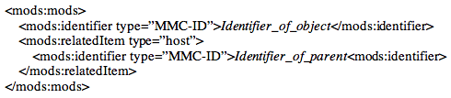
Using METS, PREMIS and MODS for Archiving EJournals
Notes:
Journal – issue – Article relationships:
MODS metadata records: <mods:relatedItem type=“host”>
Expressing hiearchical relationships
MMCID: identifier of the metadata management component; unique; regarded as persistent
Journal -> Journal relationships:
<mods:relatedItem type=“preceding”>
Link to predecessor
Issue -> Issue / Article -> Article: relationships:
<mods:relatedItem type=“series”>
Article is part of a series; other parts can be published in other issues (even in other journals)

Slide 12
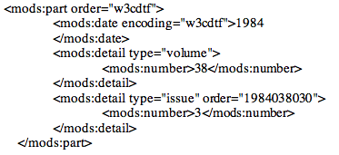
Using METS, PREMIS and MODS for Archiving EJournals
Notes:
Journal – issue – Article relationships:
MODS metadata records: <mods:relatedItem type=“host”>
Expressing hiearchical relationships
Journal -> Journal relationships:
<mods:relatedItem type=“preceding”>
Link to predecessor
Issue -> Issue / Article -> Article: relationships:
<mods:relatedItem type=“series”>
Article is part of a series; other parts can be published in other issues (even in other journals)

Slide 13
Using METS, PREMIS and MODS for Archiving EJournals
Notes:
Generations:
Premis records: <premis:relationshipSubType> generation
Premis event attached to it, event records the reason for a new generation
Manifestation:
Premis records in Manifestation METS files: <premis:relationshipSubType> manifestationOf
But no event attached

Slide 14
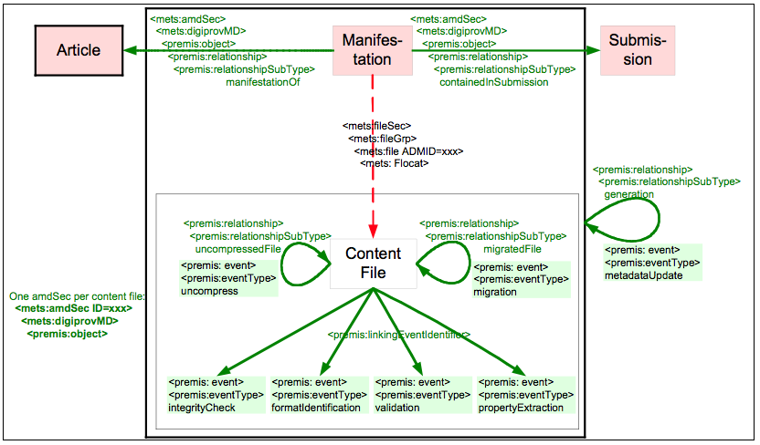
Using METS, PREMIS and MODS for Archiving EJournals
Notes:
Manifestation:
Premis records in Manifestation METS files: <premis:relationshipSubType> manifestationOf
But no event attached
Relationship to submission:
ContentFile:
<mets:fptr> file pointer used
Premis events for each file:
integrityCheck, formatIdentification, validation, propertyExtraction
(change: wellformedness as a separate event)
Uncompress event:
Relationship to the archive file (zip or tar)
Archive file must be in the same submission as linked from Manifestation
(redundant data -> refinement of “containedInSubmission” link
Migration Event:
Relationship to source file; file the new was derived from

Slide 15
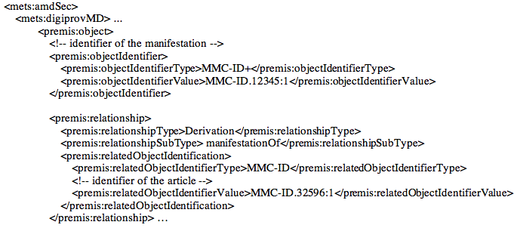
Using METS, PREMIS and MODS for Archiving EJournals
Notes:
Manifestation:
Premis records in Manifestation METS files: <premis:relationshipSubType> manifestationOf
But no event attached
Relationship to submission:
ContentFile:
<mets:fptr> file pointer used
Premis events for each file:
integrityCheck, formatIdentification, validation, propertyExtraction
(change: wellformedness as a separate event)
Uncompress event:
Relationship to the archive file (zip or tar)
Archive file must be in the same submission as linked from Manifestation
(redundant data -> refinement of “containedInSubmission” link
Migration Event:
Relationship to source file; file the new was derived from

Slide 16
Using METS, PREMIS and MODS for Archiving EJournals
PREMIS and MODS metadata are embedded into METS
  Extension schemas
  Premis: <amdSec>
  MODS: <dmdSec>
Attached to <mets:div>
  Journal, issue, article, manifestation, submission
  PREMIS: representation - object
    PREMIS data in <mets:digiprovMD>
Attached to <mets:file>
  File only
  PREMIS: file – object
    PREMIS data in <mets:digiprovMD> AND <mets:techMD>
Notes:
PREMIS and MODS embedded into METS:
Extension schemas
In different sections – section either attached to a <div> element (title
More provenance metadata besides relationships:
Format information,
Fixitiy information
Identification
NOT used as publisher’s don’t provided that information:
Creating application
Hardware and software enviroment

Slide 17
Using METS, PREMIS and MODS for Archiving EJournals
METS, PREMIS, MODS
  some metadata can be represented in either or several metadata schemas
    Checksums:
      <mets:file CHECKSUM=…./>
      <premis:objectCharacteristics><premis:fixity>
    File size:
      <mets:file SIZE=…/>
      <premis:objectCharacteristics><premis:size>
  Store this information redundantly as they might be used for different purposes
Notes:
Like the identifers: some metadata is available in more than one schema
Decision:
Store information redudantly. Used for different purposes:
METS: presentation
PREMIS: perservation; might store more than one CHECKSUM (using different algorythms)
PREMIS records might be used separately in the future

Slide 18
Using METS, PREMIS and MODS for Archiving EJournals
METS, PREMIS, MODS
  some metadata can be represented in either or several metadata schemas
    Format information:
      <mets:file MIMETYPE=…./>
        For display and delivery e.g. via http
      <premis:format>
        Refines the MIMETYPE
        Links to PRONOM database
        For preservation purposes (preservation planing & preservation actions as e.g. migration)
Notes:
METS: presentation
MIMETYPE important for delivering an http-response
PREMIS: perservation; link to format registries, refinement of METS MIMETYPE attribute
PRONOM database

Slide 19
Using METS, PREMIS and MODS for Archiving EJournals
METS, PREMIS, MODS
  some metadata can be represented in either or several metadata schemas
    Technical Metadata (file):
      Use PREMIS:
        Fixitiy information
        Format
      PREMIS technical information (for files)
        In mets:techMD
      PREMIS non-technical information (for files)
        In mets:digiprovMD

Slide 20
Using METS, PREMIS and MODS for Archiving EJournals
METS, PREMIS, MODS
  some metadata can be represented in either or several metadata schemas
    Technical Metadata (file):
      Use PREMIS:
        Fixitiy information
        Format
      Use additional extension schemas for format specific technical metadata (optional) – e.g. rendering & display
        Directly in mets:techMD
      Don’t use MODS <mods:physicalDescription>

Slide 21
Using METS, PREMIS and MODS for Archiving EJournals
METS, PREMIS, MODS
  Rights information
    Not intended to be actionable
    Archival, descriptive nature
    Stored in MODS
Notes:
Rights information do not support any repository function
According the METS/PREMIS implementation guidelines

Slide 22
Using METS, PREMIS and MODS for Archiving EJournals
METS, PREMIS, MODS
  PREMIS events:
    If more than one object (representation or file) is affected, the event is stored in each PREMIS section
    Any attached agent to this event is stored in each PREMIS section as well
  What kind of events:
    On file level :
      submission, unCompress, virusCheck, validation, ingest, (wellformness)
    On file level:
      Migration (not yet implemented in software)
    On representation:
      metadataUpdate, (metadataCorrection)
Notes:
Rights information do not support any repository function
According the METS/PREMIS implementation guidelines

Slide 23
Using METS, PREMIS and MODS for Archiving EJournals
PREMIS 2.0
  Still using premis 1.1; No fundamental changes to data model -> migration is not too difficult, although xml schema it is not backwards compatible
  Extensions to extend PREMIS
    Embed metadata from other schemas into a PREMIS record
    Event outcome, creating application, object characteristics, significant properties: usage needs to be discussed
    objectCharacteristicsExtension: might be useful to store format specific metadata which are only regarded as relevant for preservation purposes
Notes:
objectCharacteristicsExtension:
Currently <mets:techMD> is used to store JHOVE output
- Two much output from JHOVE, might only want to store relevant format specific information

Slide 24
Using METS, PREMIS and MODS for Archiving EJournals
Conclusion:
No single existing metadata schema accommodates the representation of descriptive, preservation and structural metadata.
Using a combination of of METS, PREMIS and MODS allows us represent eJournal Archival Information Packages in a write-once archival system

