Slide 1
Integrating PREMIS and METS
PREMIS Tutorial
Implementers’ Panel
June 21, 2007, 9:00-5:30
Library of Congress, Jefferson Building, Whittall Pavilion
Tom Habing, thabing@uiuc.edu
Grainger Engineering Library Information Center University of Illinois at Urbana-Champaign

Slide 2
Outline
Project Background
Hub and Spoke Architecture
Using PREMIS in our METS Profile
Our Java API

Slide 3
NDIIPP ECHODEP Project http://ndiipp.uiuc.edu/
Quick Project Background
Repository Evaluation
Tools development
  Web harvesting and archiving (OCLC’s WAW)
  ** Hub and Spoke interoperability and preservation architecture **
Preservation Research
  preserving the authenticity and semantic meaning of digital resources through time.

Slide 4
Hub and Spoke
Repository Interoperability Architecture with a forward-looking emphasis on preservation metadata and activities
  A common METS-based profile
    http://www.loc.gov/standards/mets/profiles/00000015.xml
    Focus on preservation, not access
    May be overlaid on top of, or inherited from, other profiles
  A Java programming API
  A series of scripts that use the API and METS profile for creating Information Packages which can be ‘used’ across different repositories

Slide 5
METS Profile in More Detail
Descriptive Metadata
  Primary DMD is MODS
  Alternate DMD are encouraged
  Provenance for DMD is required
Technical Metadata
  PREMIS object entities
  MIX for images
  Other metadata for other media types
Digital Provenance
  PREMIS events and agents

Slide 6
Using PREMIS in METS
All linking via ID & IDREF-type attributes not identifier elements
Where to Wrap the PREMIS?
  Object in techMD
  Event in digiprovMD
  Rights in rightsMD
  Agent in digiprovMD or rightsMD
All Files at a Composition level of 0
  No packaging, compression, or encryption

Slide 7
Technical Metadata for Files
A techMD section wrapping a PREMIS object element is required for each file or bit-stream
  Minimal required elements: fixity, size, formatDesignation
    Duplicated in some METS attributes
  creatingApplication and software are encouraged especially for MIME types starting with ‘application/…’
    Plan to investigate integration with the GDFR when it becomes available

Slide 8
Technical Metadata for Representations
Technical metadata can also be associated with representations
  There is a special required techMD called the ‘primary representation’ that corresponds to the entire METS file. Used mostly for alternate identifiers for the file, but may also be used to record other technical metadata about the whole METS document
  Each structural map may also have representation technical metadata.

Slide 9
Digital Provenance
Recorded for all non-trivial changes to:
  Descriptive Metadata (must)
    Creation, Transformation, Modification, Deletion
  Files and Bitstreams (should)
    Events from PREMIS data dictionary
  Structural Maps (may)
    Creation, Transformation, Modification, Deletion
PREMIS event and optional associated agents are wrapped in a digiprovMD

Slide 10
Java Implementation
Partially complete and in-work
  Support for DSpace and to lesser degree Fedora
  Future plans for additional repository support
Open source
Javadocs:
  http://dli.grainger.uiuc.edu/echodep/HnS/JavaDocs/
Source Code:
  http://sourceforge.net/projects/echodep

Slide 11
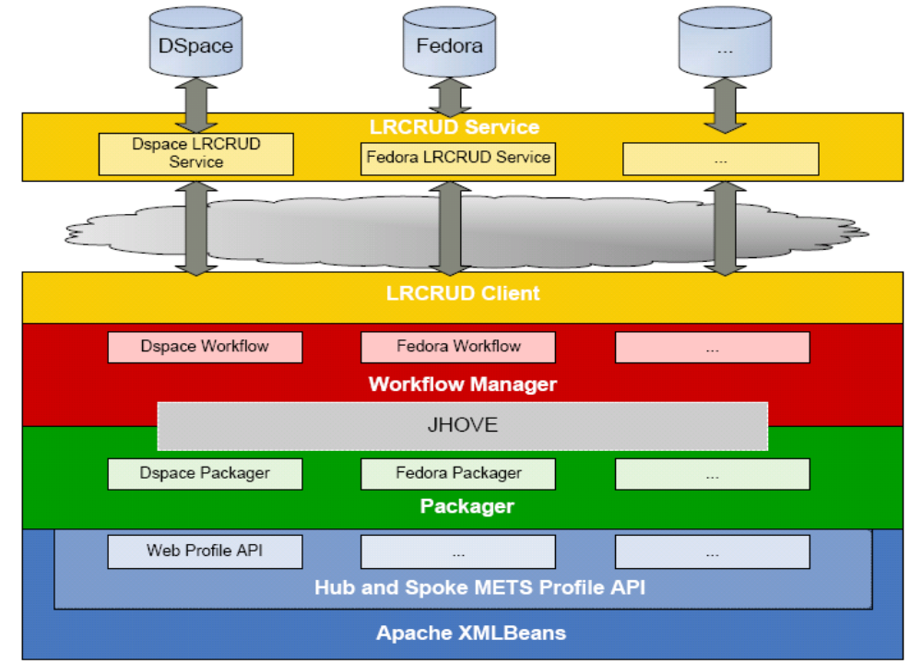
Technical Architecture (Java)

